Slide 1
Team Introduction
Group Number: 006
Section: 001

Slide 2
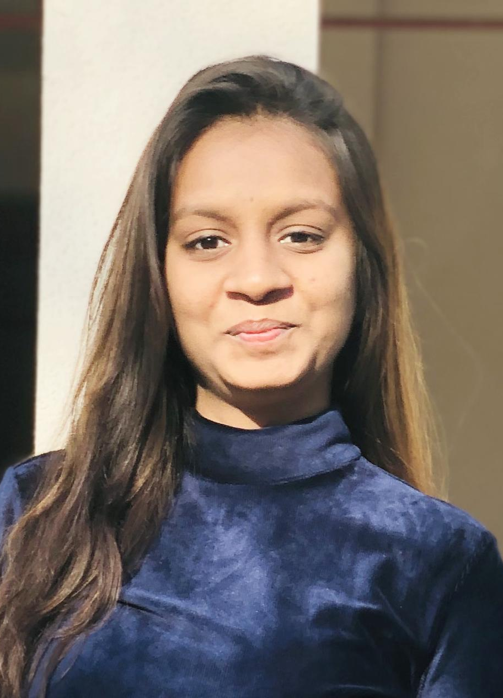

Vidhi Sanjaykumar Patel

Slide 3
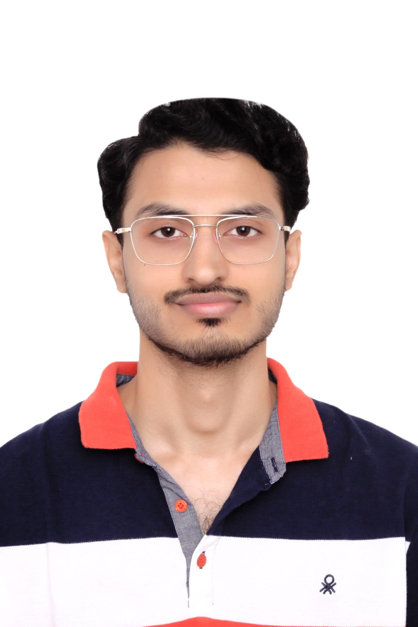

Jay Vinodkumar Modh

Slide 4
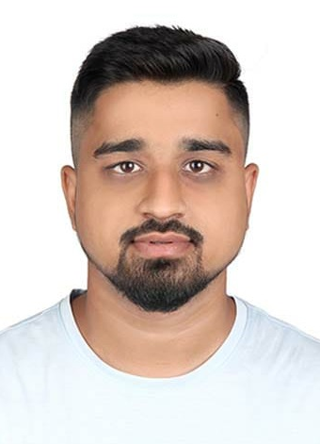

Dhruvkumar Khageshkumar Chauhan

Slide 5


Raj Balvantbhai Gabani

Slide 6
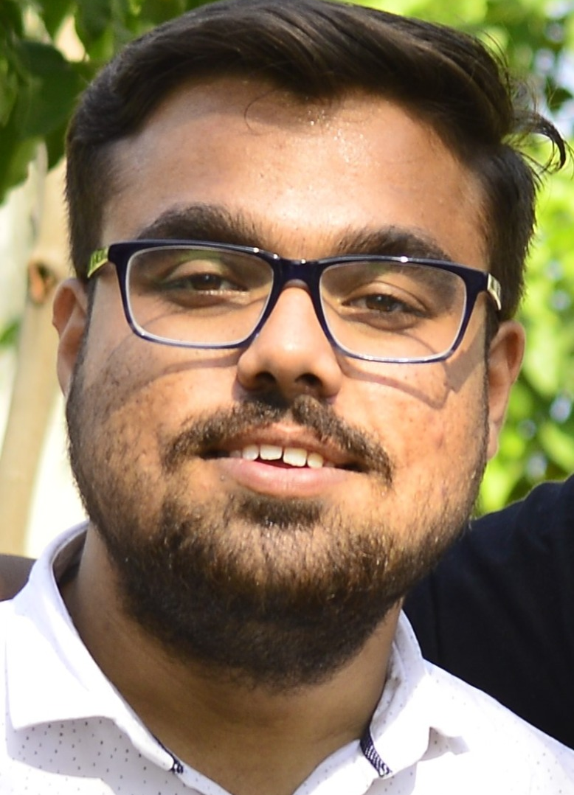

Kartik Himanshukumar Thakkar

Slide 7
Background/Motivation
The lives of almost 1.3 million people are cut short annually as a result of traffic accidents.
Road safety. (2020, June 20). WHO | World Health Organization.
https://www.who.int/health-topics/road-safety#tab=tab_1
Road crashes result in significant economic damages for victims, their families, and entire countries.

Slide 8
Problem Statement
Public policy makers needs insights into the trends in road traffic accidents and fatalities in order to make regulations or decisions that could result in reduction of road crashes.

Slide 9
Project Proposal
Our project team will create a descriptive analysis to examine trends in car crashes and gain insights to help public policy makers make certain decisions for the road safety.

Slide 10
Analysis Questions
In which age group majority of the accidents were registered?
During what part of the day accidents happen more frequently? Examine the trend for accident prone time of day on yearly basis.
How the speed at the time of impact (accident) affects the seriousness of injury ?

Slide 11

Dataset Description

Slide 12
US data, for 1997-2002, from police-reported car crashes in which there is a harmful event (people or property), and from which at least one vehicle was towed. [1]
Categorical values
dead
airbag
seatbelt
frontal
sex
yearacc
yearVeh
abcat
occRole
deploy
injSeverity
Numeric values
dvcat
weight
ageOFocc
caseid
Airbag
Dataset
Unique
caseid

Slide 13
Dataset on all road accident casualties across Calderdale, UK from 2009 - 2012 and 2014 – 2016. [2]
Categorical values
Number of Vehicles
Road surface
Lighting Conditions
Weather Conditions
Casualty Class
Casualty Severity
Sex of Casualty
Type of Vehicle
Numeric values
Accident Date
Time
Age of Casualty
Road-Accident
Dataset

Slide 14
Data Analysis using tableau

Slide 15
Analysis Question :
In which age group majority of the accidents were registered?

Slide 16
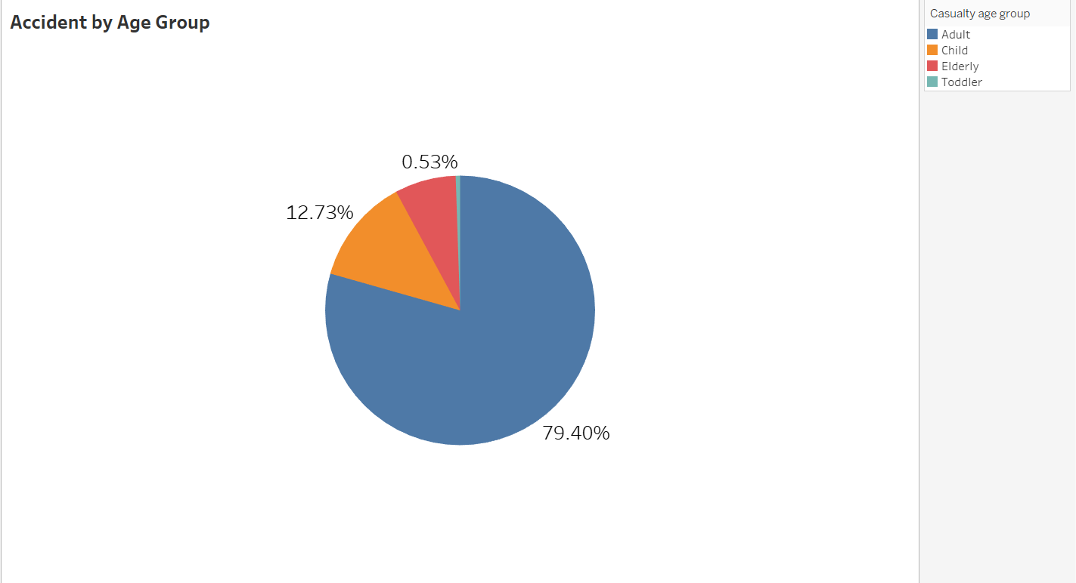
This visualization displays the percentage of accidents in different age groups.
It can be observed that most accidents happened in the adult age group followed by children and elderly people.

Slide 17
Analysis Question :
During what part of the day accidents happen more frequently? Examine the trend for accident prone time of day on yearly basis.

Slide 18
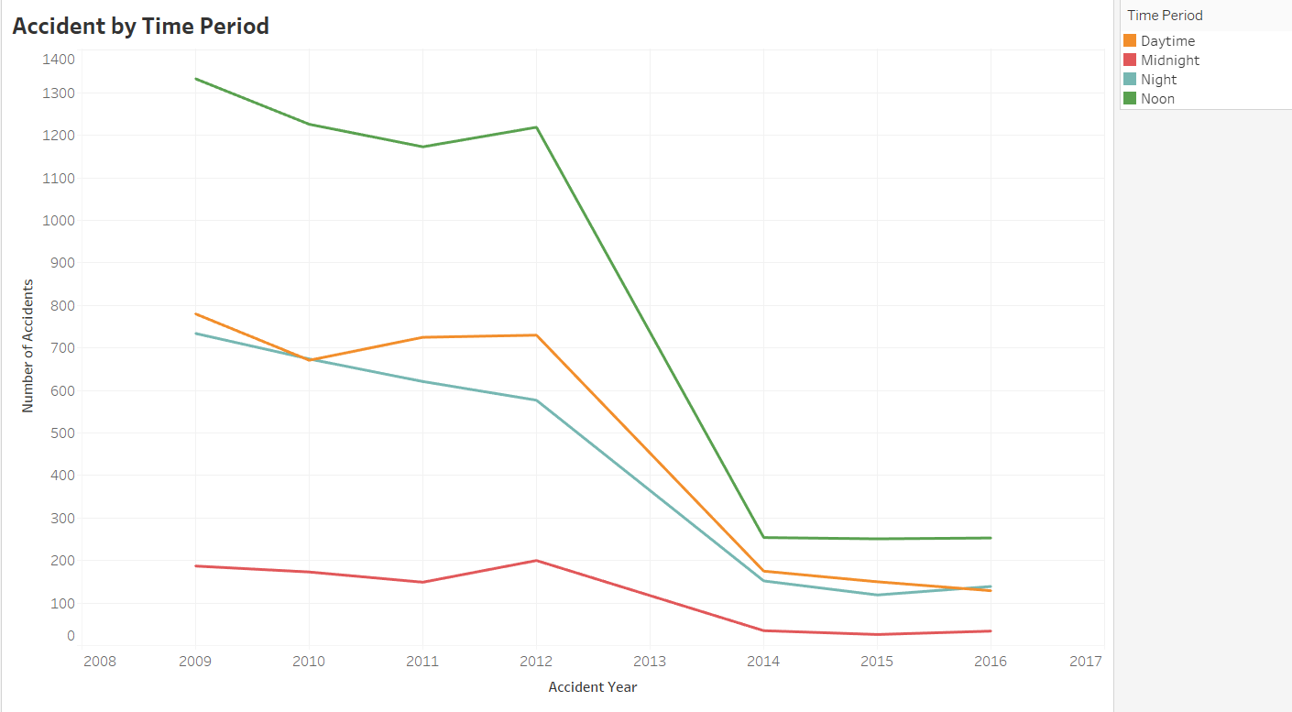
This visualization displays the trend for accident prone time of day on yearly basis.
It has been observed that Afternoon time period is the most accident prone time period of the day.

Slide 19
Analysis Question :
How the speed at the time of impact (accident) affects the seriousness of injury ?

Slide 20
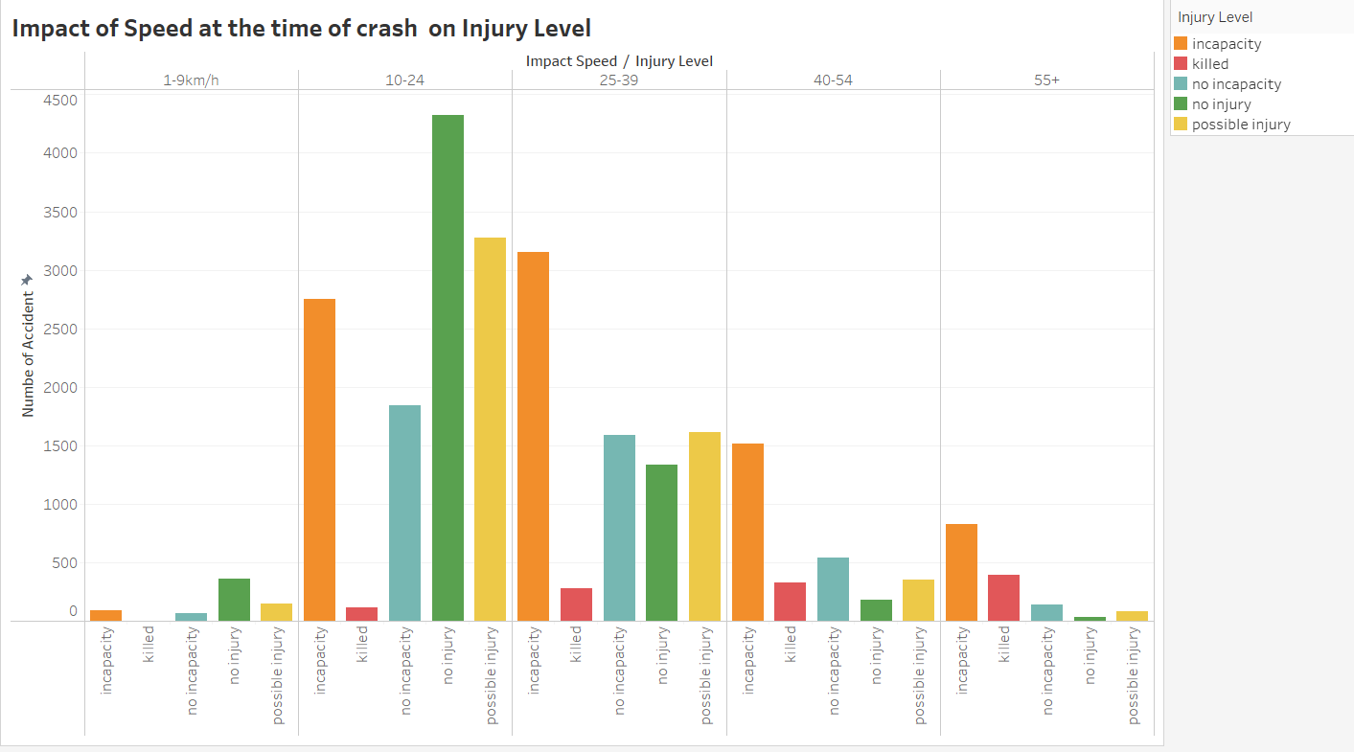
This visualization displays the count of accidents as per speed of vehicle and seriousness of accident.
It can be observed that when the speed was on the lower side (1-9 km/hr), mostly there was no injury. On the other hand, when the speed was high (55+), mostly people involved had incapacitating injury or were killed.

Slide 21
Tableau dashboard

Slide 22
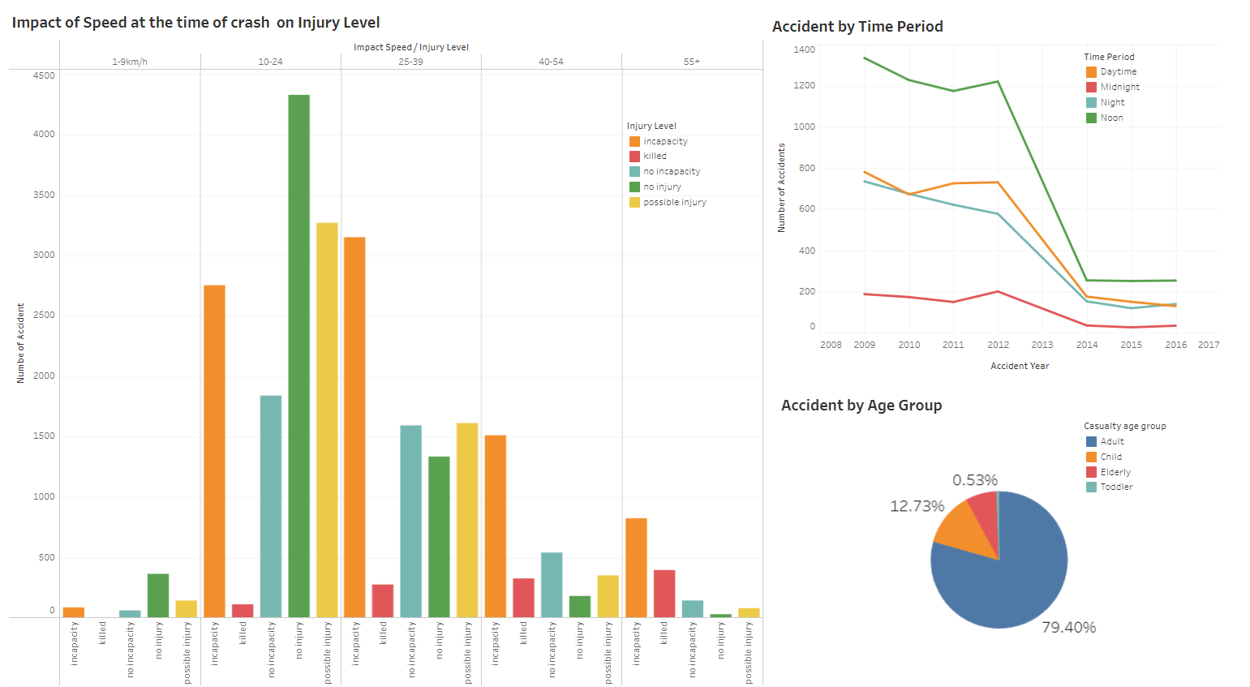

Slide 23
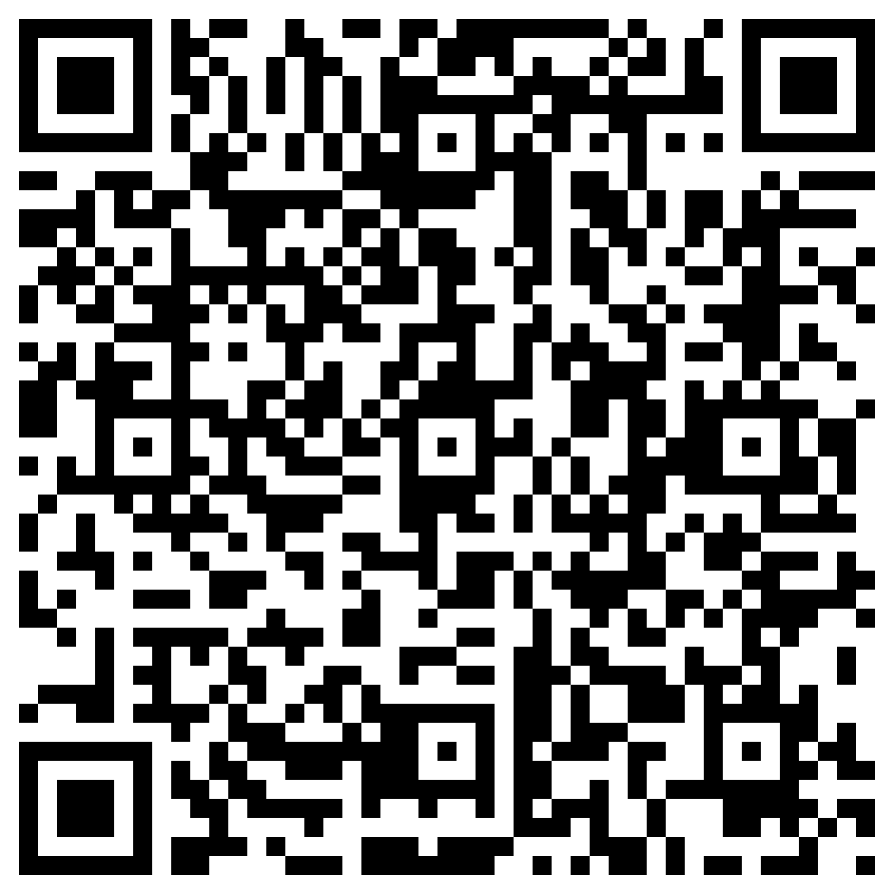
Tableau public link

Slide 24

Git-hub link

Slide 25
Conclusion

Slide 26
Our analysis showed that adults and children are the most vulnerable age groups to accidents.
Moreover, afternoon time period (12-6 PM) is the most accident prone time of the day.
Also, the speed of the vehicle at the time of crash contributed heavily to the seriousness of the injury. When the speed was on the higher end (55+ km/hr), it led to severe incapacitating injury or even death of the person. On the other hand, when it was on the lower side ( < 10 km/hr), there was no or little injury to the person involved in the crash.

Slide 27
Recommendations

Slide 28
As per our analysis, adults are the most vulnerable group to road traffic accidents followed by children. So, we recommend public policy makers to organize workshops, driver educational and preventative programs that would help them improve their knowledge, attitude, understanding of the surrounding circumstances. This as a whole, could result in reduction of road traffic accidents among adults and young children.
Afternoon time is the most accident prone time of the day as per our analysis. To reduce the risk during that dangerous period of the day, drivers need to wear seat belt and remain cautious. Public policy makers should make strict rules and ensure that drivers are wearing seat belt.
It is observed in our analysis that over speeding was a major factor resulting in fatality or incapacitating injury. There are several things public policy makers could do regarding that. Infrastructure adaptations such as speed humps, raised platforms, gateway treatments, pavement narrowings and developing roundabouts at intersections could slow down traffic and reduce speed. [3]

Slide 29
Reference
https://vincentarelbundock.github.io/Rdatasets/doc/DAAG/nassCDS.html (1)
https://data.world/datagov-uk/6efe5505-941f-45bf-b576-4c1e09b579a1 (2)
https://making-cities-safer.com/speed-reduction-methods-to-promote-road-safety-and-to-save-lives/ (3)

