Slide 1
Team Introduction
Group Number: 006
Section: 001
Vidhi Sanjaykumar Patel
Jay Vinodkumar Modh
Dhruvkumar Khageshkumar Chauhan
Raj Balvantbhai Gabani
Kartik Himanshukumar Thakkar

Slide 2
Background/Motivation
The lives of almost 1.3 million people are cut short annually as a result of traffic accidents.
Road crashes result in significant economic damages for victims, their families, and entire countries. This motivated us to create an analysis product that might be helpful in reducing the number of road accidents.

Slide 3
Problem Statement
Drivers need better insight into what speed the vehicle should be driven in various road surface and weather conditions.
What kind of safety precaution drivers have to take care to minimize injuries in accidents.

Slide 4
Project Proposal
Our project team will create a descriptive analysis to examine trends in car crashes and gain insights in the causes for crashes to help public policy makers to make certain decisions.

Slide 5
Analysis Questions
Identify pattern in which age group most of the accidents registered?
Examine trend on yearly basis, number of accident that occured during midnight?
Check how the speed at the time of impact (accident) affected the seriousness of injury ?

Slide 6
Dataset Description
Categorical values
dead
airbag
seatbelt
frontal
sex
yearacc
yearVeh
abcat
occRole
deploy
injSeverity
Numeric values
dvcat
weight
ageOFocc
caseid
Airbag
Dataset
Unique
caseid

Slide 7
Dataset Description
Fields | About
dvcat | Ordered factor with levels (estimated impact speeds)
weight | Observation weights, albeit of uncertain accuracy, designed to account for varying sampling probabilities.
dead | Factor with levels alive dead
airbag | A factor with levels none airbag
seatbelt | A factor with levels none belted
frontal | A numeric vector; 0 = non-frontal, 1=frontal impact
sex | A factor with levels f m
ageOFocc | Age of occupant in years
yearacc | Year of accident
yearVeh | Year of model of vehicle; a numeric vector
abcat | Did one or more (driver or passenger) airbag(s) deploy? This factor has levels deploy nodeploy unavail
occRole | a factor with levels driver pass
deploy | a numeric vector: 0 if an airbag was unavailable or did not deploy; 1 if one or more bags deployed.
injSeverity | a numeric vector; 0:none, 1:possible injury, 2:no incapacity, 3:incapacity, 4:killed; 5:unknown, 6:prior death
caseid | character, created by pasting together the populations sampling unit, the case number, and the vehicle number. Within each year, use this to uniquely identify the vehicle.

Slide 8
Dataset Description
Categorical values
Number of Vehicles
Road surface
Lighting Conditions
Weather Conditions
Casualty Class
Casualty Severity
Sex of Casualty
Type of Vehicle
Numeric values
Accident Date
Time
Age of Casualty
Road-Accident
Dataset

Slide 9
Dataset Description
Fields | About
Number of Vehicles | Number of vehicles included in particular accident.
Road surface | Condition of the road while accident occurs.
Lighting Conditions | Streetlight were lit or not while accident occurs.
Weather Conditions | It will provide weather condition.
Casualty Class | Class of the affected person such as driver, pedestrian or rider.
Casualty Severity | It will provide the level of seriousness of injury.
Sex of Casualty | Gender
Type of Vehicle | Gives information of vehicle type.
Age of Casualty | It will give the age of affected person.
Accident Date | Date when accident occurs.
Time | Time when accident occurs.

Slide 10
EDA and Visualization

Slide 11
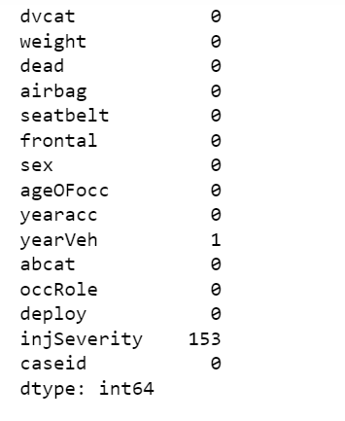
Number of Missing Elements

Slide 12
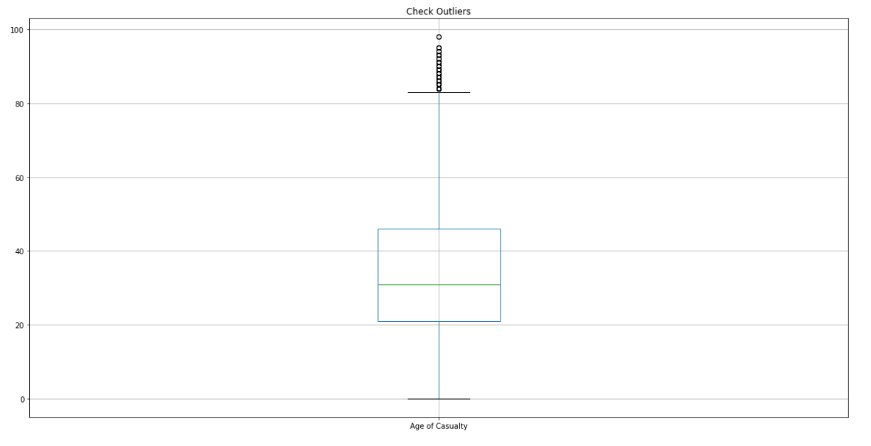
outliers for Age of Casualty
No other outliers in the dataset

Slide 13
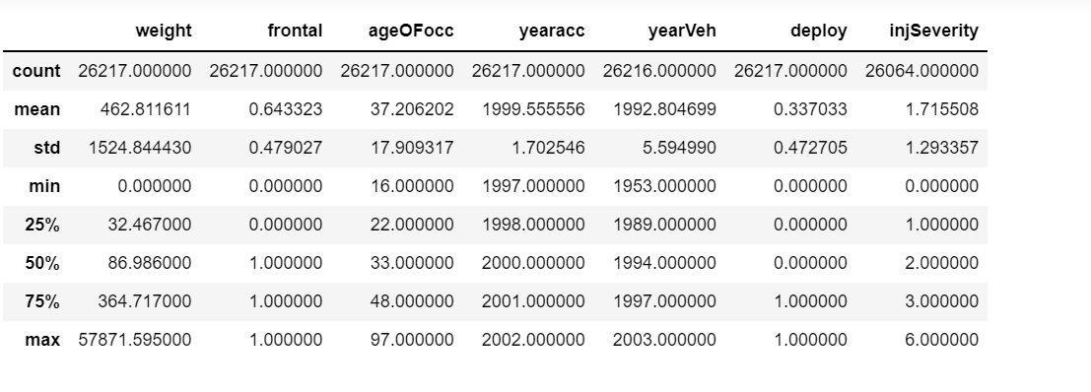
Summary Statistics for numeric values of airbag Dataset
Key Observations :
Average year of accident is 1999 in the dataset.
Average age of occupant in the vehicle is 37 years with minimum age being 16 and maximum age being 97 years.
Minimum year of vehicle is 1953, while maximum is 2003. Average year is 1992

Slide 14
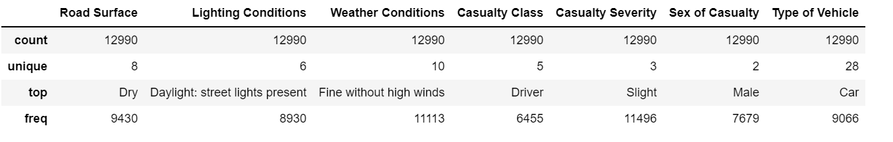
Summary Statistics for Object datatype of airbag Dataset
Key Observations :
Vehicle type which was involved the most during the crash was car and the class of the casuality was driver

Slide 15
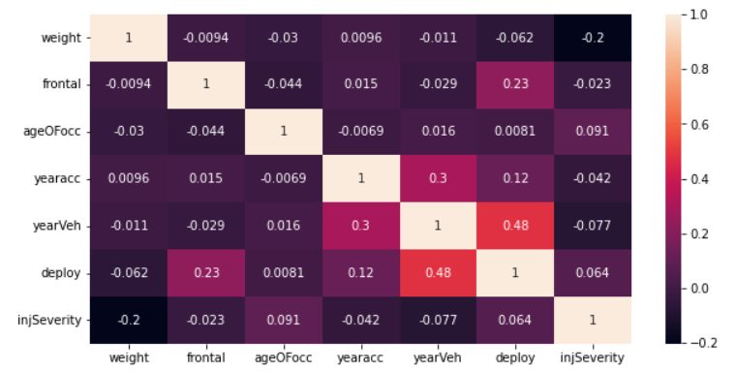
CoR-relation
There is a weak positive correlation (0.48) between year of vehicle and whether the airbag was deployed or not.
No other significant correlation between any other elements in the dataset.

Slide 16

UNIQUE VALUES OF OccRole :
Driver and Passenger

Slide 17
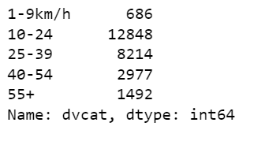
CATEGORY OF SPEED ALONG WITH COUNT AT THE TIME OF ACCDIENT

Slide 18
CATEGORICAL VALUES OF ROAD SURFACE

Slide 19
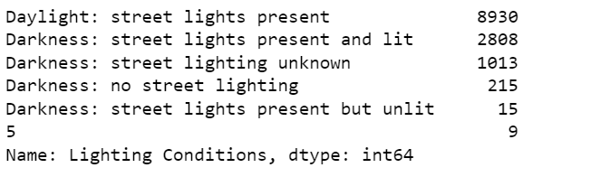
CATEGORICAL VALUES OF LIGHTING CONDITIONS ALONG WITH COUNT

Slide 20
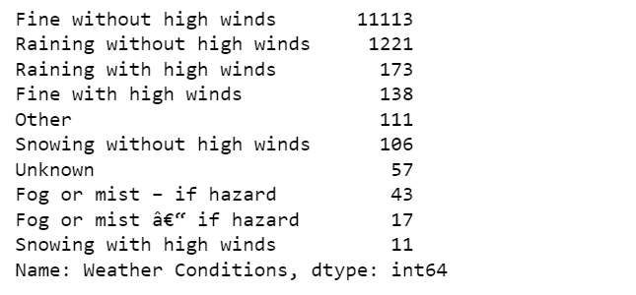
CATEGORICAL VALUES OF WEATHER CONDITIONS ALONG WITH COUNT

Slide 21
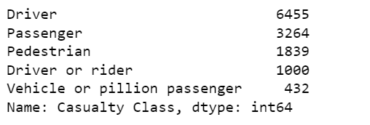
CATEGORICAL VALUES OF CASUALTY CLASS ALONG WITH COUNT

Slide 22
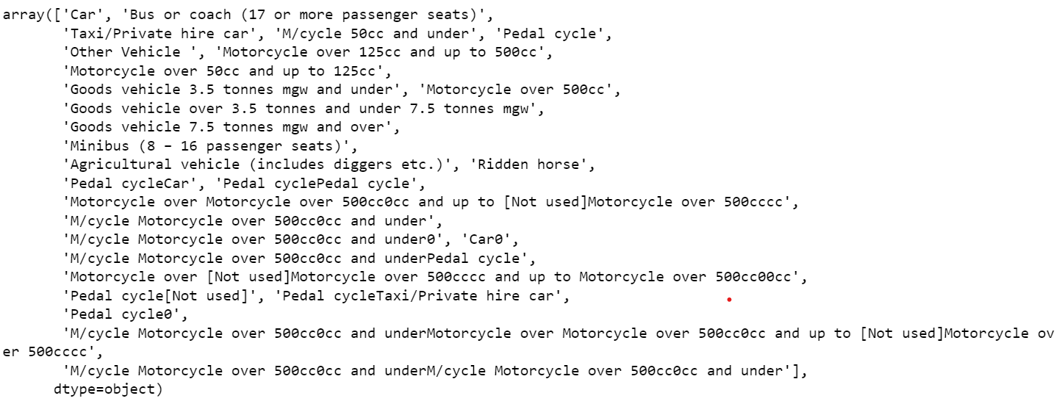
UNIQUE VALUES OF TYPE OF VEHICLE

Slide 23
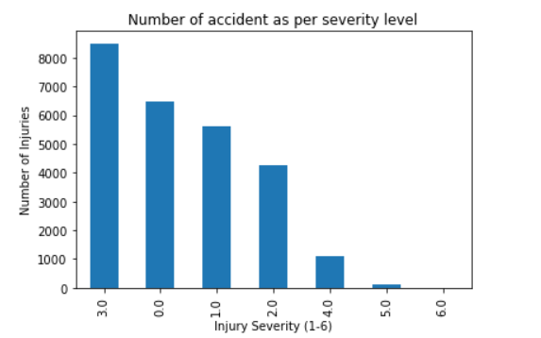
Visualization
This visualization gives information about co-relation between Number of Injuries and Injury Severity. It provides the level of seriousness while accident occurs. It can be observed that most injuries severity level was 3 followed by 0 and 1.

Slide 24
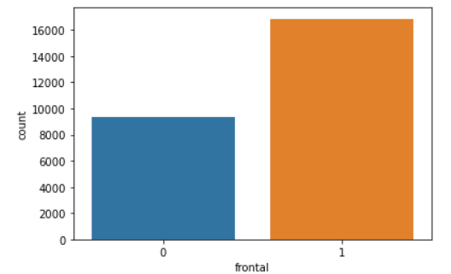
This visualization will provide information that if the accident happens from the front side or not.
Here, it can be observed that around 16000 crashes had a frontal impact (1 for frontal, 0 for non-frontal), while around 9000 crashes were non- frontal.

Slide 25
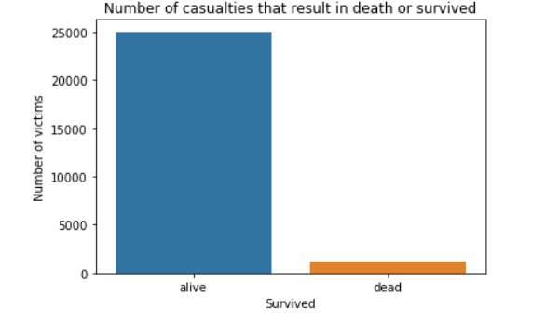
The visualization describes casualities, that resulted in death or the person survived.
It is very obvious from the count plot displayed that major proportion of people survived the crash.

Slide 26
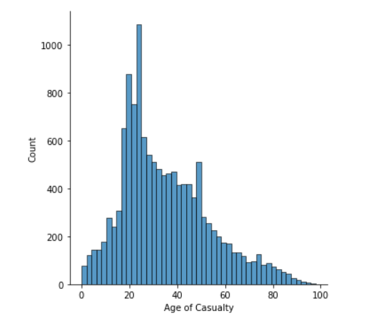
DISPLOT TO SEE THE DISTRIBUTION OF AGE OF CASUALTY COLUMN

Slide 27
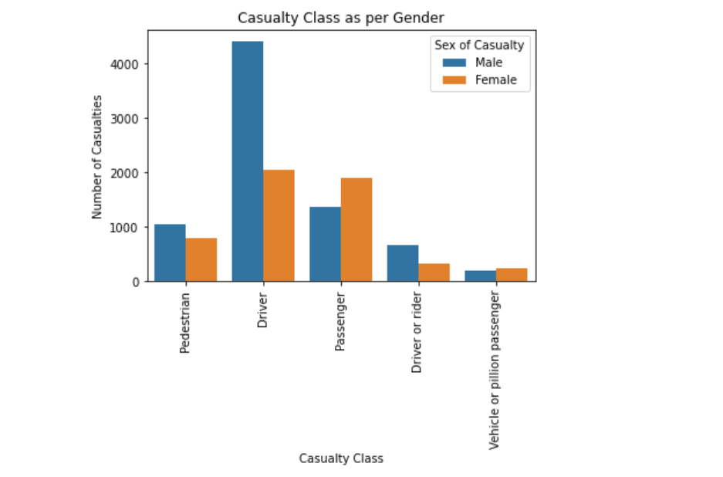
This visualization displays the count of casualties as per casualty class and gender.

Slide 28
Future changes in the dataset

Slide 29
We intend to rename the columns of airbag dataset as their names are not quite understandable.
Also, we will delete few columns that are not useful in our analysis.
In addition, we will convert age column into different age group categories

Slide 30
Jira work Management

Slide 31
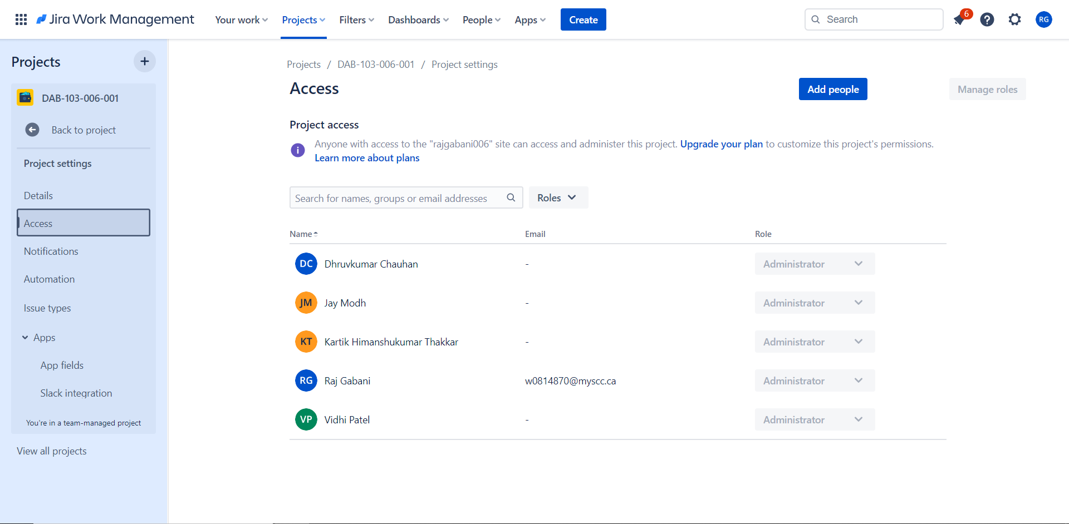

Slide 32
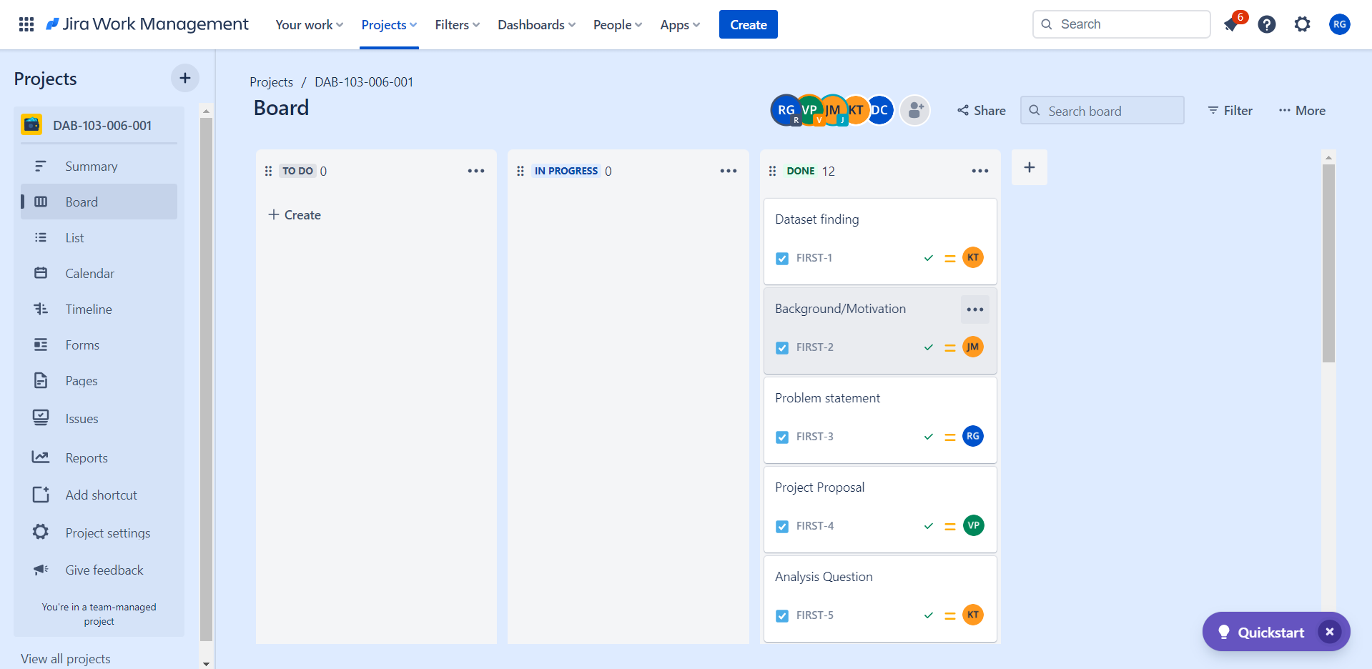

Slide 33
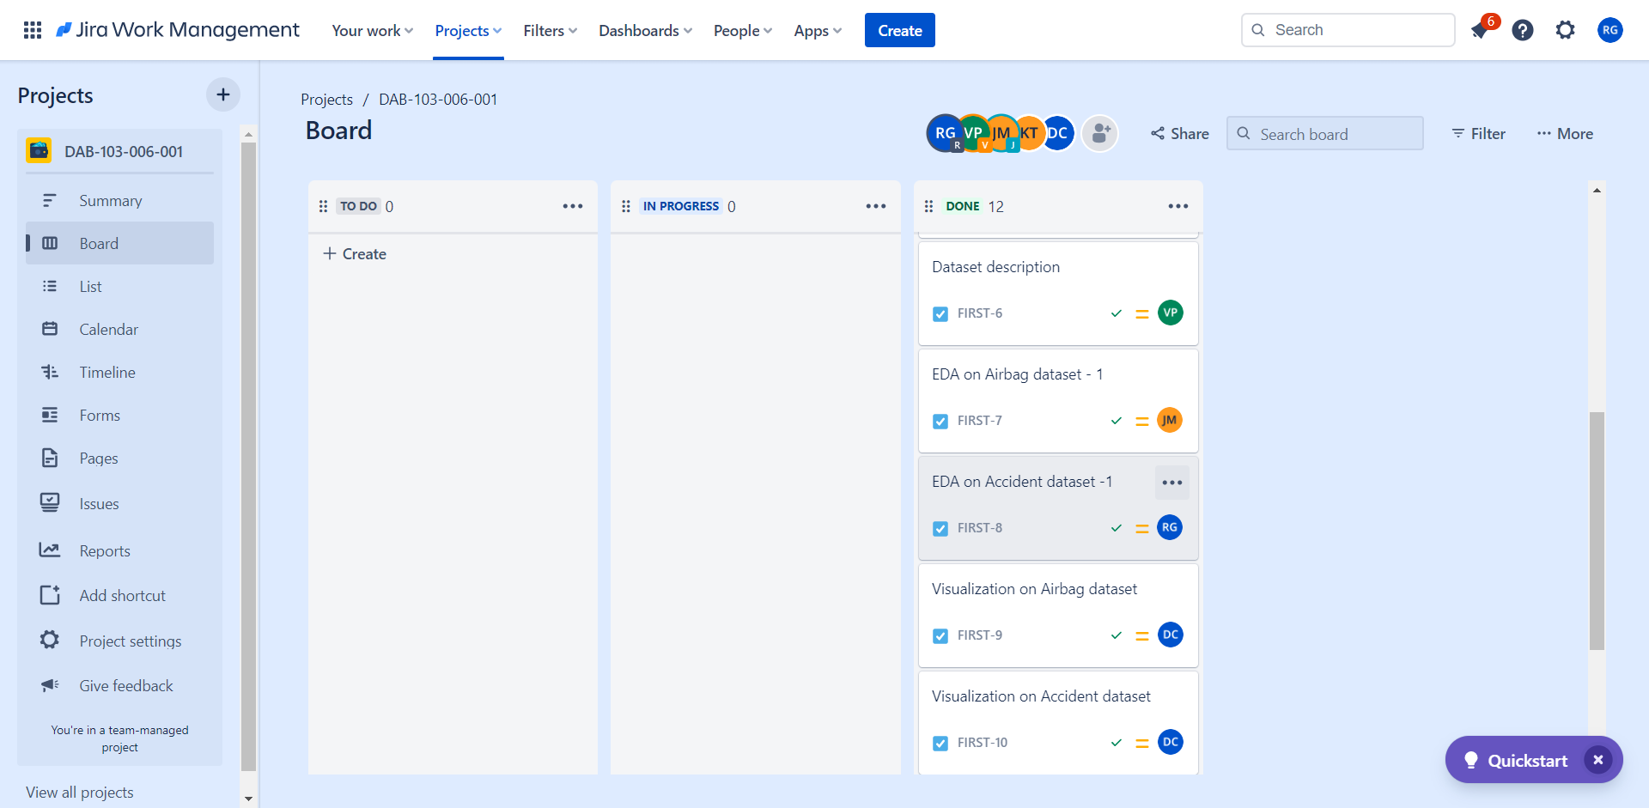

Slide 34
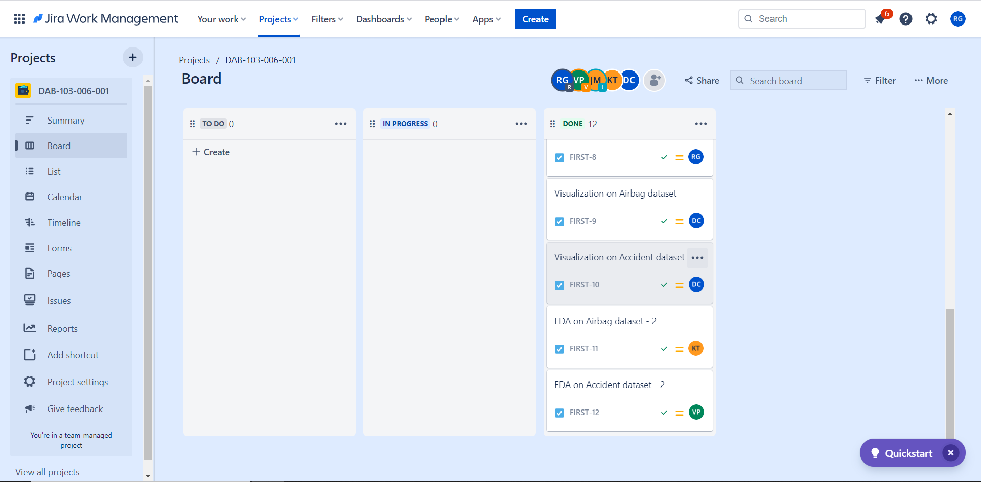

Slide 35
Github work

Slide 36
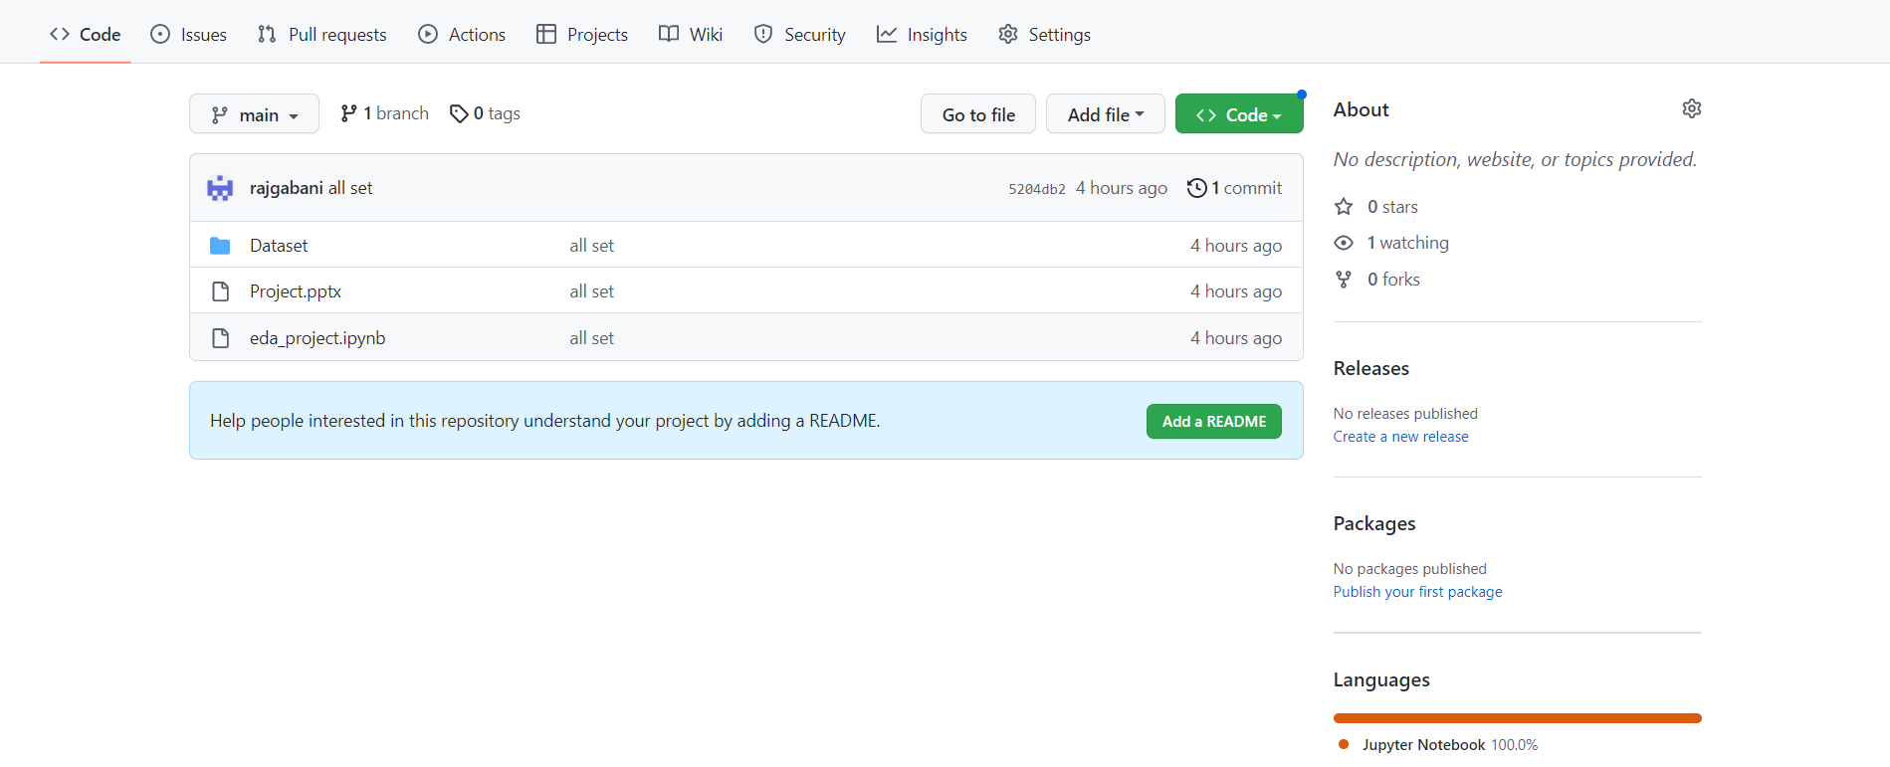
https://github.com/rajgabani/DAB-103-006-001

Slide 37
Reference
https://vincentarelbundock.github.io/Rdatasets/doc/DAAG/nassCDS.html
https://data.world/datagov-uk/6efe5505-941f-45bf-b576-4c1e09b579a1
Class notes

