Slide 1
Team Introduction
Group Number: 006
Section: 001

Slide 2

Vidhi Sanjaykumar Patel
https://www.linkedin.com/in/vidhi-patel-03922a1b2

Slide 3

Jay Vinodkumar Modh
http://linkedin.com/in/jay-modh998

Slide 4

Dhruvkumar Khageshkumar Chauhan
https://www.linkedin.com/in/dhruv-chauhan-979a3719a

Slide 5

Raj Balvantbhai Gabani
www.linkedin.com/in/raj-gabani-b87668150

Slide 6

Kartik Himanshukumar Thakkar
https://www.linkedin.com/in/kartik-thakkar-59ba8a212

Slide 7
Background/Motivation
The lives of almost 1.3 million people are cut short annually as a result of traffic accidents.
Road safety. (2020, June 20). WHO | World Health Organization.
https://www.who.int/health-topics/road-safety#tab=tab_1
Road crashes result in significant economic damages for victims, their families, and entire countries. This motivated us to create an analysis product that might be helpful in reducing the number of road accidents.

Slide 8
Problem Statement
To handle the enormous amount of road accidents, a precise analysis is required so that public policy makers can make certain regulations or decisions that could result in reduction of road traffic accidents and fatalities.

Slide 9
Project Proposal
Our project team will create a descriptive analysis to examine trends in car crashes and gain insights to help public policy makers make certain decisions for the road safety.

Slide 10
Analysis Questions
Identify pattern in which age group most of the accidents registered?
During what part of the day accidents happen more frequently? Examine the trend for accident prone time of day on yearly basis.
Check how the speed at the time of impact (accident) affected the seriousness of injury ?

Slide 11

Dataset Description

Slide 12
US data, for 1997-2002, from police-reported car crashes in which there is a harmful event (people or property), and from which at least one vehicle was towed.
Categorical values
dead
airbag
seatbelt
frontal
sex
yearacc
yearVeh
abcat
occRole
deploy
injSeverity
Numeric values
dvcat
weight
ageOFocc
caseid
Airbag
Dataset
Unique
caseid

Slide 13
Fields | About
dvcat | Ordered factor with levels (estimated impact speeds)
weight | Observation weights, albeit of uncertain accuracy, designed to account for varying sampling probabilities.
dead | Factor with levels alive dead
airbag | A factor with levels none airbag
seatbelt | A factor with levels none belted
frontal | A numeric vector; 0 = non-frontal, 1=frontal impact
sex | A factor with levels f m
ageOFocc | Age of occupant in years
yearacc | Year of accident
yearVeh | Year of model of vehicle; a numeric vector
abcat | Did one or more (driver or passenger) airbag(s) deploy? This factor has levels deploy nodeploy unavail
occRole | a factor with levels driver pass
deploy | a numeric vector: 0 if an airbag was unavailable or did not deploy; 1 if one or more bags deployed.
injSeverity | a numeric vector; 0:none, 1:possible injury, 2:no incapacity, 3:incapacity, 4:killed; 5:unknown, 6:prior death
caseid | character, created by pasting together the populations sampling unit, the case number, and the vehicle number. Within each year, use this to uniquely identify the vehicle.

Slide 14
Dataset on all road accident casualties across Calderdale, UK from 2009 - 2012 and 2014 - 2016
Categorical values
Number of Vehicles
Road surface
Lighting Conditions
Weather Conditions
Casualty Class
Casualty Severity
Sex of Casualty
Type of Vehicle
Numeric values
Accident Date
Time
Age of Casualty
Road-Accident
Dataset

Slide 15
Dataset Description
Fields | About
Number of Vehicles | Number of vehicles included in particular accident.
Road surface | Condition of the road while accident occurs.
Lighting Conditions | Streetlight were lit or not while accident occurs.
Weather Conditions | It will provide weather condition.
Casualty Class | Class of the affected person such as driver, pedestrian or rider.
Casualty Severity | It will provide the level of seriousness of injury.
Sex of Casualty | Gender
Type of Vehicle | Gives information of vehicle type.
Age of Casualty | It will give the age of affected person.
Accident Date | Date when accident occurs.
Time | Time when accident occurs.

Slide 16
EDA and Visualization

Slide 17
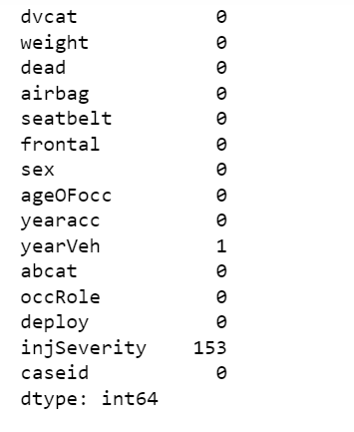
Number of Missing Elements

Slide 18
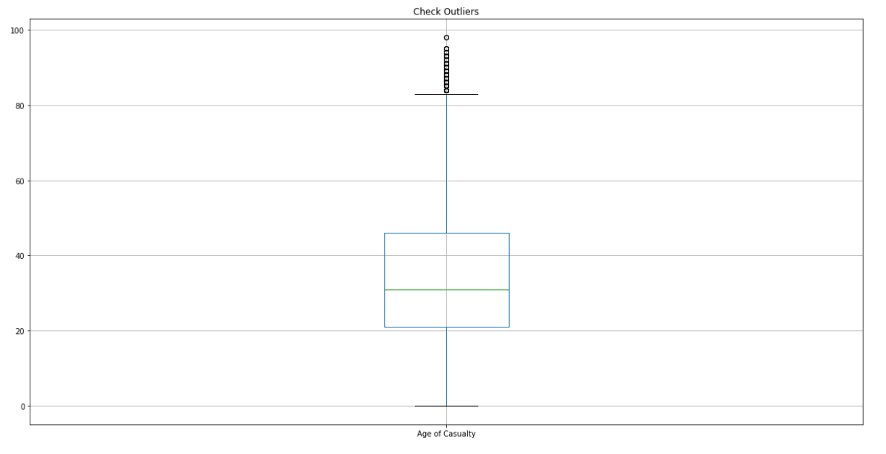
outliers for Age of Casualty
It can be observed from the visualization that there are few potential outliers but there is no need to remove or replace the data as they are error free and we intend to include them in our analysis.

Slide 19
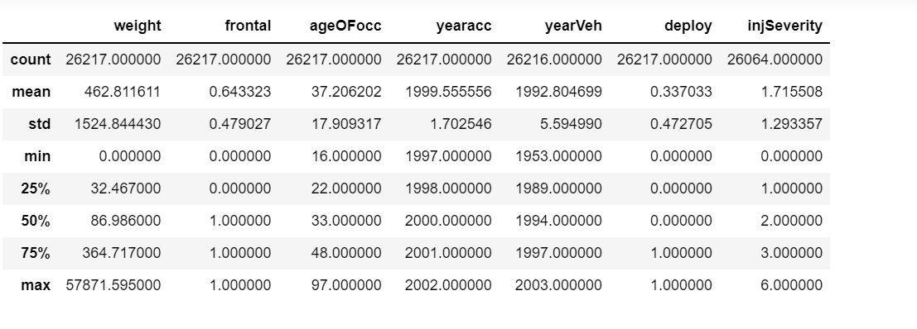
Summary Statistics for numeric values of airbag Dataset
Key Observations :
Average year of accident is 1999 in the dataset.
Average age of occupant in the vehicle is 37 years with minimum age being 16 and maximum age being 97 years.
Minimum year of vehicle is 1953, while maximum is 2003. Average year is 1992

Slide 20
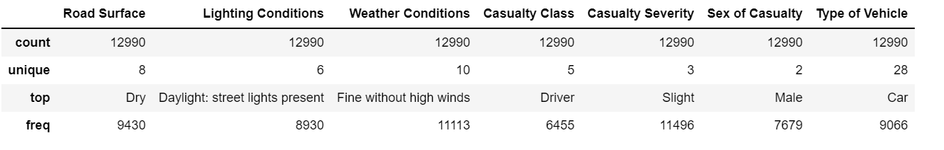
Summary Statistics for Object datatype of airbag Dataset
Key Observations :
Vehicle type which was involved the most during the crash was car and the class of the casuality was driver

Slide 21
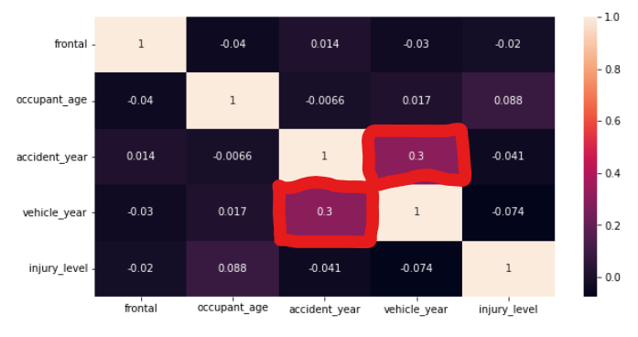
CoR-relation
There is a weak positive correlation (0.3) between year of vehicle and year of accident.
No other significant correlation between any other elements in the dataset.

Slide 22

UNIQUE VALUES OF OccRole:
Driver and Passenger

Slide 23
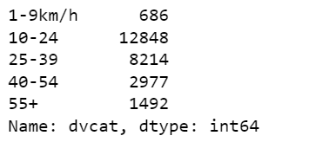
CATEGORY OF SPEED ALONG WITH COUNT AT THE TIME OF ACCDIENT

Slide 24
CATEGORICAL VALUES OF ROAD SURFACE

Slide 25
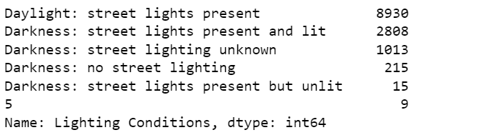
CATEGORICAL VALUES OF LIGHTING CONDITIONS ALONG WITH COUNT

Slide 26
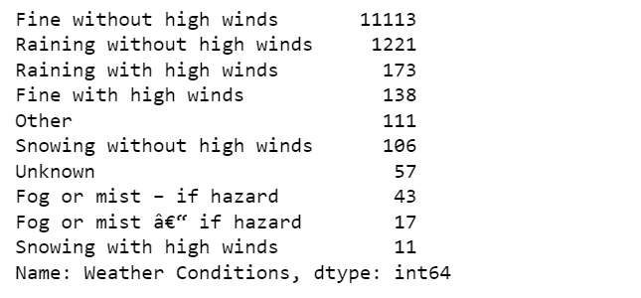
CATEGORICAL VALUES OF WEATHER CONDITIONS ALONG WITH COUNT

Slide 27
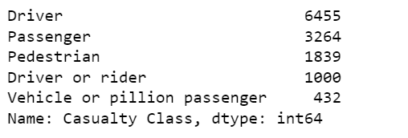
CATEGORICAL VALUES OF CASUALTY CLASS ALONG WITH COUNT

Slide 28
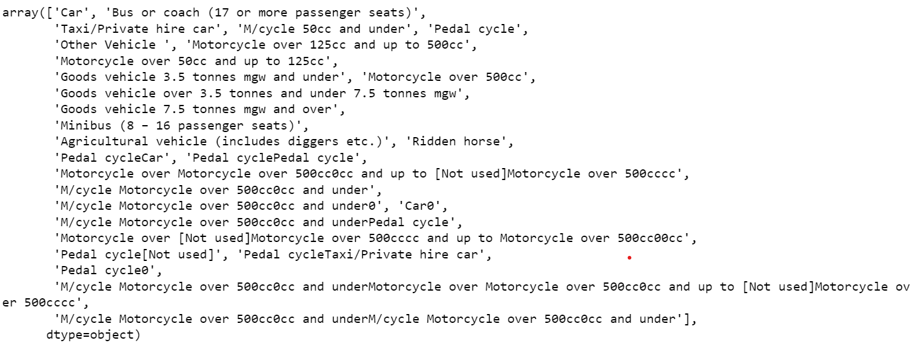
UNIQUE VALUES OF TYPE OF VEHICLE

Slide 29
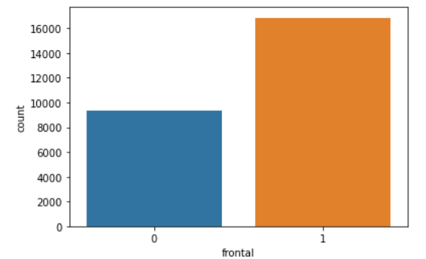
This visualization will provide information that if the accident happens from the front side or not.
Here, it can be observed that around 16000 crashes had a frontal impact (1 for frontal, 0 for non-frontal), while around 9000 crashes were non- frontal.

Slide 30
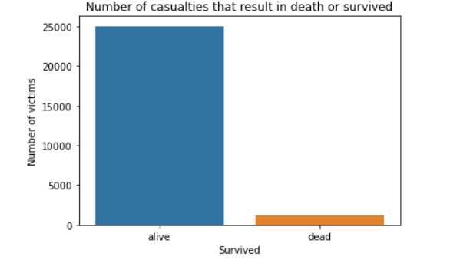
The visualization describes casualties, that resulted in death or the person survived.
It is very obvious from the count plot displayed that major proportion of people survived the crash.

Slide 31
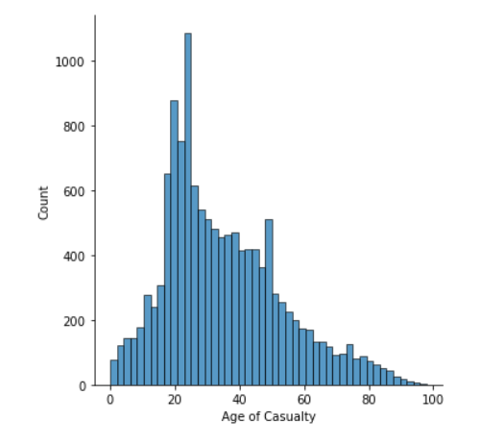
DISPLOT TO SEE THE DISTRIBUTION OF AGE OF CASUALTY COLUMN

Slide 32
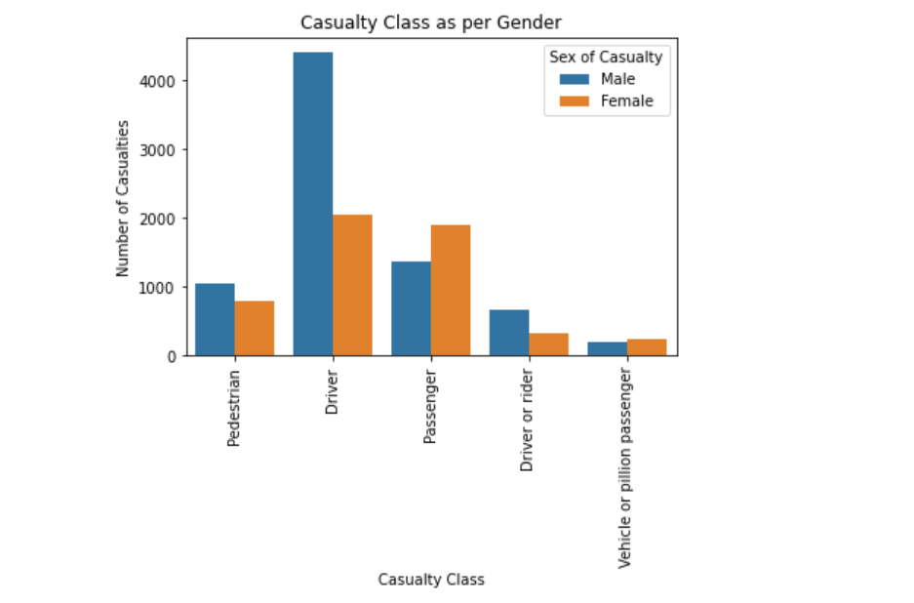
This visualization displays the count of casualties as per casualty class and gender.
It can be observed that driver were the highest among the casualty class. Also, sex of casualty was mostly male with only passenger casualty class being the exception.

Slide 33
Future changes in the dataset

Slide 34
We intend to rename the columns of airbag dataset as their names are not quite understandable.
Also, we will delete few columns that are not useful in our analysis.
In addition, we will convert age column into different age group categories.

Slide 35
Data Cleaning & Transformation

Slide 36
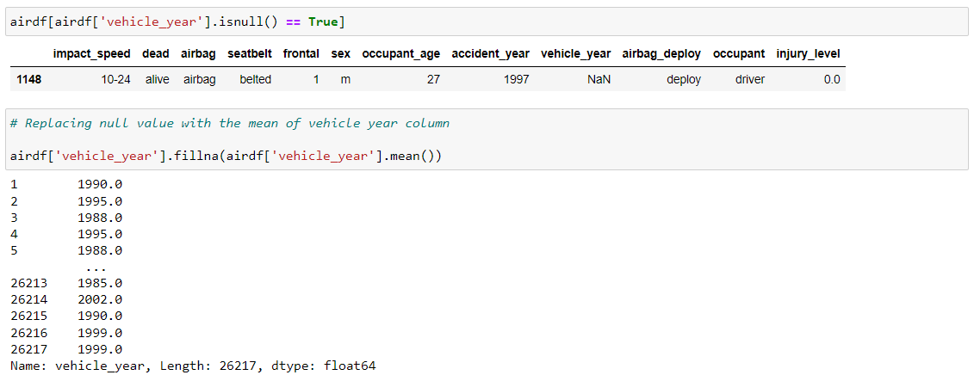
Replace null value in vehicle_year with mean value.

Slide 37
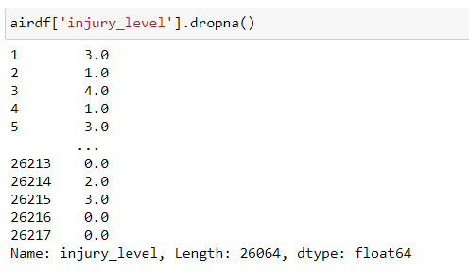
Drop null values from injury_level

Slide 38
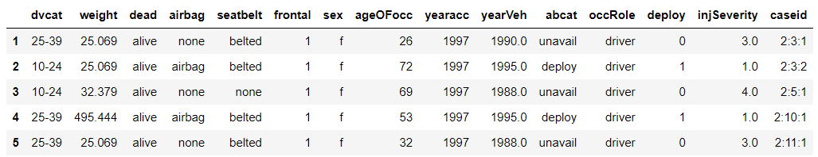
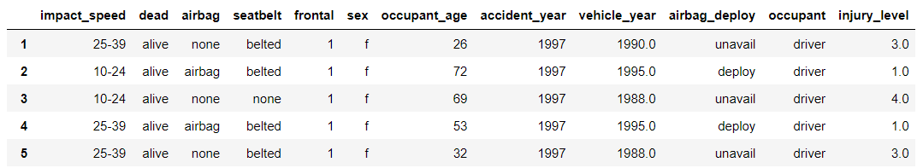
Removed unwanted fields - weight, abcat and caseid, as this fields were not required to do analysis.
Change the fields name so that it is more easier to understand the data.
Before
After

Slide 39
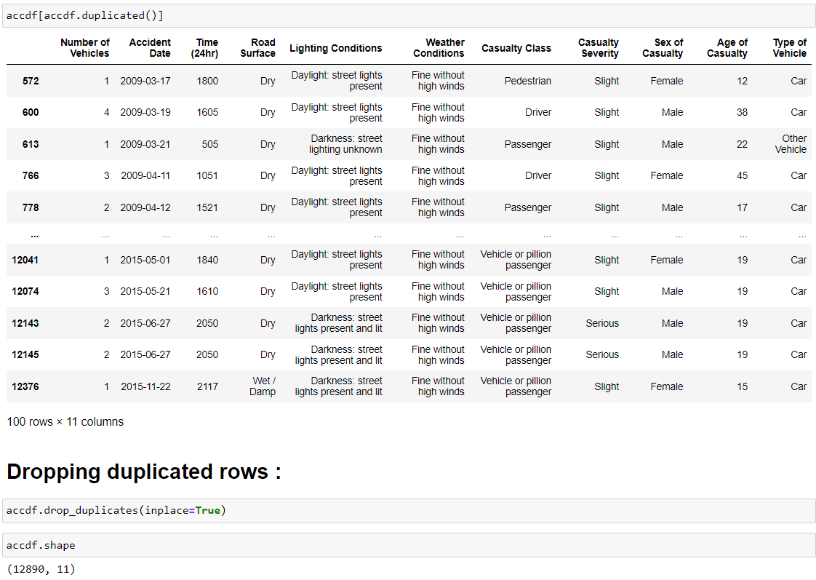
Remove duplicated data from accident dataset.

Slide 40
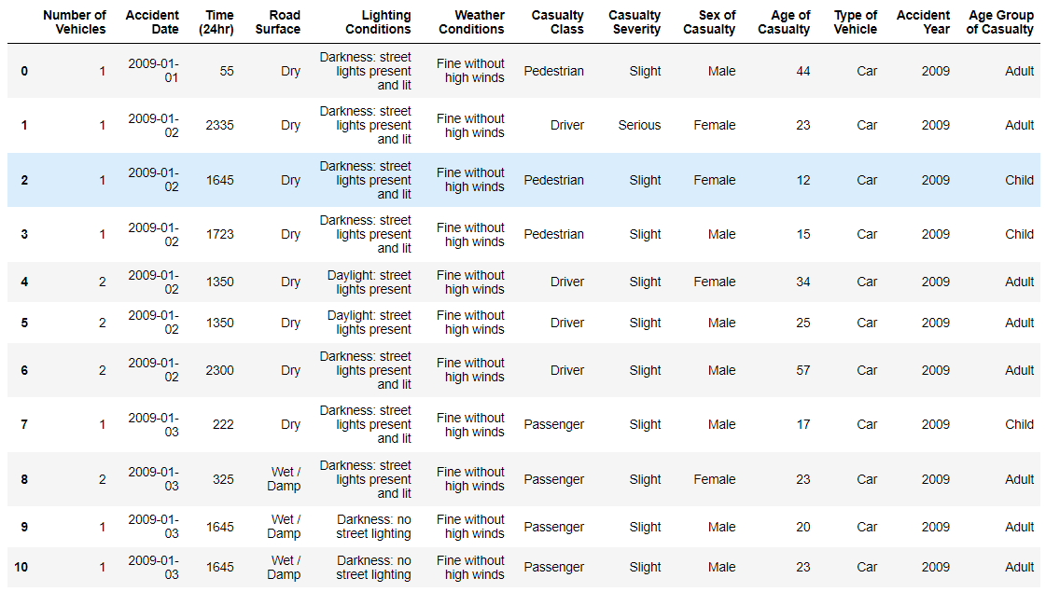
Created Age Group of Casualty from Age where age is converted into different age groups – Toddler, Child, Adult, Elderly.
Separated year from Accident date and created new field called Accident year.

Slide 41
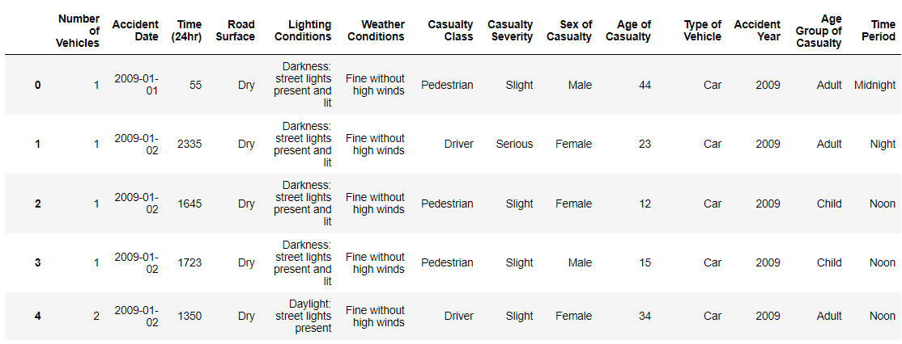
Created new categorical field Time Period from field name Time.

Slide 42
Data Analysis

Slide 43
Analysis Question :
Identify pattern in which age group most of the accidents registered?

Slide 44
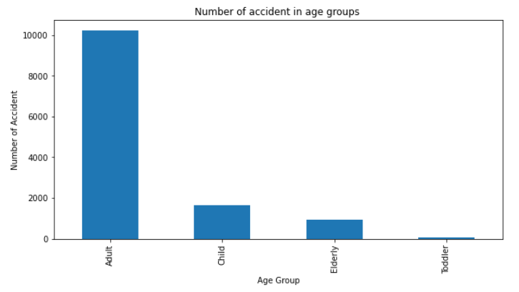
This visualization displays the number of accidents in different age groups.
It can be observed that most accidents happened in the adult age group followed by children and elderly people.

Slide 45
Analysis Question :
During what part of the day accidents happen more frequently? Examine the trend for accident prone time of day on yearly basis.

Slide 46
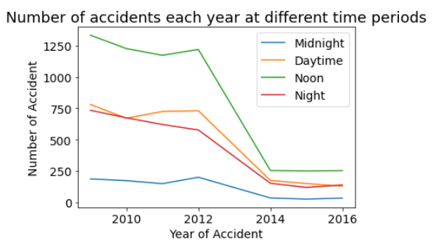
This visualization displays the trend for accident prone time of day on yearly basis.
It has been observed that afternoon time period is the most accident prone time period of the day.

Slide 47
Analysis Question :
Check how the speed at the time of impact (accident) affected the seriousness of injury ?

Slide 48
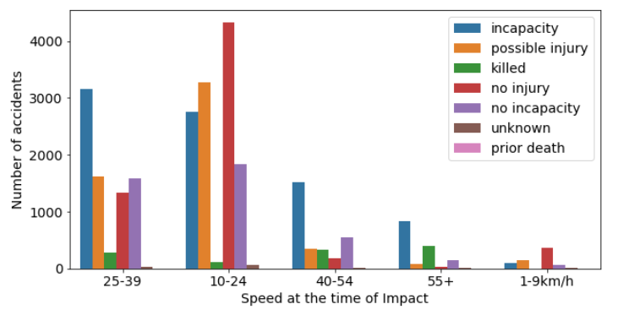
This visualization displays the count of accidents as per speed of vehicle and seriousness of accident.
It can be observed that when the speed was on the lower side (1-9 km/hr), mostly there was no injury. On the other hand, when the speed was high (55+), mostly people involved had incapacitating injury or were killed.

Slide 49
Conclusion

Slide 50
Our analysis showed that adults and children are the most vulnerable age groups to accidents. Moreover, afternoon time period (12-6 PM) is the most accident prone time of the day. Also, the speed of the vehicle at the time of crash contributed heavily to the seriousness of the injury. When the speed was on the higher end (55+ km/hr), it led to severe incapacitating injury or even death of the person. On the other hand, when it was on the lower side ( < 10 km/hr), there was no or little injury to the person involved in the crash.

Slide 51
Recommendations

Slide 52
As per our analysis, adults are the most vulnerable group to road traffic accidents followed by children. So, we recommend public policy makers to organize workshops, driver educational and preventative programs that would help them improve their knowledge, attitude, understanding of the surrounding circumstances. This as a whole, could result in reduction of road traffic accidents among adults and young children.
Afternoon time is the most accident prone time of the day as per our analysis. To reduce the risk during that dangerous period of the day, drivers need to wear seat belt and remain cautious. Public policy makers should make strict rules and ensure that drivers are wearing seat belt.
It is observed in our analysis that over speeding was a major factor resulting in fatality or incapacitating injury. There are several things public policy makers could do regarding that. Infrastructure adaptations such as speed humps, raised platforms, gateway treatments, pavement narrowings and developing roundabouts at intersections could slow down traffic and reduce speed.

Slide 53
Jira work Management
Phase-1

Slide 54
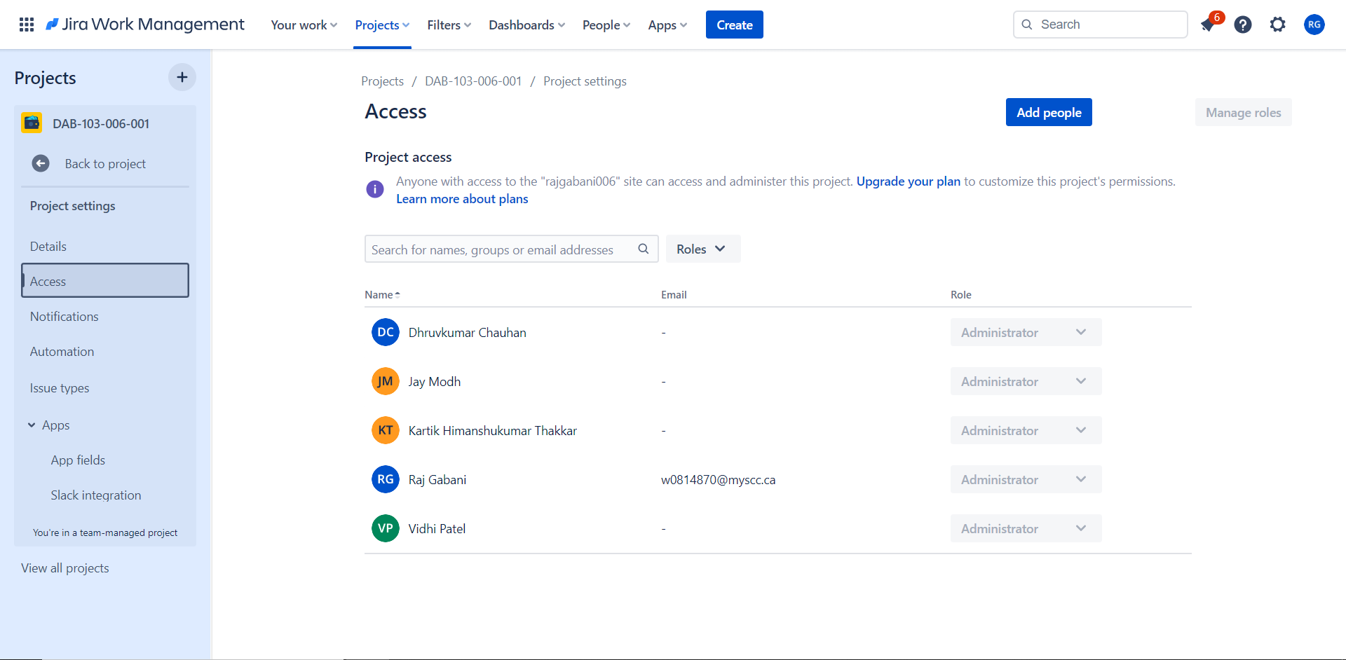

Slide 55
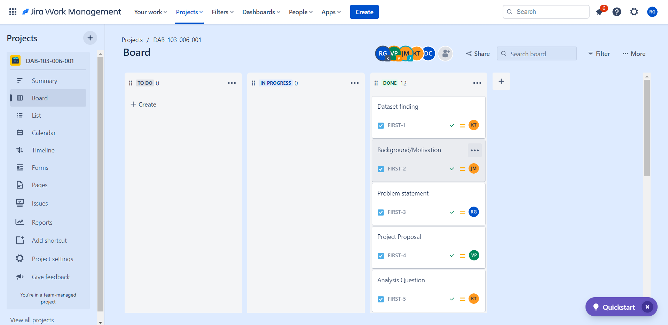

Slide 56
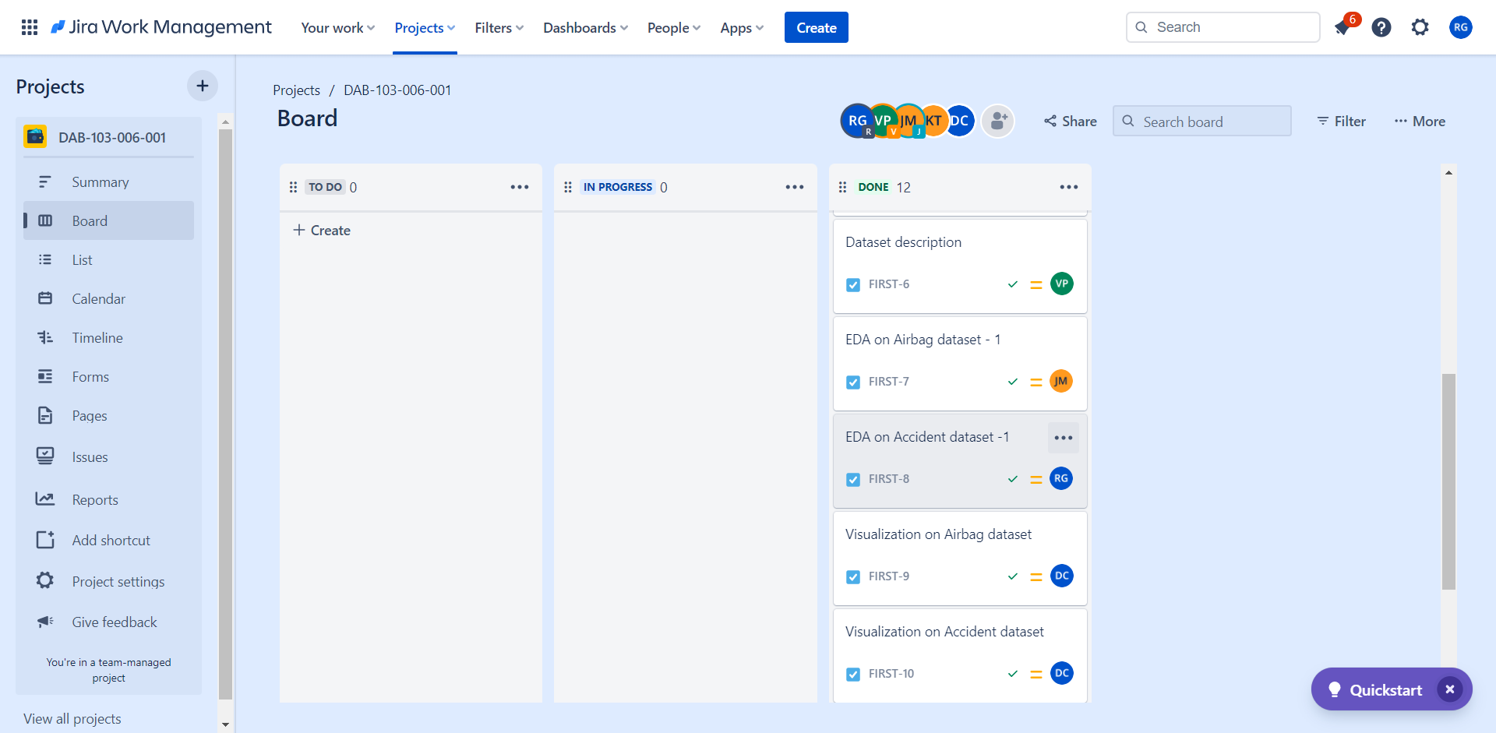

Slide 57
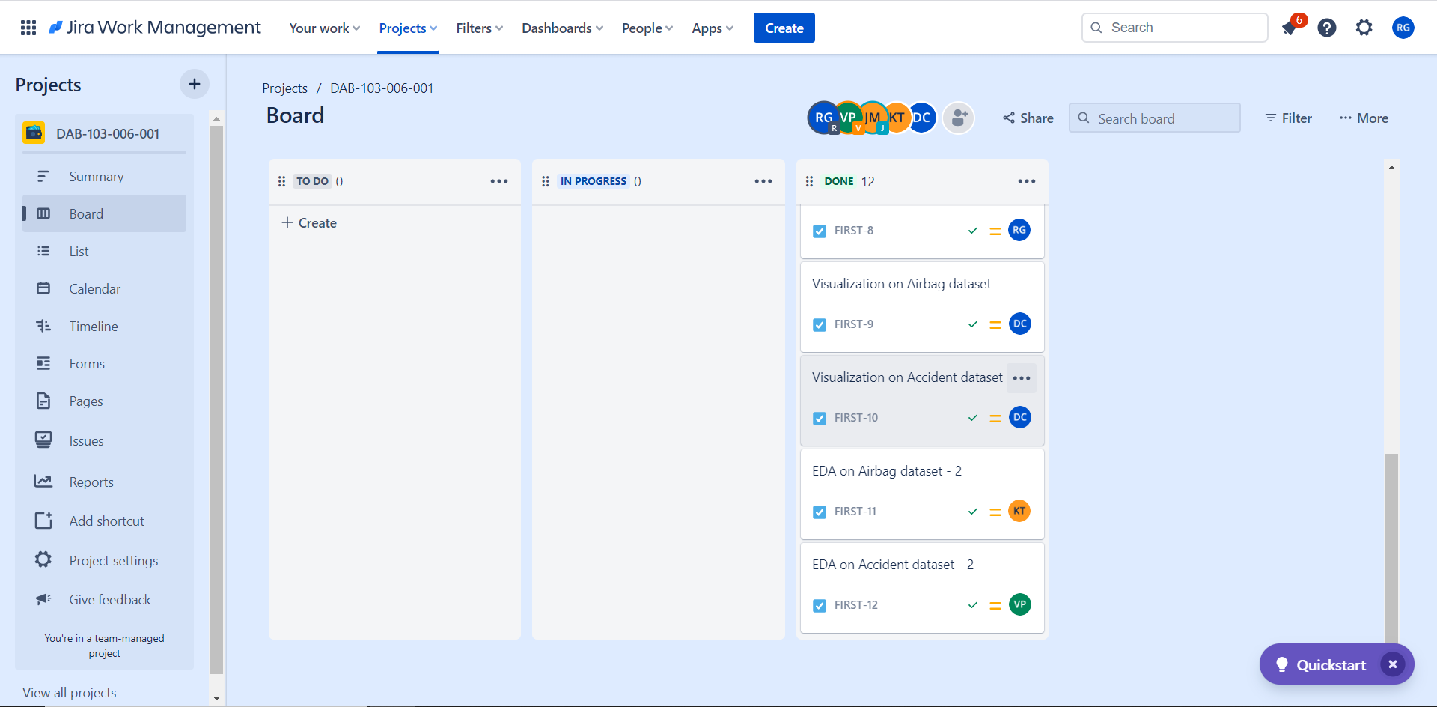

Slide 58
Jira work Management
Phase-2

Slide 59
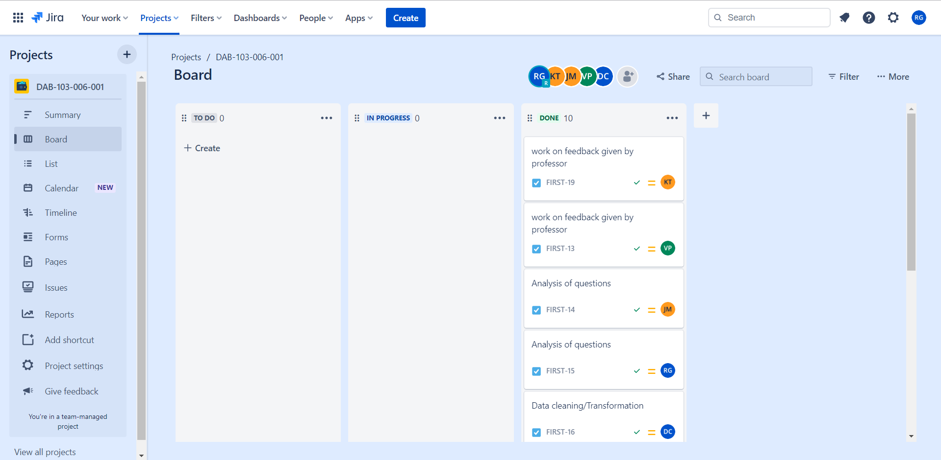

Slide 60
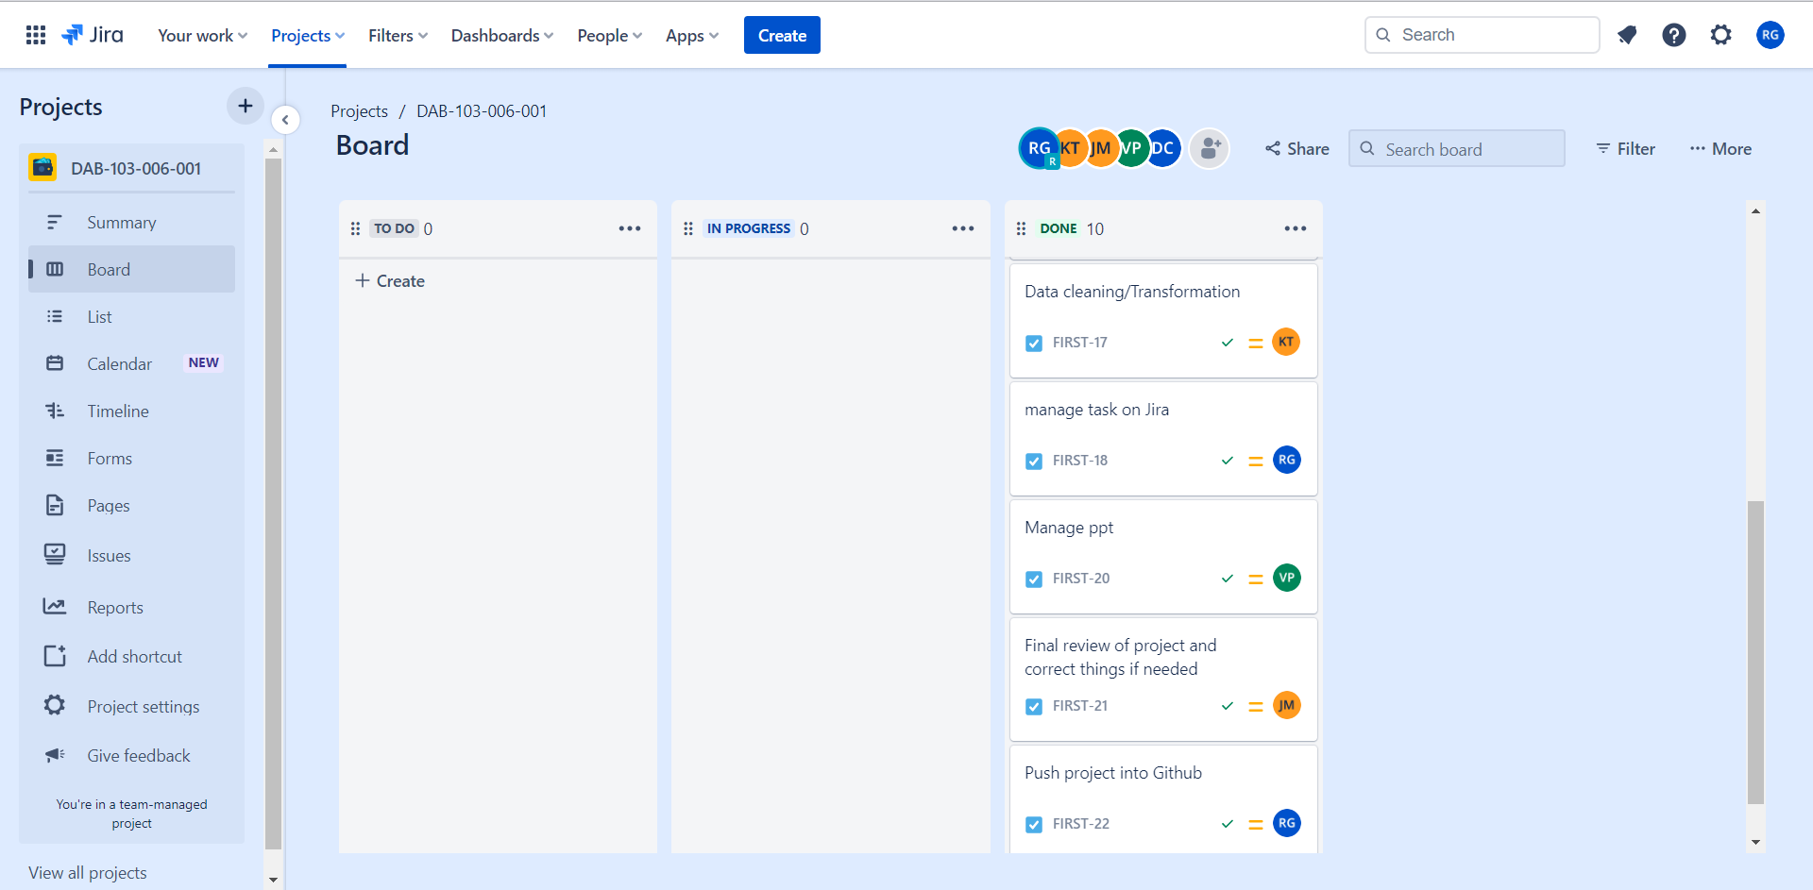

Slide 61
Github work

Slide 62
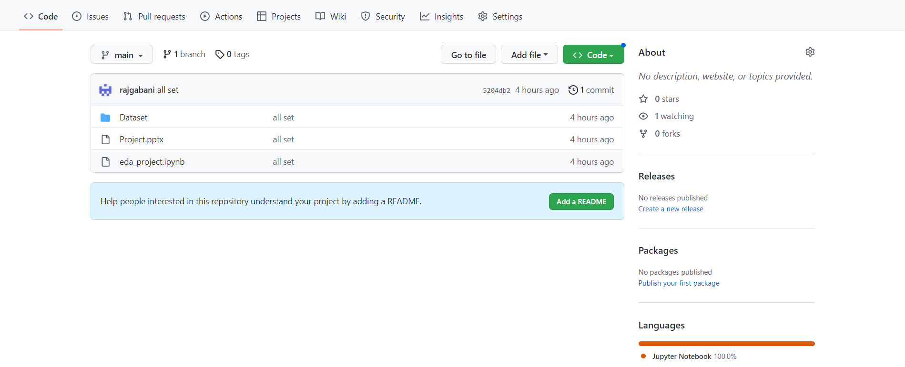
https://github.com/rajgabani/DAB-103-006-001

Slide 63
Reference
https://vincentarelbundock.github.io/Rdatasets/doc/DAAG/nassCDS.html
https://data.world/datagov-uk/6efe5505-941f-45bf-b576-4c1e09b579a1
https://making-cities-safer.com/speed-reduction-methods-to-promote-road-safety-and-to-save-lives/

