Slide 1
01
02
Architecture
API GATEWAY
03
04
Agenda
Services/Tools
Deliverables

Slide 2

01
Architecture

Slide 3
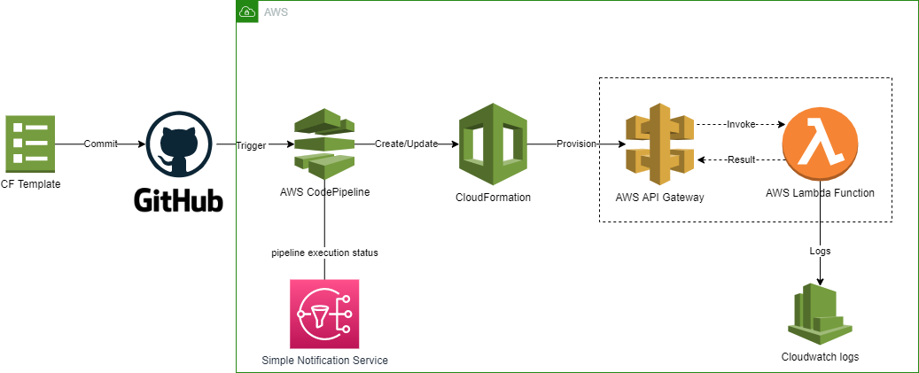

Slide 4

02
API GATEWAY

Slide 5
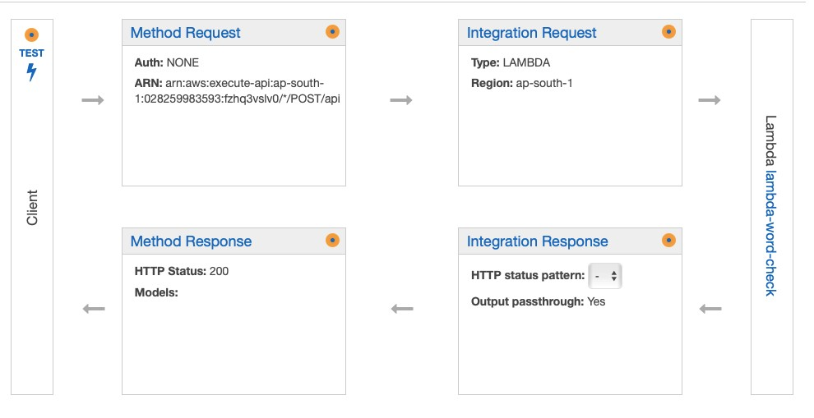
API GATEWAY COMPONENT

Slide 6

03
Services/Tools

Slide 7








Tools/AWS Services used
Github
Identity and Access Management
AWS CodePipeline
AWS API GATEWAY
Lambda
Cloudwatch
CloudFormation
SNS

Slide 8

04
Deliverables

Slide 9
Github Link
API URL
https://github.com/rajgaurav603/deloitte-api-replace-word
https://fzhq3vslv0.execute-api.ap-south-1.amazonaws.com/live/api

Slide 10
THANK YOU!

