Slide 1


CAPSTONE PROJECT
Personal Notes Manager
Presented By
Student Name: Rishit GHOSH
College Name: Geethanjali College of Engineering and Technology
Department: CSE – AI&ML
Email ID: rishitghosh06@gmail.com

Slide 2
OUTLINE:
Problem Statement (Should not include solution)
Proposed System/Solution
System Development Approach (Technology Used)
Algorithm & Deployment
Result (Output Image)
Conclusion
Future Scope
References

Slide 3
Problem Statement:
Students and professionals often struggle to organize personal notes effectively.
Traditional paper-based or scattered digital notes lead to:
Difficulty in searching specific information
Lack of structured storage
Risk of losing important notes
There is a need for a lightweight, reliable, and persistent system to manage notes efficiently.

Slide 4
Proposed Solution:
Overview
A lightweight, command-line tool to manage personal notes with simplicity and reliability.
Key Features
Add Notes – Quickly capture ideas or tasks
View Notes – Display stored notes in the terminal
Search Notes – Find notes by keywords instantly
Delete Notes – Remove outdated or irrelevant entries
Technical Highlights
Persistent Storage – Notes saved in JSON for durability
Modular Design – Helper functions ensure clean, maintainable code
Unit Tests – Guarantee correctness and reliability
Benefits
Easy to manage
Fast and searchable
Safely stored for long-term use

Slide 5

System Approach:
System Requirements
Python 3.10+
Pure Python (no external dependencies)
Libraries Used
json – Persistent storage of notes
os – File handling and path operations
unittest – Automated testing framework
Folder Structure
main-scripts/ – Core application logic
utils/ – Helper functions for file operations
tests/ – Unit tests for reliability
exports/ – Screenshots, PDFs, and outputs
Highlights
Lightweight & dependency-free
Clean modular organization
Easy to test, maintain, and extend

Slide 6
Algorithm & Deployment:
Algorithm Flow
Initialize Storage – Create notes_storage.json if missing
Add Note – Append title + content to JSON
View Notes – Display all stored notes
Search Notes – Match keywords in title/content
Delete Note – Remove note by title
Deployment
Run Application -> “python -m main-scripts.notes_manager ”
Run Tests -> “python -m unittest tests.test_notes ”
Highlights
Simple, intuitive workflow
CLI‑friendly execution
Reliable testing ensures stability

Slide 7
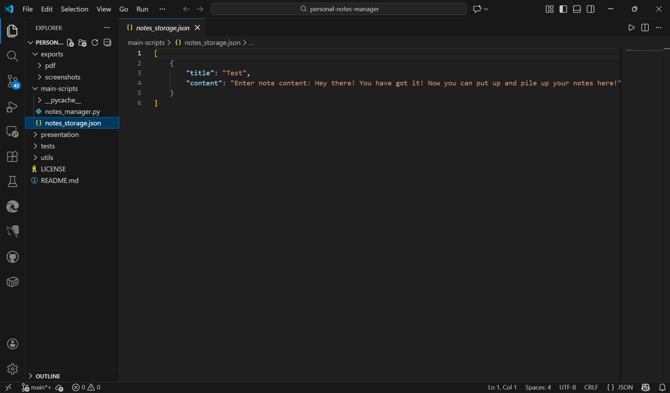
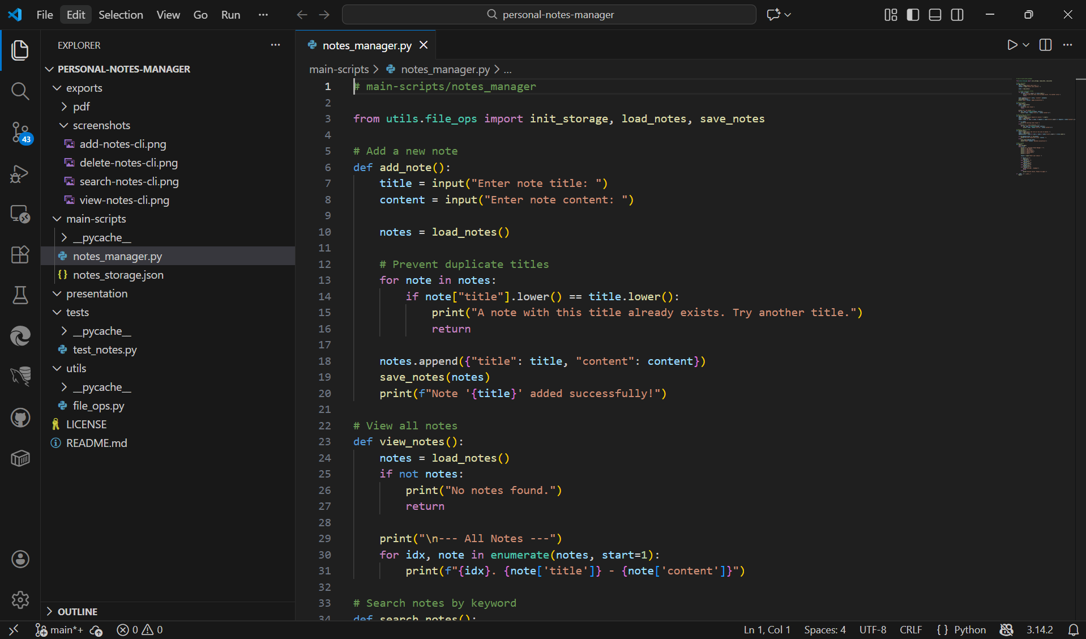
Result:
The Personal Notes Manager successfully demonstrated all core features — Add, View, Search, and Delete — with persistent JSON storage.
Unit tests executed with Python’s unittest framework confirmed reliable functionality and accurate data handling.
.json file where the notes are saved.
Code Sample.

Slide 8
Conclusion:
Problem Solved
Tackles the issue of scattered note‑taking by providing a centralized, structured solution
Key Strengths
Lightweight – Minimal setup, runs smoothly in any environment
Reliable – JSON persistence + unit tests ensure stability
Easy to Use – Simple CLI interface for quick note management
Fully Tested – Verified functionality for confidence in daily use
Outcome
Demonstrates practical application of Python for workflow automation
Enhances productivity through organized, searchable, and secure notes

Slide 9
Future scope:
Planned Features
Timestamps on Notes – Automatically record creation and update times for better tracking
Export to PDF – Generate shareable, professional note documents
GUI Interface – User‑friendly front end via Tkinter (desktop) or Flask (web)
Cloud Integration – Sync and access notes anywhere using Azure Functions
Copilot Integration – Smart suggestions to improve note organization and productivity
Impact
Enhances usability with multiple interfaces
Enables portability and sharing of notes
Provides intelligent assistance for smarter workflows
Scales from personal use to cloud‑connected productivity

Slide 10
References:
Python Documentation
json (docs.python.org in Bing) – JSON encoder/decoder
os (docs.python.org in Bing) – Miscellaneous operating system interfaces
unittest (docs.python.org in Bing) – Unit testing framework
GitHub Repository – Click here [https://github.com/rajghosh06-dev/personal-notes-manager]

Slide 11
Thank You

