Slide 1
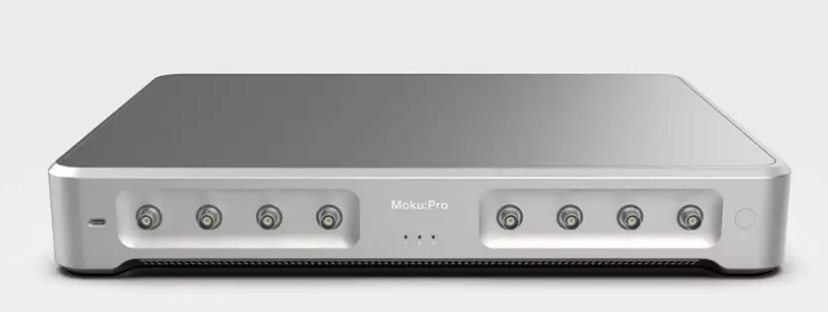
Moku business for SKPM
Purpose:
Advantages are:
Generally quite fast, according to Stefan Weber and others
Can achieve good time-resolution as a result for point spectroscopy (cross-sections and related)
Moku has other specific non-SKPM advantages
Integrated oscilloscope + digitizer (Gage card) + waveform function generator + LIA so it’s many instruments in 1
Python SDK

Slide 2
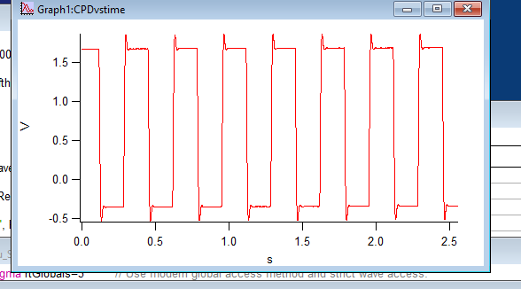
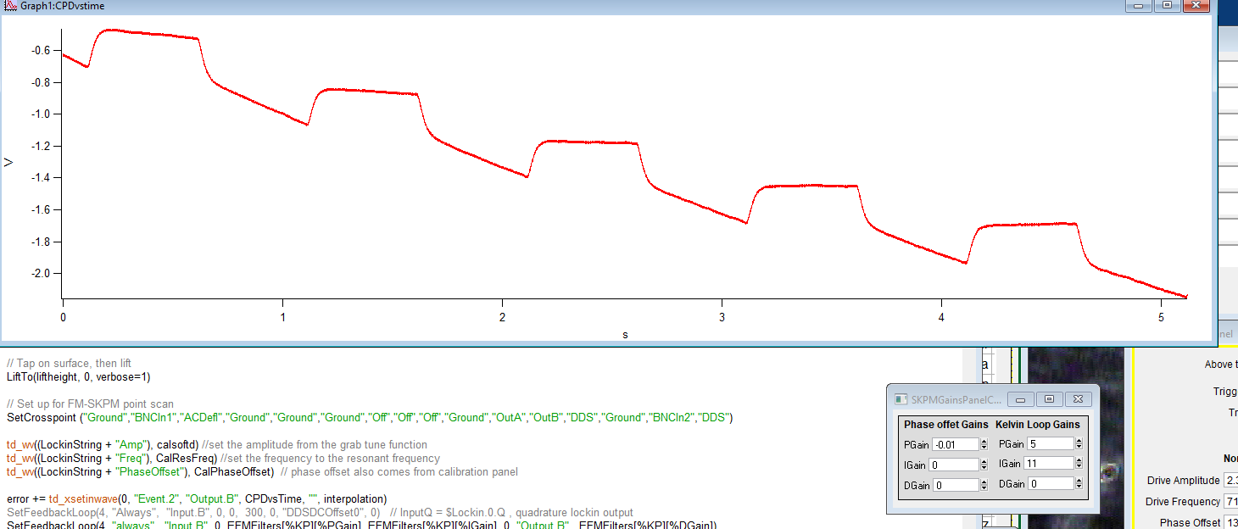
Function AM-SKPM feedback using the Moku instead of the ARC.
Proof of principle that the Moku is fast enough to function in this paradigm.
Here, applying a square wave to the substrate and measuring the signal using the Moku
FM-SKPM is not quite as smooth yet if using the Moku internal LIA!
Moku internal LIA for both the amplitude detection, and a second LIA that takes phase from first LIA as the input.
This is how we do SKPM now, except we use the LIA from the ARC and spoof an output for the phase to the SRS Lockin. I’m trying to get around that issue.
Here, it tracks an input but gains are weird, as is the magnitude…

Slide 3
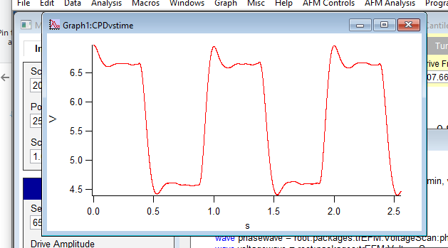
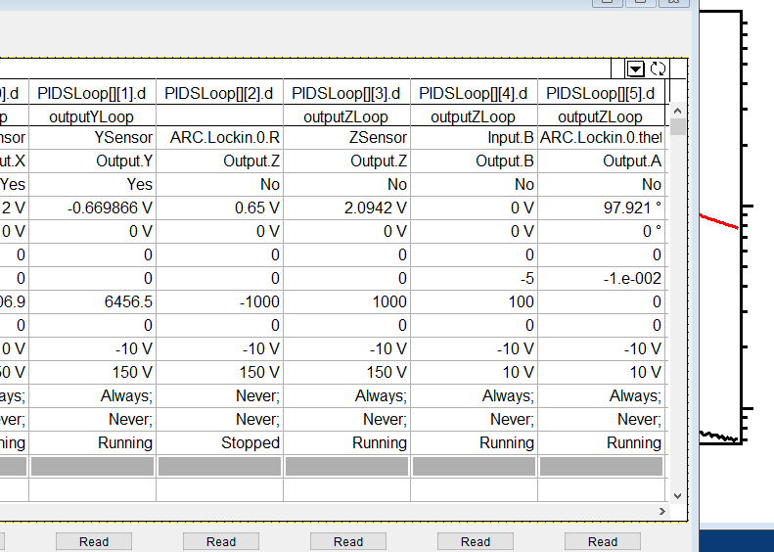
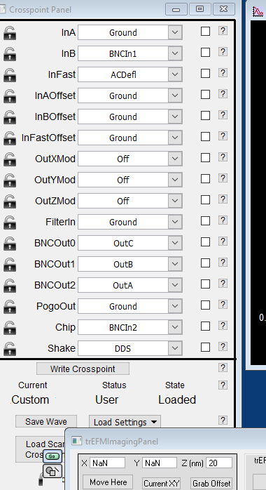
FM version 2, like old code (using ARC internal LIA to spoof theta out)
Finally working! But the DC offset is way off…
Also have to use negative P gains for some reason

Slide 4
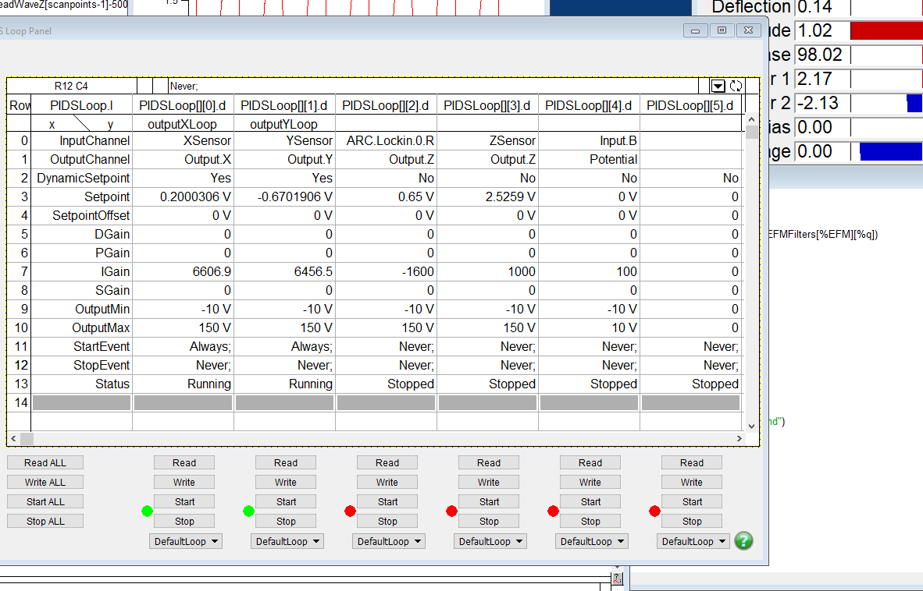
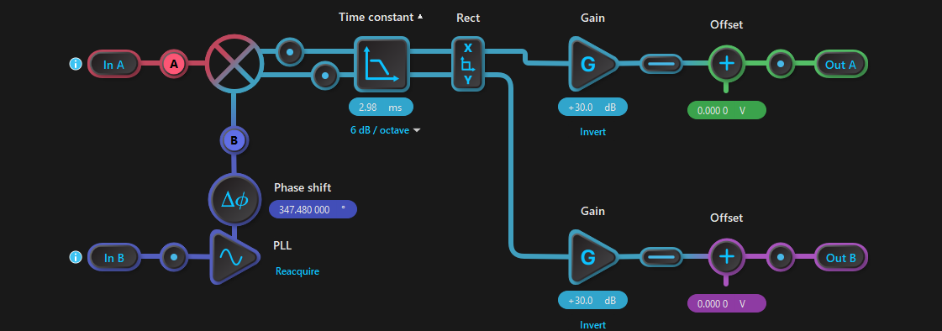
Examples of the setup for AM-SKPM
Unfortunately you can’t really save the settings on here. Hence the need for Python interface (which works! I just want to get this working via the software where I can quickly iterate)

Slide 5
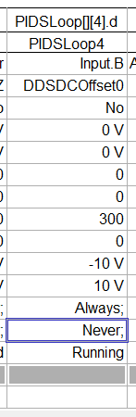
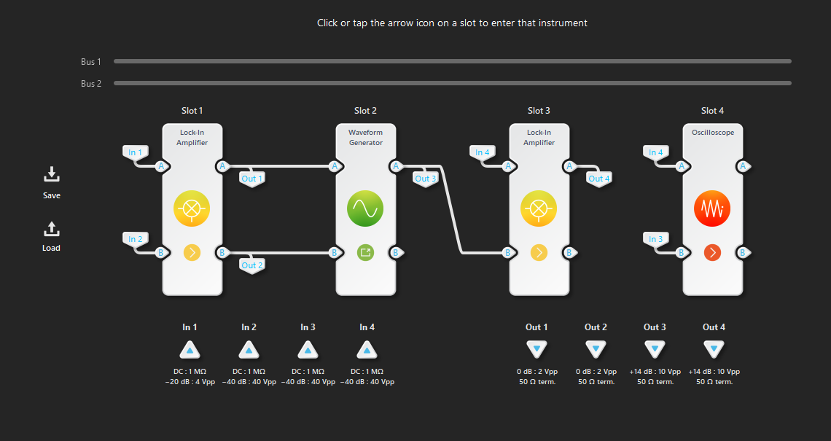
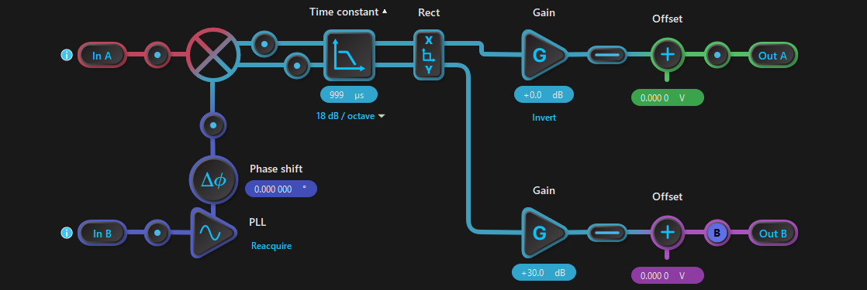
This setup works for AM-SKPM, using the first LIA on the Moku to track a potential.
Sometimes the LIA gets in a weird state where it’s not really reading anything and you have to reacquire via the PLL

Slide 6
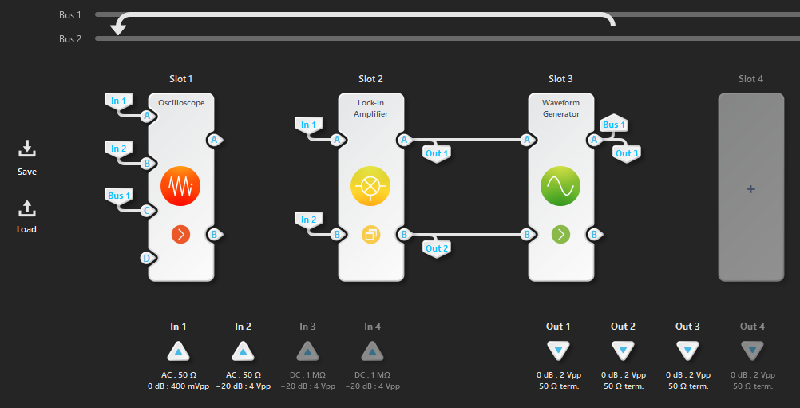
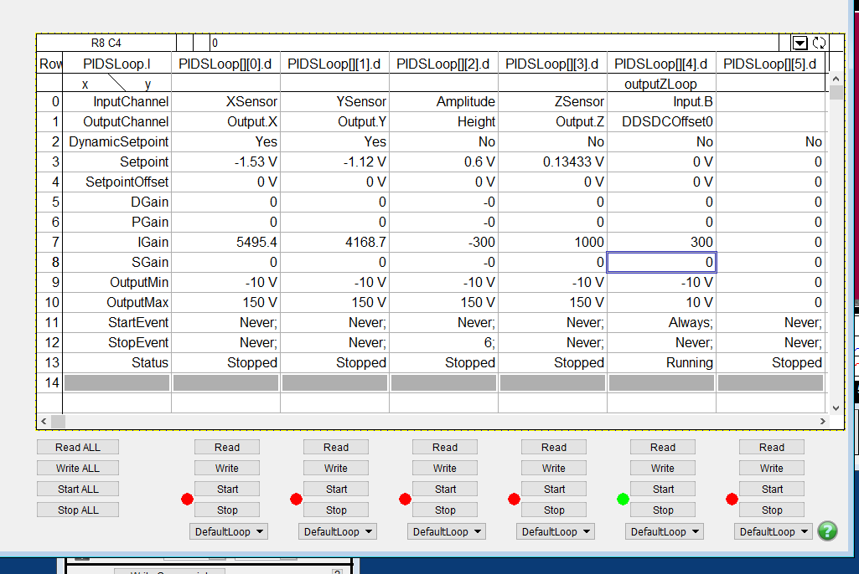
AM-Moku redone 2026
This is using the electric tune to drive things.
Note that switching to AC coupling helps a lot.
The existing gains in the Moku file work (300 I Gain)
Note sometimes gets in weird loop and need -300 I Gain. This is when the PLL is 90 degrees out of phase with the signal, so you need to adjust the phase to compensate
Should have Tip Bias set to 0 V before starting

Slide 7
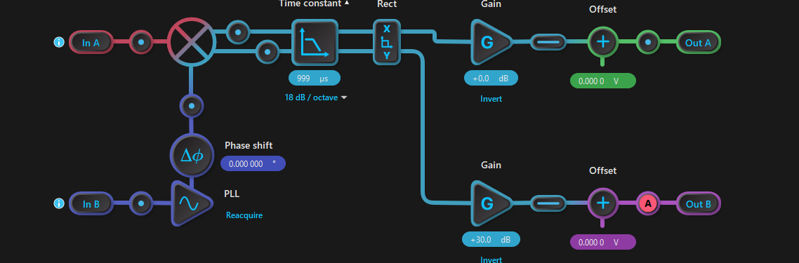
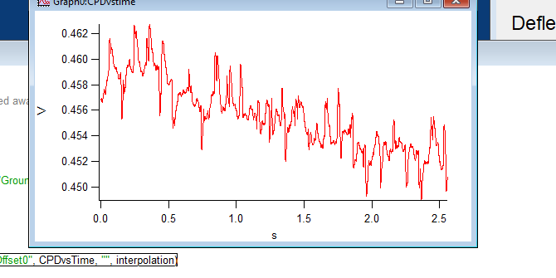
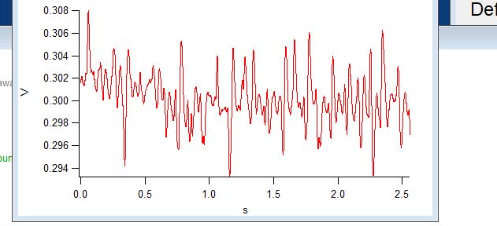
Trying to integrate both AM and FM on same multiinstrument mode
AM SKPM noise on graphite
1ms time constant on LIA; 3 ms time constant-→

Slide 8
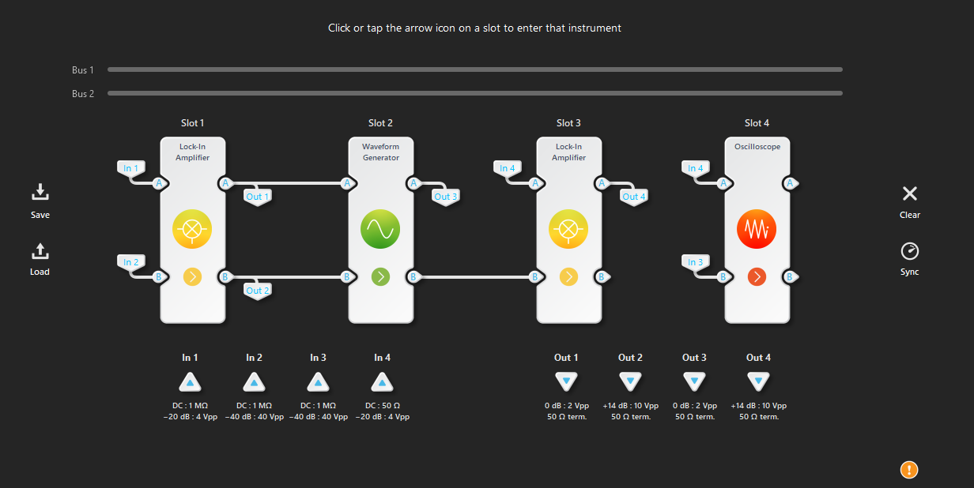
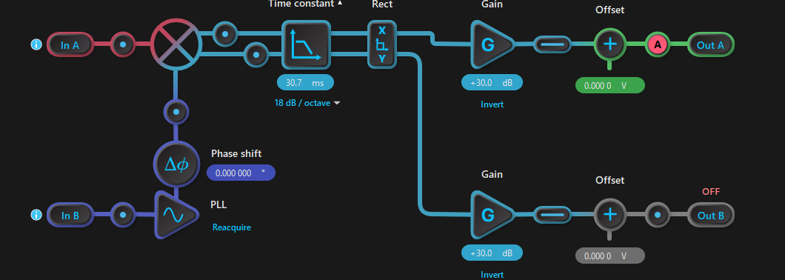
In this mode, only using the wave function generator and the SECOND LIA since first LIA is coming from the LIA.
More LIAs more problems

Slide 9
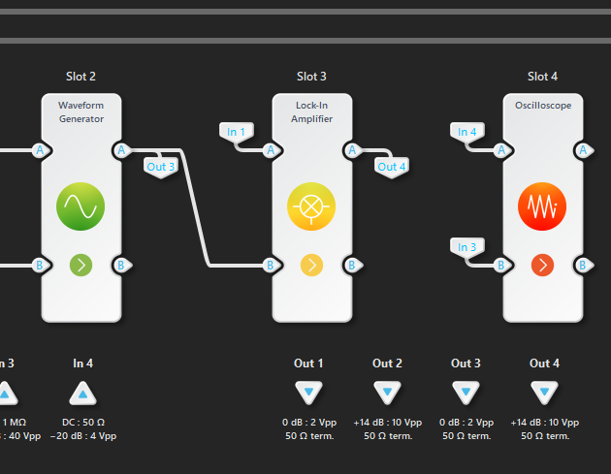
Heterodyne Setup
Examples of using the sideband:
W1 = 80.826, w2=513.520, wm=432.694 kHz
Closer to working. Using only LIA3
Set manually with the Moku waveform generator + external summing amplifier

Slide 10
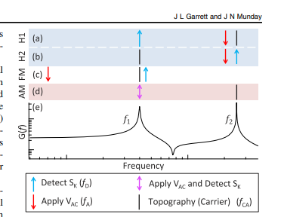
Heterodyne setup
These show the various detection schemes we could potentially use.
H2 is topo at first resonance, modulate at w2-w1, detect at w2
Moku LIA sort of works.
Some issues.
Having to use the “ARC Deflection” from the controller itself which is very noisy and might be filtered? Not sure.
Systematic drift in the signal unless you use weird gains. Similar to this case on the right→ which leads me to believe case 1 is the issue.
Next steps:
Use the AFM head with raw deflection out (we have it available)
Write imaging code
Write in Python
Deploy on each AFM to see if it works for perovskites
Profit

Slide 11
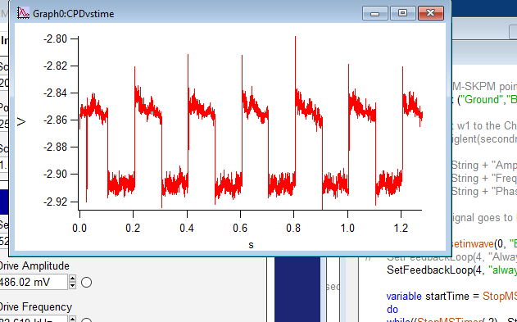
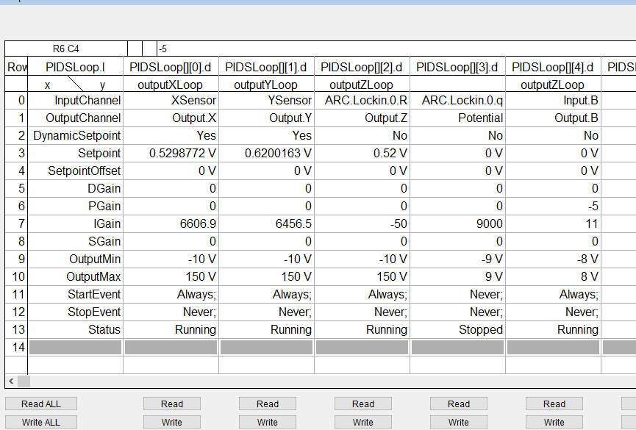
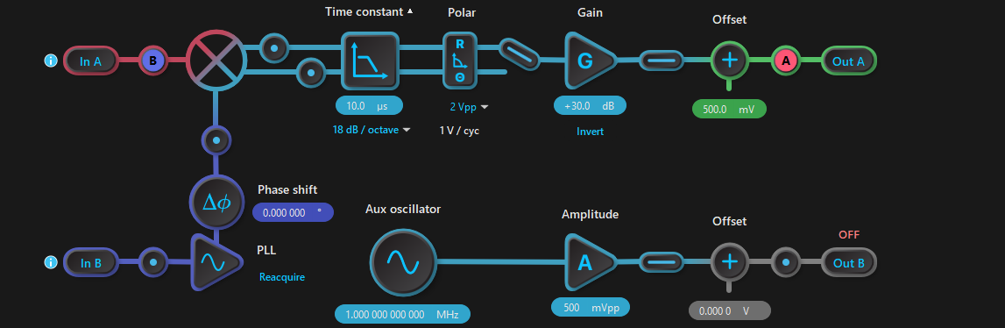
Heterodyne setup
w1 = 82.619 (topography), w2 = 525.478 (detect SKPM), delta_w (Vac) = 442.859 kHz
Wrong magnitude ☹ But it seems to show something (I’m applying a square wave pulse to the graphite sample)
Feedback loop setting
Lockin Setting

Slide 12
Troubleshooting
Note that the system doesn’t like it when you pause, it doesn’t seem to write the amplitude to the LIA correctly (the tip amplitude)
Need to manually input the instrument modules

Slide 13
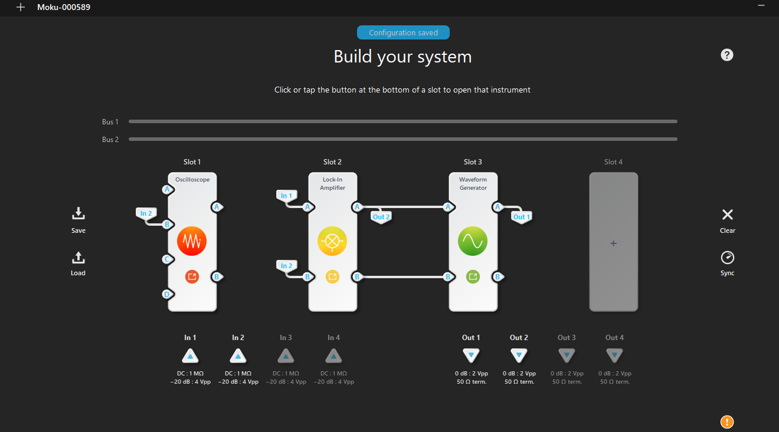
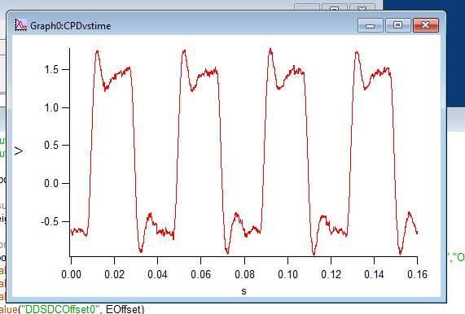
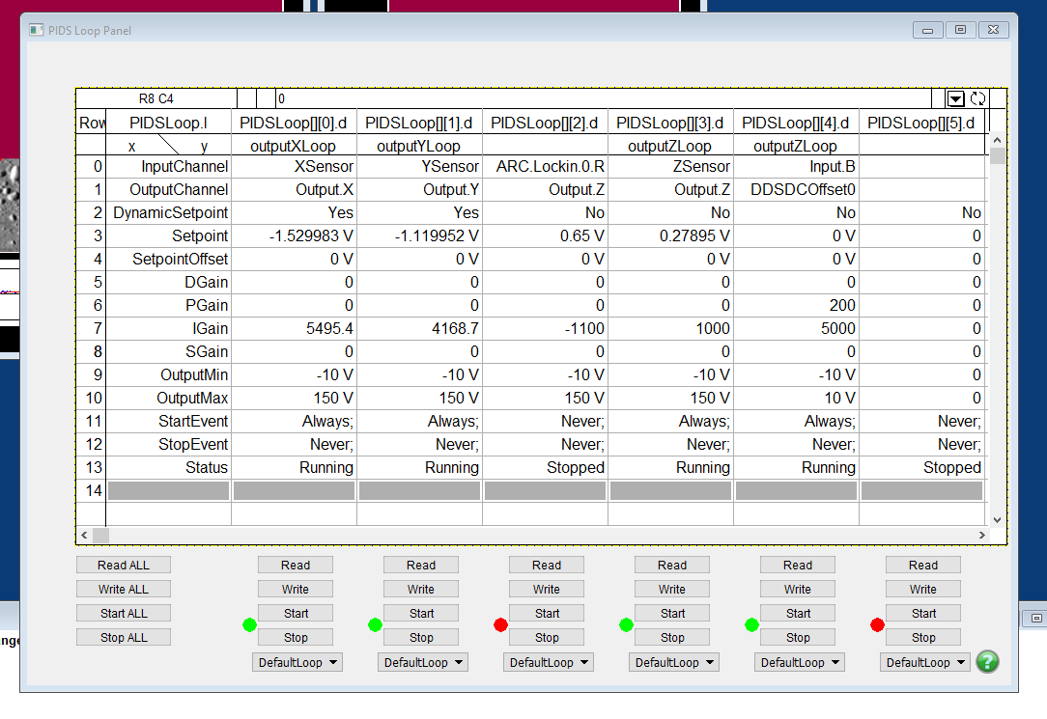
Debugging on PV-AFM: 1/4/2025+
AM-SKPM
AM-SKPM with P=200, I=5000 Using Moku as feedback loop

