Slide 1
Unit Testing an Existing Metro Style Apps (XAML/C#) with Visual Studio 2012
Raj Aththanayake
.NET Consultant - QuantumIT
http://blog.rajsoftware.com
@raj_kba

Slide 2
About Me
Unit Testing/TDD Junkie
Open Source
Presenter / Blogger
X-Box Games
AFL / Tennis
Air Crafts

Slide 3
Disclaimer
“The content of this presentation is entirely my personal work and does not represent neither the QuantumIT nor any of its materials.”

Slide 4
Agenda
New VS2012 Unit Testing capabilities and metro style app development
Improving the testability of an existing metro app using MVVM & TDD
Challenges of Unit Testing metro style apps (Async, MoqRT)
Summary
Questions

Slide 5

Things you will know after this talk
New Unit Testing capabilities in Visual Studio 2012
(Across the board & specific to metro apps)
How to refactor an existing metro app for higher testability using MVVM (Model-View-ViewModel) pattern
Challenges of Unit Testing metro apps, and how to overcome those challenges. i.e Asynchrony, Isolating Dependencies (MoqRT)

Slide 6
What I defined as Unit Testing…
“Unit Testing is a software development process performed by developers, which verifies the behaviour of a smallest unit of work whether it fits for the purpose.”

Slide 7
Other types of testing…
Integration Testing
Functional Testing/System Testing
Exploratory Testing
Performance Testing
Etc.

Slide 8
Visual Studio Unit Testing
Visual Studio Test Tools and MS-Test framework so far..

Slide 9
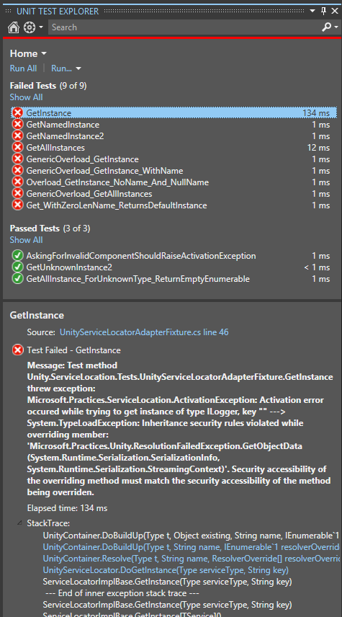





VS2012 Unit Testing
New Unit Test Explorer
Seamless
Fast
Extensible

Slide 10
demo
Testing metro style API
A quick demo on the new Unit Test Explorer, and metro style Unit Testing.

Slide 11
Unit Testing an existing xaml based (C#) metro style app

Slide 12
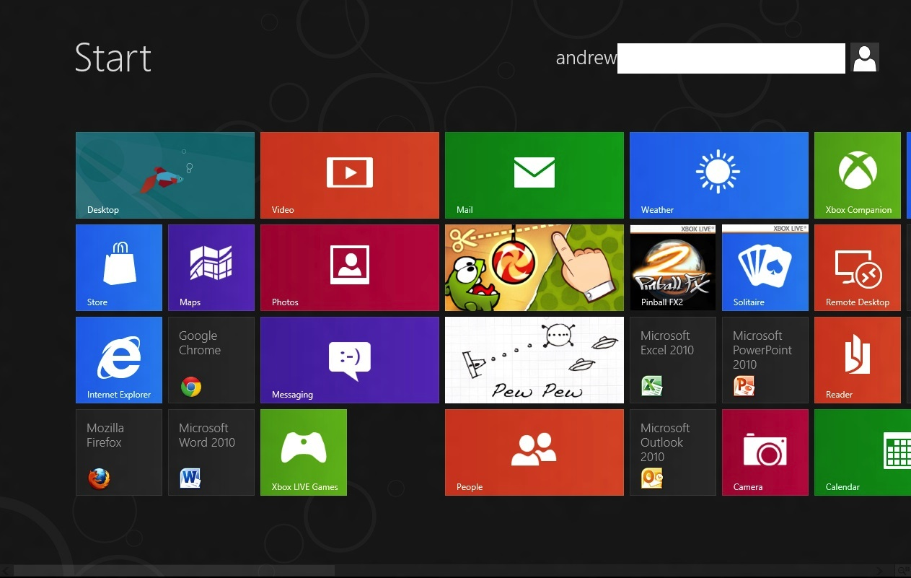
Metro Style Apps
Windows 8 experience.
WinRT API available via HTML5,
CSS3,
JavaScript,
XAML, C#
etc.

Slide 13
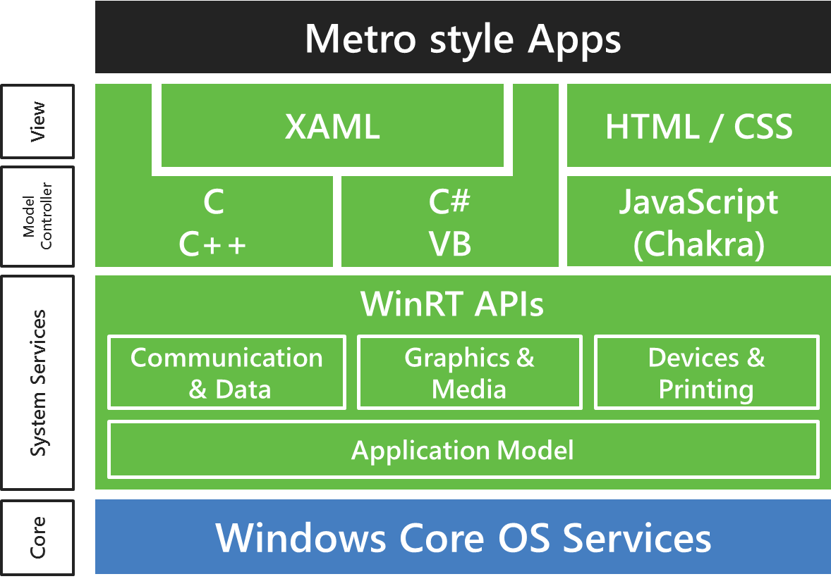

Slide 14
File Access metro style app
Unit Tests
&
Integration Tests
XAML
(UI)
C# Code Behind
Access File System
(WinRT)
File System

Slide 15
demo
Challenges facing when Unit Testing
an existing XAML/C# based metro style app

Slide 16
Challenges of Unit Testing metro apps
General Design issues:
Business Logic in Code Behind file
Harder to maintain, harder to test
Metro:
Run in an AppContainer Sandbox
Require a special Unit Test project (integration type tests)
Limited access to many .NET API
Your favorite Isolation/Mock object Framework won’t work!
Asynchronous API

Slide 17
Making your metro app testable
Resolving Design Issues:
Decouple the dependencies using MVVM (Model-View-ViewModel)
Test in isolation
Resolving Metro specific issues:
New metro style Unit testing Test template
Test frameworks that support for Asynchronous Testing
MoqRT for isolating dependencies in metro style apps

Slide 18
Designing your metro app for Testability
MVVM (Model-View-ViewModel)
Asynchronous Testing
Isolating Dependencies/MoqRT
Testable metro style App
Existing
Harder to Test
metro style App

Slide 19
demo
Making your XAML based metro style app testable
using MVVM (Model-View-View Model)

Slide 20
Metro & Asynchrony
Async is becoming a common programming model for future apps. Responsive and scalable apps
Supported .NET 4.5 (beta) two new key words async/await
First is the Task functionality in .NET 4, and based on Task and Task<TResult>. While Task was intended to be the primary means of asynchronous programmingwith .NET 4, the .NET Framework was still based mainly on the Asynchronous Pattern and the Event-based Asynchronous Pattern.
Metro style apps:
In WinRT API any thing takes longer than 50ms are Async
80% > metro API asynchronous

Slide 21
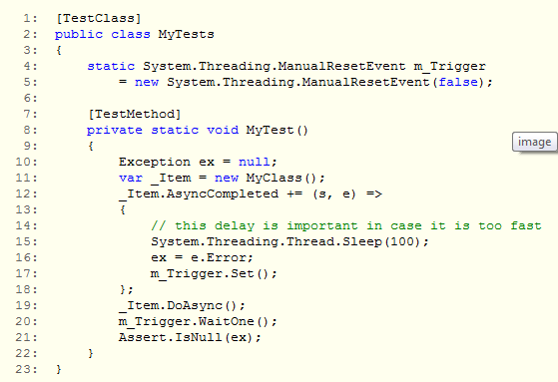
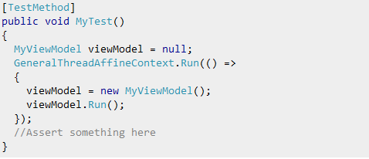
Async Unit Testing is challenging/complicated

Slide 22
demo
Unit Testing asynchronous metro API

Slide 23
Isolating/faking Dependencies in metro apps
In metro, your standard Mock Object Framework/Isolation Framework won’t work.
The new Visual Studio Fakes / Moles won’t work.
WinRT has no support for Dynamic Code Generation

Slide 24

MoqRT (Open Source – Mathew Baxter)
Baking

Slide 25

MoqRT
Unit Tests Lib
Baking
SUT Lib
Proxy Lib

Slide 26
demo
Unit Testing/TDD with MoqRT

Slide 27
What we have covered?
Some of the new VS2012 Unit Testing features
How to make your existing XAML based metro
style app testable (Refactoring / MVVM, and TDD)
Usage of App Container manifest file for Integration testing
Async Unit Testing (async/await) support
How to use MoqRT for Isolating Dependencies

Slide 28
References
http://blog.rajsoftware.com
Slides
Source code
References

Slide 29
Questions

Slide 30
Thank You

