Slide 1
Unit Testing an Existing Metro Style Apps (XAML/C#) with Visual Studio 2012
Raj Aththanayake
.NET Consultant - QuantumIT
http://blog.rajsoftware.com
@raj_kba

Slide 2
About Me
Unit Testing/TDD Junkie
Open Source
Presenter / Blogger
X-Box Games
AFL / Tennis
Air Crafts

Slide 3
Disclaimer
“The content of this presentation is entirely my personal work and does not represent neither the QuantumIT nor any of its materials.”

Slide 4
Agenda
New VS2012 Unit Testing capabilities and metro style app development
Improving the testability of an existing metro app using MVVM pattern
Challenges of Unit Testing metro style apps
Summary
Questions

Slide 5
Things you will know after this talk
New Unit Testing capabilities in Visual Studio 11
(Across the board & specific to metro apps)
How to refactor an existing metro app for higher testability using MVVM (Model-View-ViewModel) pattern
Challenges of Unit Testing metro apps, and how to overcome those challenges. i.e Asynchrony, Mock objects (MoqRT)

Slide 6
What I defined as Unit Testing…
“Unit Testing is a software development process performed by developers, which verifies the behaviour of a smallest unit of work whether it fits for the purpose.”

Slide 7
Other types of testing…
Integration Testing
Functional Testing/System Testing
Exploratory Testing
Performance Testing
Etc.

Slide 8
Visual Studio Unit Testing
Visual Studio Test Tools and MS-Test framework so far..

Slide 9
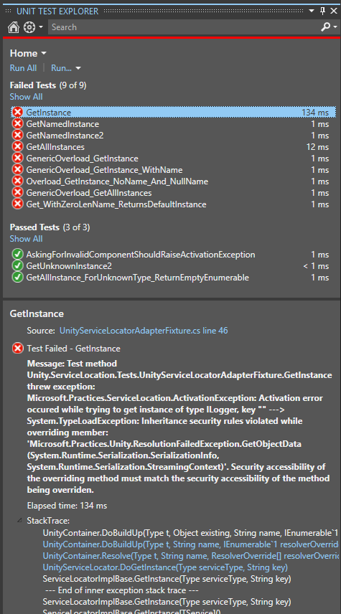





VS2012 Unit Testing
New Unit Test Explorer
Seamless
Fast
Extensible

Slide 10
demo
Running your first metro style Unit Test
A quick demo on the new Unit Test Explorer,
and metro style Unit Testing.

Slide 11
Unit Testing an existing xaml based (C#) metro style app

Slide 12
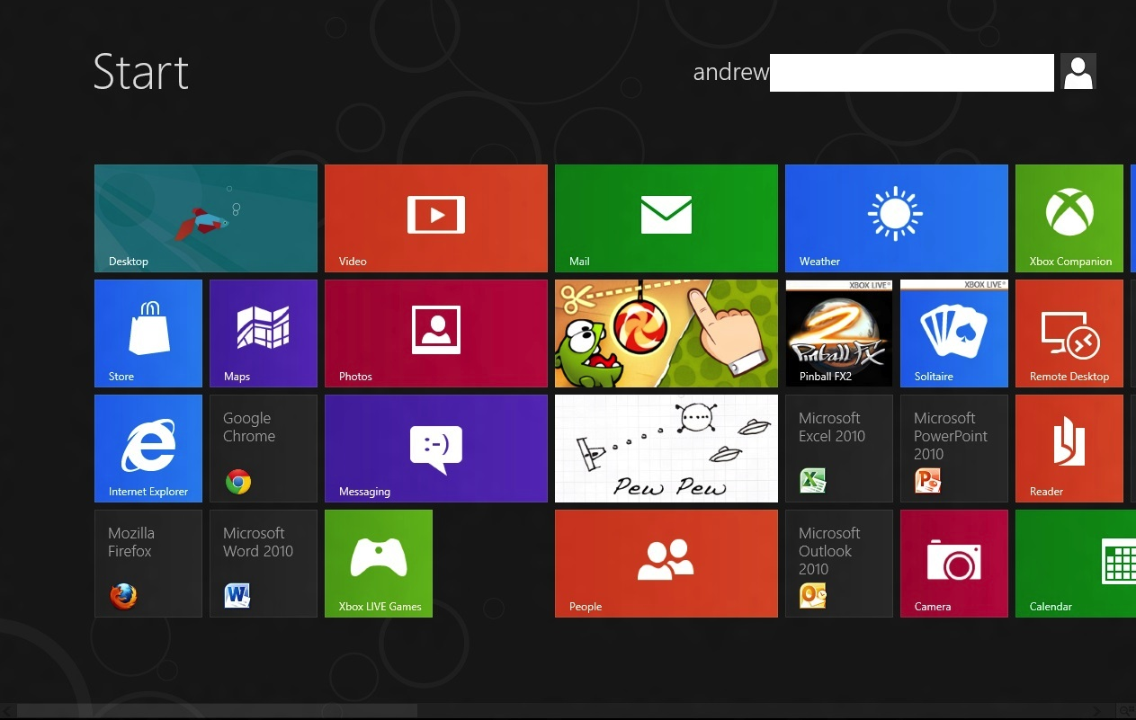
Metro Style Apps
Windows 8 experience.
WinRT API available via HTML5,
CSS3,
JavaScript,
XAML, C#
etc.

Slide 13
File Access metro style app
Unit Testing
File Read method
XAML
C# Code Behind
Access File System
(WinRT)
File System

Slide 14
demo
Challenges facing when Unit Testing
an existing XAML based metro style app

Slide 15
Challenges of Unit Testing metro apps
Metro:
Run in an AppContainer Sandbox
Require a special Unit Test project (integration type tests)
Limited access to many .NET API
Your favorite Isolation Framework won’t work!
Asynchronous API
General Design issues:
Business Logic in Code Behind file
Harder to maintain, harder to test

Slide 16
Making your metro app testable
Metro:
New metro style Unit testing Test template
Test frameworks that support for Async
MockRT for metro app
General Design Issues:
Decouple the dependencies using MVVM
Test in isolation.

Slide 17
Designing your metro app for Testability
MVVM
Handling Asynchrony
Isolating Dependencies/Mocking
MVVM
Existing un-testable
metro App
Testable metro App

Slide 18
demo
Making your XAML based metro style app testable using MVVM (Model-View-View Model)

Slide 19
Async Overview
Async is becoming a common programming model for future apps.
Responsive and scalable apps
Supported .NET 4.5 (beta) two new key words async/await
First is the Task functionality in .NET 4, and based on Task and Task<TResult>. While Task was intended to be the primary means of asynchronous programmingwith .NET 4, the .NET Framework was still based mainly on the Asynchronous Pattern and the Event-based Asynchronous Pattern.
In WinRT any thing takes longer than 50ms are Async

Slide 20
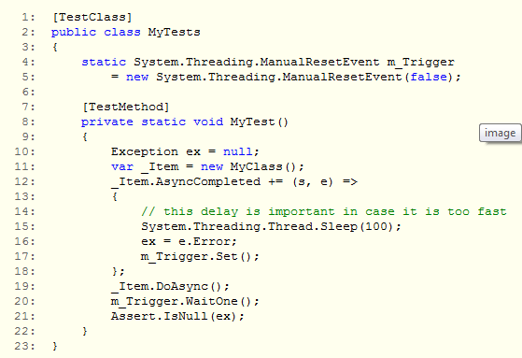
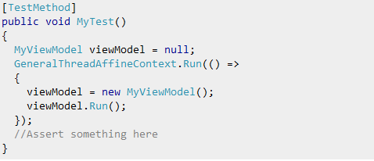
Async Unit Testing is challenging

Slide 21
demo
Unit Testing Async methods

Slide 22
Isolating Dependencies?
Your standard Mock Object Framework/Isolation Framework
won’t work.
WinRT has no Dynamic Code Generation support.
MoqRT

Slide 23
MoqRT
Baking
Get your Unit Test assembly and

Slide 24
demo
Unit Testing with MoqRT

Slide 25
What we have covered?
Some of the New VS11 Unit Testing features
Usage of App Container manifest file for Integration testing
How to make your existing XAML based metro app testable
Async Unit Testing support and MoqRT for Isolating Dependencies

Slide 26
References
VS11 Test Explorer plugins
http://blogs.msdn.com/b/visualstudioalm/archive/2012/03/02/visual-studio-11-beta-unit- testing-plugins-list.aspx
link2
link2
..

Slide 27
References

Slide 28
Questions

Slide 29
Thank You

