Slide 1


Unit Testing Tips
Raj Aththanayake
Email:raj@software.com
Blog:http://blog.rajsoftware.com
Computershare

Slide 2
Topics in Brief
Decision making on Unit Tests.
Research Tools.

Slide 3
Decision making on Unit Tests
Writing Unit Tests are important but…
Cost, Time, Maintenances.
Wikipedia….
“for every line of code written, programmers often need 3 to 5 lines of test code. This obviously takes time and its investment”
How we manage?

Slide 4
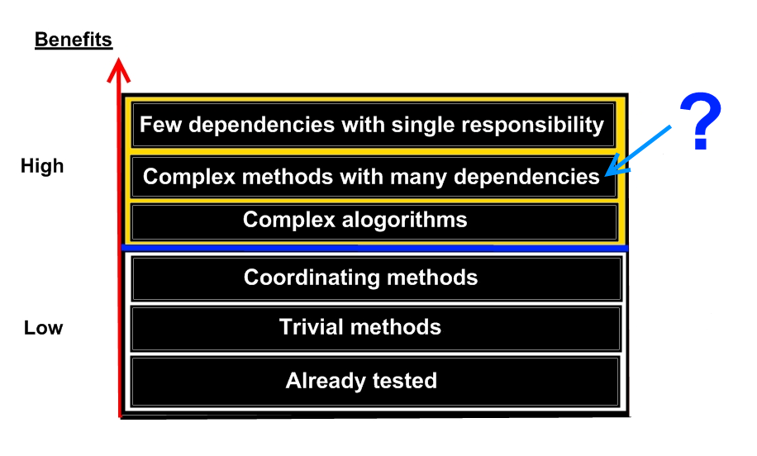
Decision making on Unit Tests
How you
Unit Test
Refactor

Slide 5


Research Tools
Microsoft Pex
- White Box Testing.
- Good for regression testing.
- VS2010 Power Tools.
CHESS
- Finding and Reproducing Heisenbugs
in Concurrent Programs.
- Managed & Native.
http://research.microsoft.com

Slide 6

raj@software.com

Slide 7
Thank you.

