Slide 1
Ticketing Software
Group - 4

Slide 2
Table of Contents
Introduction
Tools and Technologies
Development Process
Conceptualization
Functional Requirements
Design
  Data design
  Data structure
  Architecture Design
Test Cases
Summary
Design Implementation screenshots

Slide 3
Introduction
System development often referred to as the application development life cycle, is the architecting of the system via planning, creating, testing, and deploying it as well.
In this presentation, we shall discuss our system development process in stage one, as well as the full plan of the system thereof.
This project is accentual in a way that an issue can be posted to the particular department authority immediately, to solve problem, in this case we are preparing this project to reach the student’s requirement in the university. The main agenda of our project is to create a software, ticketing tool, where every individual can either suggest or inform according to their perspective, regarding certain issue, to the officials.

Slide 4
Introduction(Cont…)
This is one of the various software, which is helpful to rectify complications, ticketing tool. By using the web, we can raise an issue, so called ticket, it’ll reach to the respective host. This process not only help the students but also the management, in this way they can improve their respective task and help them to notice and solve easily, besides going through abundant mails.

Slide 5
Tools and Technologies
Technology/Domain: Java
Front-End: JSP, Html, CSS, JS, Bootstrap.
Server-side: php.
Back-end: MYSQL.
Server: Xampp
Modules and Functionalities of Helpdesk Ticket System
There are two main roles that is Admin & User. Let us see the functionality of each
Admin:
Admin can ADD/VIEW/UPDATE/DELETE ticket category(type).
Admin can ADD/VIEW/UPDATE/DELETE ticket status.
It can ADD/VIEW/UPDATE/DELETE a new ticket.
Admin can VIEW/UPDATE/DELETE tickets raised by users.
Admin can ADD comments on a particular ticket raised.
It can close the ticket also.
It can VIEW all the users in the system.

Slide 6
Tools and Technologies(Cont…)
User:
  Users can raise helpdesk tickets.
  Users can VIEW/UPDATE/DELETE tickets raised.
  It can ADD the comment also.

Slide 7
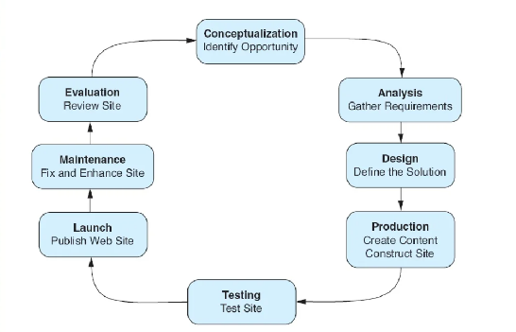
Development Process

Slide 8
Functional Requirements
Functional requirements simply refer to the product features. The product features consist of the aid features that enable users to accomplish their tasks. The requirements must consist of system behaviors under specific conditions.
These requirements do not describe the implementable, rather, they describe the question, how?
Technically, defining functional requirements describes the base start of the software development and implementation.

Slide 9
Functional Requirements
The functional requirements of the Ticketing Tool would be as follows:
Authentication Module:
The module simply allows users to be signed by the system and therefore able to login and access the dashboard. The dashboard is where an authenticated user heads to perform most tasks regarding ticketing.
2. Creating Events:
This module consists of one task which acts as the main driver of issuing tickets and so on and so forth. Creating events and assigning status for each event helps the ticket issuer to issue the tickets in respect to the Event chosen.

Slide 10
Functional Requirements(Cont…)
3. Event management module:
Simply conforms to the management of events, updating events details, deleting and changing of an event detail like, theme, dates and several other details and event was created initially to having.
4. Creating Tickets:
Well, creating tickets and issuing tickets is the main agenda and crux of the program output. Creating tickets simply handles the creation of tickets in respect to an event created, chosen and active.
Creation of tickets will be categorized in respect to events. With that said, each event will have its own tickets, so on and so forth.

Slide 11
Functional Requirements(Cont…)
5. Management of tickets:
This module will have to deal with management of tickets as well as deletion, updating and selling of the tickets to clients. When selling a ticket, One has to pay, to receive a ticket via email.
6. Users Management:
This is the user’s management module. System users, client users and Administration is done by this module. Users Permissions grants should be done by the administrator of the system. The system will have a super administrator, who holds all the administration rights and controls everything that system is expected to do.

Slide 12
Design
All inbound IT-related requests from customers and other corporate divisions are handled using an IT ticketing Tool. Every support request will be turned into a separate ticket by its design, which also streamlines the support procedure through features like ticket management, enhanced collaboration, automation, and others.
Here are some additional goals you can accomplish with powerful IT ticketing software:
Bring all your support inquiries from various channels together on one platform.
Consolidate various inboxes into a shared inbox that all your agents may access.
Specialists with tickets and monitor their progress.
Track and evaluate important support metrics.
Obtain customer feedback to enhance your IT support procedures.
1.1 Goals and objectives
Now, the main objective of every service provider would be to provide trustworthy support to end users, which is essentially the same. However, you can set more focused objectives, such maximizing first-contact resolutions or reducing the time it takes your support staff to respond to a problem.
Once your objectives are clear, you may create a strategy to accomplish them. To ensure that everyone is on the same page, it is also crucial to write down and discuss these goals with the relevant team members.

Slide 13
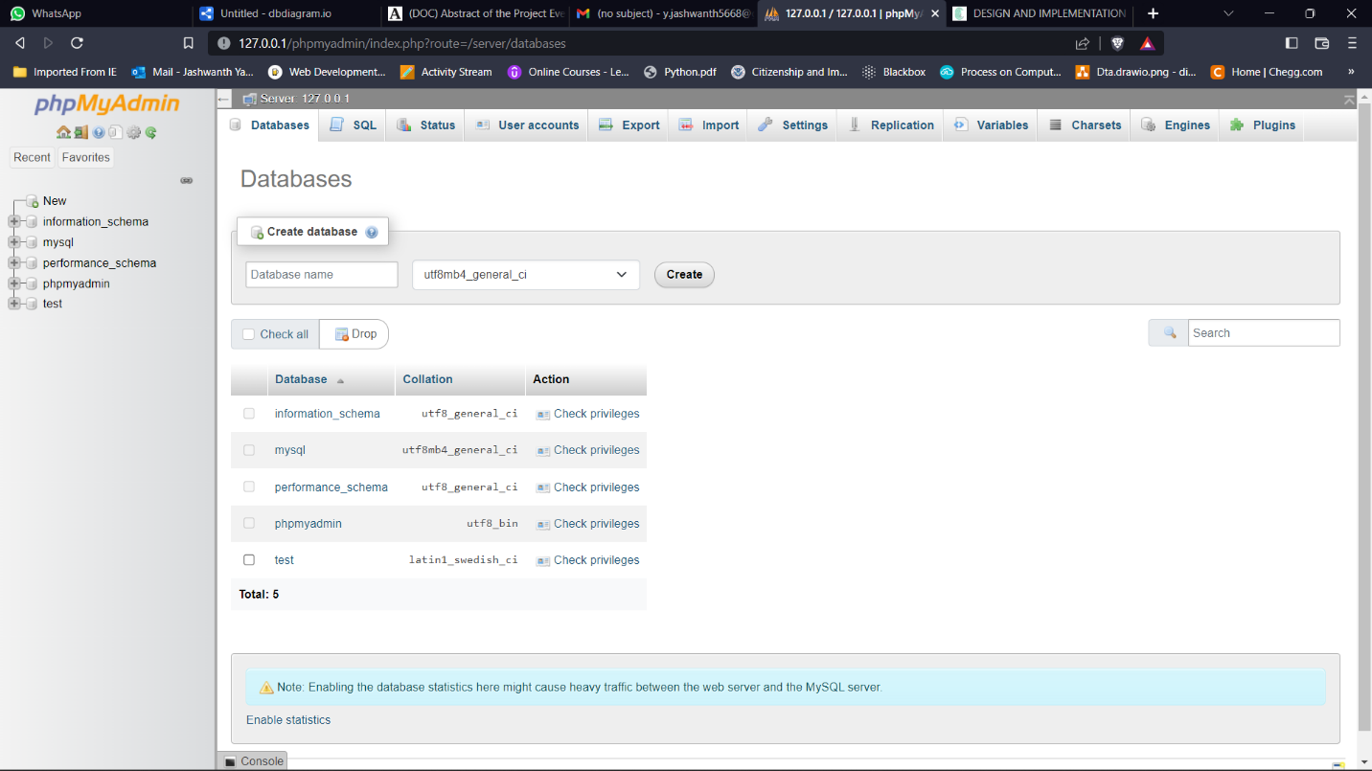
Data design and Database description
phpMyAdmin a utility used to manage the administration of MySQL server where all application data is stored for you have to open phpMyAdmin portal from following link: http://127.0.0.1/phpmyadmin/index.php
After, we need to create a database in the portal:

Slide 14
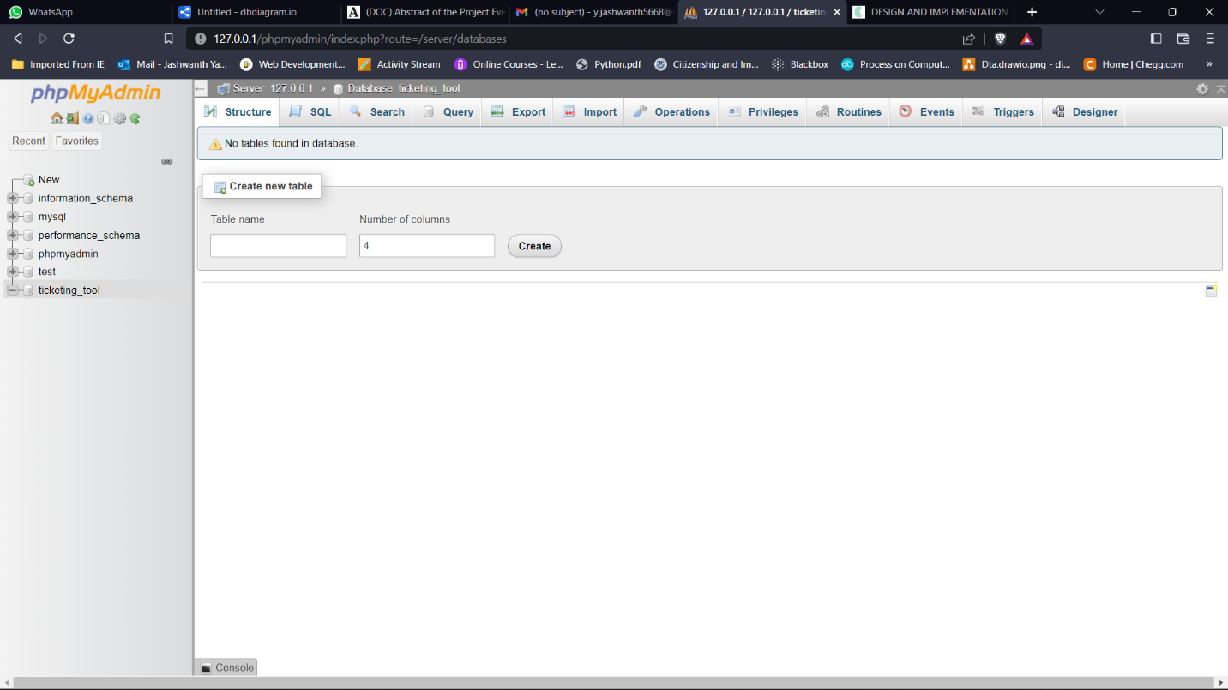
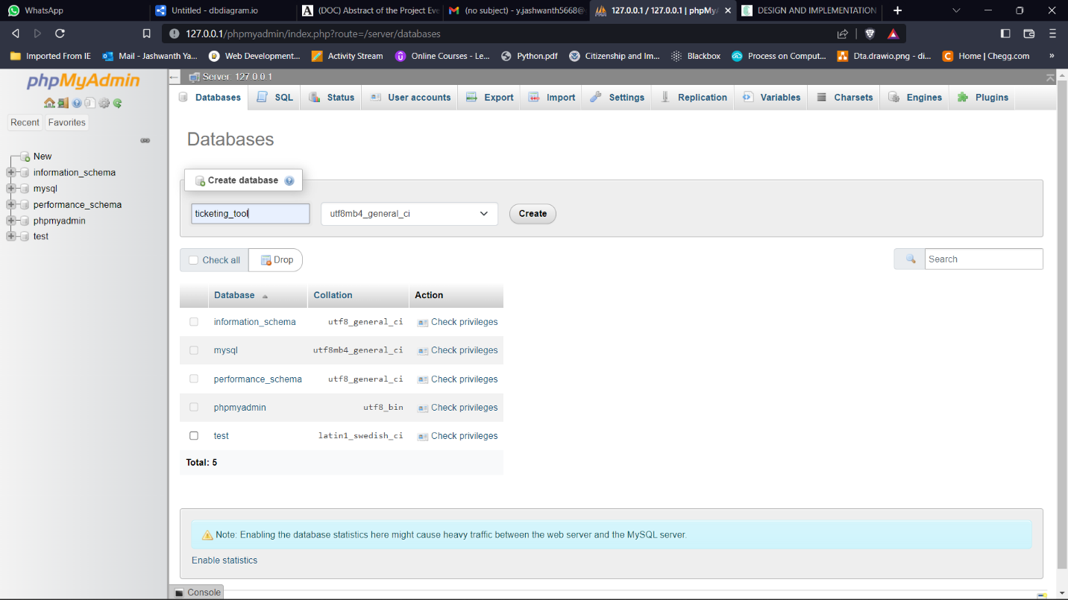
We need to create a database
Give same database name mentioned in MySQL server
Database has been created

Slide 15
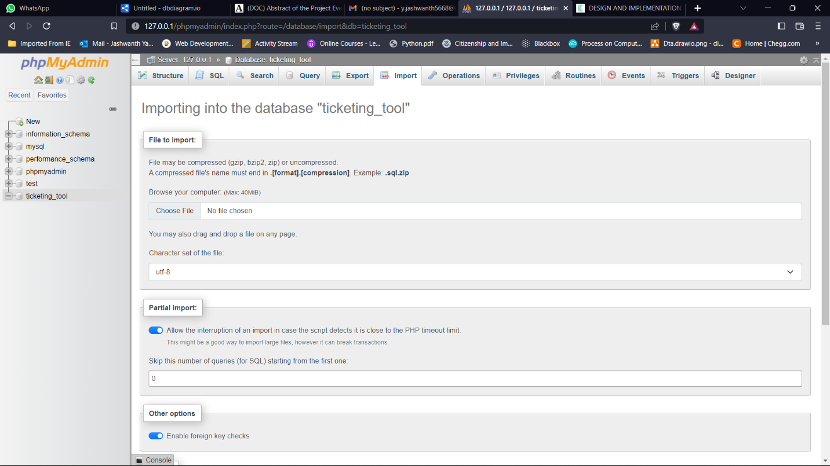
Once the database has been created now, we need to create tables, attributes for the tables and define the primary key, foreign key, and unique key for each table

Slide 16
Data structures
To perform and store all essential data, we primarily employ Character and Integer data types. The character data type is used to store all string-formatted inputs.
And we are using datetime module which allows to track the ticket created by user like when it was created and when the ticket was solved.
Also, we used the longtext datatype for user message or description to state problem which the user is facing.

Slide 17
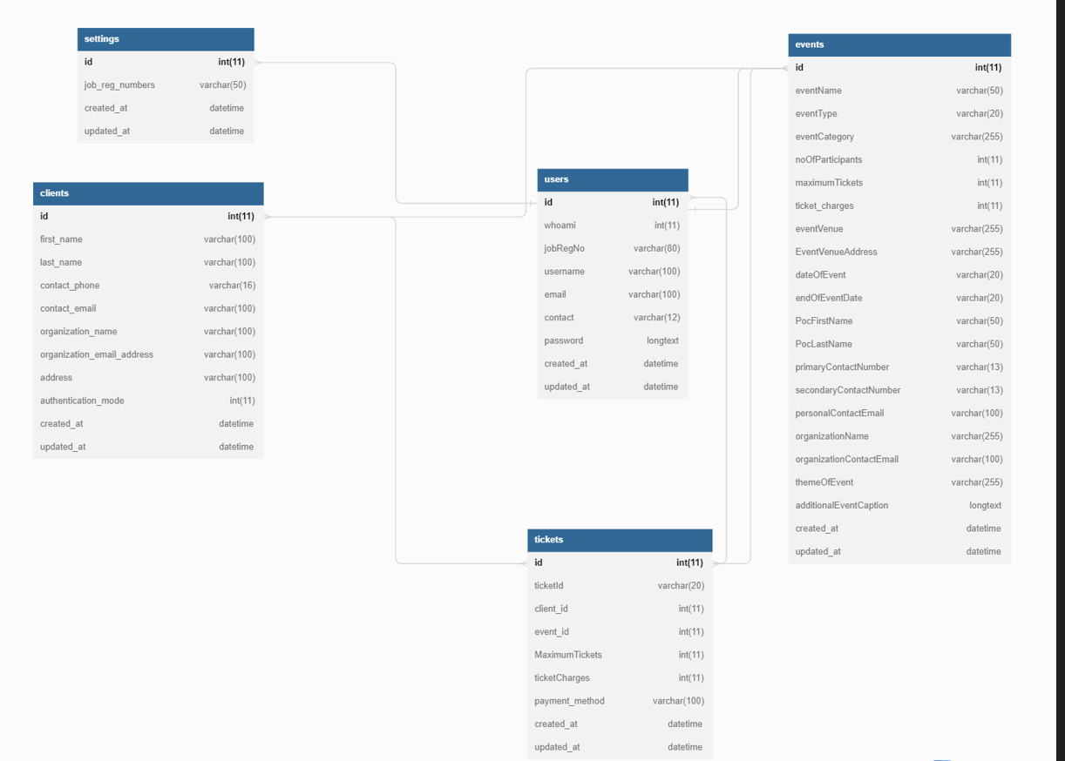
The Database schema as follows:

Slide 18
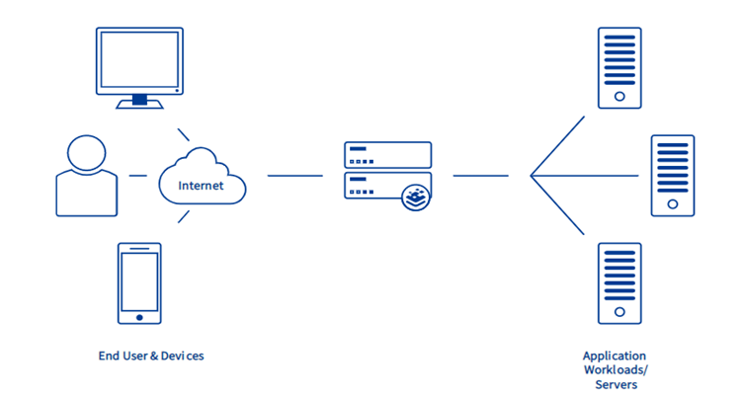
Architectural and component-level design
Clients are nothing but the end user who raise tickets once the ticket is raised which basically sends a request to different application server and the request is sent based on the incoming traffic to server for example, is a server is busy then it transfers the request to another server this technique is called Load Balancing.
The framework of load balancer:

Slide 19
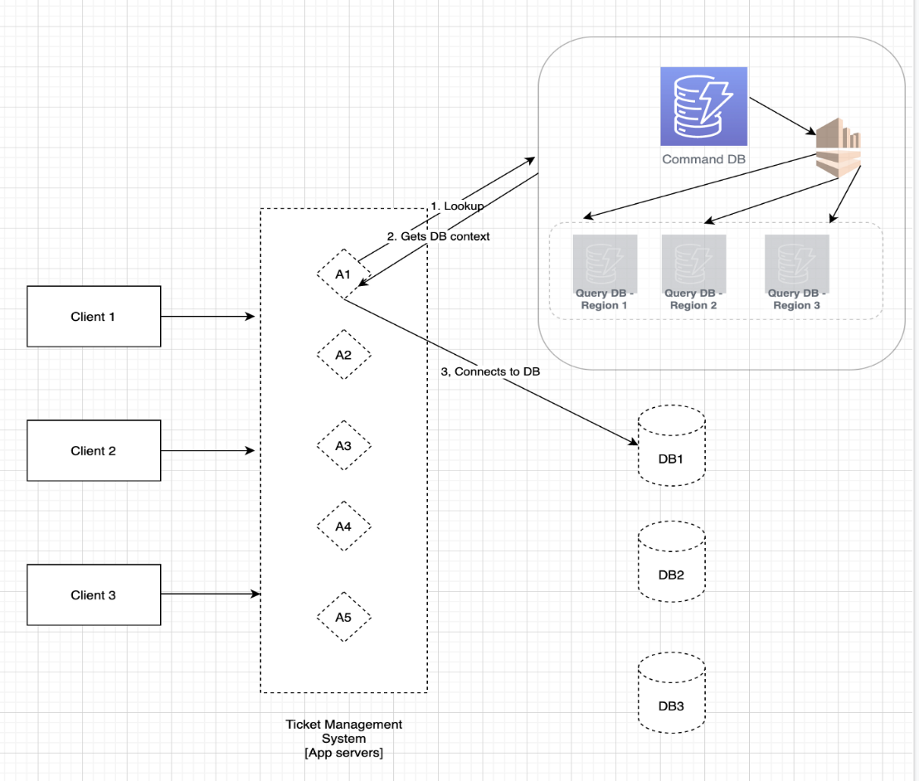
Architecture diagrams:
Clients are simply end users who raise tickets. When a ticket is raised, a request is sent to a different application server based on incoming traffic; for instance, if a server is busy, the request is transferred to another server.

Slide 20
Test Cases
ID | Test Case Title | Test Input | Expected Output | Description | Result
9 | Create clients | Required clients’ details name, address, contact info | Successful registration of client | Create more clients for improved developments | Pass
10 | Manage clients | Admin credentials, only admin have access | To manage the created clients | To manage the created clients | Fail
11 | User management | Admin credentials, only admin have access | To manage user Grant Authentication type | Grant Authentication type | Pass
12 | Settings tab | Login Id and Password of user | Pops-up the settings page | Allows to edit the user credentials and details | Fail
6 | Managing raised ticket | Admin credentials, only admin have access | Solve the raised ticket | To provide a solution for customers problems | Pass
7 | Event creation in the system | To describe the type of ticket raised | To create an event | This allows us to understand which type of ticket is raised | Pass
8 | Manage events | Admin credentials, only admin have access | Successful creation of an event | To create an event for frequently raised tickets | Fail

Slide 21
Test Cases
ID | Test Case Title | Test Input | Expected Output | Description | Result
1 | User Registration | User’s name, email ID, contact and password | Creates the user and able to login | User registration page | Pass
2 | Authentication of the users | Username and Password | Successful login and navigated to homepage | User can login without any issues with his/her login credentials | Pass
3 | Validating the user credentials | Login Id and Password | Successful login and Dashboard pops-up | To validate the user entered valid credentials | Pass
4 | Dashboard Access | online interface, or page in your website, that displays real-time data as insightful charts and reports | to show a comprehensive overview of data from different sources | Users can manage their ticket raised from the Dashboard | Pass
5 | Create a ticket | Contact, address, event name and charges | Successful ticket raised | To create, manage, and maintain a list (or lists) of customer problems | Pass

Slide 22
Test Cases
6 | Managing raised ticket | Admin credentials, only admin have access | Solve the raised ticket | To provide a solution for customers problems | Pass
7 | Event creation in the system | To describe the type of ticket raised | To create an event | This allows us to understand which type of ticket is raised | Pass
8 | Manage events | Admin credentials, only admin have access | Successful creation of an event | To create an event for frequently raised tickets | Fail

Slide 23
Summary
The attractive and thrilling field of ticketing tool needs a lot of hard work and dynamism. As the name implies, it refers to envisioning, planning, organizing, and ultimately carrying out an event. The event could be of any genre, such as a musical performance, concert, exhibition, product launch, etc., this industry has a lot of potential for growth. For young individuals who are ambitious, it provides a ton of opportunity.
The planning and execution of events, both big and small, that support a company's marketing objectives is known as event management. The field of event management is expanding quickly and is predicted to do so even more so during the coming ten years. Professional event organizers typically plan parties, sponsored events, sporting events, competitions, and product launches. concerts, festivals, trade exhibits, open houses for businesses, conferences.

Slide 24
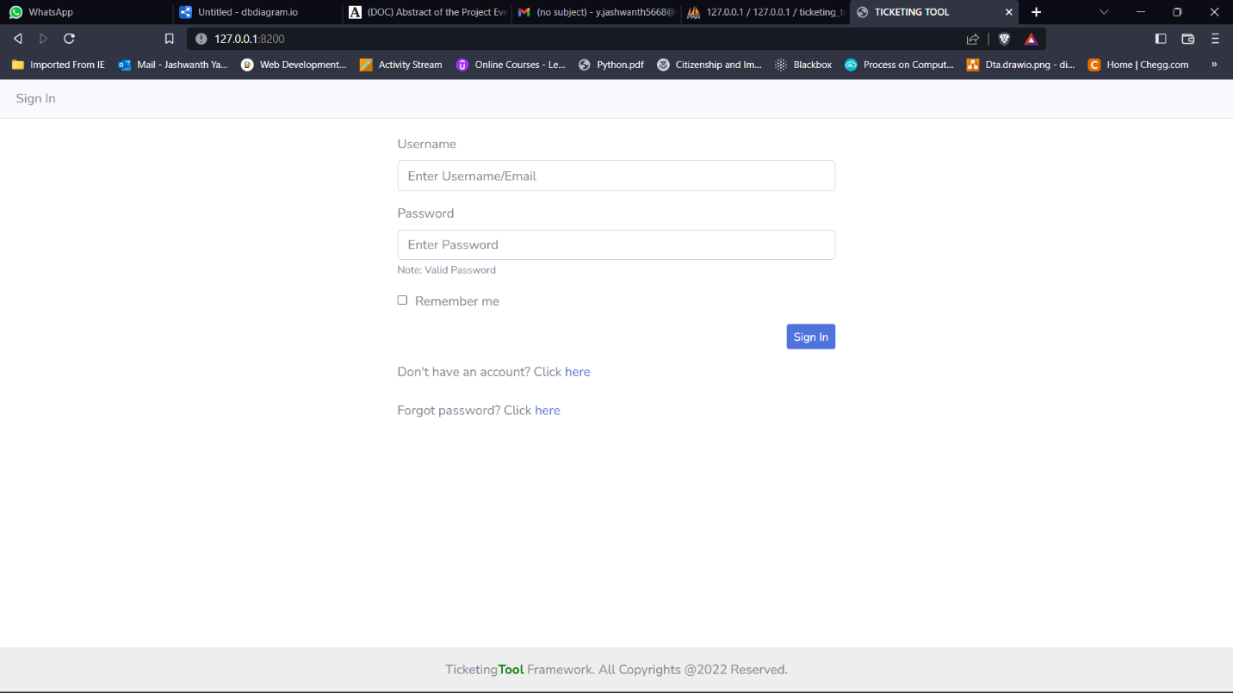
Ready Prototype System Pages
Fig 1.1: Login Page

Slide 25
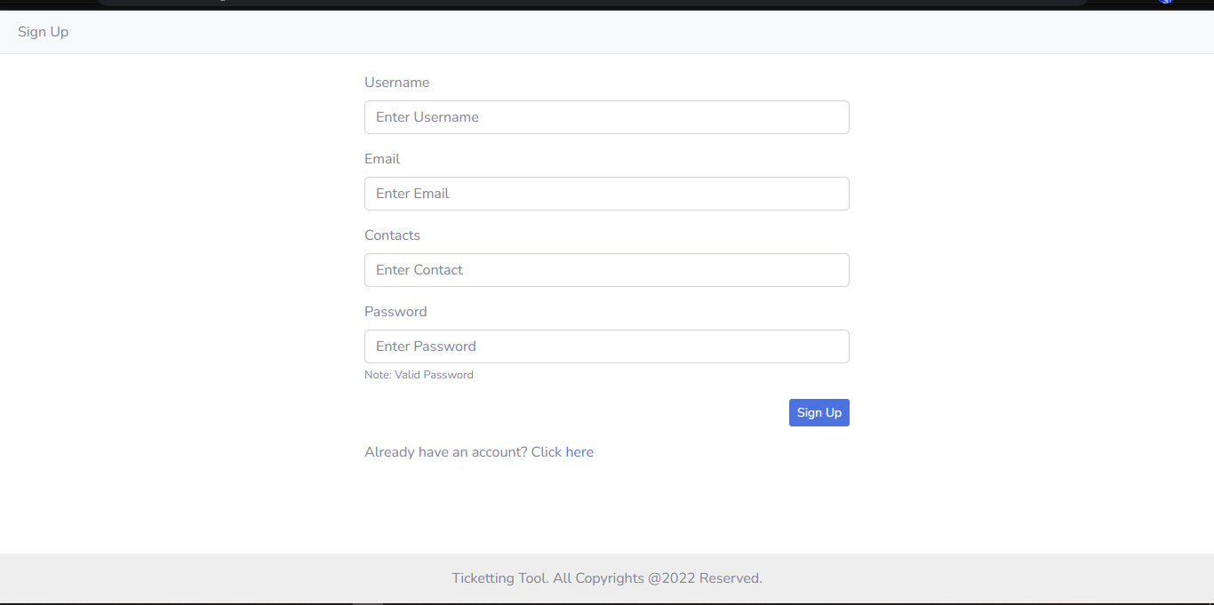
Fig 1.2: Signup Page

Slide 26
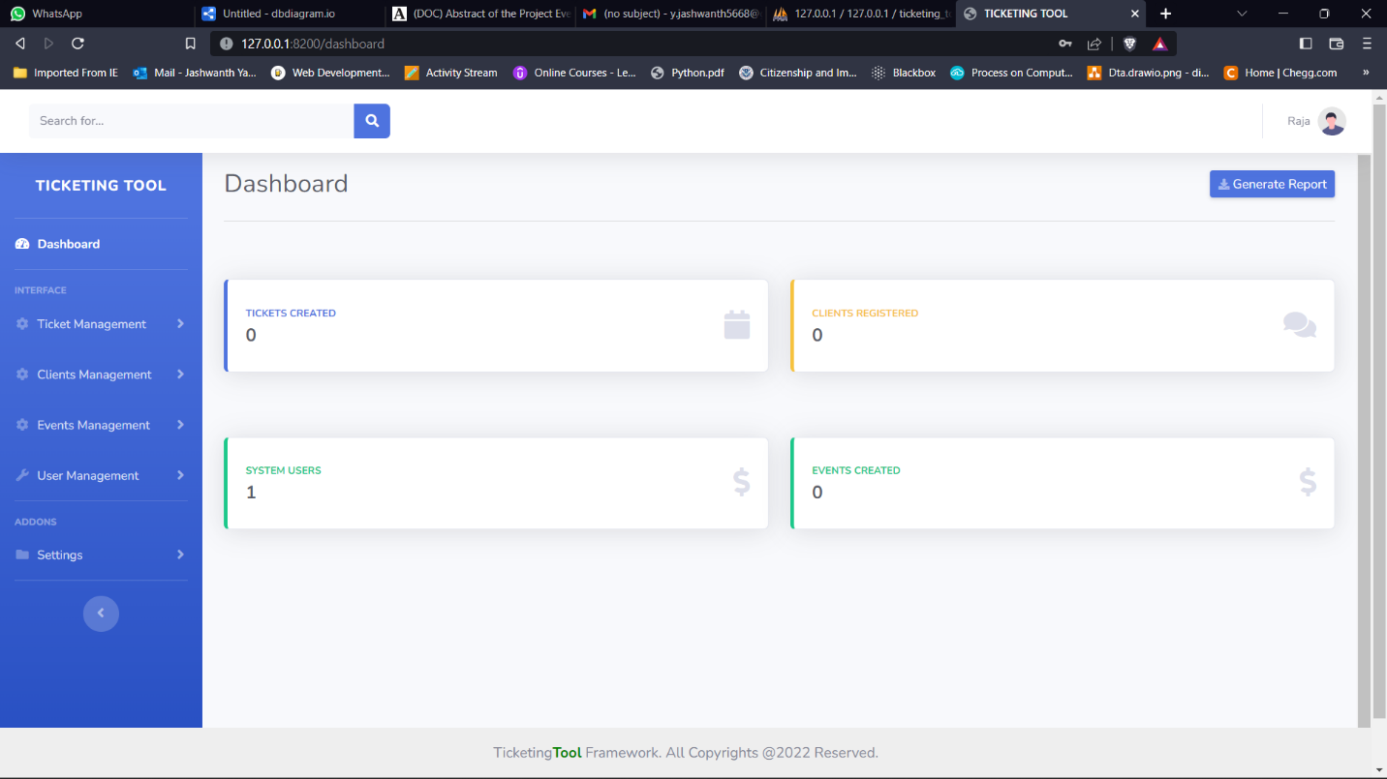
Fig 1.3: System Dashboard UI

Slide 27
This is divided into four components:
Ticket Management
Client Management
Event Management
User Management

Slide 28
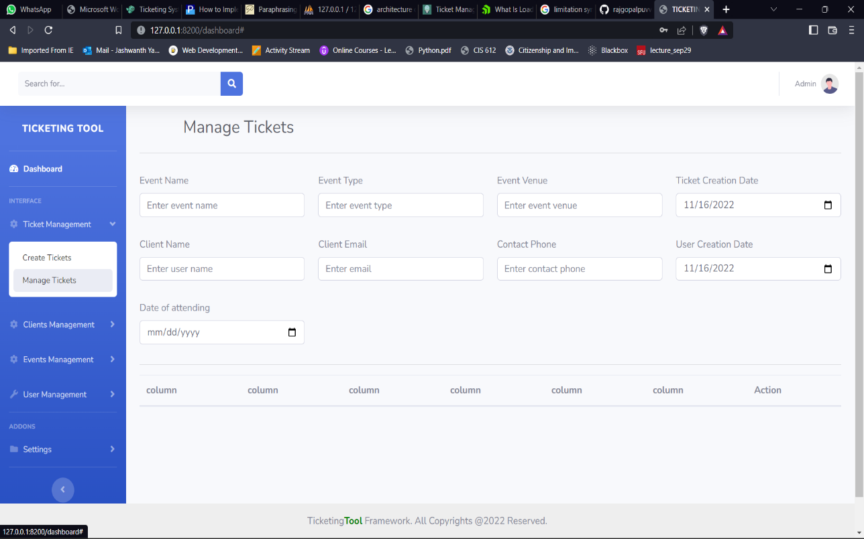
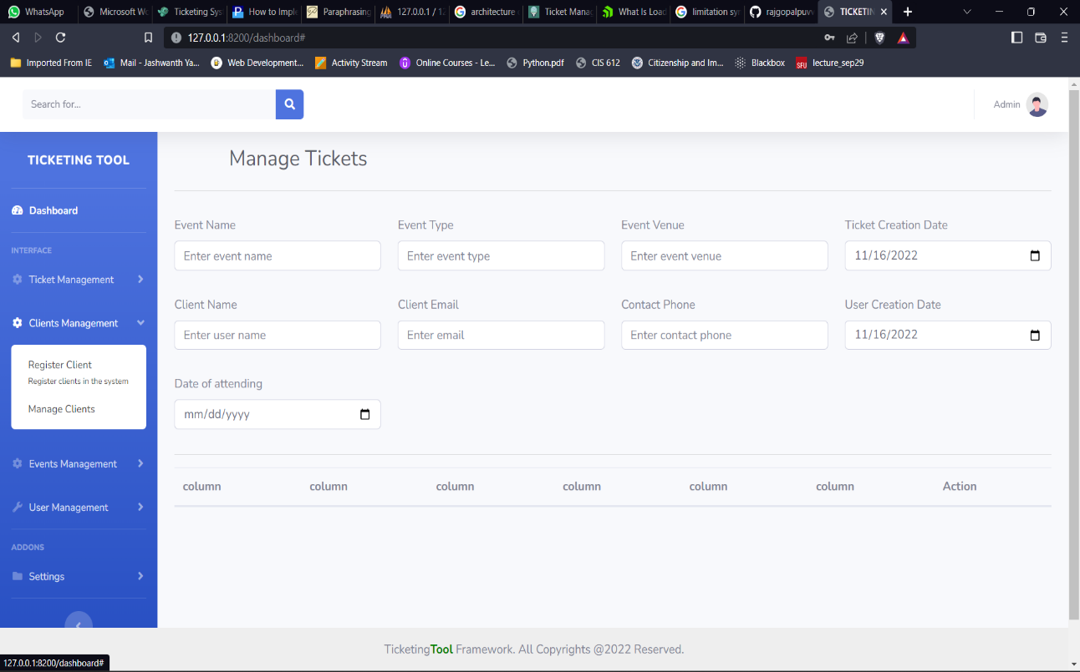

Slide 29
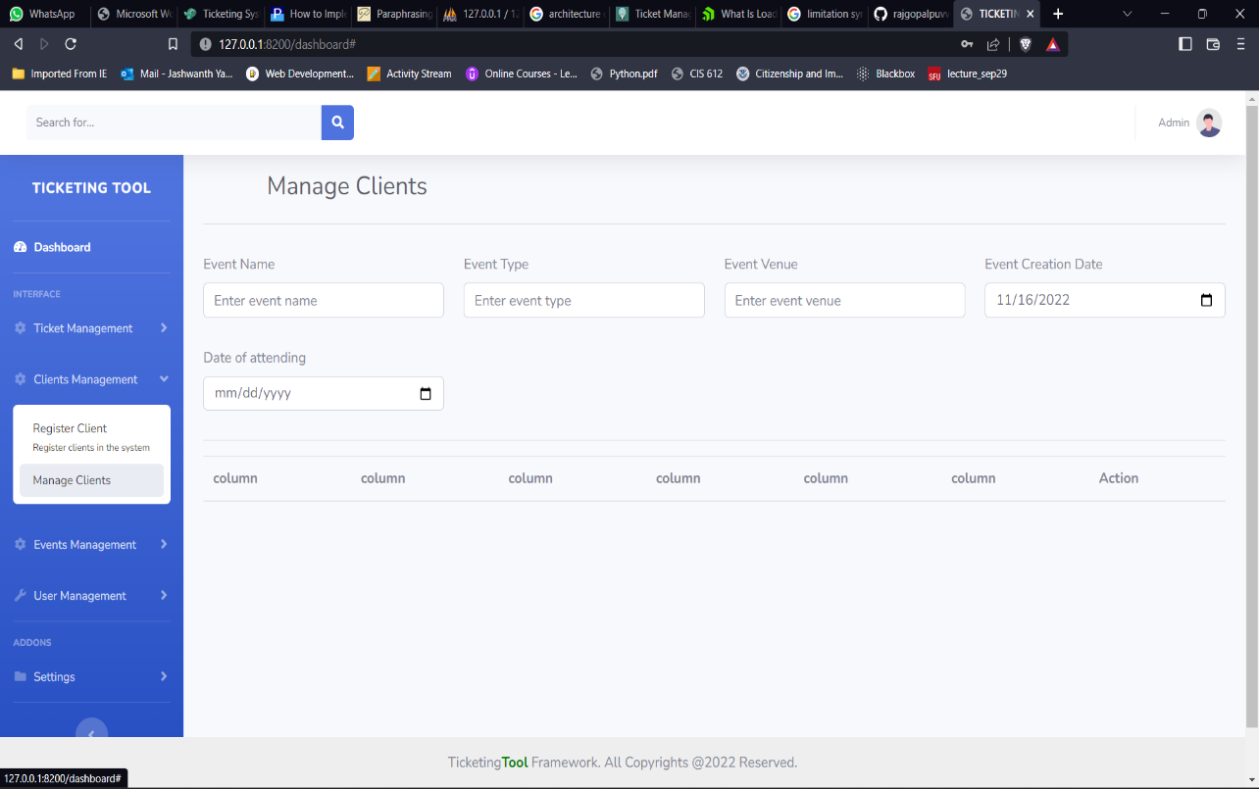
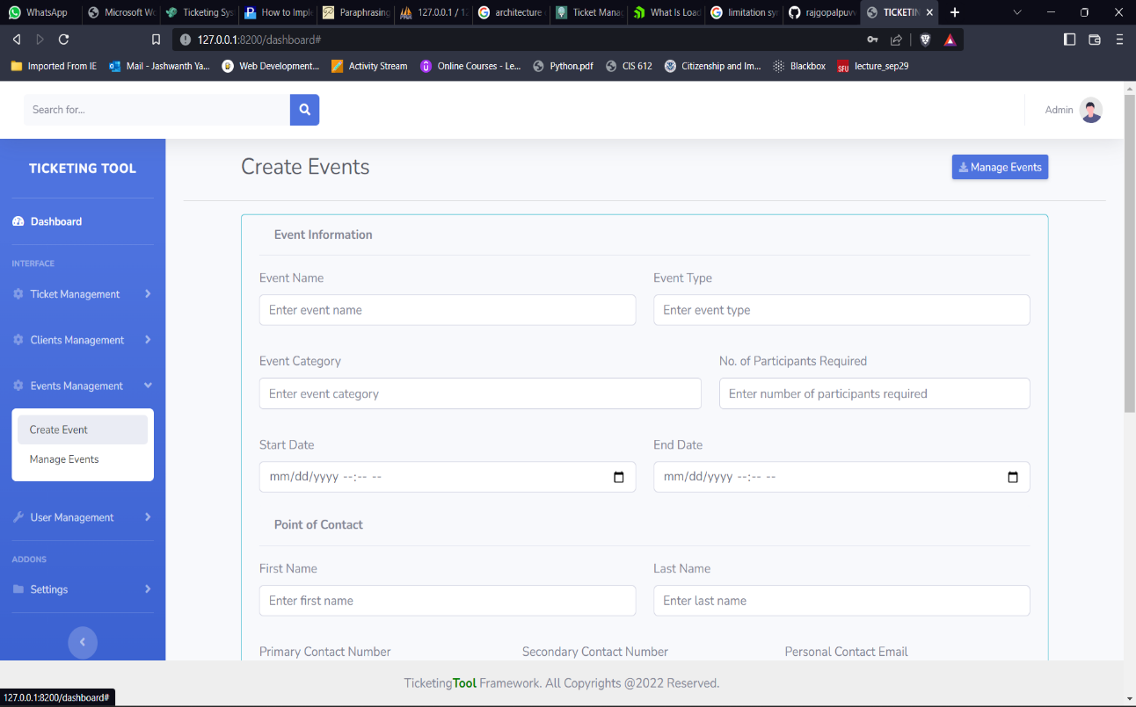

Slide 30
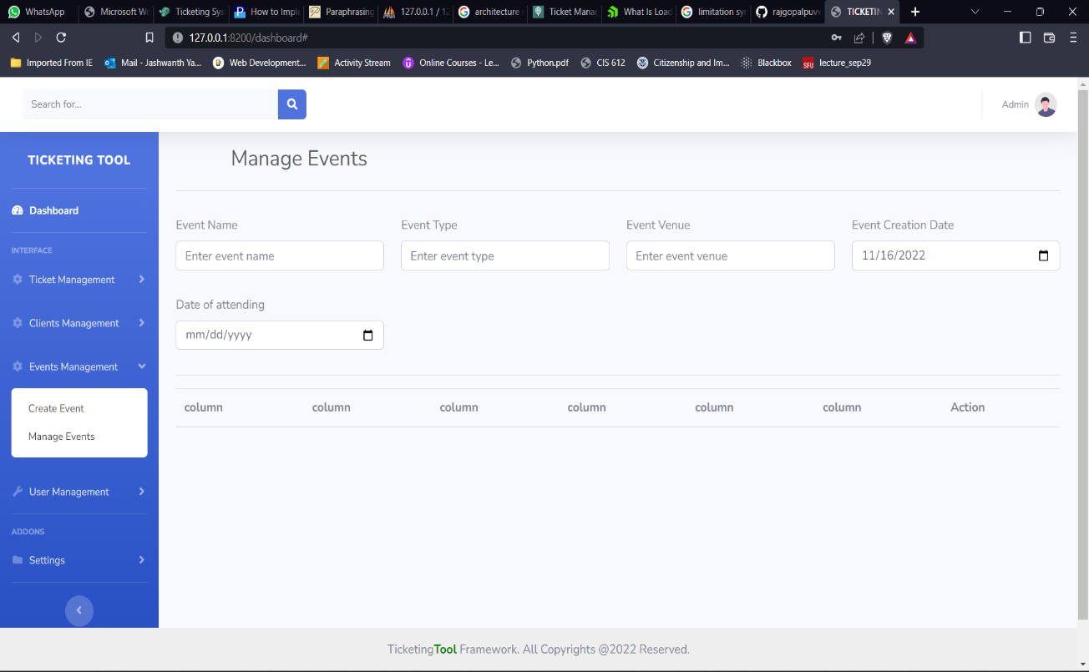
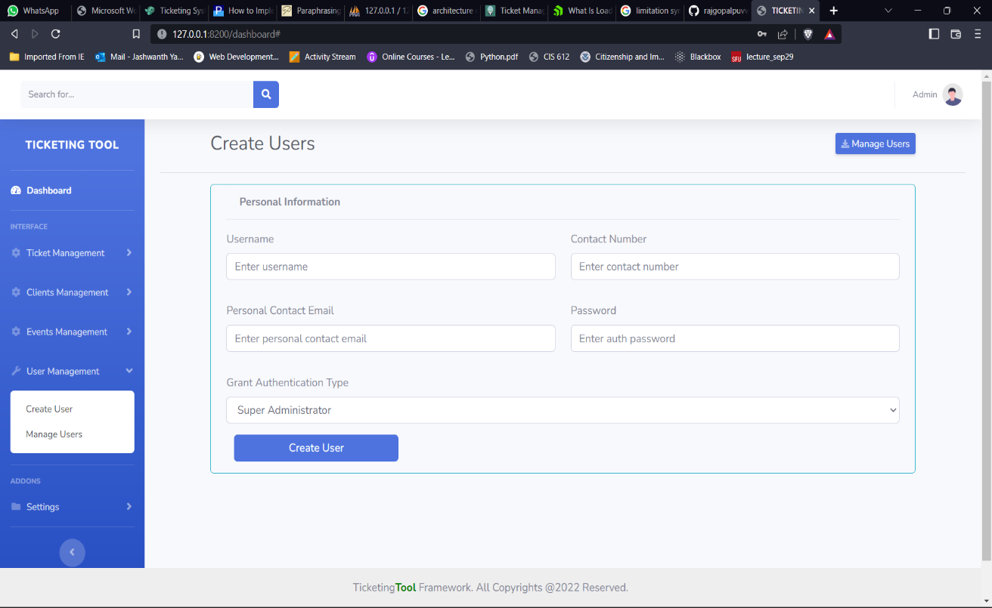

Slide 31
