Slide 1

Case Studies
Why look at case studies?
deeplearning.ai

Slide 2
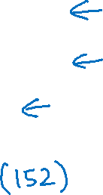
Outline
Classic networks:
LeNet-5
AlexNet
VGG
ResNet
Inception

