Slide 1

Exploratory Data Analysis

Slide 2
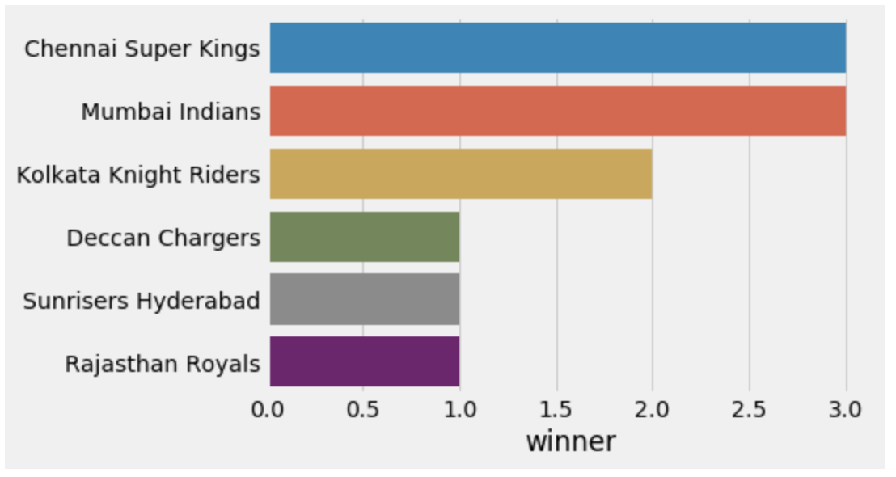
Which IPL Team has won maximum seasons?
Mumbai Indians and Chennai Super Kings has each won 3 seasons in IPL so far.

Slide 3
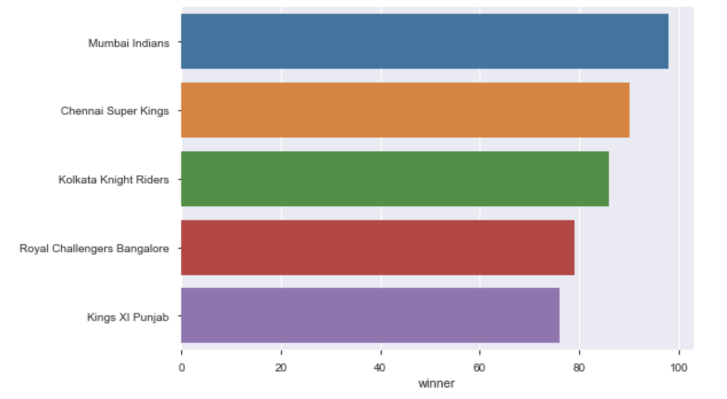
Which IPL Team is most successful?
Mumbai Indians has won maximum 98 matches in IPL out 171 matches and is most successful team.

Slide 4
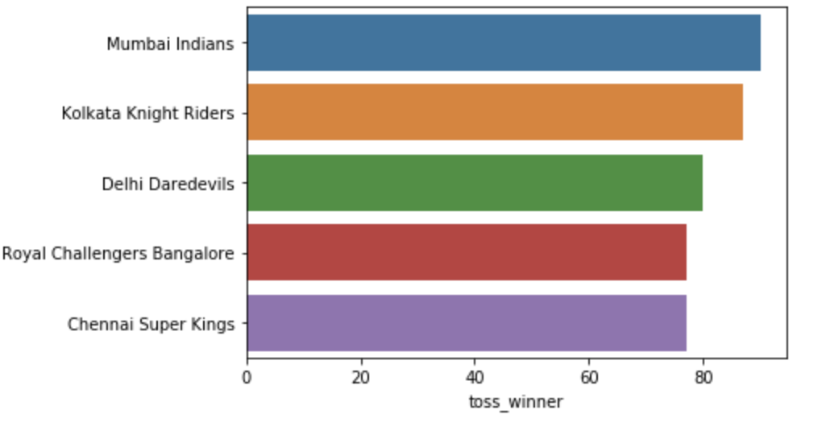
Which IPL Team has won most tosses?
Mumbai Indians has won 90 tosses in IPL so far out of which 50 times they have won the match

Slide 5
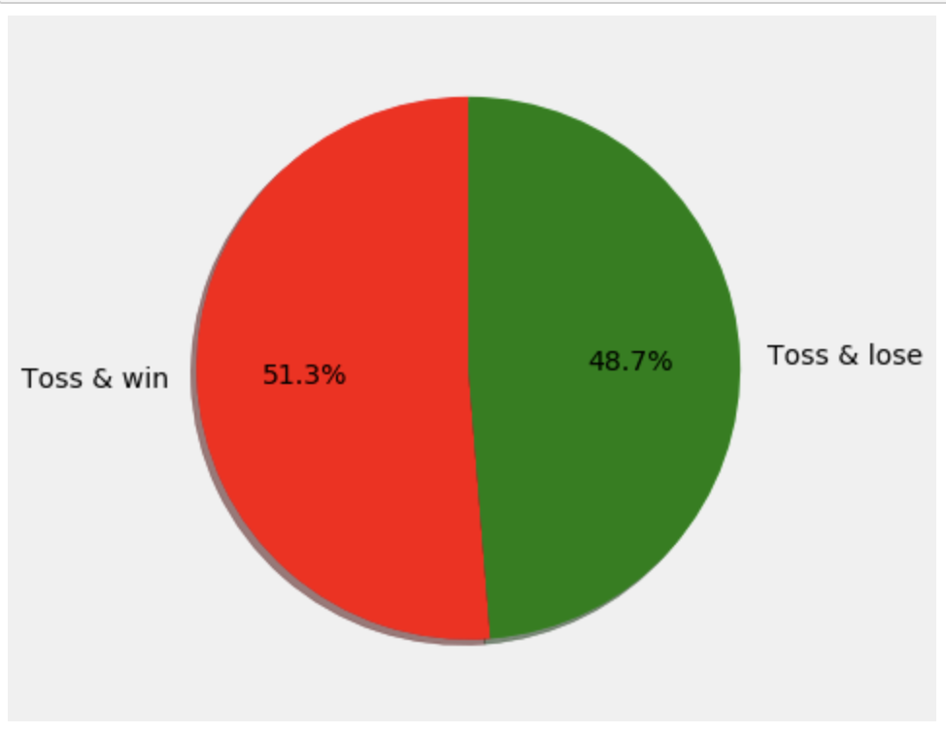
Has Toss-winning helped in winning matches?
Toss winning does not contribute much in the chances of winning the match even though Indian Players/Captains are well versed with Indian Venue and Pitch conditions

Slide 6
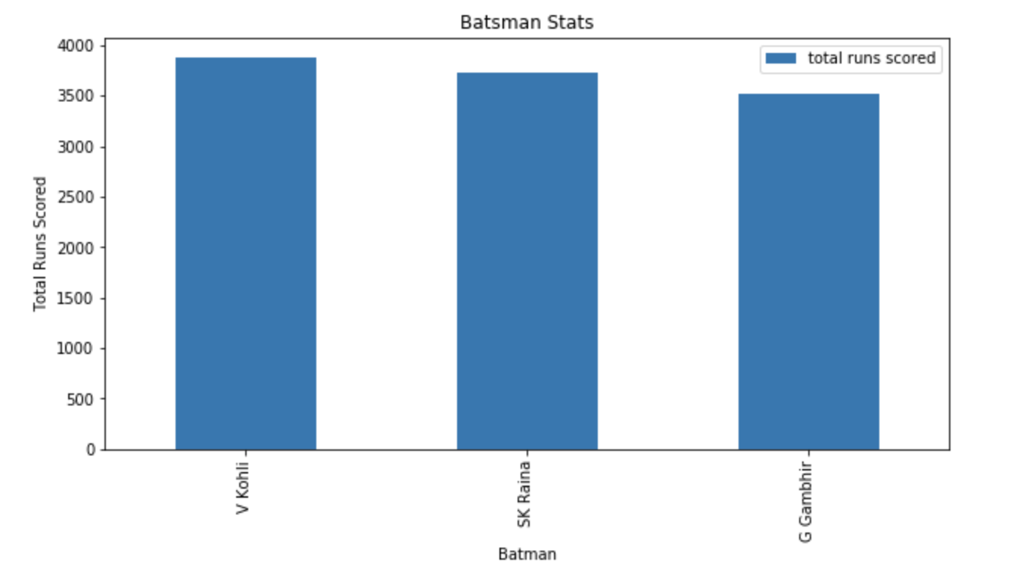
Top Batsman of the IPL
Virat Kohli is the top batsman in terms of total runs scored

Slide 7
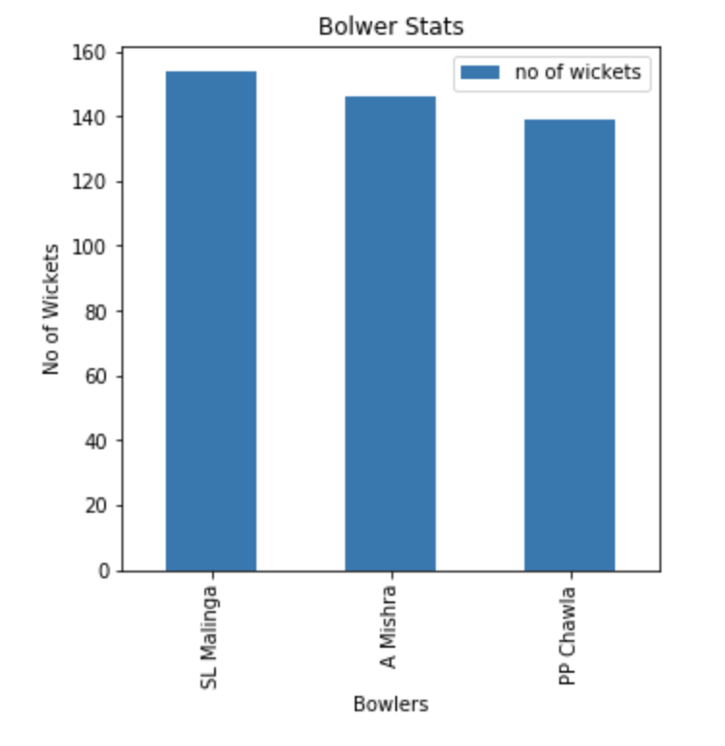
Top Bowler of the IPL
S Malinga is the top bowler in terms of total wickets taken

Slide 8
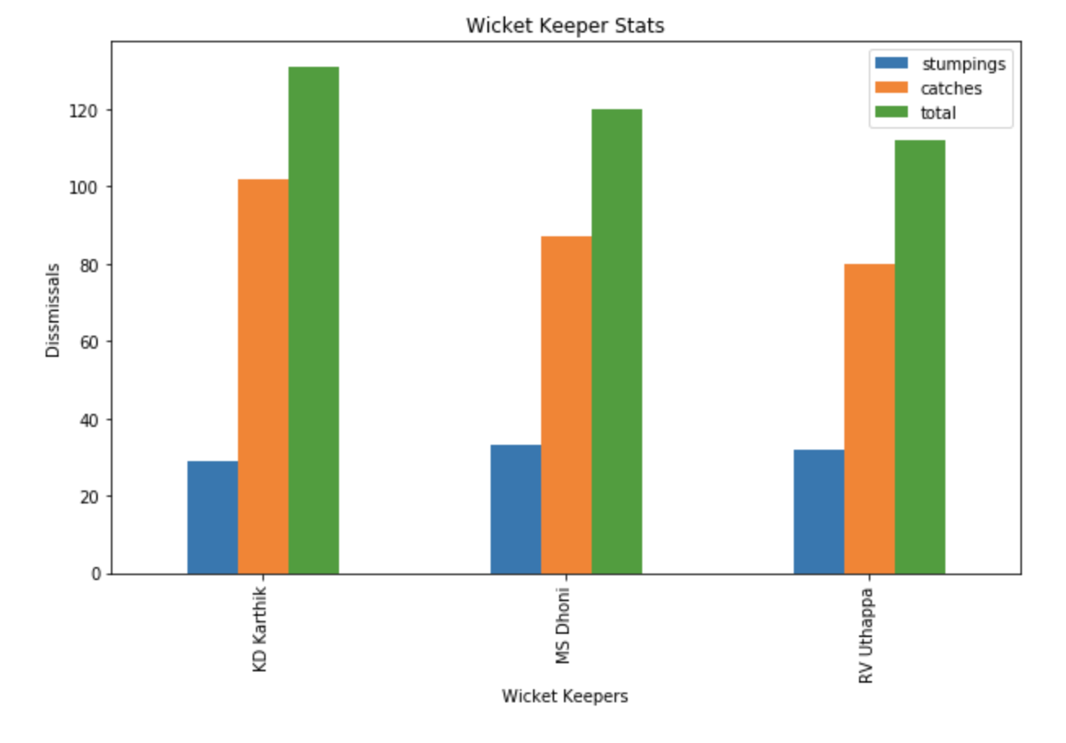
Top Wicket Keeper of the IPL
Overall KD Karthik is best wicket keeper in IPL. But when it comes to stumpings, MS Dhoni performs the best followed by RV Uthappa and KD Karthik.

Slide 9

Average runs in all IPL seasons
Average runs scored is maximum in season 2018

Slide 10
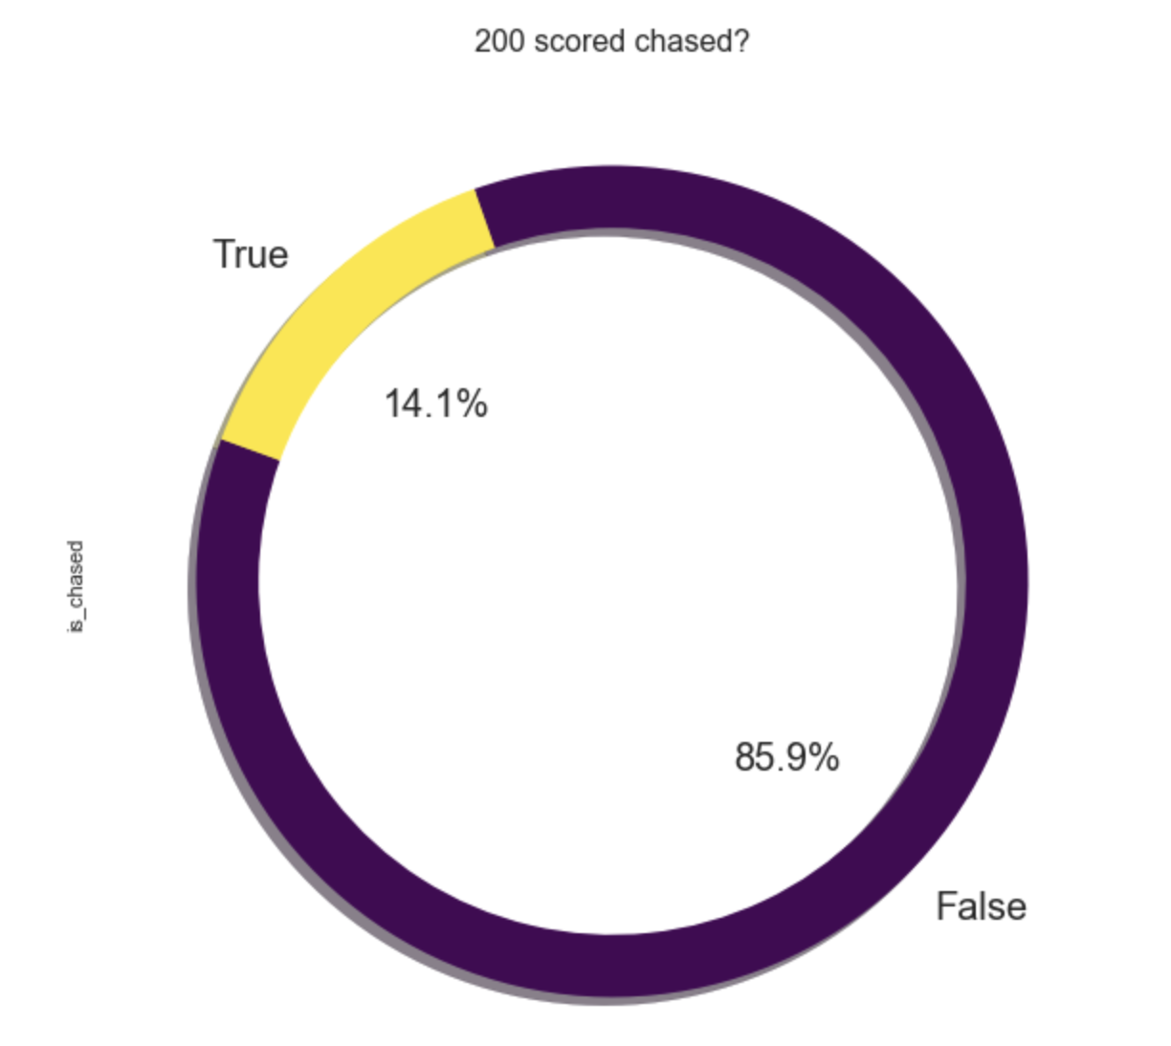
Is it possible to chase >200 Target?
Total 9 matches out of 65 matches have been chased where 1st innings total is more than 200 which shows how difficult to chase target of more than 200

