Slide 1
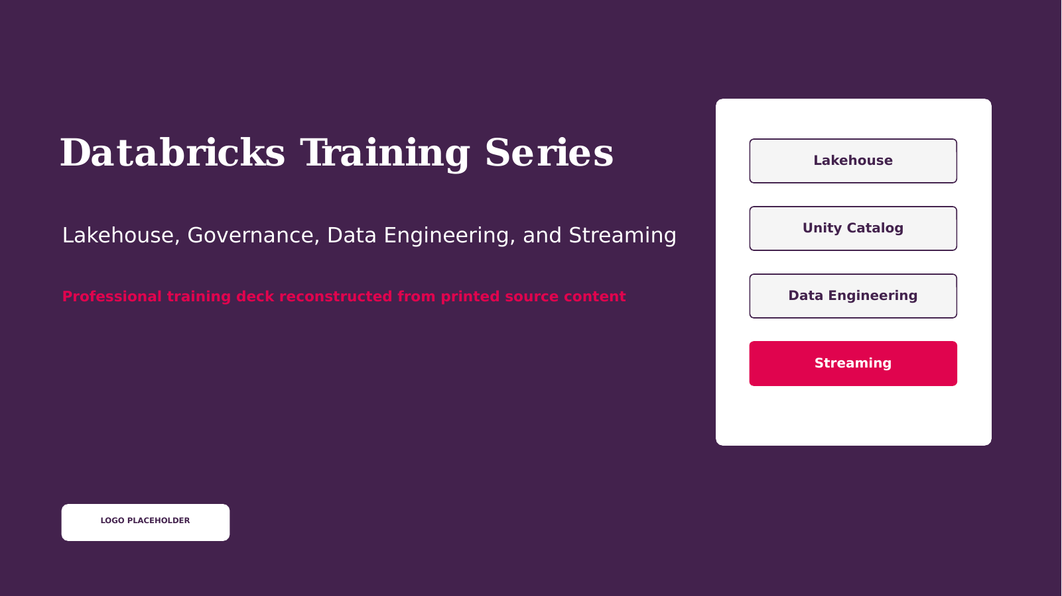
Notes:
Opening Statement
Welcome to the Databricks Training Series. This program connects lakehouse architecture, governance, data engineering, and streaming into one practical learning path.
Explanation
We will move from core platform concepts to Unity Catalog, managed data objects, SQL analytics, workflow orchestration, streaming ingestion, Delta Live Tables, and source control. The focus is not memorizing product names. The goal is understanding how these capabilities work together to deliver trusted data products.
Audience Question
Which area is most relevant to your current work: engineering, analytics, governance, or streaming?
Transition
We will begin with Databricks fundamentals and the platform capabilities that distinguish a managed service from standalone Apache Spark.
Source: DATABRICKS#01+(1).pdf, page 1.
[Sources]
DATABRICKS#01+(1).pdf (attached).
Databricks_Training_Series_Clean_Doc1 1 11.pptx (attached).

Slide 2
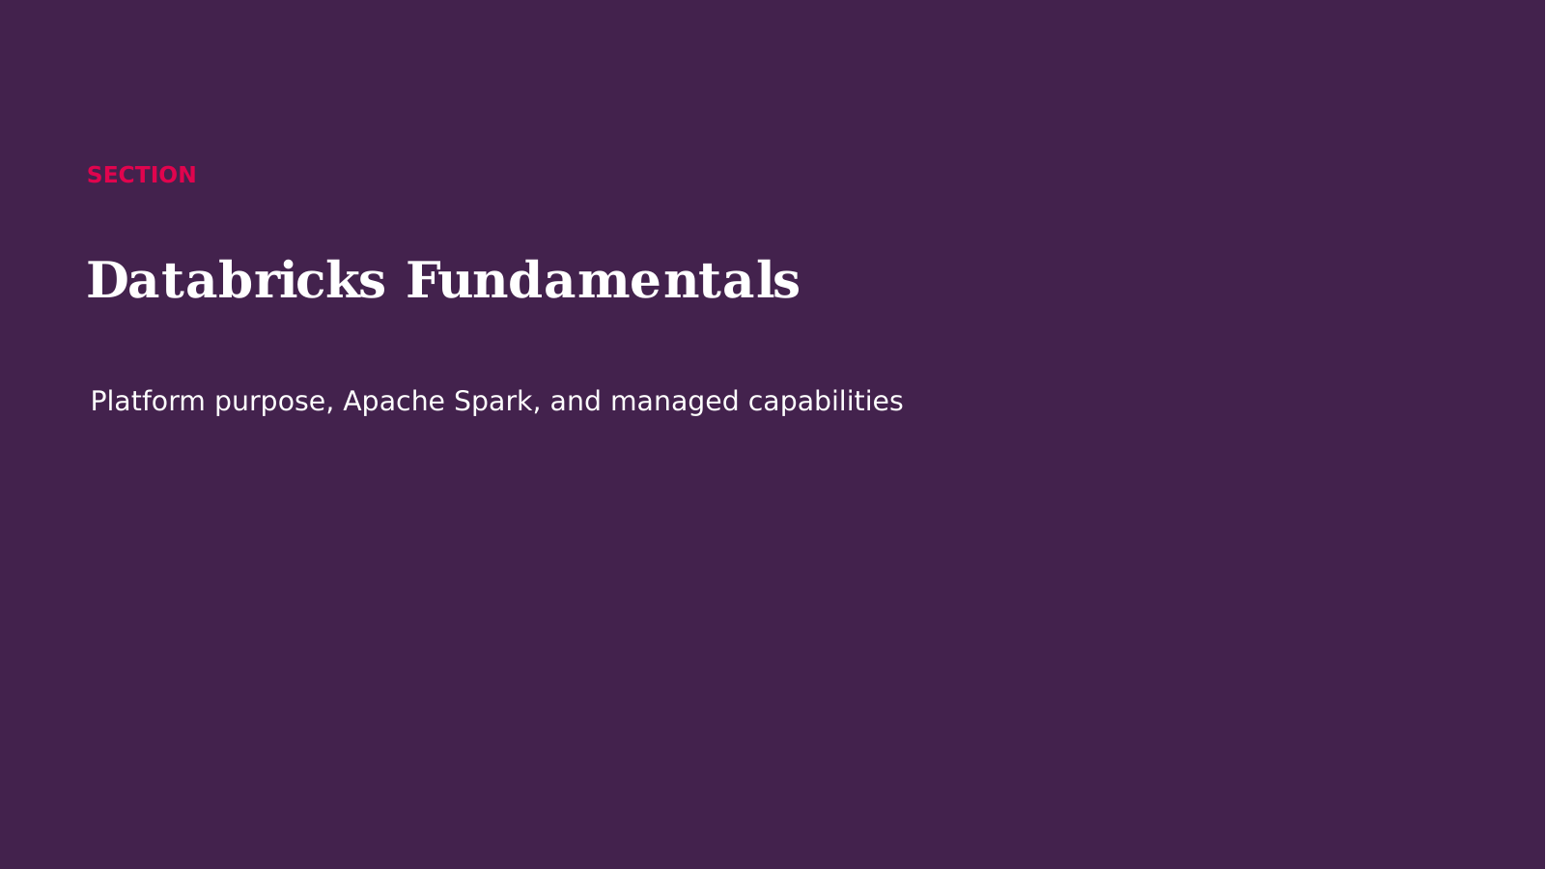
Notes:
Opening Statement
We are now moving into SECTION.
Explanation
This section builds on Databricks Training Series and introduces the concepts needed for the next implementation decisions. We will focus on what each capability does, why it matters to a governed data platform, and how it fits into an end-to-end Databricks solution. Keep the business outcome in mind: reliable data, controlled access, efficient processing, and understandable operations.
Audience Question
What challenge do you currently face that this section may help solve?
Transition
Let us start with What Is Databricks?.
Source: DATABRICKS#01+(1).pdf, page 1.
[Sources]
DATABRICKS#01+(1).pdf (attached).
Databricks_Training_Series_Clean_Doc1 1 11.pptx (attached).

Slide 3
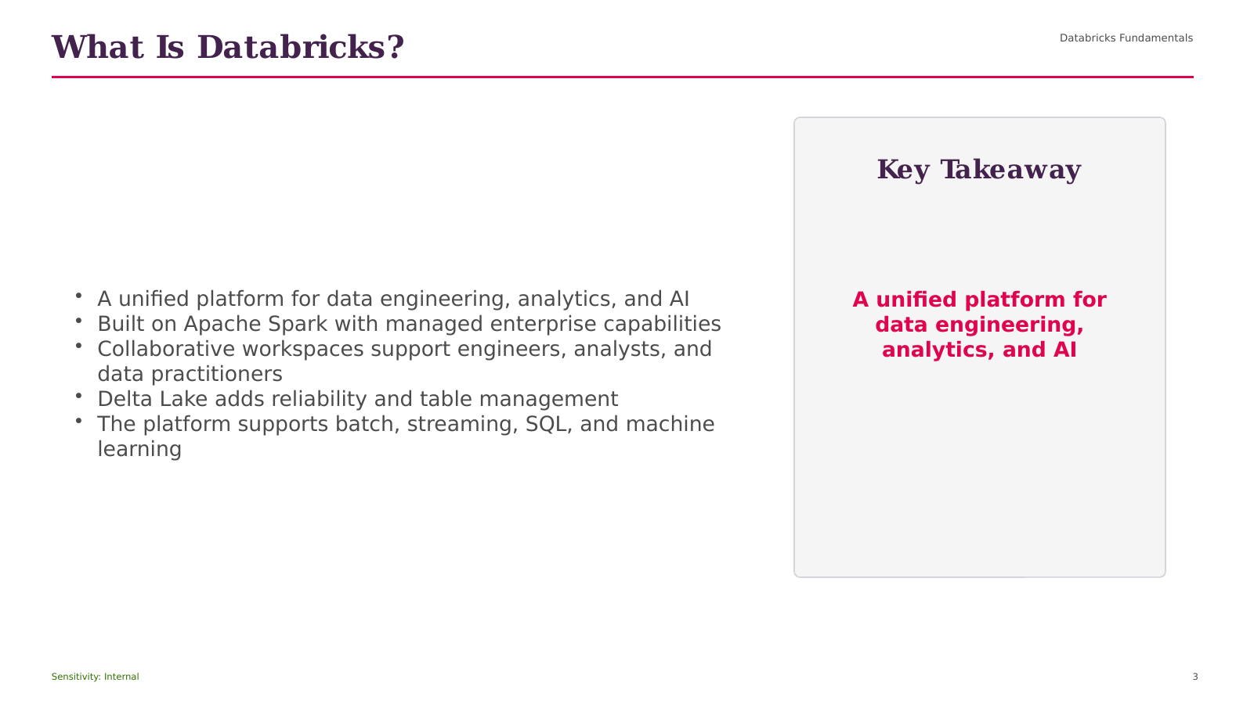
Notes:
Opening Statement
The purpose of this slide is to explain What Is Databricks? and connect it to practical Databricks delivery.
Explanation
The key points are Databricks Fundamentals; A unified platform for data engineering, analytics, and AI; Built on Apache Spark with managed enterprise capabilities; Collaborative workspaces support engineers, analysts, and data practitioners; Delta Lake adds reliability and table management. Together, these ideas show how the capability supports a unified platform rather than an isolated technical feature. For beginner users, focus first on the role of the capability, the data or objects it manages, and the consumer that receives the result.
Practical Example
In a retail analytics solution, this concept can help ingest source data, apply consistent controls, publish trusted sales information, or serve governed analysis depending on the stage shown.
Business Relevance
The value is improved reliability, clearer ownership, faster delivery, and more consistent access to data.
Best Practice
Define naming, ownership, access, quality, and monitoring before production use.
Caution or Common Mistake
Do not treat platform automation as a replacement for testing, cost control, or operational support.
Audience Question
Where would this capability fit in your current data flow?
Transition
Next, we will explore Databricks Versus Standalone Spark.
Source: DATABRICKS#01+(1).pdf, page 1.
[Sources]
DATABRICKS#01+(1).pdf (attached).
Databricks_Training_Series_Clean_Doc1 1 11.pptx (attached).

Slide 4
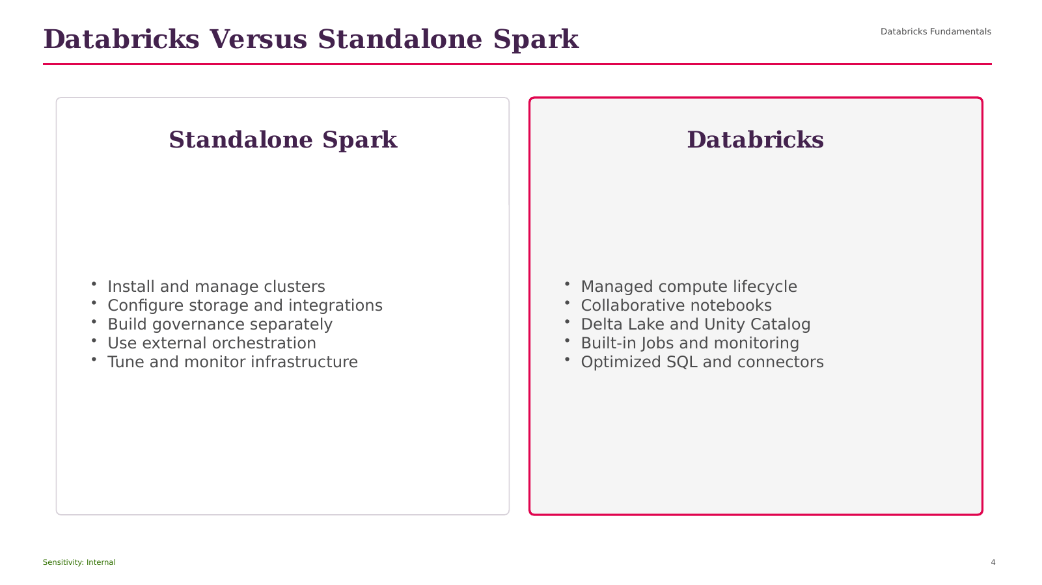
Notes:
Opening Statement
This comparison helps us choose between the alternatives presented under Databricks Versus Standalone Spark.
Explanation
The left side begins with Databricks Fundamentals, while the right side emphasizes Install and manage clusters. The choice should be based on workload pattern, scale, latency, governance, operational ownership, and cost. One option may provide greater control or simplicity, while the other may provide stronger management, automation, or continuous processing. Neither choice is universally correct.
Practical Example
For a modest scheduled file load, a simple batch pattern may be sufficient. For continuously arriving files at large scale, an incremental managed pattern is usually more appropriate.
Best Practice
Document the decision criteria and validate the choice using realistic volume and concurrency.
Caution or Common Mistake
Do not select a technology only because it is newer or more automated.
Audience Question
Which requirement would be the deciding factor in your environment?
Transition
Next, we will move to Why Managed Databricks Changes Delivery.
Source: DATABRICKS#01+(1).pdf, page 1.
[Sources]
DATABRICKS#01+(1).pdf (attached).
Databricks_Training_Series_Clean_Doc1 1 11.pptx (attached).

Slide 5
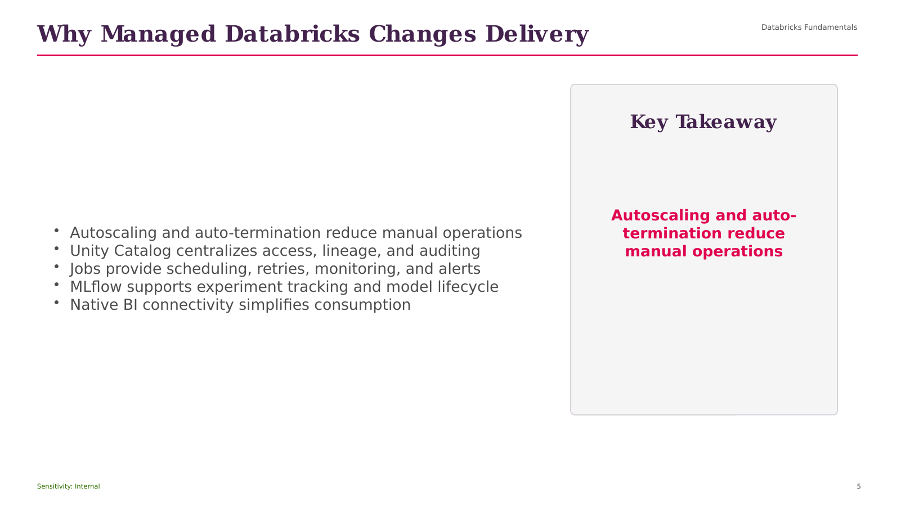
Notes:
Opening Statement
The purpose of this slide is to explain Why Managed Databricks Changes Delivery and connect it to practical Databricks delivery.
Explanation
The key points are Databricks Fundamentals; Autoscaling and auto-termination reduce manual operations; Unity Catalog centralizes access, lineage, and auditing; Jobs provide scheduling, retries, monitoring, and alerts; MLflow supports experiment tracking and model lifecycle. Together, these ideas show how the capability supports a unified platform rather than an isolated technical feature. For beginner users, focus first on the role of the capability, the data or objects it manages, and the consumer that receives the result.
Practical Example
In a retail analytics solution, this concept can help ingest source data, apply consistent controls, publish trusted sales information, or serve governed analysis depending on the stage shown.
Business Relevance
The value is improved reliability, clearer ownership, faster delivery, and more consistent access to data.
Best Practice
Define naming, ownership, access, quality, and monitoring before production use.
Caution or Common Mistake
Do not treat platform automation as a replacement for testing, cost control, or operational support.
Audience Question
Where would this capability fit in your current data flow?
Transition
Next, we will explore SECTION.
Source: DATABRICKS#01+(1).pdf, page 2.
[Sources]
DATABRICKS#01+(1).pdf (attached).
Databricks_Training_Series_Clean_Doc1 1 11.pptx (attached).

Slide 6

Notes:
Opening Statement
We are now moving into SECTION.
Explanation
This section builds on Why Managed Databricks Changes Delivery and introduces the concepts needed for the next implementation decisions. We will focus on what each capability does, why it matters to a governed data platform, and how it fits into an end-to-end Databricks solution. Keep the business outcome in mind: reliable data, controlled access, efficient processing, and understandable operations.
Audience Question
What challenge do you currently face that this section may help solve?
Transition
Let us start with Data Lake, Data Warehouse, and Lakehouse.
Source: DATABRICKS#01+(1).pdf, page 3.
[Sources]
DATABRICKS#01+(1).pdf (attached).
Databricks_Training_Series_Clean_Doc1 1 11.pptx (attached).

Slide 7
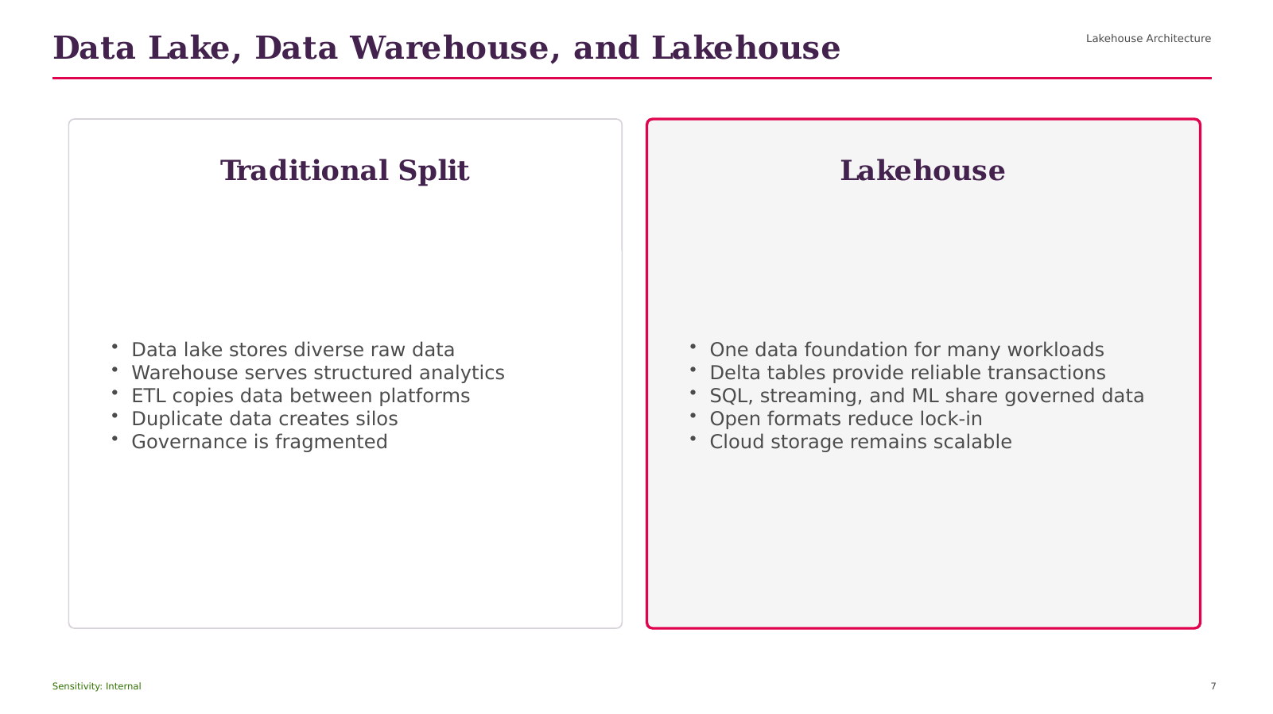
Notes:
Opening Statement
This comparison helps us choose between the alternatives presented under Data Lake, Data Warehouse, and Lakehouse.
Explanation
The left side begins with Lakehouse Architecture, while the right side emphasizes Data lake stores diverse raw data. The choice should be based on workload pattern, scale, latency, governance, operational ownership, and cost. One option may provide greater control or simplicity, while the other may provide stronger management, automation, or continuous processing. Neither choice is universally correct.
Practical Example
For a modest scheduled file load, a simple batch pattern may be sufficient. For continuously arriving files at large scale, an incremental managed pattern is usually more appropriate.
Best Practice
Document the decision criteria and validate the choice using realistic volume and concurrency.
Caution or Common Mistake
Do not select a technology only because it is newer or more automated.
Audience Question
Which requirement would be the deciding factor in your environment?
Transition
Next, we will move to How the Lakehouse Works.
Source: DATABRICKS#01+(1).pdf, page 3.
[Sources]
DATABRICKS#01+(1).pdf (attached).
Databricks_Training_Series_Clean_Doc1 1 11.pptx (attached).

Slide 8
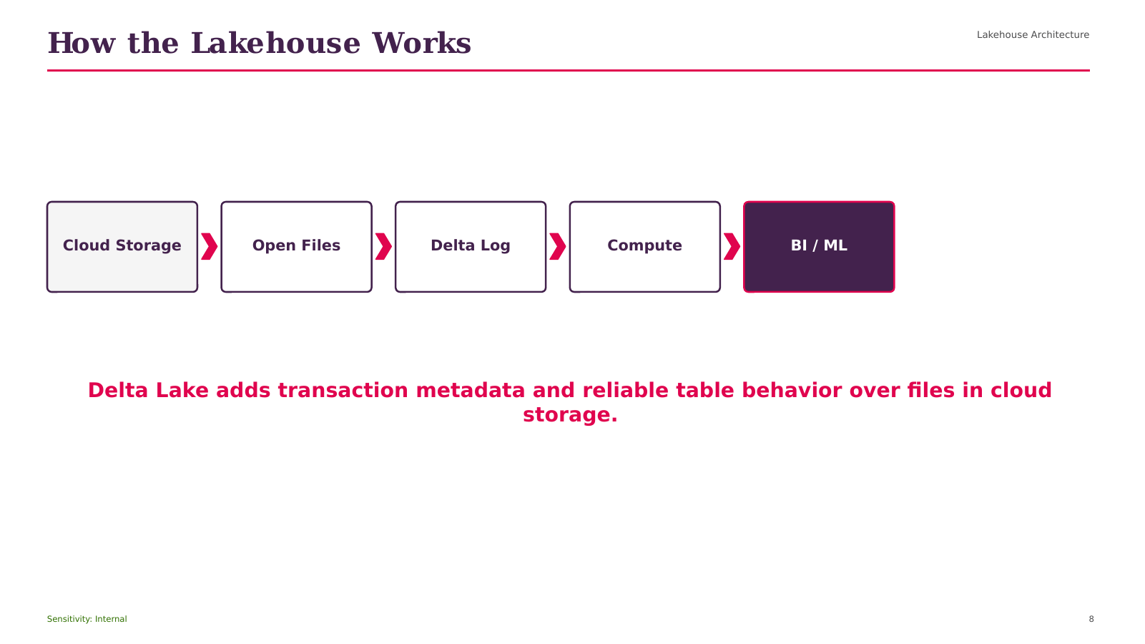
Notes:
Opening Statement
This process view explains how How the Lakehouse Works works from left to right.
Explanation
The flow begins with Lakehouse Architecture, then moves through the intermediate stages, and ends with a governed output for consumers. Each arrow represents a dependency or movement of data, not an automatic guarantee of orchestration. The main elements shown are Lakehouse Architecture; Cloud Storage; Open Files; Delta Log; Compute. The expected output is reliable data that can be monitored, governed, and consumed by the next workload.
Practical Example
A retail pipeline can ingest new files, validate data, refine records, publish business metrics, and make the results available to dashboards.
Best Practice
Record ownership, quality checks, lineage, permissions, run status, and cost at each stage.
Caution or Common Mistake
Do not add dependencies without restart logic, monitoring, and clear failure handling.
Audience Question
Where would you place the most important quality gate in this flow?
Transition
Next, we will discuss Lakehouse Benefits.
Source: DATABRICKS#01+(1).pdf, page 4.
[Sources]
DATABRICKS#01+(1).pdf (attached).
Databricks_Training_Series_Clean_Doc1 1 11.pptx (attached).

Slide 9
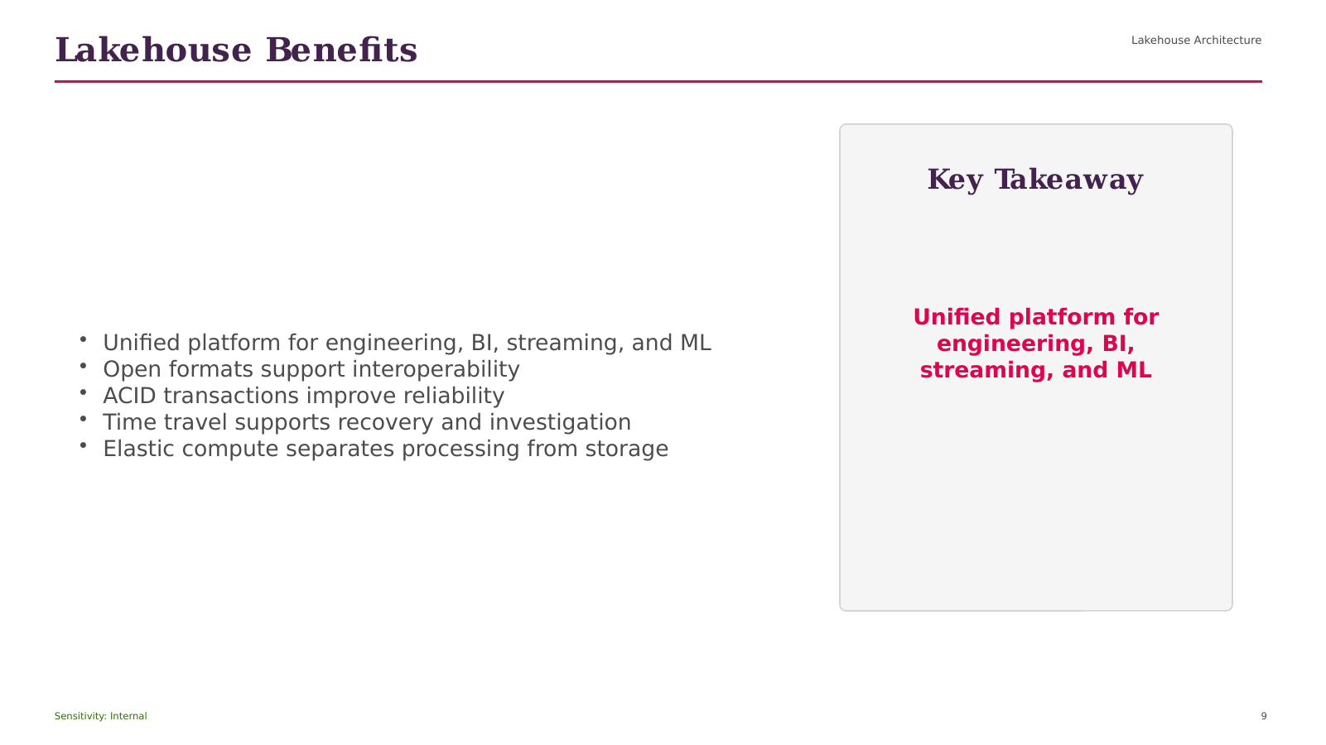
Notes:
Opening Statement
The purpose of this slide is to explain Lakehouse Benefits and connect it to practical Databricks delivery.
Explanation
The key points are Lakehouse Architecture; Unified platform for engineering, BI, streaming, and ML; Open formats support interoperability; ACID transactions improve reliability; Time travel supports recovery and investigation. Together, these ideas show how the capability supports a unified platform rather than an isolated technical feature. For beginner users, focus first on the role of the capability, the data or objects it manages, and the consumer that receives the result.
Practical Example
In a retail analytics solution, this concept can help ingest source data, apply consistent controls, publish trusted sales information, or serve governed analysis depending on the stage shown.
Business Relevance
The value is improved reliability, clearer ownership, faster delivery, and more consistent access to data.
Best Practice
Define naming, ownership, access, quality, and monitoring before production use.
Caution or Common Mistake
Do not treat platform automation as a replacement for testing, cost control, or operational support.
Audience Question
Where would this capability fit in your current data flow?
Transition
Next, we will explore SECTION.
Source: DATABRICKS#01+(1).pdf, page 4.
[Sources]
DATABRICKS#01+(1).pdf (attached).
Databricks_Training_Series_Clean_Doc1 1 11.pptx (attached).

Slide 10
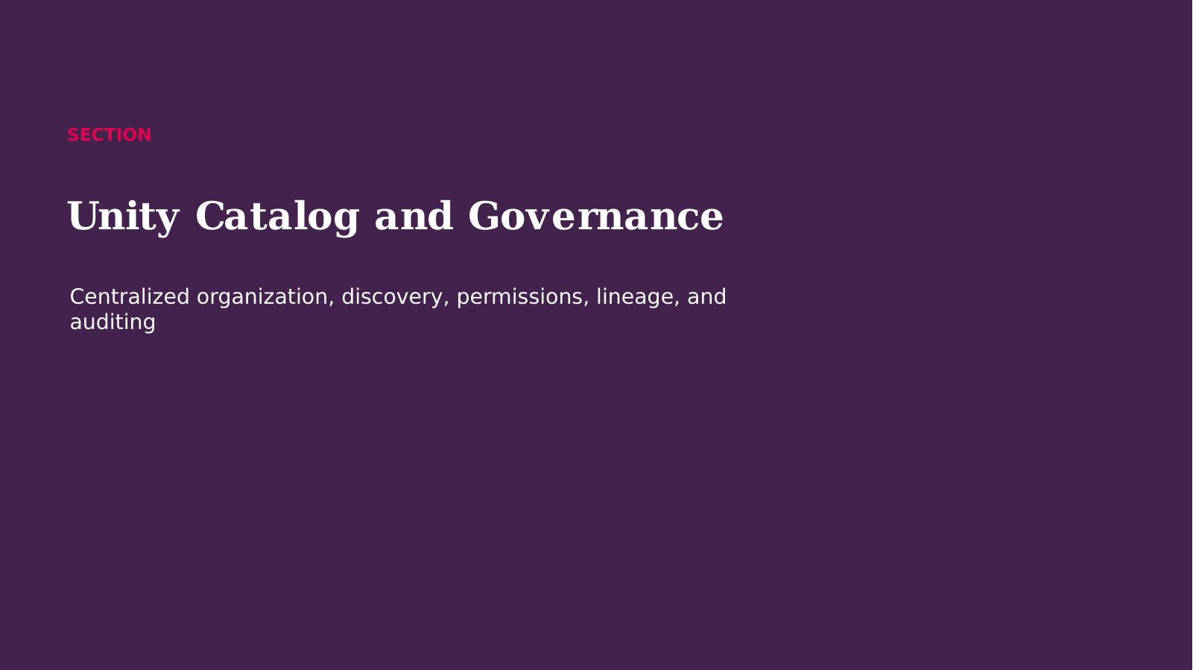
Notes:
Opening Statement
We are now moving into SECTION.
Explanation
This section builds on Lakehouse Benefits and introduces the concepts needed for the next implementation decisions. We will focus on what each capability does, why it matters to a governed data platform, and how it fits into an end-to-end Databricks solution. Keep the business outcome in mind: reliable data, controlled access, efficient processing, and understandable operations.
Audience Question
What challenge do you currently face that this section may help solve?
Transition
Let us start with What Is Unity Catalog?.
Source: DATABRICKS#01+(1).pdf, page 5.
[Sources]
DATABRICKS#01+(1).pdf (attached).
Databricks_Training_Series_Clean_Doc1 1 11.pptx (attached).

Slide 11
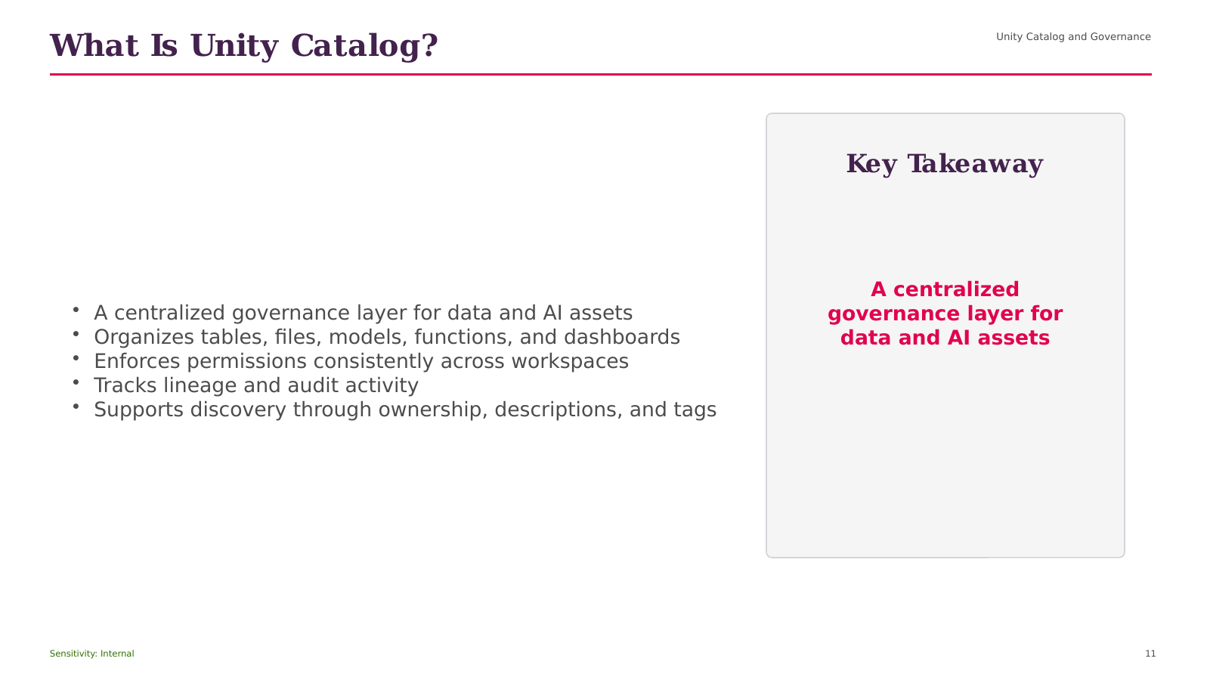
Notes:
Opening Statement
The purpose of this slide is to explain What Is Unity Catalog? and connect it to practical Databricks delivery.
Explanation
The key points are Unity Catalog and Governance; A centralized governance layer for data and AI assets; Organizes tables, files, models, functions, and dashboards; Enforces permissions consistently across workspaces; Tracks lineage and audit activity. Together, these ideas show how the capability supports a unified platform rather than an isolated technical feature. For beginner users, focus first on the role of the capability, the data or objects it manages, and the consumer that receives the result.
Practical Example
In a retail analytics solution, this concept can help ingest source data, apply consistent controls, publish trusted sales information, or serve governed analysis depending on the stage shown.
Business Relevance
The value is improved reliability, clearer ownership, faster delivery, and more consistent access to data.
Best Practice
Define naming, ownership, access, quality, and monitoring before production use.
Caution or Common Mistake
Do not treat platform automation as a replacement for testing, cost control, or operational support.
Audience Question
Where would this capability fit in your current data flow?
Transition
Next, we will explore Unity Catalog Object Model.
Source: DATABRICKS#01+(1).pdf, page 5.
[Sources]
DATABRICKS#01+(1).pdf (attached).
Databricks_Training_Series_Clean_Doc1 1 11.pptx (attached).

Slide 12

Notes:
Opening Statement
This process view explains how Unity Catalog Object Model works from left to right.
Explanation
The flow begins with Unity Catalog and Governance, then moves through the intermediate stages, and ends with a governed output for consumers. Each arrow represents a dependency or movement of data, not an automatic guarantee of orchestration. The main elements shown are Unity Catalog and Governance; Metastore; Catalog; Schema; Table / View. The expected output is reliable data that can be monitored, governed, and consumed by the next workload.
Practical Example
A retail pipeline can ingest new files, validate data, refine records, publish business metrics, and make the results available to dashboards.
Best Practice
Record ownership, quality checks, lineage, permissions, run status, and cost at each stage.
Caution or Common Mistake
Do not add dependencies without restart logic, monitoring, and clear failure handling.
Audience Question
Where would you place the most important quality gate in this flow?
Transition
Next, we will discuss Without and With Unity Catalog.
Source: DATABRICKS#01+(1).pdf, page 5.
[Sources]
DATABRICKS#01+(1).pdf (attached).
Databricks_Training_Series_Clean_Doc1 1 11.pptx (attached).

Slide 13
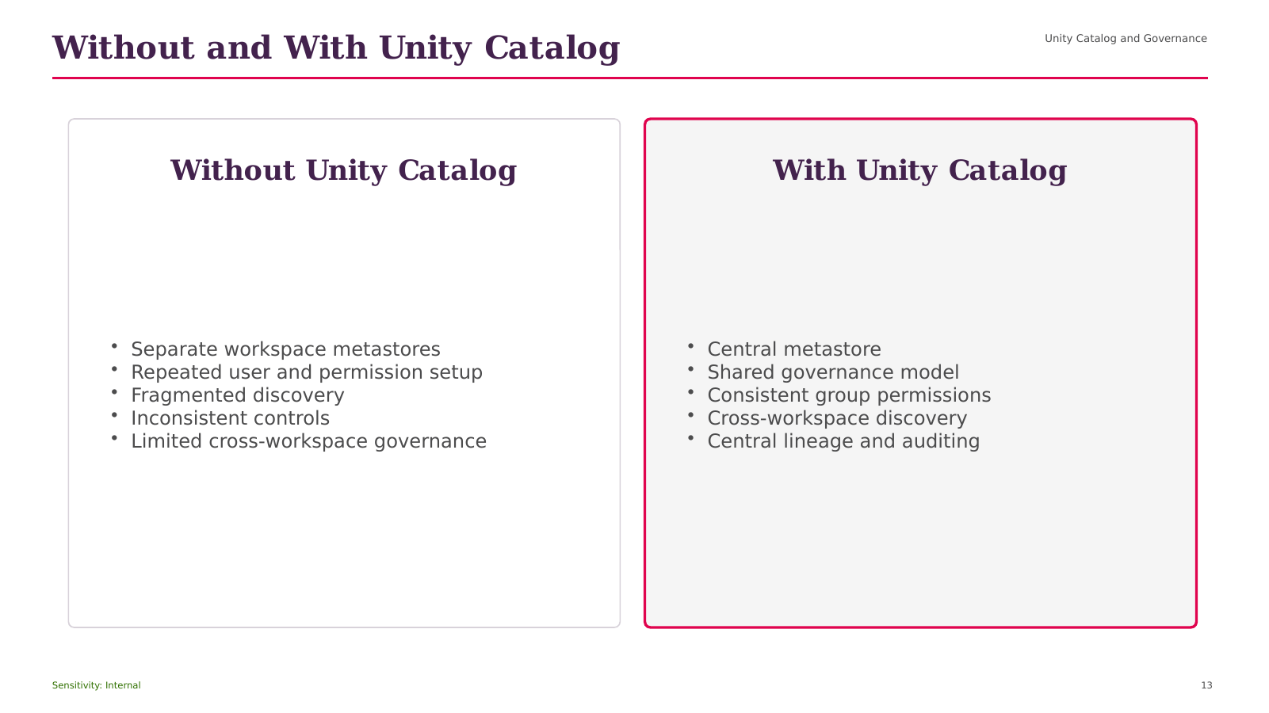
Notes:
Opening Statement
This comparison helps us choose between the alternatives presented under Without and With Unity Catalog.
Explanation
The left side begins with Unity Catalog and Governance, while the right side emphasizes Separate workspace metastores. The choice should be based on workload pattern, scale, latency, governance, operational ownership, and cost. One option may provide greater control or simplicity, while the other may provide stronger management, automation, or continuous processing. Neither choice is universally correct.
Practical Example
For a modest scheduled file load, a simple batch pattern may be sufficient. For continuously arriving files at large scale, an incremental managed pattern is usually more appropriate.
Best Practice
Document the decision criteria and validate the choice using realistic volume and concurrency.
Caution or Common Mistake
Do not select a technology only because it is newer or more automated.
Audience Question
Which requirement would be the deciding factor in your environment?
Transition
Next, we will move to SECTION.
Source: DATABRICKS#01+(1).pdf, page 6.
[Sources]
DATABRICKS#01+(1).pdf (attached).
Databricks_Training_Series_Clean_Doc1 1 11.pptx (attached).

Slide 14
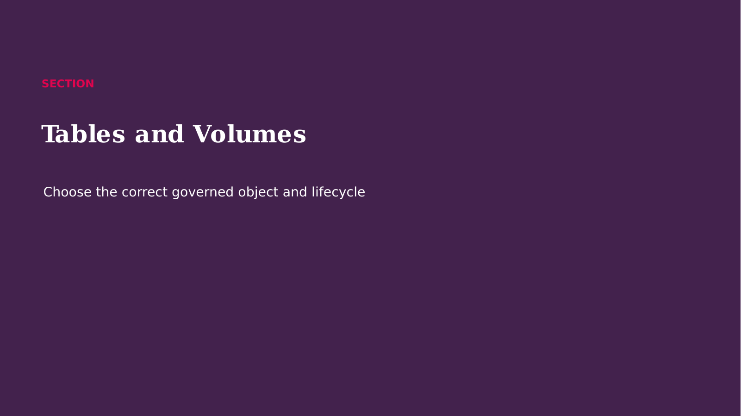
Notes:
Opening Statement
We are now moving into SECTION.
Explanation
This section builds on Without and With Unity Catalog and introduces the concepts needed for the next implementation decisions. We will focus on what each capability does, why it matters to a governed data platform, and how it fits into an end-to-end Databricks solution. Keep the business outcome in mind: reliable data, controlled access, efficient processing, and understandable operations.
Audience Question
What challenge do you currently face that this section may help solve?
Transition
Let us start with Managed Versus External Tables.
Source: DATABRICKS#01+(1).pdf, page 7.
[Sources]
DATABRICKS#01+(1).pdf (attached).
Databricks_Training_Series_Clean_Doc1 1 11.pptx (attached).

Slide 15
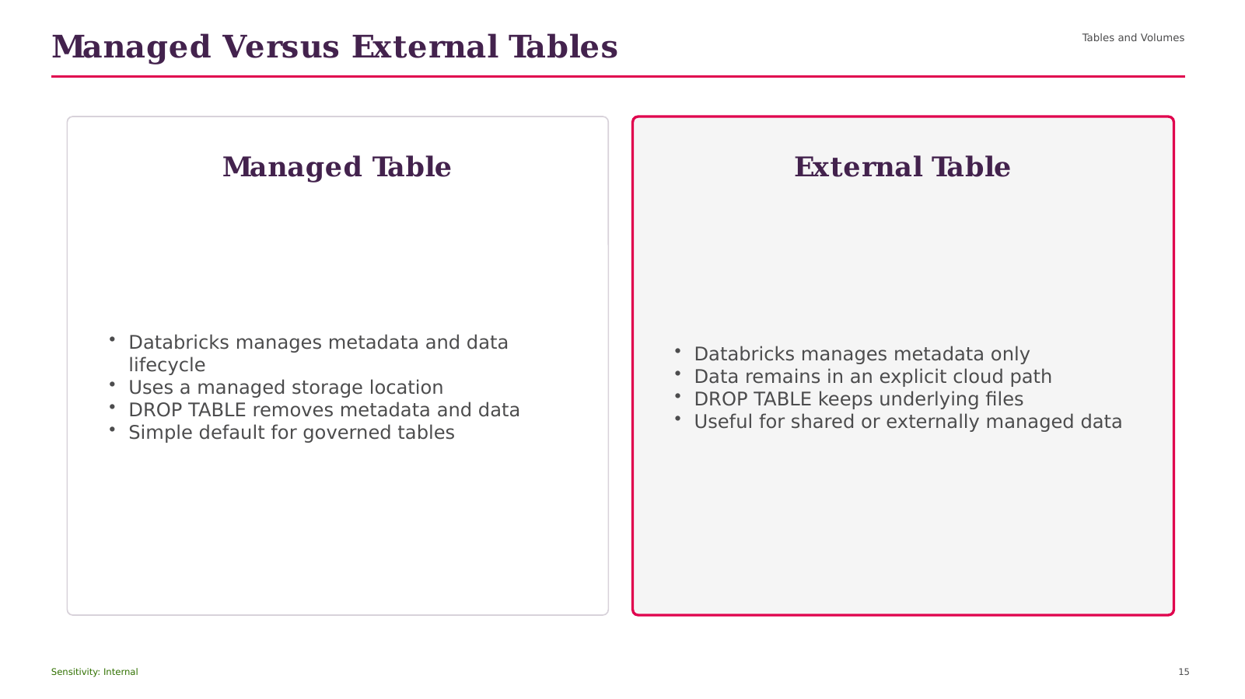
Notes:
Opening Statement
This comparison helps us choose between the alternatives presented under Managed Versus External Tables.
Explanation
The left side begins with Tables and Volumes, while the right side emphasizes Databricks manages metadata and data lifecycle. The choice should be based on workload pattern, scale, latency, governance, operational ownership, and cost. One option may provide greater control or simplicity, while the other may provide stronger management, automation, or continuous processing. Neither choice is universally correct.
Practical Example
For a modest scheduled file load, a simple batch pattern may be sufficient. For continuously arriving files at large scale, an incremental managed pattern is usually more appropriate.
Best Practice
Document the decision criteria and validate the choice using realistic volume and concurrency.
Caution or Common Mistake
Do not select a technology only because it is newer or more automated.
Audience Question
Which requirement would be the deciding factor in your environment?
Transition
Next, we will move to Create Managed and External Delta Tables.
Source: DATABRICKS#01+(1).pdf, page 7.
[Sources]
DATABRICKS#01+(1).pdf (attached).
Databricks_Training_Series_Clean_Doc1 1 11.pptx (attached).

Slide 16
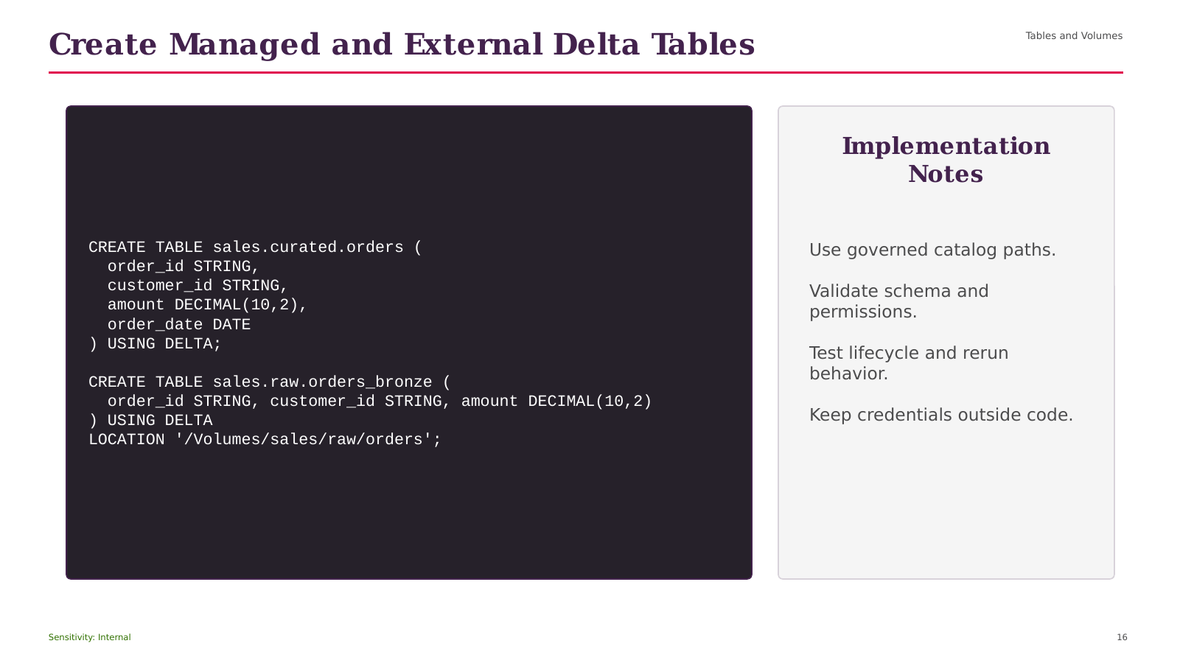
Notes:
Opening Statement
This demonstration translates Create Managed and External Delta Tables into an implementation pattern that can be tested in a Databricks workspace.
Explanation
Read the code in logical sections. First, identify the target catalog, schema, table, volume, source path, schema location, or checkpoint location. Next, review how the operation creates or writes the governed object. Finally, confirm the expected result and lifecycle behavior. The visible example includes Tables and Volumes CREATE TABLE sales.curated.orders (. Replace sample names and paths with values approved for your environment.
Practical Example
Run the example in a development catalog, validate the schema and row counts, and confirm that the expected table or stream is created.
Best Practice
Use explicit schemas, governed locations, version control, and separate development and production configuration.
Caution or Common Mistake
A wrong path, missing permission, reused checkpoint, or unintended write mode can fail the run or affect existing data.
Audience Question
Which values in this example must be environment-specific?
Transition
Next, we will examine Unity Catalog Volumes.
Source: DATABRICKS#01+(1).pdf, page 7.
[Sources]
DATABRICKS#01+(1).pdf (attached).
Databricks_Training_Series_Clean_Doc1 1 11.pptx (attached).

Slide 17
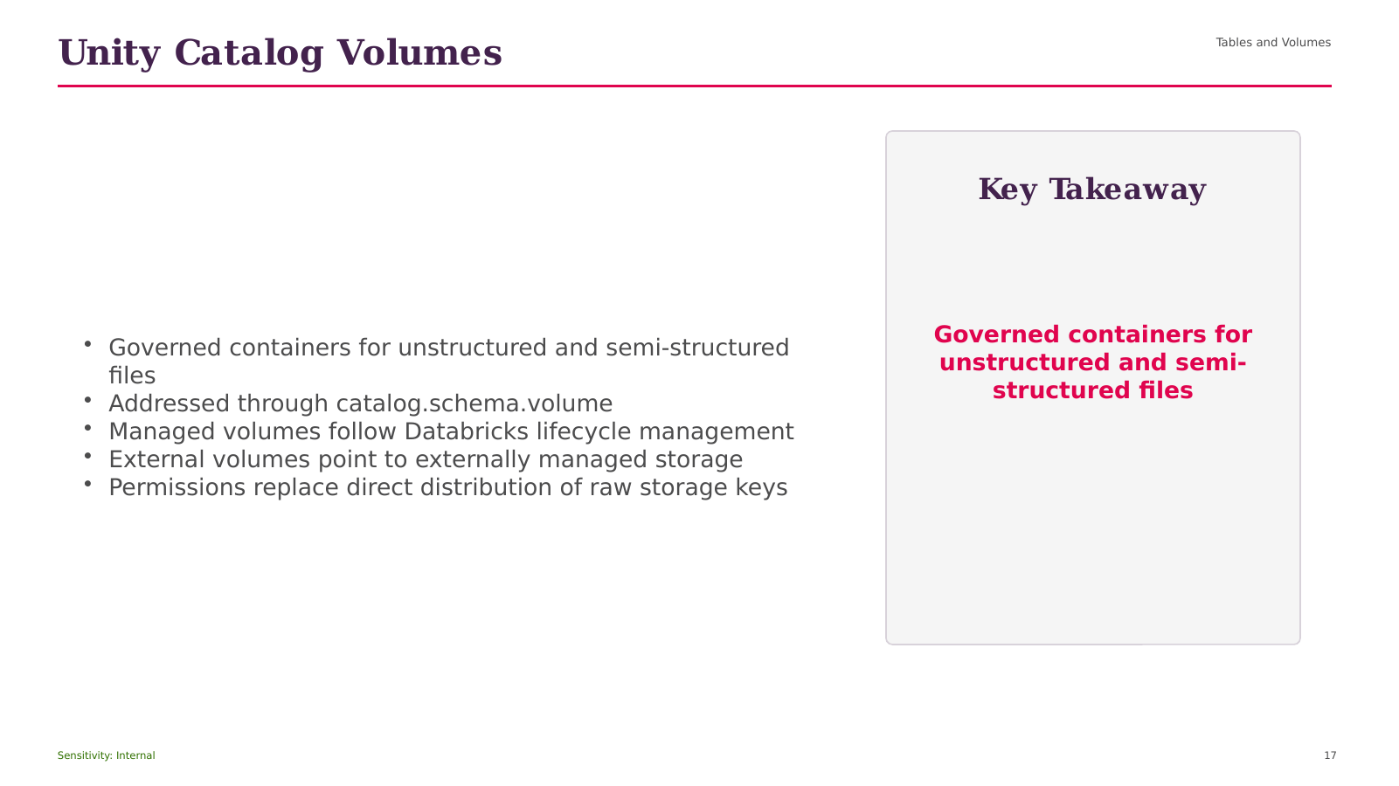
Notes:
Opening Statement
The purpose of this slide is to explain Unity Catalog Volumes and connect it to practical Databricks delivery.
Explanation
The key points are Tables and Volumes; Governed containers for unstructured and semi-structured files; Addressed through catalog.schema.volume; Managed volumes follow Databricks lifecycle management; External volumes point to externally managed storage. Together, these ideas show how the capability supports a unified platform rather than an isolated technical feature. For beginner users, focus first on the role of the capability, the data or objects it manages, and the consumer that receives the result.
Practical Example
In a retail analytics solution, this concept can help ingest source data, apply consistent controls, publish trusted sales information, or serve governed analysis depending on the stage shown.
Business Relevance
The value is improved reliability, clearer ownership, faster delivery, and more consistent access to data.
Best Practice
Define naming, ownership, access, quality, and monitoring before production use.
Caution or Common Mistake
Do not treat platform automation as a replacement for testing, cost control, or operational support.
Audience Question
Where would this capability fit in your current data flow?
Transition
Next, we will explore How Volumes Improve File Governance.
Source: DATABRICKS#01+(1).pdf, page 8.
[Sources]
DATABRICKS#01+(1).pdf (attached).
Databricks_Training_Series_Clean_Doc1 1 11.pptx (attached).

Slide 18

Notes:
Opening Statement
This process view explains how How Volumes Improve File Governance works from left to right.
Explanation
The flow begins with Tables and Volumes, then moves through the intermediate stages, and ends with a governed output for consumers. Each arrow represents a dependency or movement of data, not an automatic guarantee of orchestration. The main elements shown are Tables and Volumes; Cloud Files; UC Volume; Permissions; Metadata. The expected output is reliable data that can be monitored, governed, and consumed by the next workload.
Practical Example
A retail pipeline can ingest new files, validate data, refine records, publish business metrics, and make the results available to dashboards.
Best Practice
Record ownership, quality checks, lineage, permissions, run status, and cost at each stage.
Caution or Common Mistake
Do not add dependencies without restart logic, monitoring, and clear failure handling.
Audience Question
Where would you place the most important quality gate in this flow?
Transition
Next, we will discuss SECTION.
Source: DATABRICKS#01+(1).pdf, page 9.
[Sources]
DATABRICKS#01+(1).pdf (attached).
Databricks_Training_Series_Clean_Doc1 1 11.pptx (attached).

Slide 19
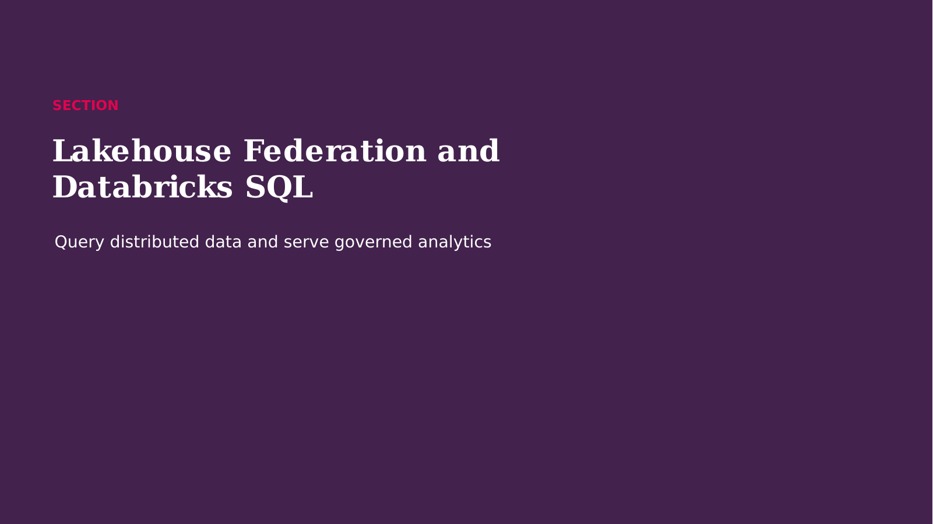
Notes:
Opening Statement
We are now moving into SECTION.
Explanation
This section builds on How Volumes Improve File Governance and introduces the concepts needed for the next implementation decisions. We will focus on what each capability does, why it matters to a governed data platform, and how it fits into an end-to-end Databricks solution. Keep the business outcome in mind: reliable data, controlled access, efficient processing, and understandable operations.
Audience Question
What challenge do you currently face that this section may help solve?
Transition
Let us start with Lakehouse Federation.
Source: DATABRICKS#01+(1).pdf, page 10.
[Sources]
DATABRICKS#01+(1).pdf (attached).
Databricks_Training_Series_Clean_Doc1 1 11.pptx (attached).

Slide 20
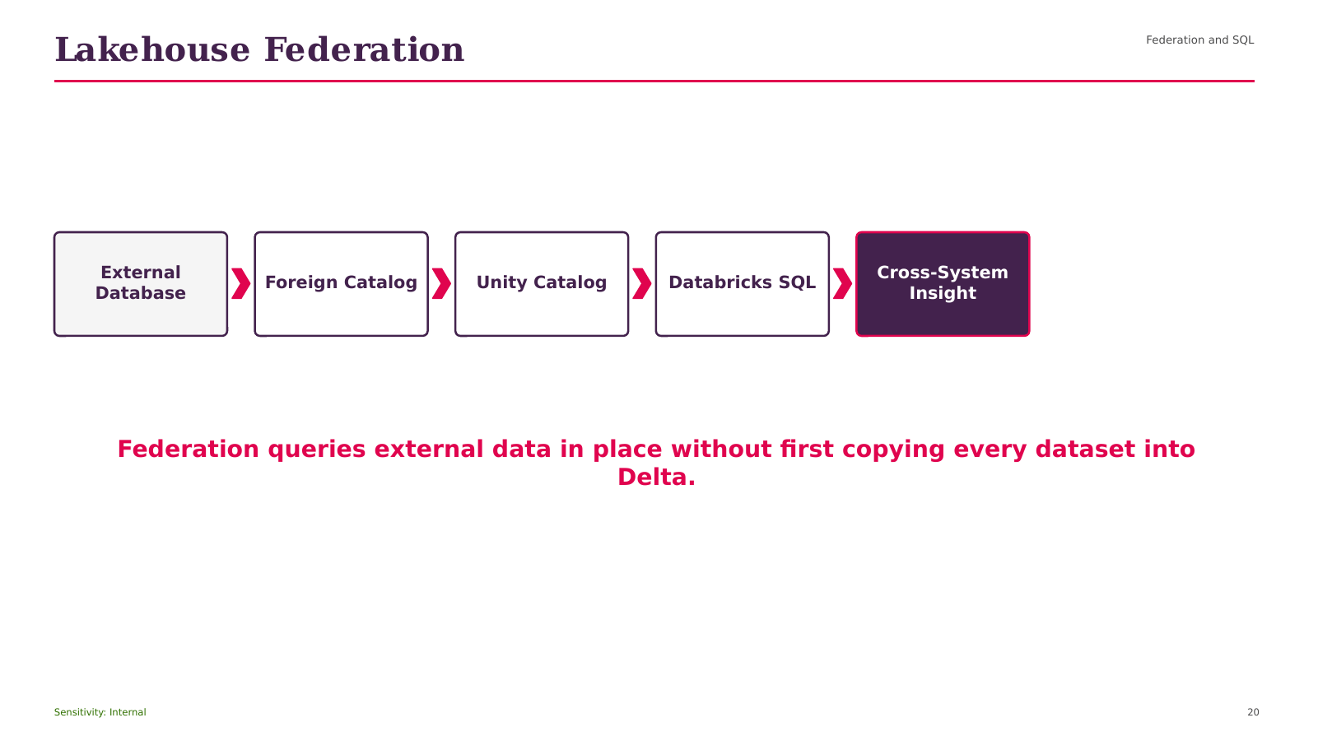
Notes:
Opening Statement
This process view explains how Lakehouse Federation works from left to right.
Explanation
The flow begins with Federation and SQL, then moves through the intermediate stages, and ends with a governed output for consumers. Each arrow represents a dependency or movement of data, not an automatic guarantee of orchestration. The main elements shown are Federation and SQL; External Database; Foreign Catalog; Unity Catalog; Databricks SQL. The expected output is reliable data that can be monitored, governed, and consumed by the next workload.
Practical Example
A retail pipeline can ingest new files, validate data, refine records, publish business metrics, and make the results available to dashboards.
Best Practice
Record ownership, quality checks, lineage, permissions, run status, and cost at each stage.
Caution or Common Mistake
Do not add dependencies without restart logic, monitoring, and clear failure handling.
Audience Question
Where would you place the most important quality gate in this flow?
Transition
Next, we will discuss When Federation Adds Value.
Source: DATABRICKS#01+(1).pdf, page 10.
[Sources]
DATABRICKS#01+(1).pdf (attached).
Databricks_Training_Series_Clean_Doc1 1 11.pptx (attached).

Slide 21
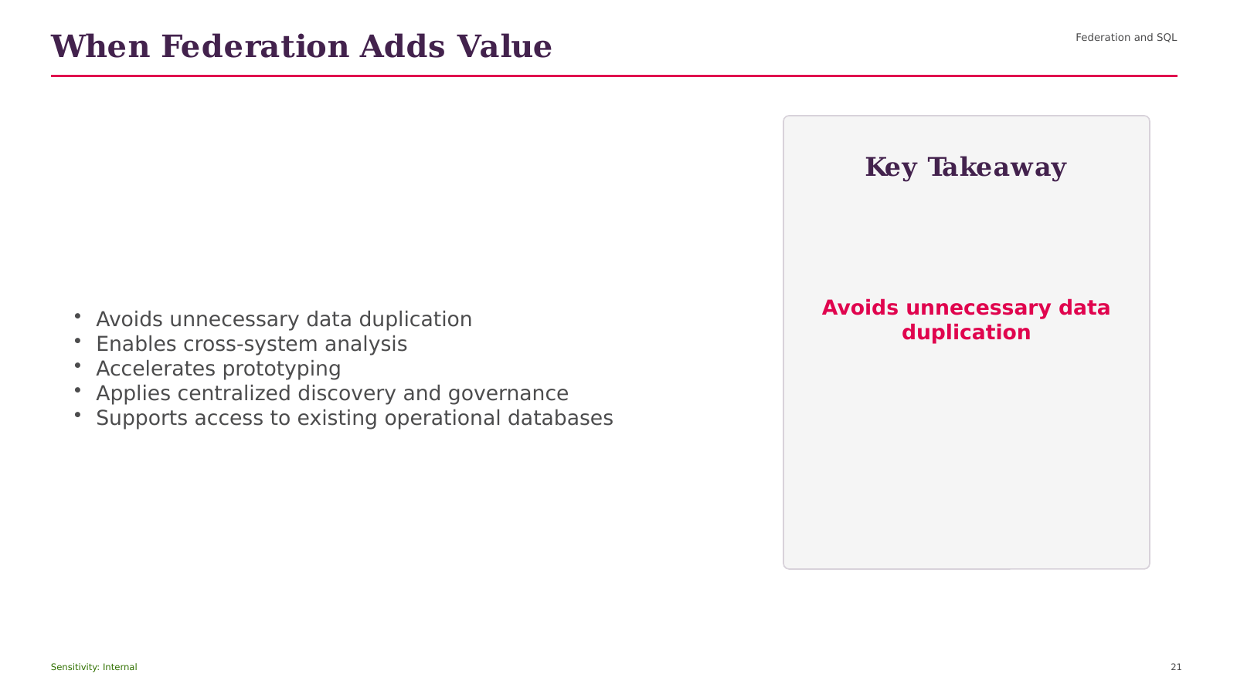
Notes:
Opening Statement
The purpose of this slide is to explain When Federation Adds Value and connect it to practical Databricks delivery.
Explanation
The key points are Federation and SQL; Avoids unnecessary data duplication; Enables cross-system analysis; Accelerates prototyping; Applies centralized discovery and governance. Together, these ideas show how the capability supports a unified platform rather than an isolated technical feature. For beginner users, focus first on the role of the capability, the data or objects it manages, and the consumer that receives the result.
Practical Example
In a retail analytics solution, this concept can help ingest source data, apply consistent controls, publish trusted sales information, or serve governed analysis depending on the stage shown.
Business Relevance
The value is improved reliability, clearer ownership, faster delivery, and more consistent access to data.
Best Practice
Define naming, ownership, access, quality, and monitoring before production use.
Caution or Common Mistake
Do not treat platform automation as a replacement for testing, cost control, or operational support.
Audience Question
Where would this capability fit in your current data flow?
Transition
Next, we will explore What Is Databricks SQL?.
Source: DATABRICKS#01+(1).pdf, page 10.
[Sources]
DATABRICKS#01+(1).pdf (attached).
Databricks_Training_Series_Clean_Doc1 1 11.pptx (attached).

Slide 22
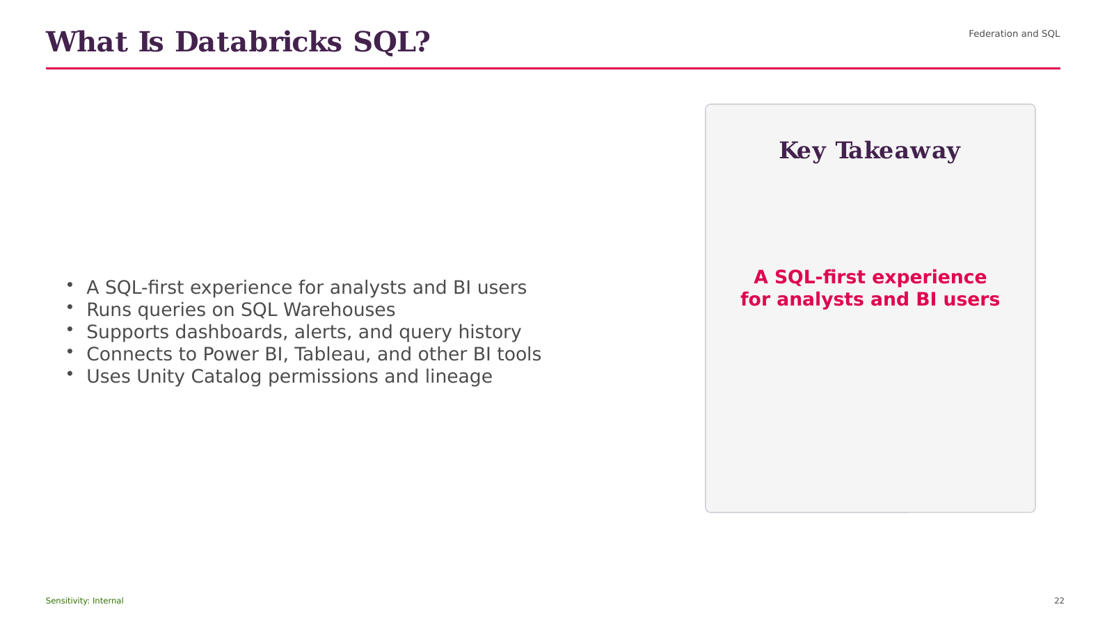
Notes:
Opening Statement
The purpose of this slide is to explain What Is Databricks Structured Query Language (SQL)? and connect it to practical Databricks delivery.
Explanation
The key points are Federation and SQL; A SQL-first experience for analysts and BI users; Runs queries on SQL Warehouses; Supports dashboards, alerts, and query history; Connects to Power BI, Tableau, and other BI tools. Together, these ideas show how the capability supports a unified platform rather than an isolated technical feature. For beginner users, focus first on the role of the capability, the data or objects it manages, and the consumer that receives the result.
Practical Example
In a retail analytics solution, this concept can help ingest source data, apply consistent controls, publish trusted sales information, or serve governed analysis depending on the stage shown.
Business Relevance
The value is improved reliability, clearer ownership, faster delivery, and more consistent access to data.
Best Practice
Define naming, ownership, access, quality, and monitoring before production use.
Caution or Common Mistake
Do not treat platform automation as a replacement for testing, cost control, or operational support.
Audience Question
Where would this capability fit in your current data flow?
Transition
Next, we will explore Business Value of Databricks SQL.
Source: DATABRICKS#01+(1).pdf, page 11.
[Sources]
DATABRICKS#01+(1).pdf (attached).
Databricks_Training_Series_Clean_Doc1 1 11.pptx (attached).

Slide 23
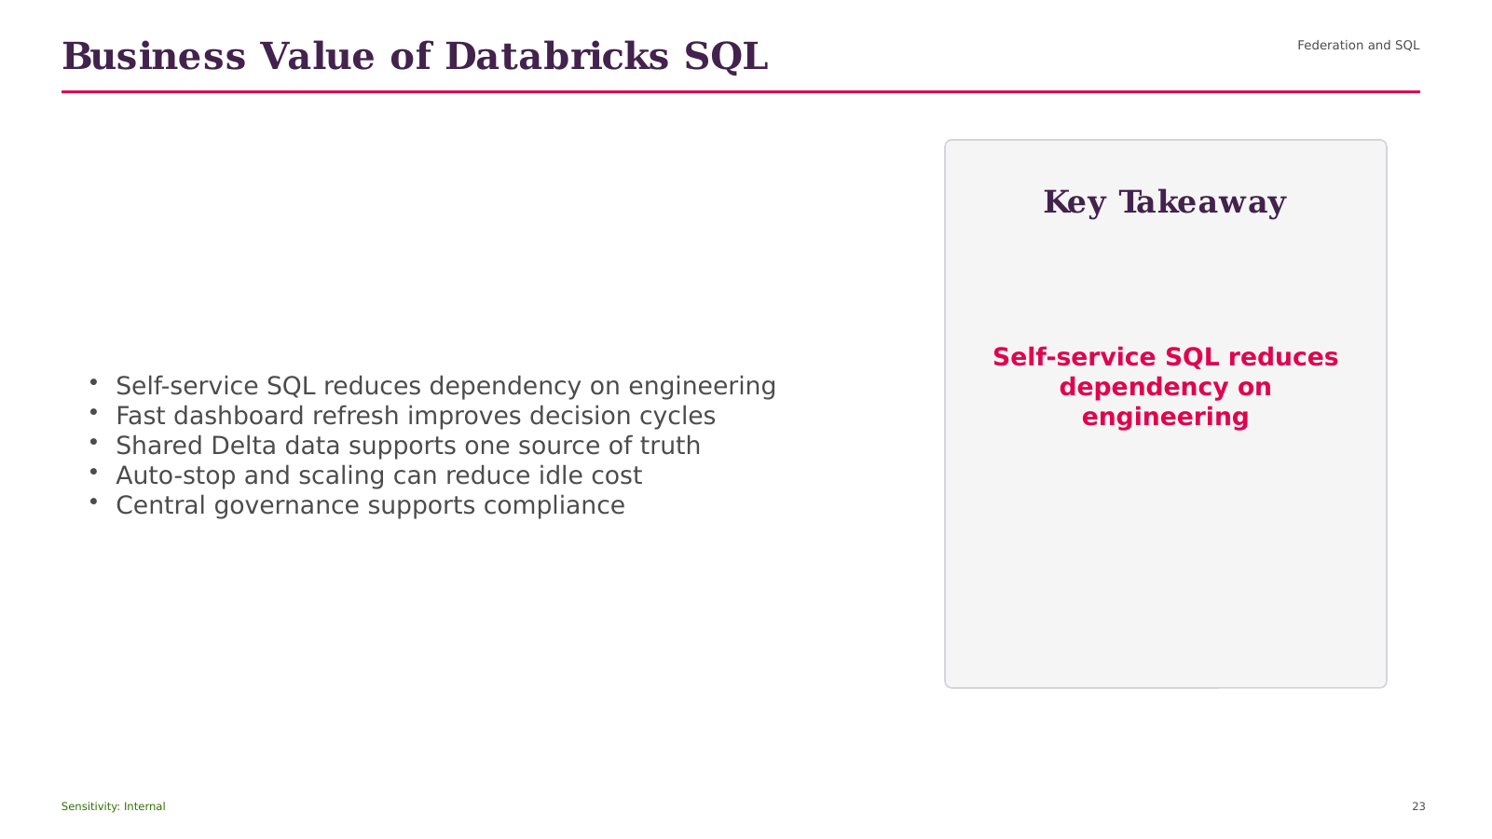
Notes:
Opening Statement
The purpose of this slide is to explain Business Value of Databricks Structured Query Language (SQL) and connect it to practical Databricks delivery.
Explanation
The key points are Federation and SQL; Self-service SQL reduces dependency on engineering; Fast dashboard refresh improves decision cycles; Shared Delta data supports one source of truth; Auto-stop and scaling can reduce idle cost. Together, these ideas show how the capability supports a unified platform rather than an isolated technical feature. For beginner users, focus first on the role of the capability, the data or objects it manages, and the consumer that receives the result.
Practical Example
In a retail analytics solution, this concept can help ingest source data, apply consistent controls, publish trusted sales information, or serve governed analysis depending on the stage shown.
Business Relevance
The value is improved reliability, clearer ownership, faster delivery, and more consistent access to data.
Best Practice
Define naming, ownership, access, quality, and monitoring before production use.
Caution or Common Mistake
Do not treat platform automation as a replacement for testing, cost control, or operational support.
Audience Question
Where would this capability fit in your current data flow?
Transition
Next, we will explore SECTION.
Source: DATABRICKS#01+(1).pdf, page 12.
[Sources]
DATABRICKS#01+(1).pdf (attached).
Databricks_Training_Series_Clean_Doc1 1 11.pptx (attached).

Slide 24
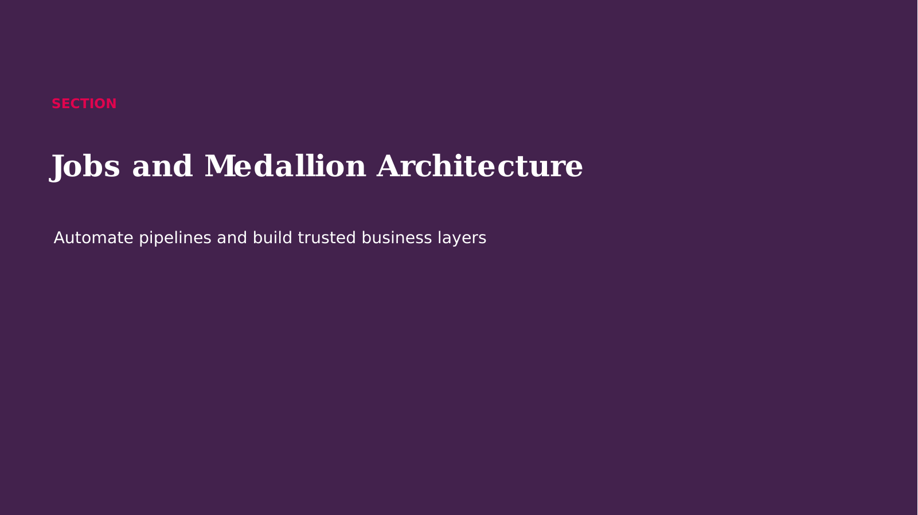
Notes:
Opening Statement
We are now moving into SECTION.
Explanation
This section builds on Business Value of Databricks SQL and introduces the concepts needed for the next implementation decisions. We will focus on what each capability does, why it matters to a governed data platform, and how it fits into an end-to-end Databricks solution. Keep the business outcome in mind: reliable data, controlled access, efficient processing, and understandable operations.
Audience Question
What challenge do you currently face that this section may help solve?
Transition
Let us start with Lakehouse Jobs Workflow.
Source: DATABRICKS#01+(1).pdf, page 13.
[Sources]
DATABRICKS#01+(1).pdf (attached).
Databricks_Training_Series_Clean_Doc1 1 11.pptx (attached).

Slide 25
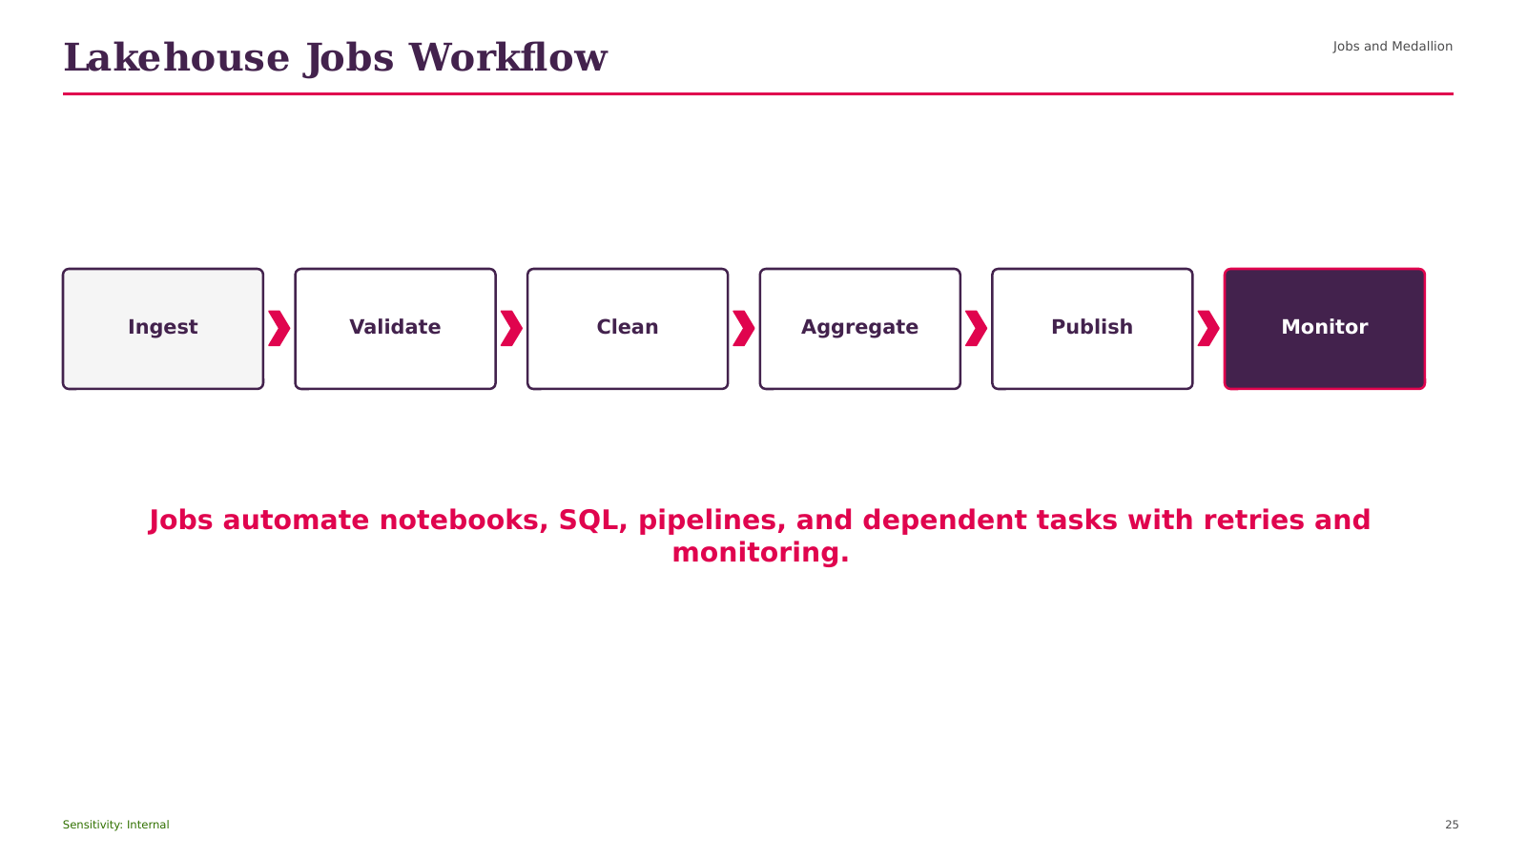
Notes:
Opening Statement
This process view explains how Lakehouse Jobs Workflow works from left to right.
Explanation
The flow begins with Jobs and Medallion, then moves through the intermediate stages, and ends with a governed output for consumers. Each arrow represents a dependency or movement of data, not an automatic guarantee of orchestration. The main elements shown are Jobs and Medallion; Ingest; Validate; Clean; Aggregate. The expected output is reliable data that can be monitored, governed, and consumed by the next workload.
Practical Example
A retail pipeline can ingest new files, validate data, refine records, publish business metrics, and make the results available to dashboards.
Best Practice
Record ownership, quality checks, lineage, permissions, run status, and cost at each stage.
Caution or Common Mistake
Do not add dependencies without restart logic, monitoring, and clear failure handling.
Audience Question
Where would you place the most important quality gate in this flow?
Transition
Next, we will discuss Retail Sales Analytics Use Case.
Source: DATABRICKS#01+(1).pdf, page 13.
[Sources]
DATABRICKS#01+(1).pdf (attached).
Databricks_Training_Series_Clean_Doc1 1 11.pptx (attached).

Slide 26
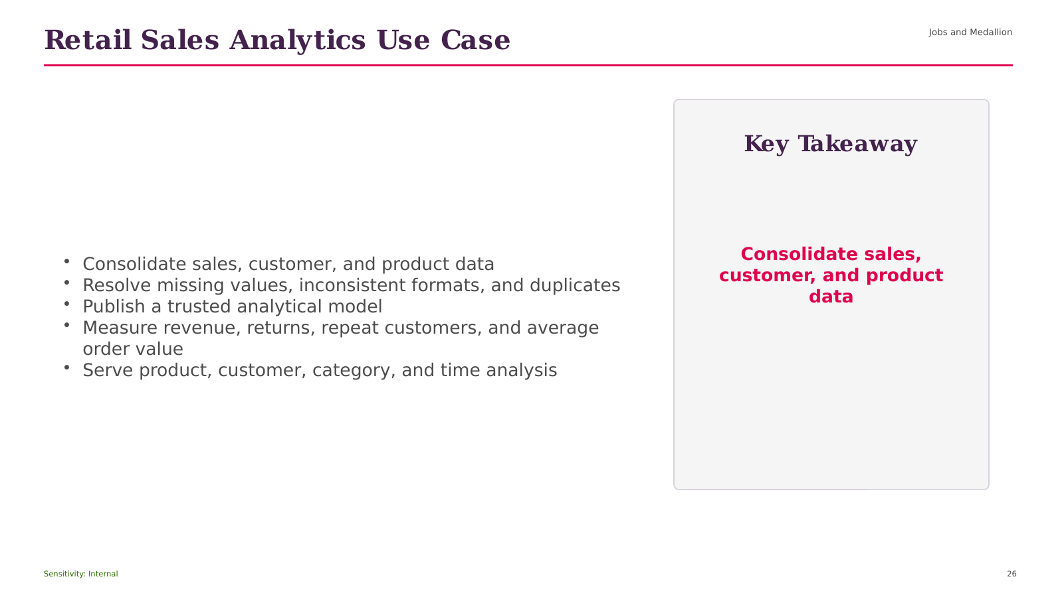
Notes:
Opening Statement
The purpose of this slide is to explain Retail Sales Analytics Use Case and connect it to practical Databricks delivery.
Explanation
The key points are Jobs and Medallion; Consolidate sales, customer, and product data; Resolve missing values, inconsistent formats, and duplicates; Publish a trusted analytical model; Measure revenue, returns, repeat customers, and average order value. Together, these ideas show how the capability supports a unified platform rather than an isolated technical feature. For beginner users, focus first on the role of the capability, the data or objects it manages, and the consumer that receives the result.
Practical Example
In a retail analytics solution, this concept can help ingest source data, apply consistent controls, publish trusted sales information, or serve governed analysis depending on the stage shown.
Business Relevance
The value is improved reliability, clearer ownership, faster delivery, and more consistent access to data.
Best Practice
Define naming, ownership, access, quality, and monitoring before production use.
Caution or Common Mistake
Do not treat platform automation as a replacement for testing, cost control, or operational support.
Audience Question
Where would this capability fit in your current data flow?
Transition
Next, we will explore Medallion Architecture.
Source: DATABRICKS#01+(1).pdf, page 14.
[Sources]
DATABRICKS#01+(1).pdf (attached).
Databricks_Training_Series_Clean_Doc1 1 11.pptx (attached).

Slide 27

Notes:
Opening Statement
This process view explains how Medallion Architecture works from left to right.
Explanation
The flow begins with Jobs and Medallion, then moves through the intermediate stages, and ends with a governed output for consumers. Each arrow represents a dependency or movement of data, not an automatic guarantee of orchestration. The main elements shown are Jobs and Medallion; Raw Files; Bronze; Silver; Gold. The expected output is reliable data that can be monitored, governed, and consumed by the next workload.
Practical Example
A retail pipeline can ingest new files, validate data, refine records, publish business metrics, and make the results available to dashboards.
Best Practice
Record ownership, quality checks, lineage, permissions, run status, and cost at each stage.
Caution or Common Mistake
Do not add dependencies without restart logic, monitoring, and clear failure handling.
Audience Question
Where would you place the most important quality gate in this flow?
Transition
Next, we will discuss Retail Analytics KPIs.
Source: DATABRICKS#01+(1).pdf, page 14.
[Sources]
DATABRICKS#01+(1).pdf (attached).
Databricks_Training_Series_Clean_Doc1 1 11.pptx (attached).

Slide 28
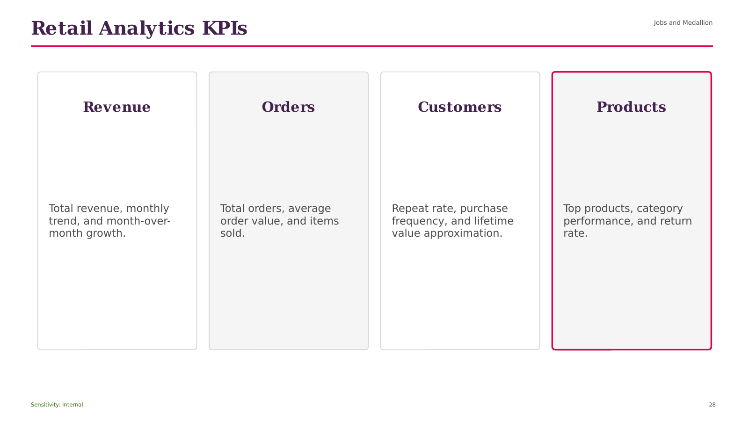
Notes:
Opening Statement
The purpose of this slide is to explain Retail Analytics KPIs and connect it to practical Databricks delivery.
Explanation
The key points are Jobs and Medallion; Revenue; Total revenue, monthly trend, and month-over-month growth; Orders; Total orders, average order value, and items sold. Together, these ideas show how the capability supports a unified platform rather than an isolated technical feature. For beginner users, focus first on the role of the capability, the data or objects it manages, and the consumer that receives the result.
Practical Example
In a retail analytics solution, this concept can help ingest source data, apply consistent controls, publish trusted sales information, or serve governed analysis depending on the stage shown.
Business Relevance
The value is improved reliability, clearer ownership, faster delivery, and more consistent access to data.
Best Practice
Define naming, ownership, access, quality, and monitoring before production use.
Caution or Common Mistake
Do not treat platform automation as a replacement for testing, cost control, or operational support.
Audience Question
Where would this capability fit in your current data flow?
Transition
Next, we will explore SECTION.
Source: DATABRICKS#01+(1).pdf, page 14.
[Sources]
DATABRICKS#01+(1).pdf (attached).
Databricks_Training_Series_Clean_Doc1 1 11.pptx (attached).

Slide 29
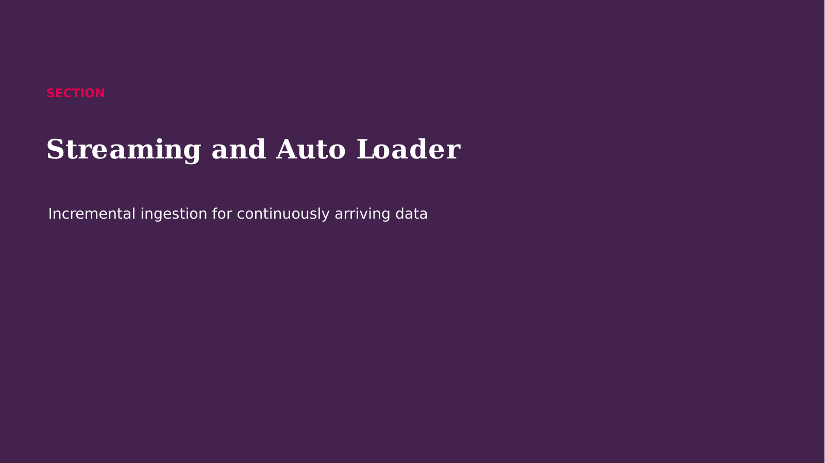
Notes:
Opening Statement
We are now moving into SECTION.
Explanation
This section builds on Retail Analytics KPIs and introduces the concepts needed for the next implementation decisions. We will focus on what each capability does, why it matters to a governed data platform, and how it fits into an end-to-end Databricks solution. Keep the business outcome in mind: reliable data, controlled access, efficient processing, and understandable operations.
Audience Question
What challenge do you currently face that this section may help solve?
Transition
Let us start with Batch Versus Structured Streaming.
Source: DATABRICKS#01+(1).pdf, page 16.
[Sources]
DATABRICKS#01+(1).pdf (attached).
Databricks_Training_Series_Clean_Doc1 1 11.pptx (attached).

Slide 30
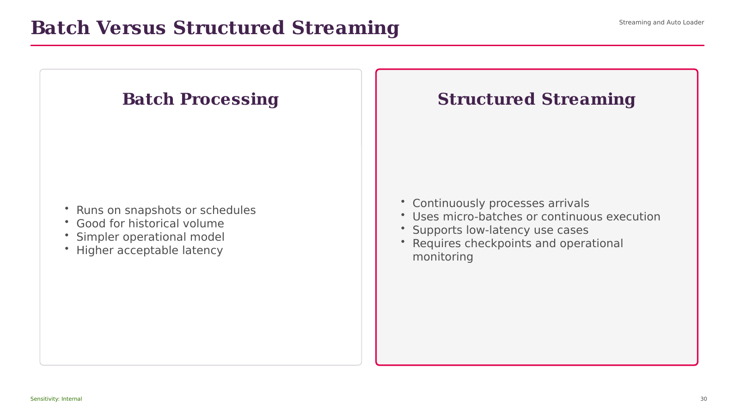
Notes:
Opening Statement
This comparison helps us choose between the alternatives presented under Batch Versus Structured Streaming.
Explanation
The left side begins with Streaming and Auto Loader, while the right side emphasizes Runs on snapshots or schedules. The choice should be based on workload pattern, scale, latency, governance, operational ownership, and cost. One option may provide greater control or simplicity, while the other may provide stronger management, automation, or continuous processing. Neither choice is universally correct.
Practical Example
For a modest scheduled file load, a simple batch pattern may be sufficient. For continuously arriving files at large scale, an incremental managed pattern is usually more appropriate.
Best Practice
Document the decision criteria and validate the choice using realistic volume and concurrency.
Caution or Common Mistake
Do not select a technology only because it is newer or more automated.
Audience Question
Which requirement would be the deciding factor in your environment?
Transition
Next, we will move to Structured Streaming Pattern.
Source: DATABRICKS#01+(1).pdf, page 16.
[Sources]
DATABRICKS#01+(1).pdf (attached).
Databricks_Training_Series_Clean_Doc1 1 11.pptx (attached).

Slide 31
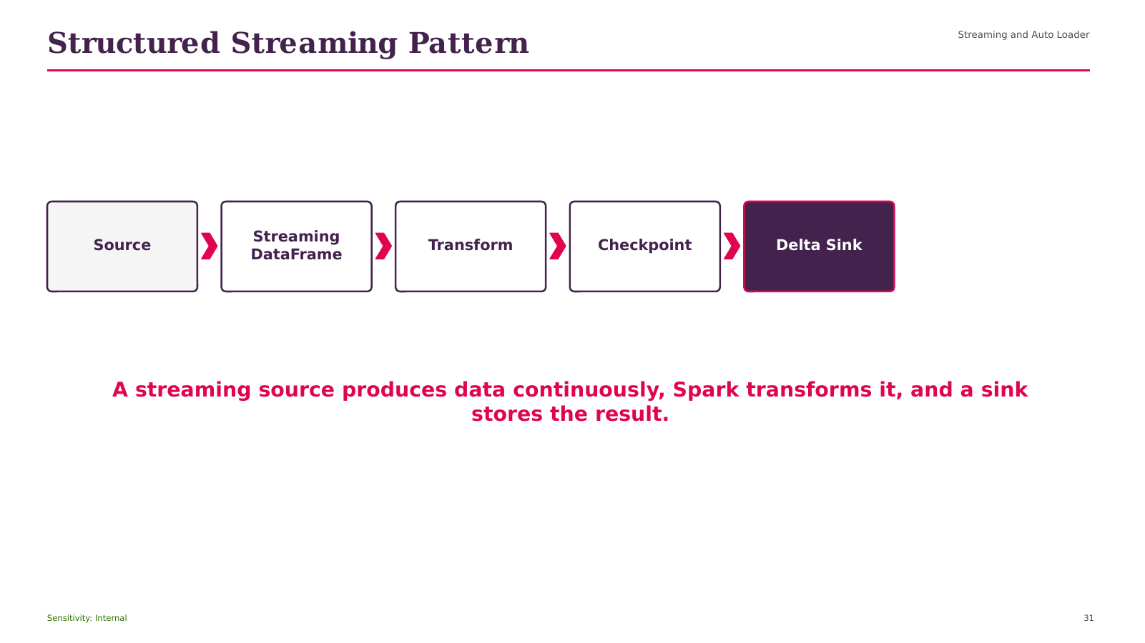
Notes:
Opening Statement
This process view explains how Structured Streaming Pattern works from left to right.
Explanation
The flow begins with Streaming and Auto Loader, then moves through the intermediate stages, and ends with a governed output for consumers. Each arrow represents a dependency or movement of data, not an automatic guarantee of orchestration. The main elements shown are Streaming and Auto Loader; Source; Streaming DataFrame; Transform; Checkpoint. The expected output is reliable data that can be monitored, governed, and consumed by the next workload.
Practical Example
A retail pipeline can ingest new files, validate data, refine records, publish business metrics, and make the results available to dashboards.
Best Practice
Record ownership, quality checks, lineage, permissions, run status, and cost at each stage.
Caution or Common Mistake
Do not add dependencies without restart logic, monitoring, and clear failure handling.
Audience Question
Where would you place the most important quality gate in this flow?
Transition
Next, we will discuss What Auto Loader Adds.
Source: DATABRICKS#01+(1).pdf, page 17.
[Sources]
DATABRICKS#01+(1).pdf (attached).
Databricks_Training_Series_Clean_Doc1 1 11.pptx (attached).

Slide 32
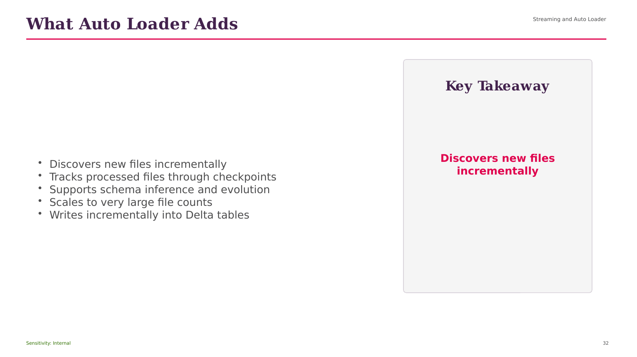
Notes:
Opening Statement
The purpose of this slide is to explain What Auto Loader Adds and connect it to practical Databricks delivery.
Explanation
The key points are Streaming and Auto Loader; Discovers new files incrementally; Tracks processed files through checkpoints; Supports schema inference and evolution; Scales to very large file counts. Together, these ideas show how the capability supports a unified platform rather than an isolated technical feature. For beginner users, focus first on the role of the capability, the data or objects it manages, and the consumer that receives the result.
Practical Example
In a retail analytics solution, this concept can help ingest source data, apply consistent controls, publish trusted sales information, or serve governed analysis depending on the stage shown.
Business Relevance
The value is improved reliability, clearer ownership, faster delivery, and more consistent access to data.
Best Practice
Define naming, ownership, access, quality, and monitoring before production use.
Caution or Common Mistake
Do not treat platform automation as a replacement for testing, cost control, or operational support.
Audience Question
Where would this capability fit in your current data flow?
Transition
Next, we will explore Checkpointing and Recovery.
Source: DATABRICKS#01+(1).pdf, page 18.
[Sources]
DATABRICKS#01+(1).pdf (attached).
Databricks_Training_Series_Clean_Doc1 1 11.pptx (attached).

Slide 33
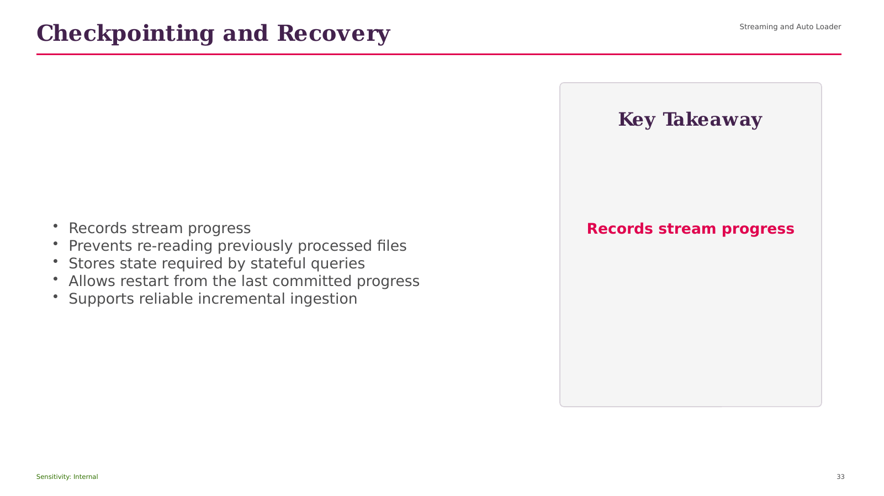
Notes:
Opening Statement
The purpose of this slide is to explain Checkpointing and Recovery and connect it to practical Databricks delivery.
Explanation
The key points are Streaming and Auto Loader; Records stream progress; Prevents re-reading previously processed files; Stores state required by stateful queries; Allows restart from the last committed progress. Together, these ideas show how the capability supports a unified platform rather than an isolated technical feature. For beginner users, focus first on the role of the capability, the data or objects it manages, and the consumer that receives the result.
Practical Example
In a retail analytics solution, this concept can help ingest source data, apply consistent controls, publish trusted sales information, or serve governed analysis depending on the stage shown.
Business Relevance
The value is improved reliability, clearer ownership, faster delivery, and more consistent access to data.
Best Practice
Define naming, ownership, access, quality, and monitoring before production use.
Caution or Common Mistake
Do not treat platform automation as a replacement for testing, cost control, or operational support.
Audience Question
Where would this capability fit in your current data flow?
Transition
Next, we will explore Auto Loader Pattern.
Source: DATABRICKS#01+(1).pdf, page 19.
[Sources]
DATABRICKS#01+(1).pdf (attached).
Databricks_Training_Series_Clean_Doc1 1 11.pptx (attached).

Slide 34
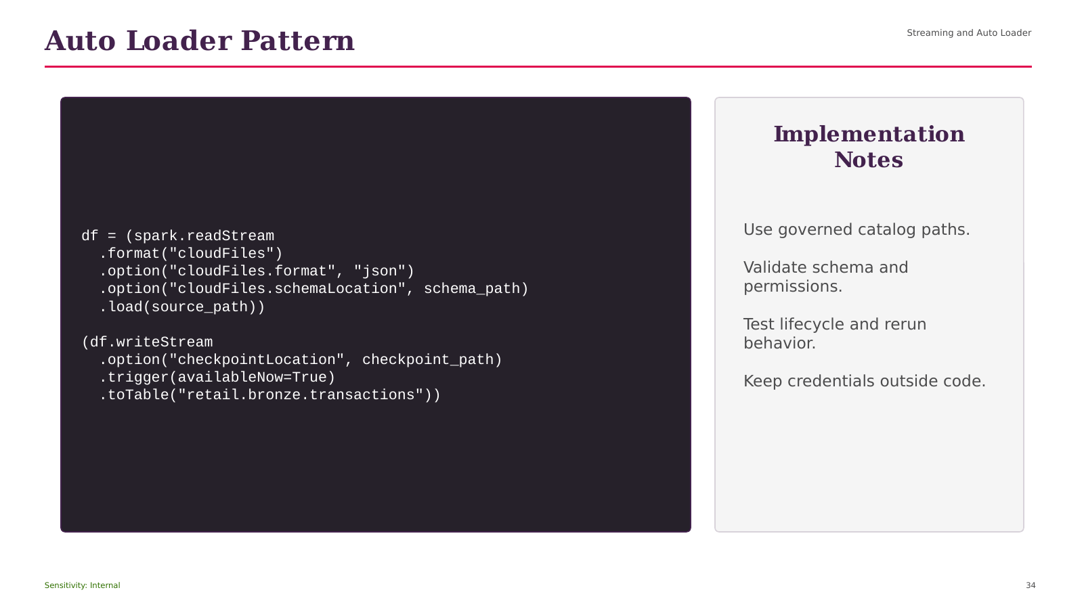
Notes:
Opening Statement
This demonstration translates Auto Loader Pattern into an implementation pattern that can be tested in a Databricks workspace.
Explanation
Read the code in logical sections. First, identify the target catalog, schema, table, volume, source path, schema location, or checkpoint location. Next, review how the operation creates or writes the governed object. Finally, confirm the expected result and lifecycle behavior. The visible example includes Streaming and Auto Loader df = (spark.readStream. Replace sample names and paths with values approved for your environment.
Practical Example
Run the example in a development catalog, validate the schema and row counts, and confirm that the expected table or stream is created.
Best Practice
Use explicit schemas, governed locations, version control, and separate development and production configuration.
Caution or Common Mistake
A wrong path, missing permission, reused checkpoint, or unintended write mode can fail the run or affect existing data.
Audience Question
Which values in this example must be environment-specific?
Transition
Next, we will examine Schema Inference and Evolution.
Source: DATABRICKS#01+(1).pdf, page 18.
[Sources]
DATABRICKS#01+(1).pdf (attached).
Databricks_Training_Series_Clean_Doc1 1 11.pptx (attached).

Slide 35
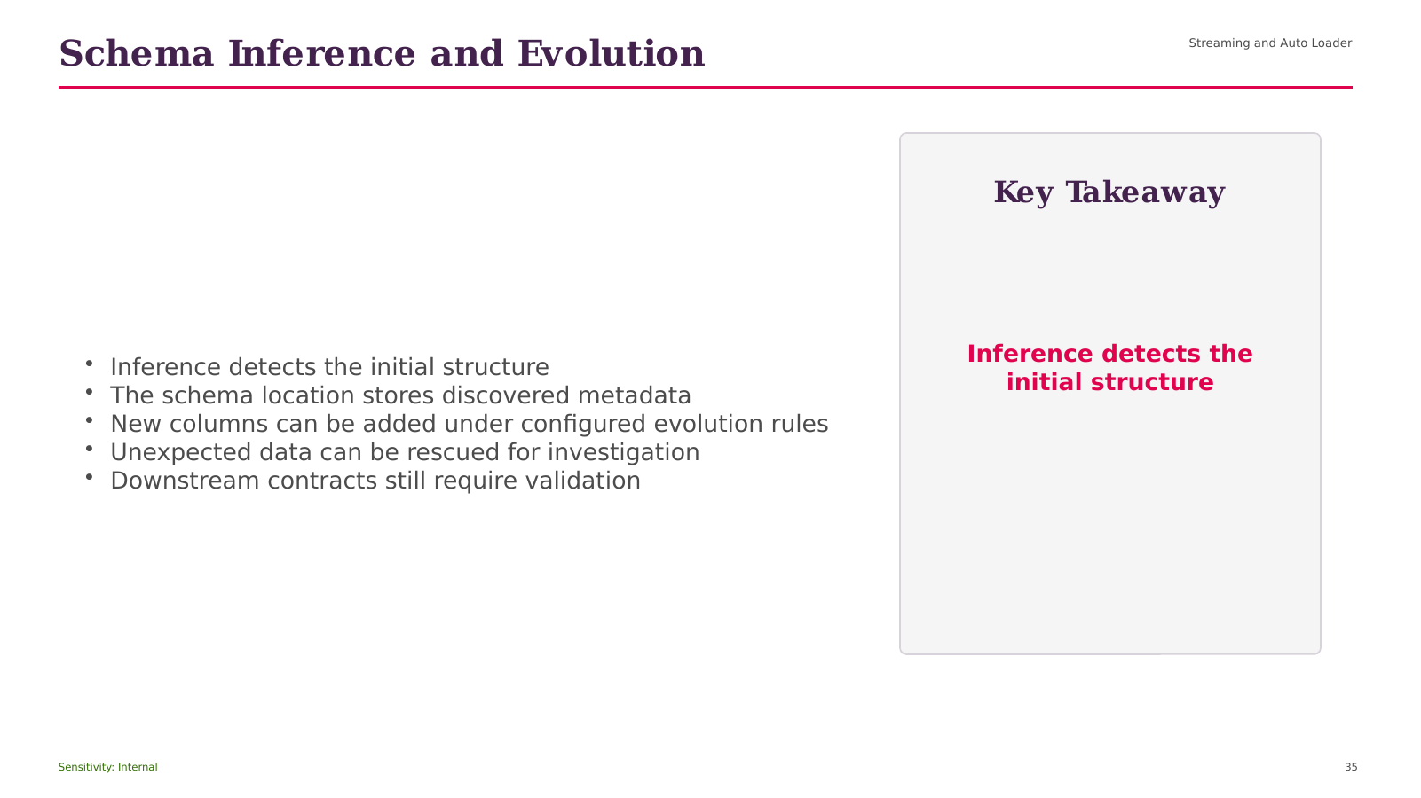
Notes:
Opening Statement
The purpose of this slide is to explain Schema Inference and Evolution and connect it to practical Databricks delivery.
Explanation
The key points are Streaming and Auto Loader; Inference detects the initial structure; The schema location stores discovered metadata; New columns can be added under configured evolution rules; Unexpected data can be rescued for investigation. Together, these ideas show how the capability supports a unified platform rather than an isolated technical feature. For beginner users, focus first on the role of the capability, the data or objects it manages, and the consumer that receives the result.
Practical Example
In a retail analytics solution, this concept can help ingest source data, apply consistent controls, publish trusted sales information, or serve governed analysis depending on the stage shown.
Business Relevance
The value is improved reliability, clearer ownership, faster delivery, and more consistent access to data.
Best Practice
Define naming, ownership, access, quality, and monitoring before production use.
Caution or Common Mistake
Do not treat platform automation as a replacement for testing, cost control, or operational support.
Audience Question
Where would this capability fit in your current data flow?
Transition
Next, we will explore SECTION.
Source: DATABRICKS#01+(1).pdf, page 20.
[Sources]
DATABRICKS#01+(1).pdf (attached).
Databricks_Training_Series_Clean_Doc1 1 11.pptx (attached).

Slide 36
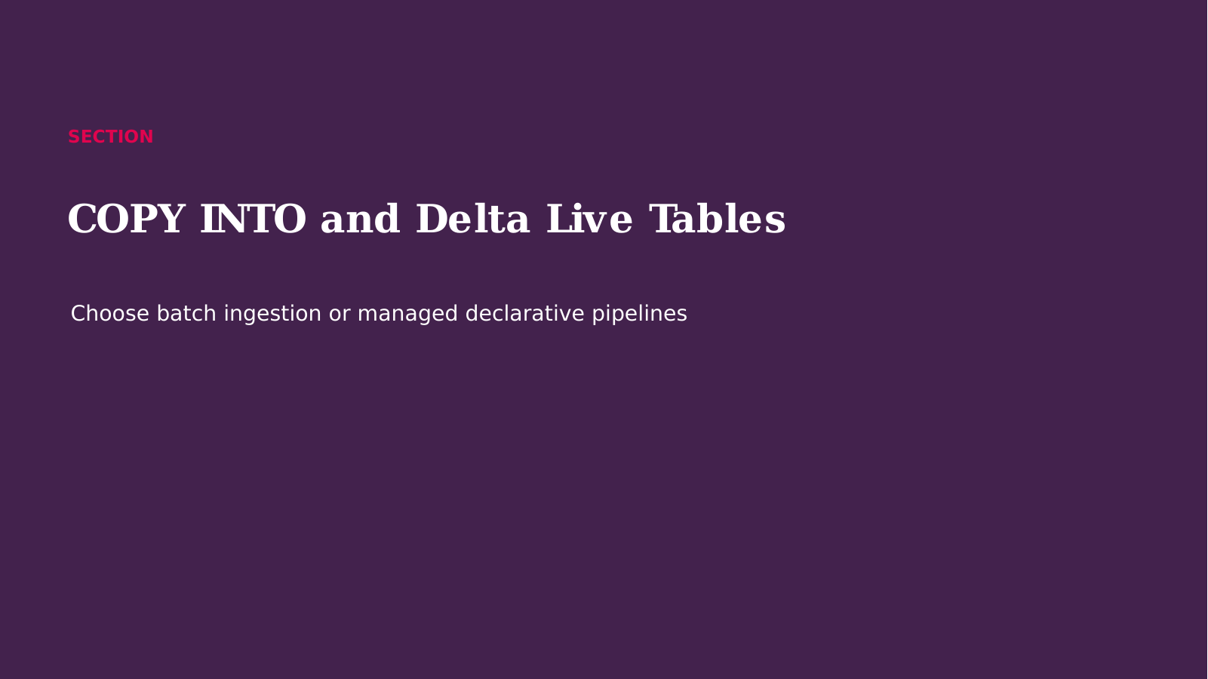
Notes:
Opening Statement
We are now moving into SECTION.
Explanation
This section builds on Schema Inference and Evolution and introduces the concepts needed for the next implementation decisions. We will focus on what each capability does, why it matters to a governed data platform, and how it fits into an end-to-end Databricks solution. Keep the business outcome in mind: reliable data, controlled access, efficient processing, and understandable operations.
Audience Question
What challenge do you currently face that this section may help solve?
Transition
Let us start with COPY INTO Versus Auto Loader.
Source: DATABRICKS#01+(1).pdf, page 21.
[Sources]
DATABRICKS#01+(1).pdf (attached).
Databricks_Training_Series_Clean_Doc1 1 11.pptx (attached).

Slide 37
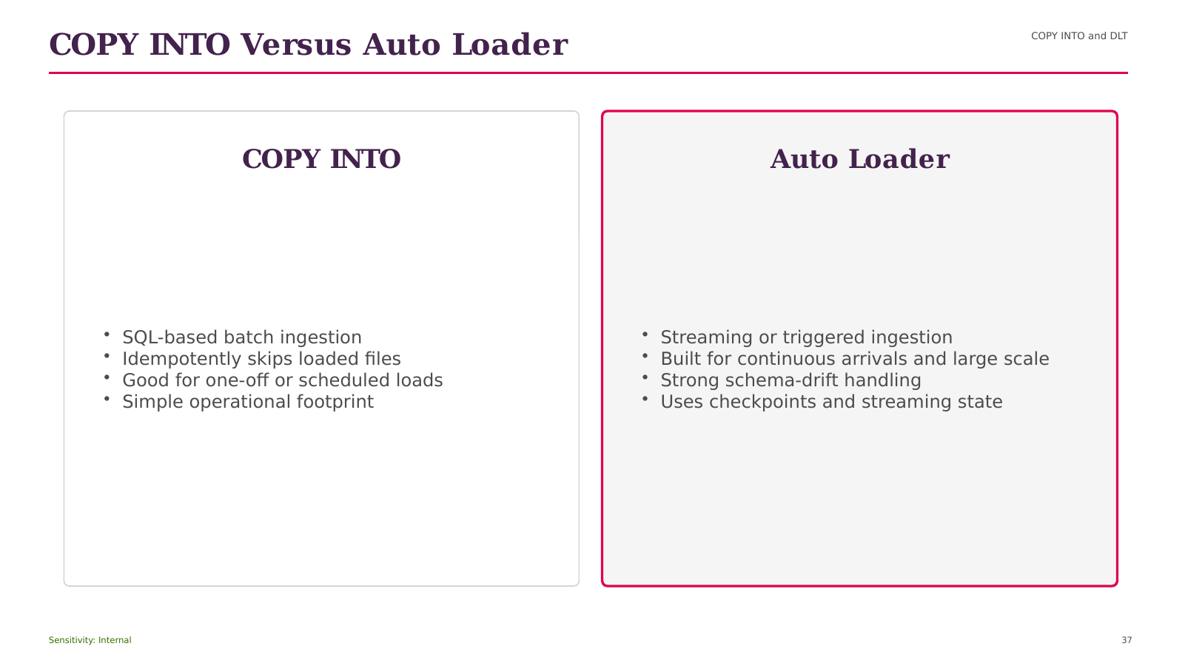
Notes:
Opening Statement
This comparison helps us choose between the alternatives presented under COPY INTO Versus Auto Loader.
Explanation
The left side begins with COPY INTO and DLT, while the right side emphasizes SQL-based batch ingestion. The choice should be based on workload pattern, scale, latency, governance, operational ownership, and cost. One option may provide greater control or simplicity, while the other may provide stronger management, automation, or continuous processing. Neither choice is universally correct.
Practical Example
For a modest scheduled file load, a simple batch pattern may be sufficient. For continuously arriving files at large scale, an incremental managed pattern is usually more appropriate.
Best Practice
Document the decision criteria and validate the choice using realistic volume and concurrency.
Caution or Common Mistake
Do not select a technology only because it is newer or more automated.
Audience Question
Which requirement would be the deciding factor in your environment?
Transition
Next, we will move to What Are Delta Live Tables?.
Source: DATABRICKS#01+(1).pdf, page 21.
[Sources]
DATABRICKS#01+(1).pdf (attached).
Databricks_Training_Series_Clean_Doc1 1 11.pptx (attached).

Slide 38
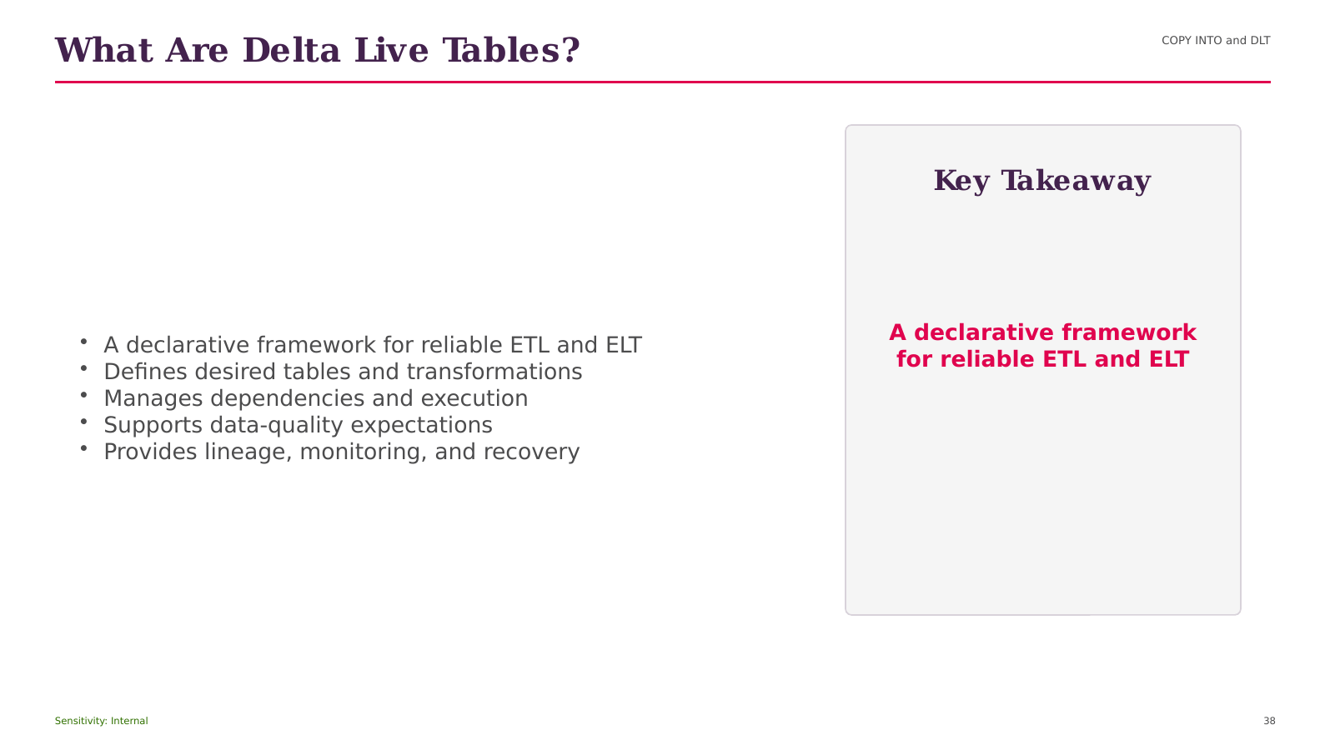
Notes:
Opening Statement
The purpose of this slide is to explain What Are Delta Live Tables? and connect it to practical Databricks delivery.
Explanation
The key points are COPY INTO and DLT; A declarative framework for reliable ETL and ELT; Defines desired tables and transformations; Manages dependencies and execution; Supports data-quality expectations. Together, these ideas show how the capability supports a unified platform rather than an isolated technical feature. For beginner users, focus first on the role of the capability, the data or objects it manages, and the consumer that receives the result.
Practical Example
In a retail analytics solution, this concept can help ingest source data, apply consistent controls, publish trusted sales information, or serve governed analysis depending on the stage shown.
Business Relevance
The value is improved reliability, clearer ownership, faster delivery, and more consistent access to data.
Best Practice
Define naming, ownership, access, quality, and monitoring before production use.
Caution or Common Mistake
Do not treat platform automation as a replacement for testing, cost control, or operational support.
Audience Question
Where would this capability fit in your current data flow?
Transition
Next, we will explore DLT Dependency Flow.
Source: DATABRICKS#01+(1).pdf, page 22.
[Sources]
DATABRICKS#01+(1).pdf (attached).
Databricks_Training_Series_Clean_Doc1 1 11.pptx (attached).

Slide 39

Notes:
Opening Statement
This process view explains how Delta Live Tables (DLT) Dependency Flow works from left to right.
Explanation
The flow begins with COPY INTO and DLT, then moves through the intermediate stages, and ends with a governed output for consumers. Each arrow represents a dependency or movement of data, not an automatic guarantee of orchestration. The main elements shown are COPY INTO and DLT; Source; Bronze Table; Quality Gate; Silver Table. The expected output is reliable data that can be monitored, governed, and consumed by the next workload.
Practical Example
A retail pipeline can ingest new files, validate data, refine records, publish business metrics, and make the results available to dashboards.
Best Practice
Record ownership, quality checks, lineage, permissions, run status, and cost at each stage.
Caution or Common Mistake
Do not add dependencies without restart logic, monitoring, and clear failure handling.
Audience Question
Where would you place the most important quality gate in this flow?
Transition
Next, we will discuss DLT Use Cases.
Source: DATABRICKS#01+(1).pdf, page 22.
[Sources]
DATABRICKS#01+(1).pdf (attached).
Databricks_Training_Series_Clean_Doc1 1 11.pptx (attached).

Slide 40
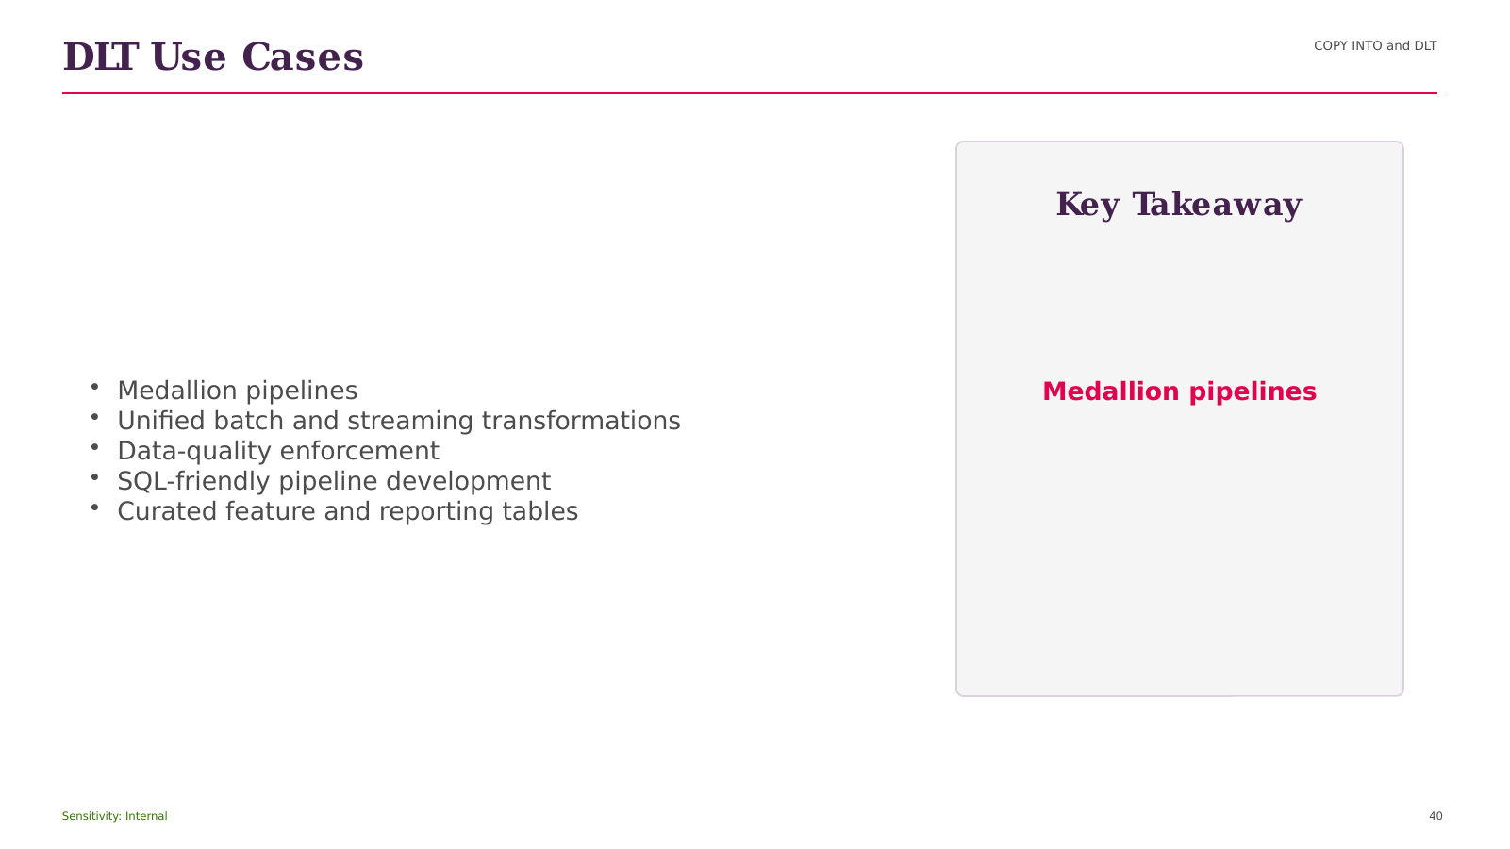
Notes:
Opening Statement
The purpose of this slide is to explain Delta Live Tables (DLT) Use Cases and connect it to practical Databricks delivery.
Explanation
The key points are COPY INTO and DLT; Medallion pipelines; Unified batch and streaming transformations; Data-quality enforcement; SQL-friendly pipeline development. Together, these ideas show how the capability supports a unified platform rather than an isolated technical feature. For beginner users, focus first on the role of the capability, the data or objects it manages, and the consumer that receives the result.
Practical Example
In a retail analytics solution, this concept can help ingest source data, apply consistent controls, publish trusted sales information, or serve governed analysis depending on the stage shown.
Business Relevance
The value is improved reliability, clearer ownership, faster delivery, and more consistent access to data.
Best Practice
Define naming, ownership, access, quality, and monitoring before production use.
Caution or Common Mistake
Do not treat platform automation as a replacement for testing, cost control, or operational support.
Audience Question
Where would this capability fit in your current data flow?
Transition
Next, we will explore DLT Versus Traditional Jobs.
Source: DATABRICKS#01+(1).pdf, page 24.
[Sources]
DATABRICKS#01+(1).pdf (attached).
Databricks_Training_Series_Clean_Doc1 1 11.pptx (attached).

Slide 41
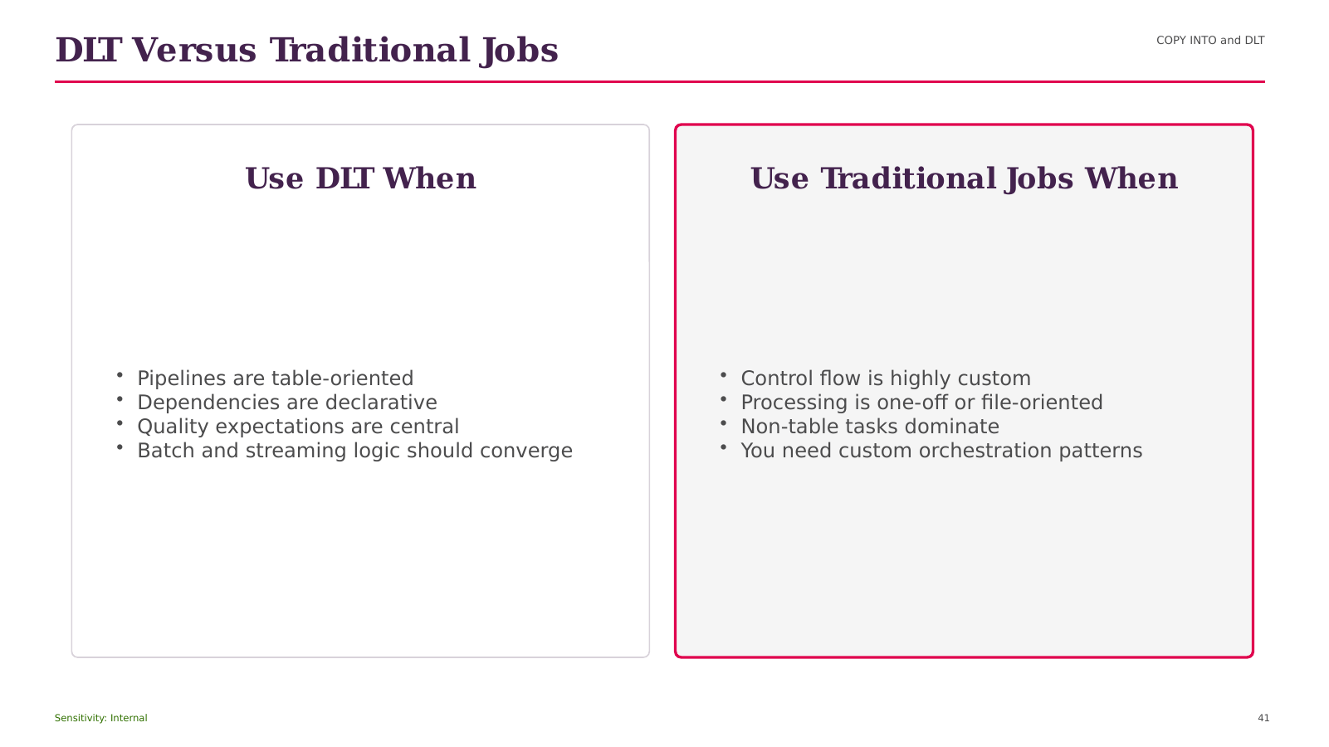
Notes:
Opening Statement
This comparison helps us choose between the alternatives presented under Delta Live Tables (DLT) Versus Traditional Jobs.
Explanation
The left side begins with COPY INTO and DLT, while the right side emphasizes Pipelines are table-oriented. The choice should be based on workload pattern, scale, latency, governance, operational ownership, and cost. One option may provide greater control or simplicity, while the other may provide stronger management, automation, or continuous processing. Neither choice is universally correct.
Practical Example
For a modest scheduled file load, a simple batch pattern may be sufficient. For continuously arriving files at large scale, an incremental managed pattern is usually more appropriate.
Best Practice
Document the decision criteria and validate the choice using realistic volume and concurrency.
Caution or Common Mistake
Do not select a technology only because it is newer or more automated.
Audience Question
Which requirement would be the deciding factor in your environment?
Transition
Next, we will move to SECTION.
Source: DATABRICKS#01+(1).pdf, page 25.
[Sources]
DATABRICKS#01+(1).pdf (attached).
Databricks_Training_Series_Clean_Doc1 1 11.pptx (attached).

Slide 42
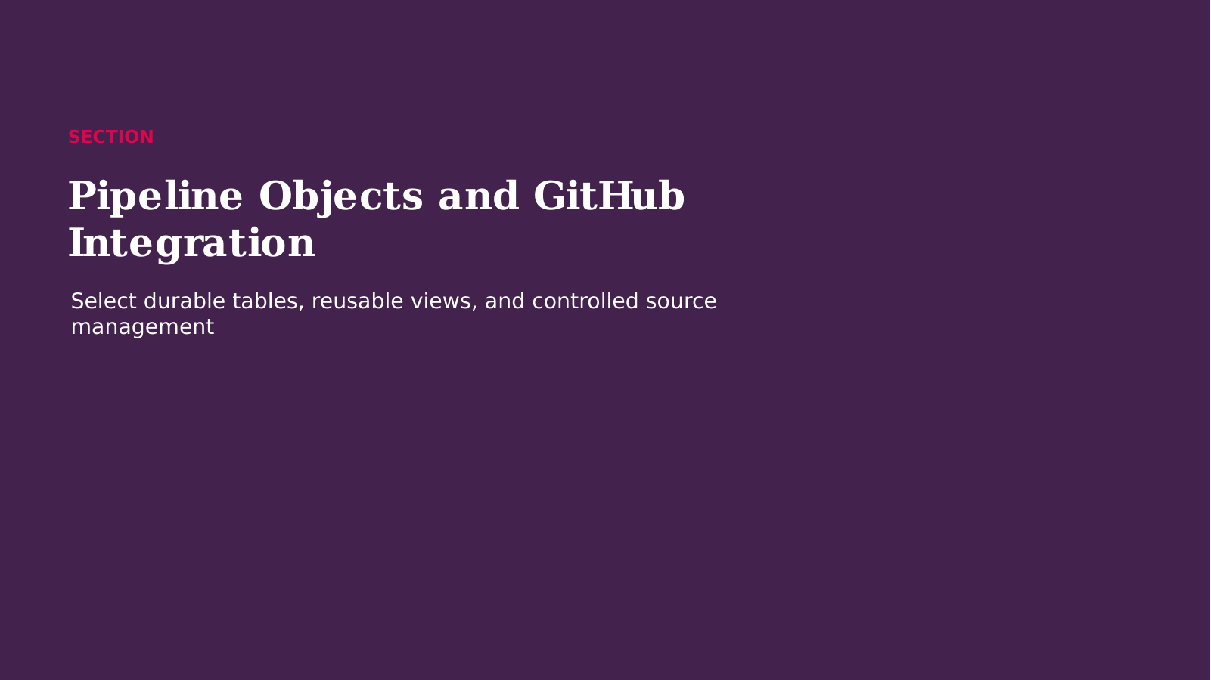
Notes:
Opening Statement
We are now moving into SECTION.
Explanation
This section builds on DLT Versus Traditional Jobs and introduces the concepts needed for the next implementation decisions. We will focus on what each capability does, why it matters to a governed data platform, and how it fits into an end-to-end Databricks solution. Keep the business outcome in mind: reliable data, controlled access, efficient processing, and understandable operations.
Audience Question
What challenge do you currently face that this section may help solve?
Transition
Let us start with Streaming Tables, Materialized Views, and Views.
Source: DATABRICKS#01+(1).pdf, page 26.
[Sources]
DATABRICKS#01+(1).pdf (attached).
Databricks_Training_Series_Clean_Doc1 1 11.pptx (attached).

Slide 43
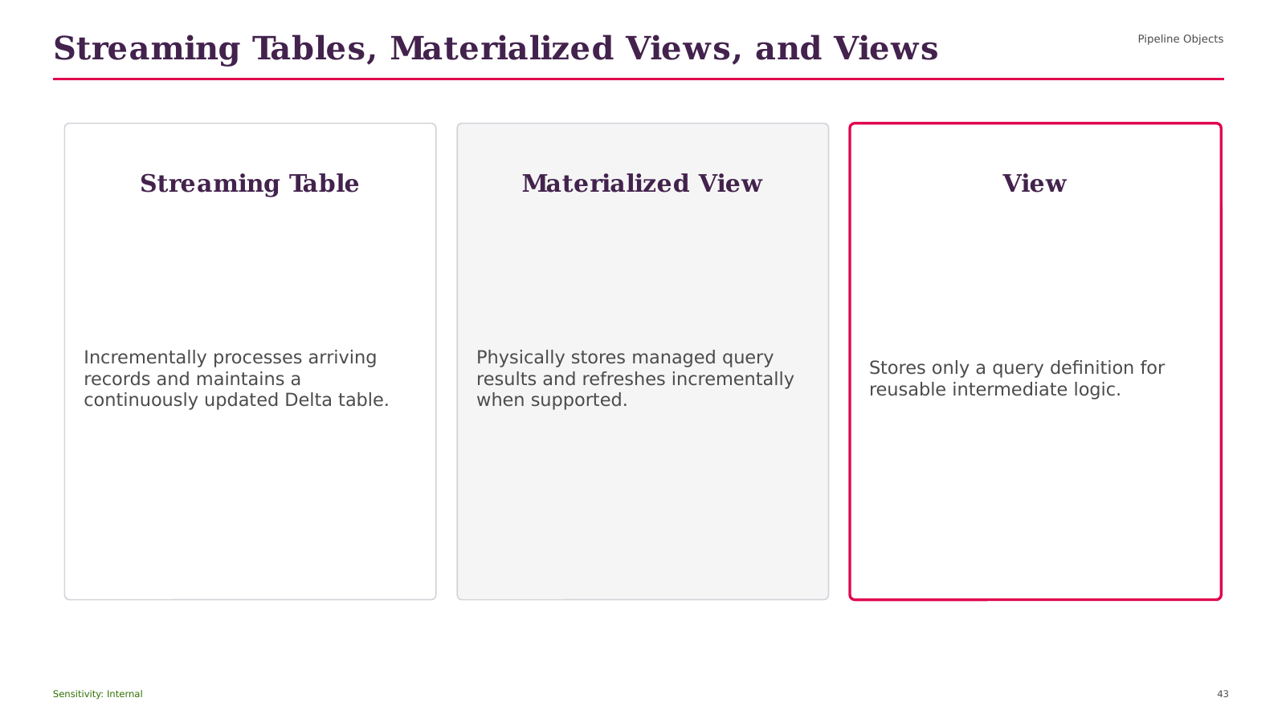
Notes:
Opening Statement
The purpose of this slide is to explain Streaming Tables, Materialized Views, and Views and connect it to practical Databricks delivery.
Explanation
The key points are Pipeline Objects; Streaming Table; Incrementally processes arriving records and maintains a continuously updated Delta table; Materialized View; Physically stores managed query results and refreshes incrementally when supported. Together, these ideas show how the capability supports a unified platform rather than an isolated technical feature. For beginner users, focus first on the role of the capability, the data or objects it manages, and the consumer that receives the result.
Practical Example
In a retail analytics solution, this concept can help ingest source data, apply consistent controls, publish trusted sales information, or serve governed analysis depending on the stage shown.
Business Relevance
The value is improved reliability, clearer ownership, faster delivery, and more consistent access to data.
Best Practice
Define naming, ownership, access, quality, and monitoring before production use.
Caution or Common Mistake
Do not treat platform automation as a replacement for testing, cost control, or operational support.
Audience Question
Where would this capability fit in your current data flow?
Transition
Next, we will explore Choose the Right Pipeline Object.
Source: DATABRICKS#01+(1).pdf, page 26.
[Sources]
DATABRICKS#01+(1).pdf (attached).
Databricks_Training_Series_Clean_Doc1 1 11.pptx (attached).

Slide 44
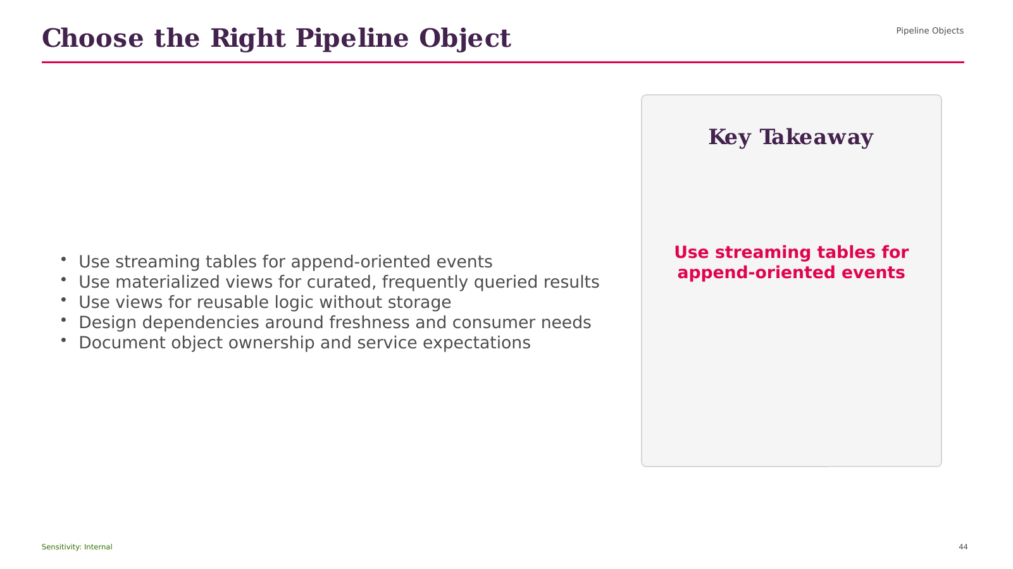
Notes:
Opening Statement
The purpose of this slide is to explain Choose the Right Pipeline Object and connect it to practical Databricks delivery.
Explanation
The key points are Pipeline Objects; Use streaming tables for append-oriented events; Use materialized views for curated, frequently queried results; Use views for reusable logic without storage; Design dependencies around freshness and consumer needs. Together, these ideas show how the capability supports a unified platform rather than an isolated technical feature. For beginner users, focus first on the role of the capability, the data or objects it manages, and the consumer that receives the result.
Practical Example
In a retail analytics solution, this concept can help ingest source data, apply consistent controls, publish trusted sales information, or serve governed analysis depending on the stage shown.
Business Relevance
The value is improved reliability, clearer ownership, faster delivery, and more consistent access to data.
Best Practice
Define naming, ownership, access, quality, and monitoring before production use.
Caution or Common Mistake
Do not treat platform automation as a replacement for testing, cost control, or operational support.
Audience Question
Where would this capability fit in your current data flow?
Transition
Next, we will explore GitHub and Databricks Workflow.
Source: DATABRICKS#01+(1).pdf, page 27.
[Sources]
DATABRICKS#01+(1).pdf (attached).
Databricks_Training_Series_Clean_Doc1 1 11.pptx (attached).

Slide 45

Notes:
Opening Statement
This process view explains how GitHub and Databricks Workflow works from left to right.
Explanation
The flow begins with Pipeline Objects, then moves through the intermediate stages, and ends with a governed output for consumers. Each arrow represents a dependency or movement of data, not an automatic guarantee of orchestration. The main elements shown are Pipeline Objects; Git Repository; Feature Branch; Databricks Workspace; Pull Request. The expected output is reliable data that can be monitored, governed, and consumed by the next workload.
Practical Example
A retail pipeline can ingest new files, validate data, refine records, publish business metrics, and make the results available to dashboards.
Best Practice
Record ownership, quality checks, lineage, permissions, run status, and cost at each stage.
Caution or Common Mistake
Do not add dependencies without restart logic, monitoring, and clear failure handling.
Audience Question
Where would you place the most important quality gate in this flow?
Transition
Next, we will discuss Implementation Checklist.
Source: DATABRICKS#01+(1).pdf, page 28.
[Sources]
DATABRICKS#01+(1).pdf (attached).
Databricks_Training_Series_Clean_Doc1 1 11.pptx (attached).

Slide 46
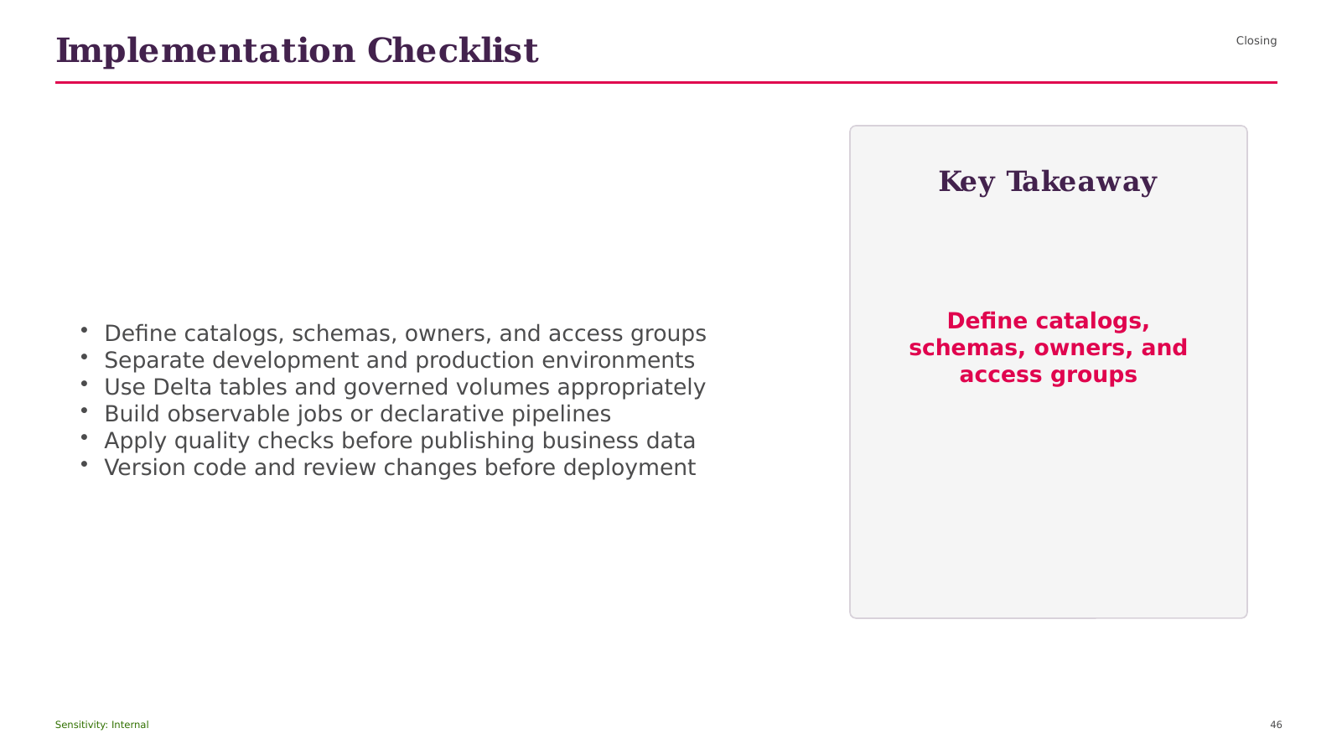
Notes:
Opening Statement
The purpose of this slide is to explain Implementation Checklist and connect it to practical Databricks delivery.
Explanation
The key points are Closing; Define catalogs, schemas, owners, and access groups; Separate development and production environments; Use Delta tables and governed volumes appropriately; Build observable jobs or declarative pipelines. Together, these ideas show how the capability supports a unified platform rather than an isolated technical feature. For beginner users, focus first on the role of the capability, the data or objects it manages, and the consumer that receives the result.
Practical Example
In a retail analytics solution, this concept can help ingest source data, apply consistent controls, publish trusted sales information, or serve governed analysis depending on the stage shown.
Business Relevance
The value is improved reliability, clearer ownership, faster delivery, and more consistent access to data.
Best Practice
Define naming, ownership, access, quality, and monitoring before production use.
Caution or Common Mistake
Do not treat platform automation as a replacement for testing, cost control, or operational support.
Audience Question
Where would this capability fit in your current data flow?
Transition
Next, we will explore Thank You.
Source: DATABRICKS#01+(1).pdf, page 29.
[Sources]
DATABRICKS#01+(1).pdf (attached).
Databricks_Training_Series_Clean_Doc1 1 11.pptx (attached).

Slide 47

Notes:
Opening Statement
We have reached the end of the Databricks Training Series.
Explanation
We covered the unified platform, lakehouse architecture, Unity Catalog governance, tables and volumes, federation, Databricks SQL, Jobs, the Medallion pattern, Structured Streaming, Auto Loader, COPY INTO, Delta Live Tables, pipeline objects, and GitHub integration. The most important takeaway is that reliable delivery depends on architecture, governance, quality, monitoring, and ownership working together.
Practical Next Step
Select one small dataset and build a governed Bronze-to-Gold proof of concept with clear quality checks.
Audience Question
Which concept would you like to revisit or demonstrate next?
Transition
Let us move into questions and discussion.
Source: DATABRICKS#01+(1).pdf, page 29.
[Sources]
DATABRICKS#01+(1).pdf (attached).
Databricks_Training_Series_Clean_Doc1 1 11.pptx (attached).

