Slide 1
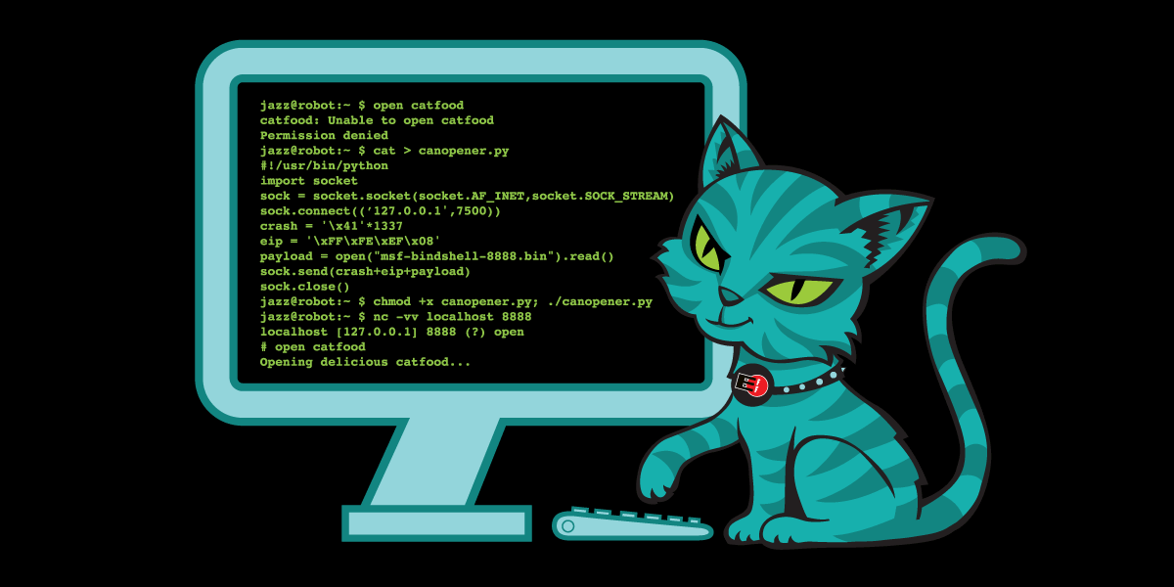
Hacking like an Advanced Persistent Threat
Maybe...
At least a little bit.
Notes:
Click to add Notes

Slide 2
#whoami
Introduced to a certain cookbook around 2002-2004. General interest in computers and security since ~2008
Saw Hackers (1995) and thought “that’d be cool”
Worked professionally managing L2/L3 (some L4) network equipment.
Moved to SOC work from networking.
Still generally support SOC work, but no longer an SOC analyst.
Like: Malware.
Like: Books.
Don’t like: People who target things like the Internet Archive :)
Notes:
Click to add Notes

Slide 3
#what is this
We’ll be working through a thought experiment and planning out an adversarial campaign based on public documentation and intel tracking standards.
Sources we’ll be using:
- MITRE ATT&CK
- NSA/CSS TCTFv2 (Technical Cyber Threat Framework v2)
Maybe we’ll be able to get to:
- Diamond Model of Intrusion Analysis
Notes:
Click to add Notes

Slide 4
#history
“Fifth Dimension” as a domain of warfare since 1996.
Adapted by Intelligence Community; development of “cyber” operations since.
Lots of money spent.
Over the years, public threat intelligence has evolved and information has been open sources through FOIA and other public releases.
Notes:
Click to add Notes

Slide 5
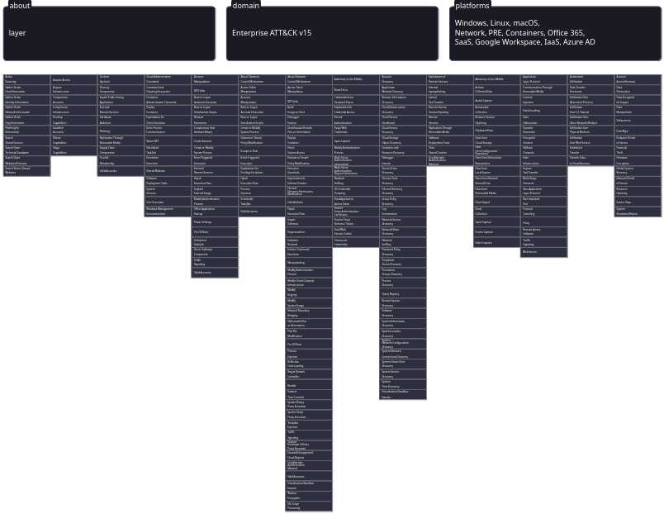
#MITRE ATT&CK
Notes:
Click to add Notes

Slide 6
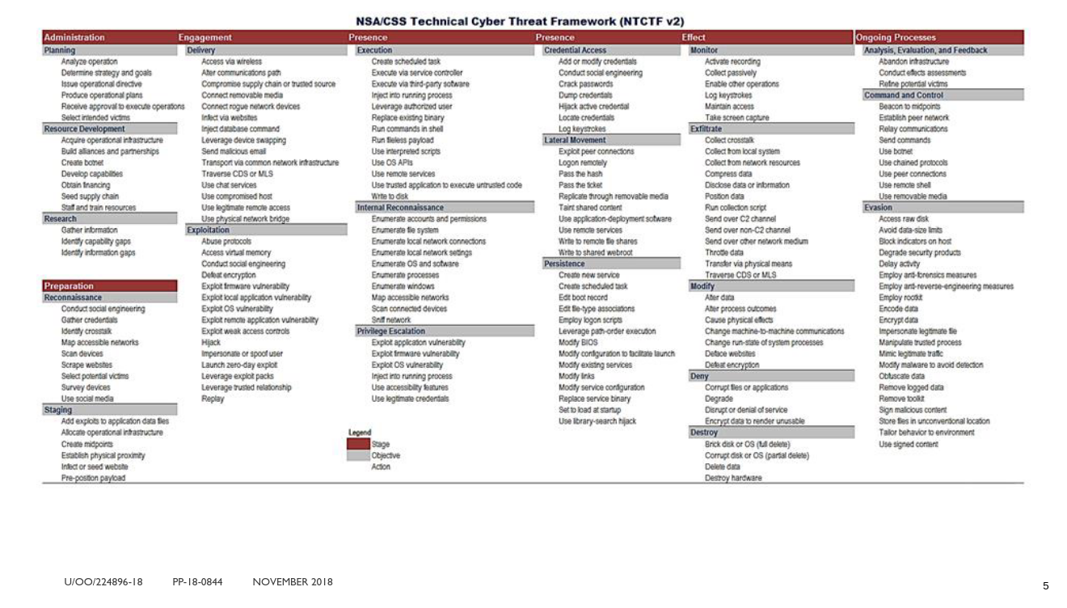
Notes:
Click to add Notes

Slide 7
#building our campaign
Choosing a cover name for our operation. Interesting read: NICKA Cover Names / Nick Names https://archive.is/hZqZu https://www.twz.com/29353/how-the-pentagon-comes-up-with-all-those-secret-project-nicknames-and-crazy-code-words
Notes:
Click to add Notes

Slide 8
#designing our campaign
Done with the slides now :)
Time to make some teams and go through the NSA/CSS TCTFv2.
Notes:
Click to add Notes

