Slide 1

Rajhans Kumar rajhans.kumar@dnata.com

Slide 2
About Apache Sqoop
Sqoop got the name from SQL + HADOOP = SQOOP
Sqoop is an Data Ingestion open source software product of the Apache Software Foundation.
Apache Sqoop is a tool designed for efficiently transferring bulk data between Apache Hadoop and structured data stores such as RDBMS/Mainframe.
Sqoop supports incremental loads of a single table or a free form SQL query, saved jobs which can be run multiple times to import updates made to a database since the last import.
Sqoop uses MapReduce to import and export the data, which provides parallel operation as well as fault tolerance.
There are many tools available for data ingestion like Apache Sqoop, Apache Kafka, Apache NIFI, Wavefront, DataTorrent, Amazon Kinesis, Apache Storm, Syncsort, Gobblin, Apache Flume, Apache Samza, Fluentd, Wavefront, Cloudera Morphlines, White Elephant, Apache Chukwa, Heka.

Slide 3
Sqoop– Key Features
Full Load
Apache Sqoop can load the whole table/all the tables by a single command.
Incremental Load
Apache Sqoop also provides the facility of incremental load where we can load parts of table whenever it is updated.
Parallel import/export
Sqoop uses YARN framework to import and export the data, which provides fault tolerance on top of parallelism.
Import results of SQL query
Sqoop can also import the result returned from an SQL query in HDFS.
Compression
Sqoop can compress your data by using deflate(gzip) algorithm with –compress/–compression-codec argument.
Load data directly into HIVE/HBase
Sqoop can load data directly into Apache Hive/HBase for further analysis and processing.
Connectivity with all major RDBMS
Apache Sqoop provides connectors for almost all RDBMS databases like MYSQL, ORACLE and POSTGRESS.

Slide 4
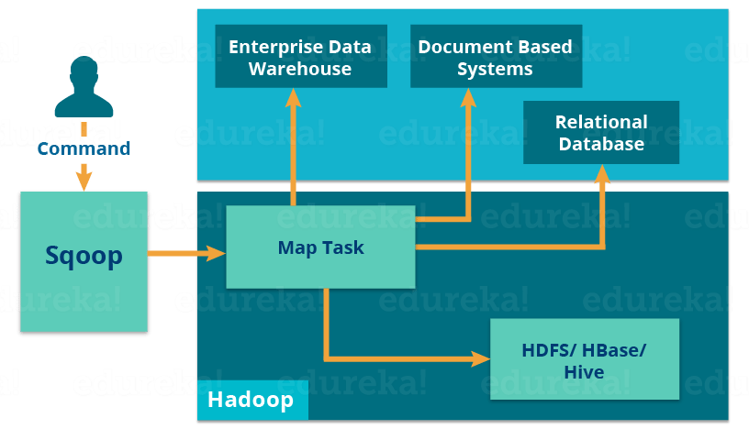
Sqoop Architecture

Slide 5
Sqoop Important commands with example

Slide 6
Everything about Apache Sqoop @
https://sqoop.apache.org/docs/1.4.7/SqoopUserGuide.html
Thank You !!!

