Slide 1
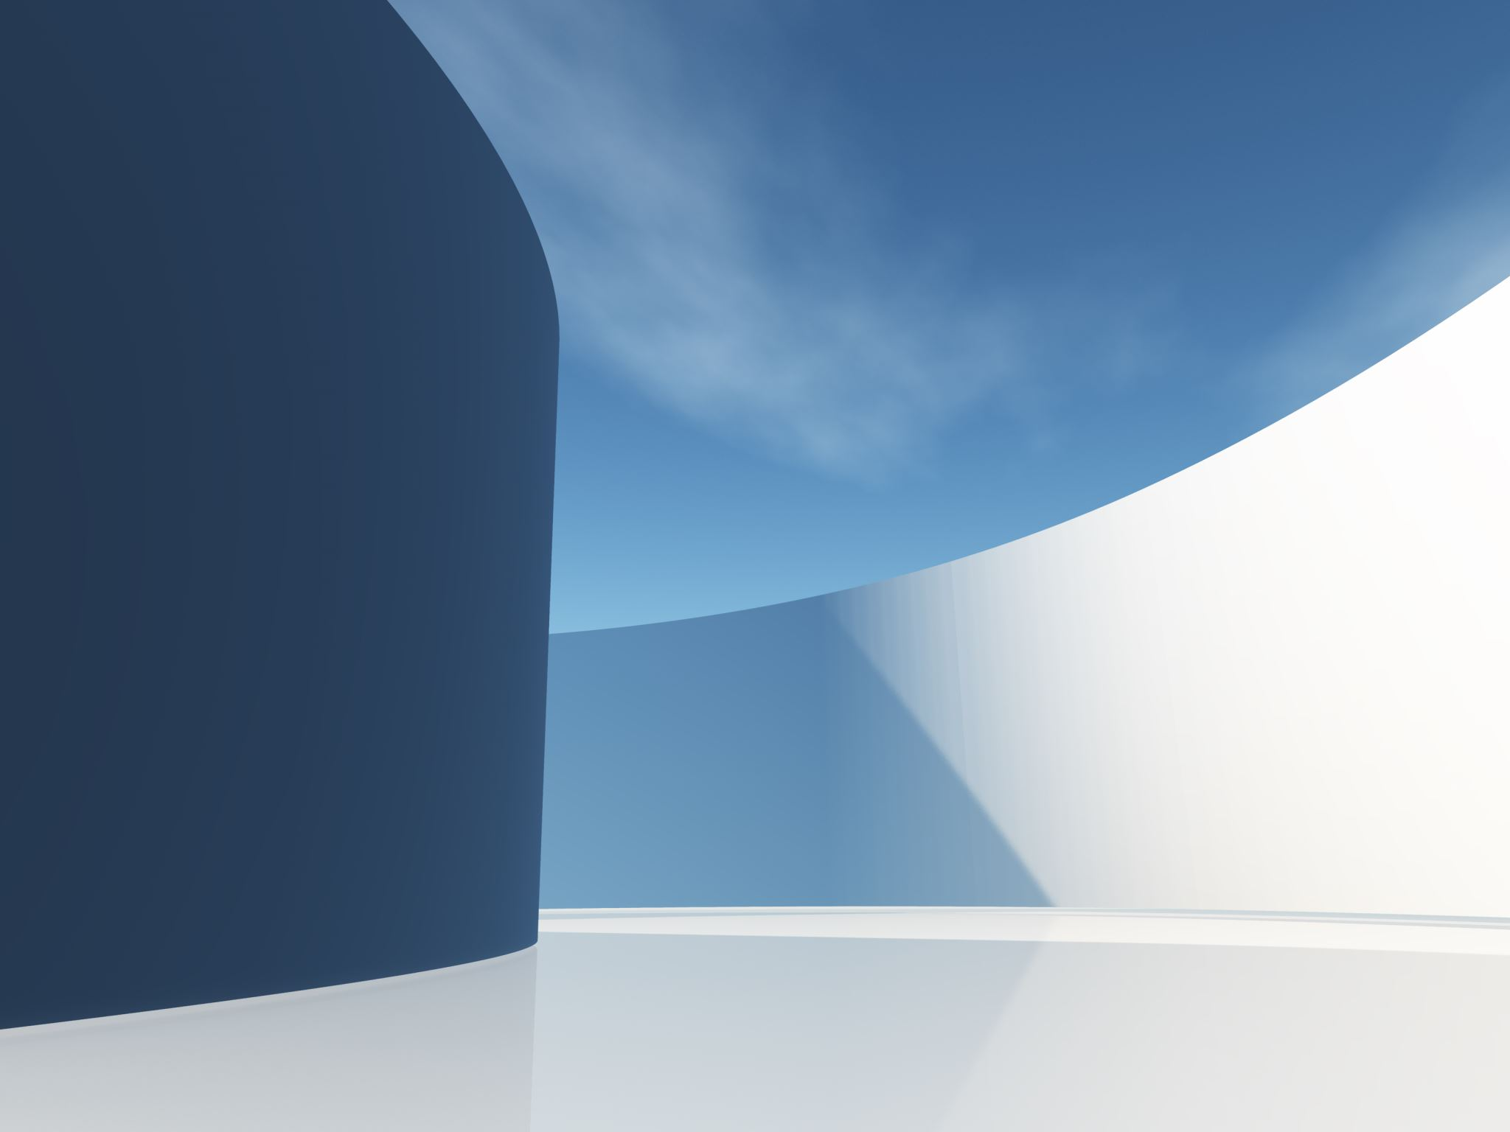
DOUBLE SPLASH
A collection of images
--Rajib Pokhrel

Slide 2
DESCRIPTION
Double Splash is a website that uses the Unsplash API to provide users with a constantly changing stream of high-quality photos. Users can browse the photos by category, or simply let the site surprise them with new images

Slide 3

MOTIVATION
I was inspired to create Double Splash because I love photography and I wanted to find a way to make it more accessible to people. I also wanted to create a website that was simple and easy to use, so that anyone could enjoy it.

Slide 4
HOW IT WORKS
Double Splash uses the Unsplash API to retrieve photos from Unsplash. Unsplash is a website that provides free, high-quality photos that anyone can use.
When you visit Double Splash, you'll be presented with a grid of photos. You can browse the photos by category, or simply click on a photo to enlarge it.
If you see a photo that you like, you can download it to your computer or share it on social media.

Slide 5

Features
Double Splash has a number of features, including:
A constantly changing stream of high-quality photos
The ability to browse photos by category
The ability to download photos or share them on social media
A simple and easy-to-use interface

Slide 6
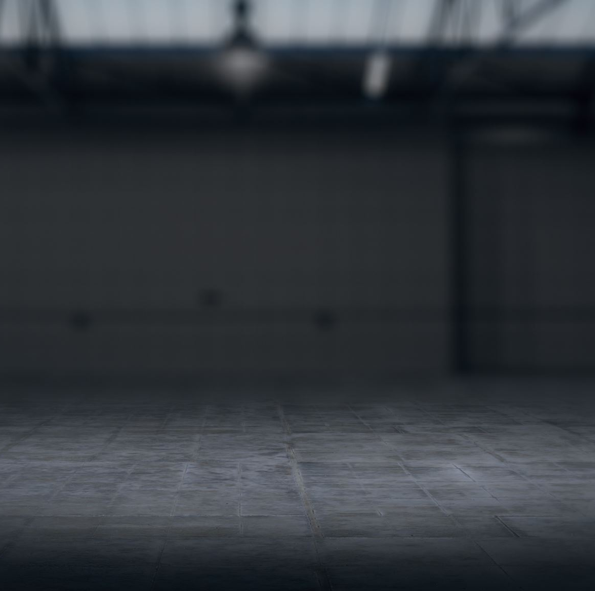
BENEFITS
Double Splash offers a number of benefits, including:
It provides users with access to a wide range of high-quality photos
It is easy to use and navigate
It is free to use

Slide 7
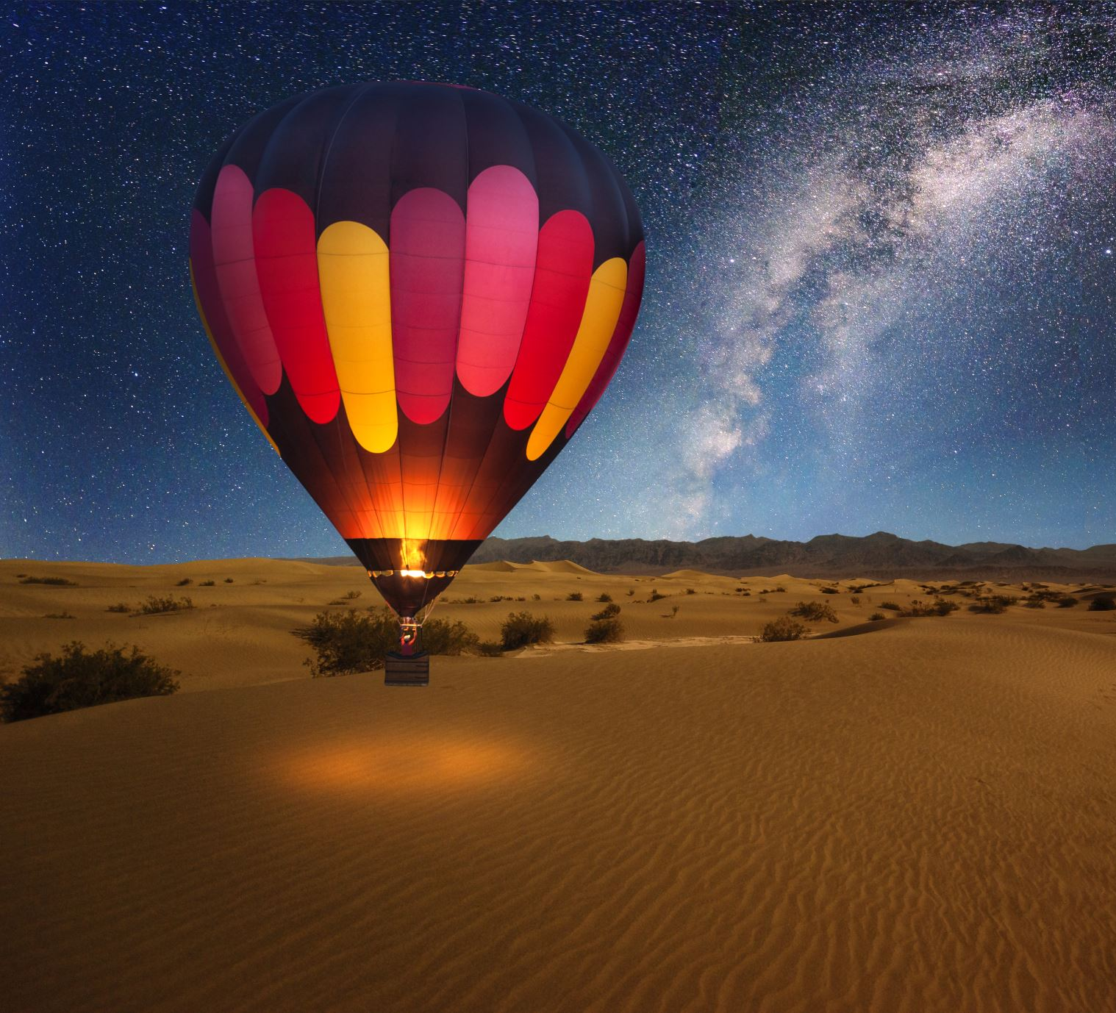
CONCLUSION
I believe that Double Splash is a valuable resource for anyone who loves photography. It is a great way to find new and interesting photos, and it is also a great way to learn more about photography.

Slide 8

FUTURE PLANS
I plan to continue developing Double Splash in the future. I would like to add more features, such as the ability to search for photos by speech and the ability to create albums.
I would also like to make Double Splash more accessible to people with disabilities.

Slide 9
THANK YOU
Thank you for listening to my presentation. I hope you learned something about Double Splash and I hope you'll visit the website sometime.

