Slide 1
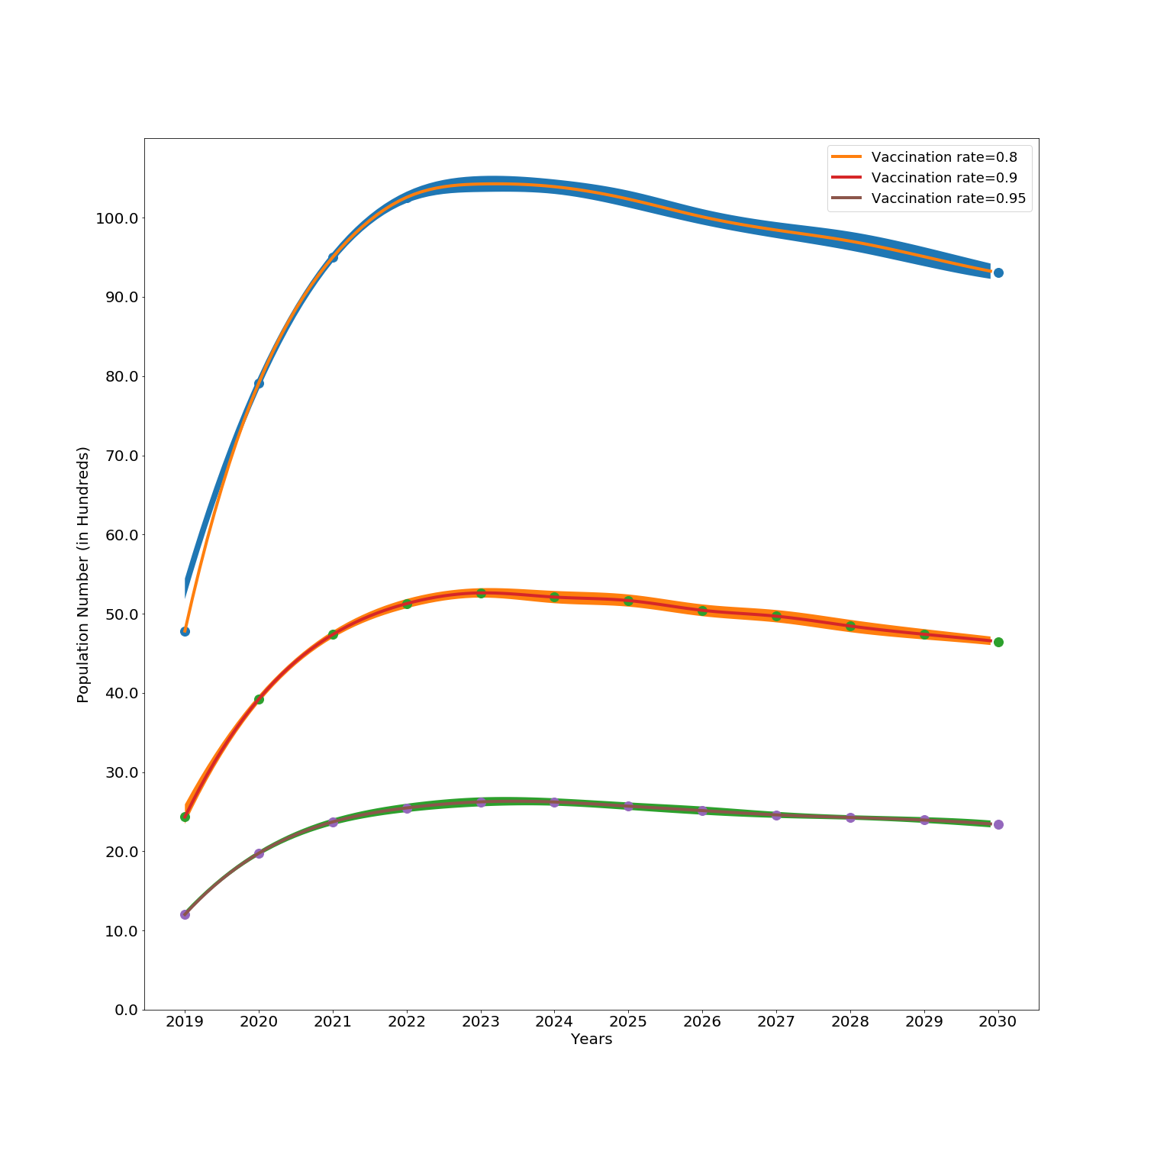
Children : Infected

Slide 2
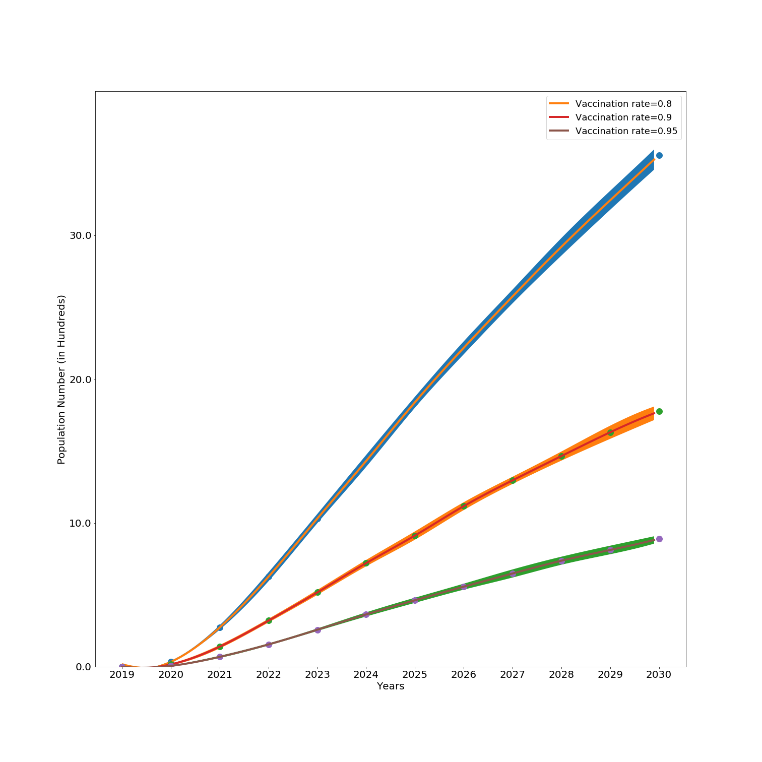
Children : Cured

Slide 3
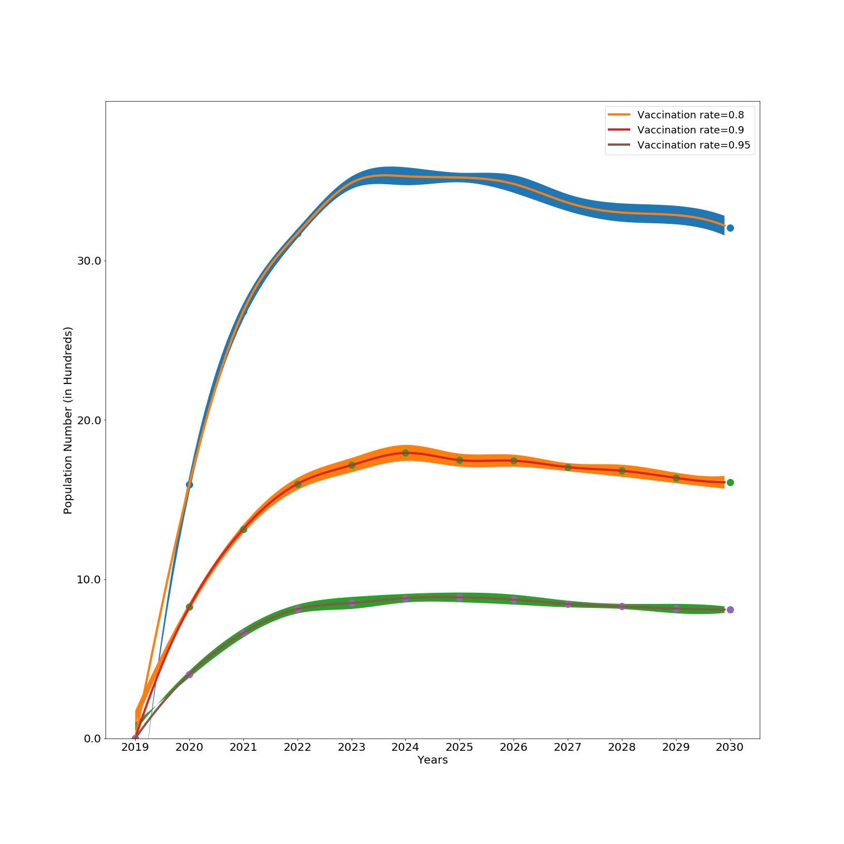
Children : Death due to HBV

Slide 4
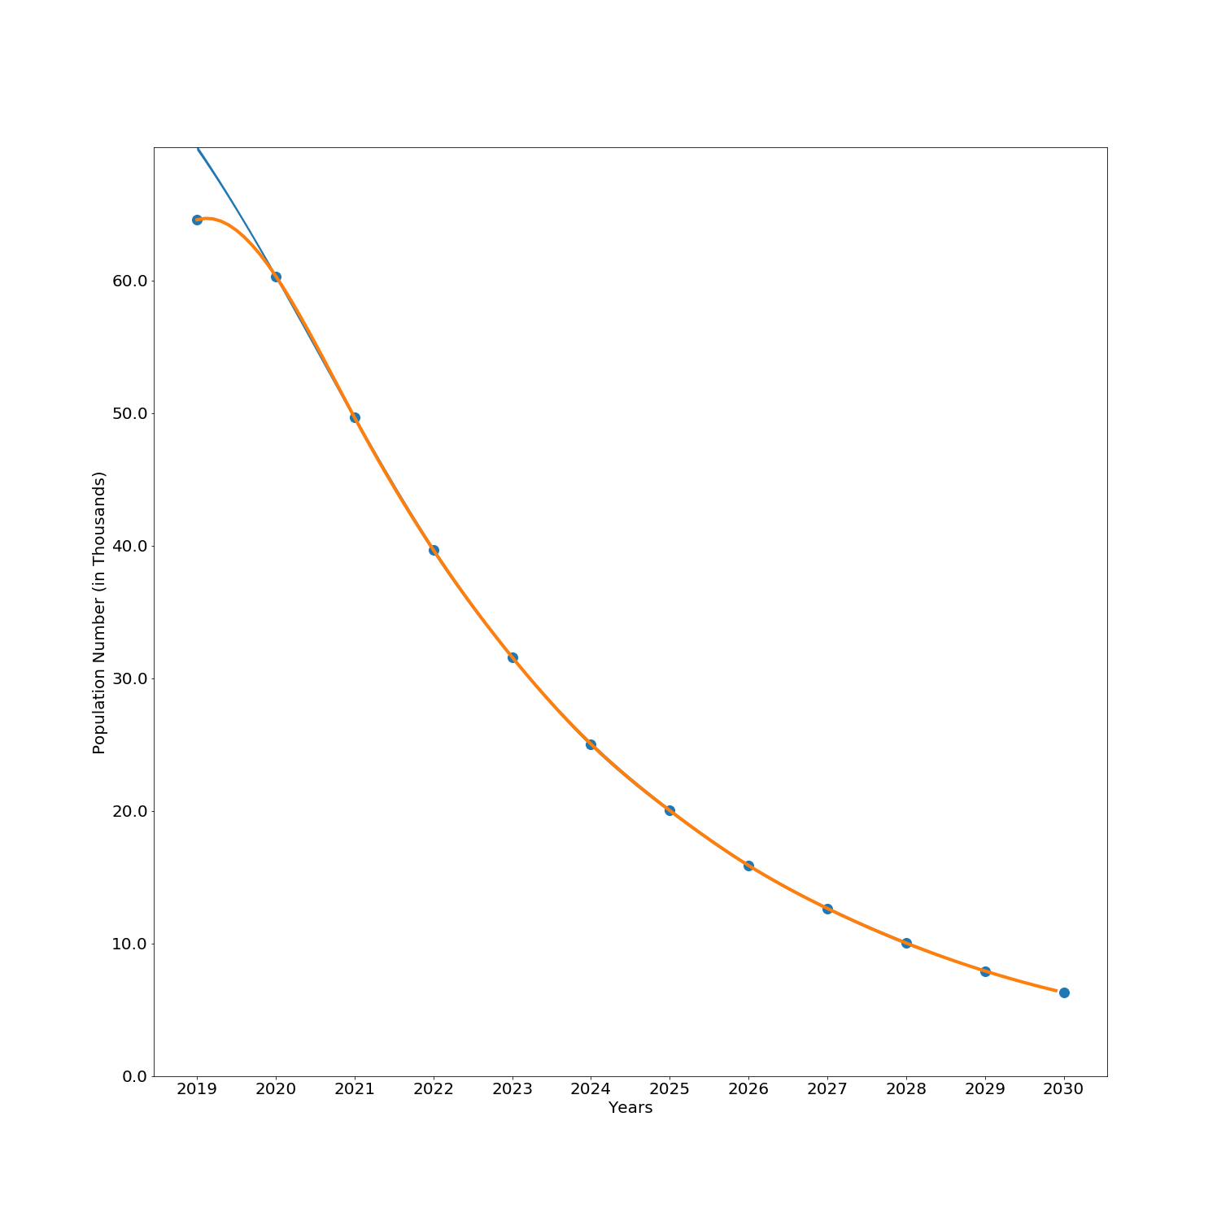
Mothers : Infected

Slide 5
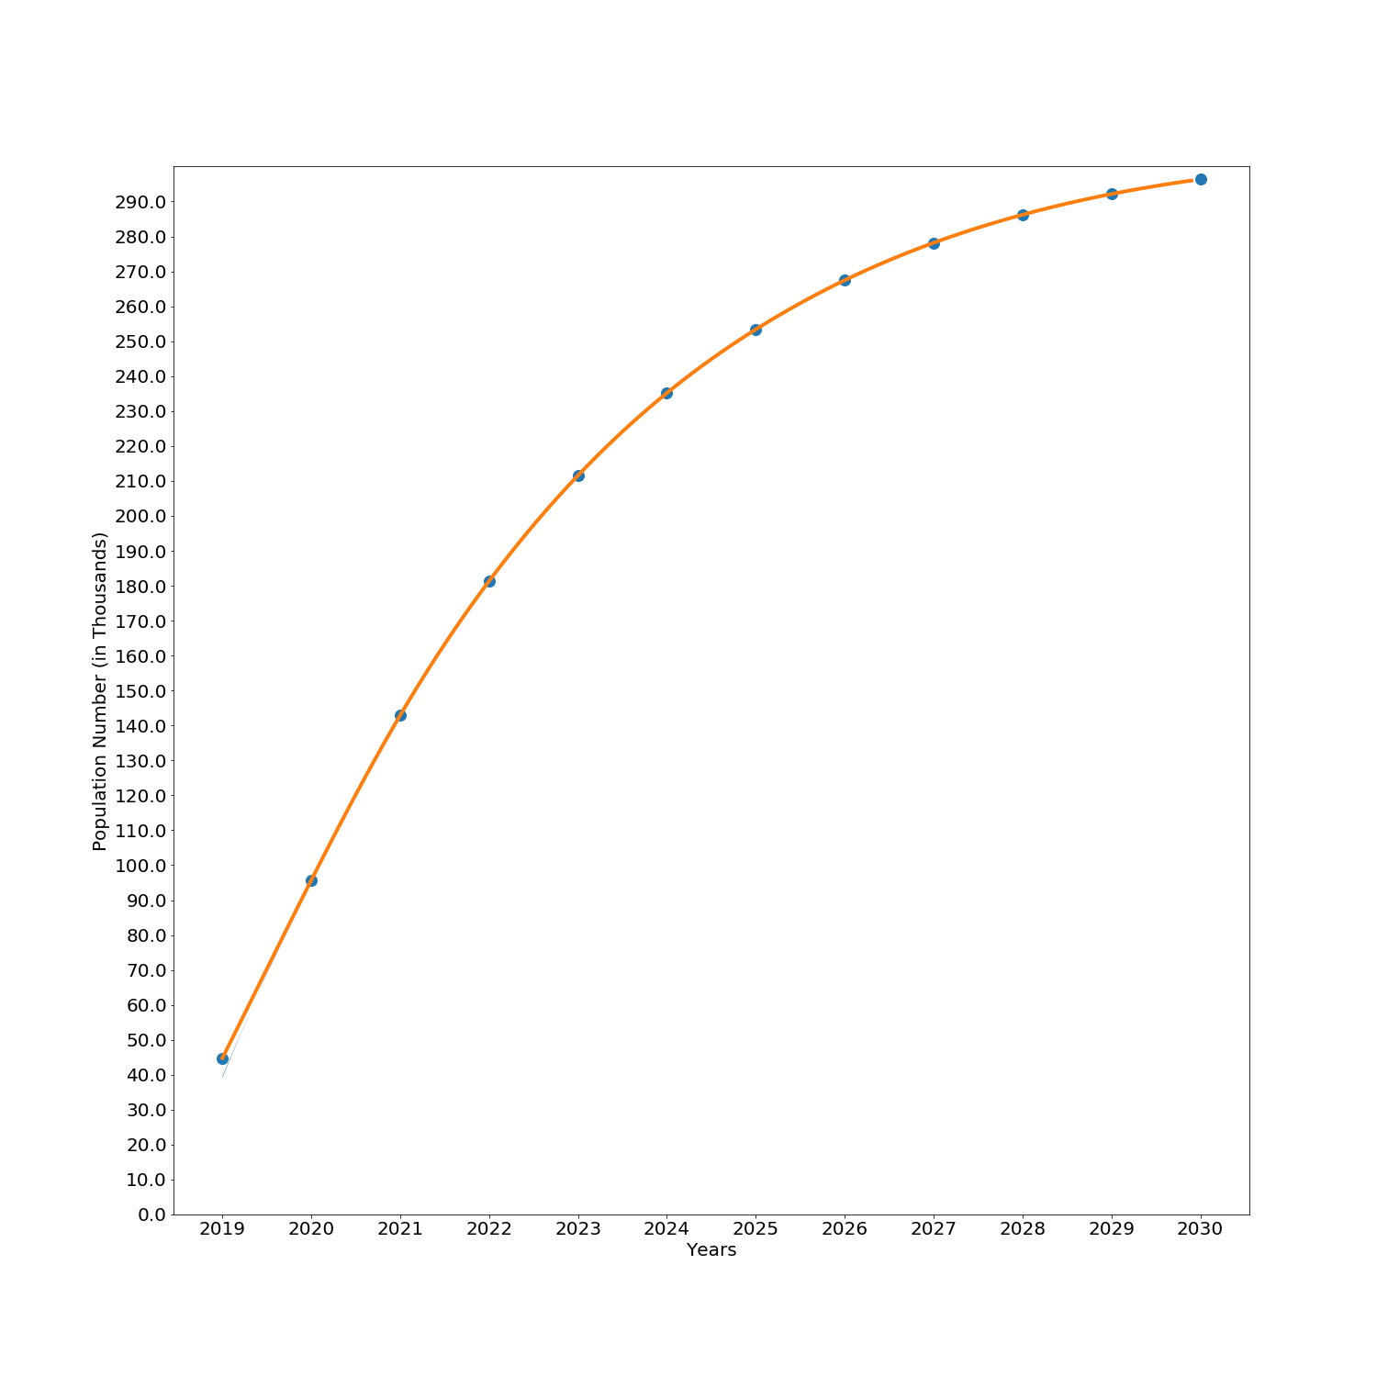
Mothers : Cured

Slide 6
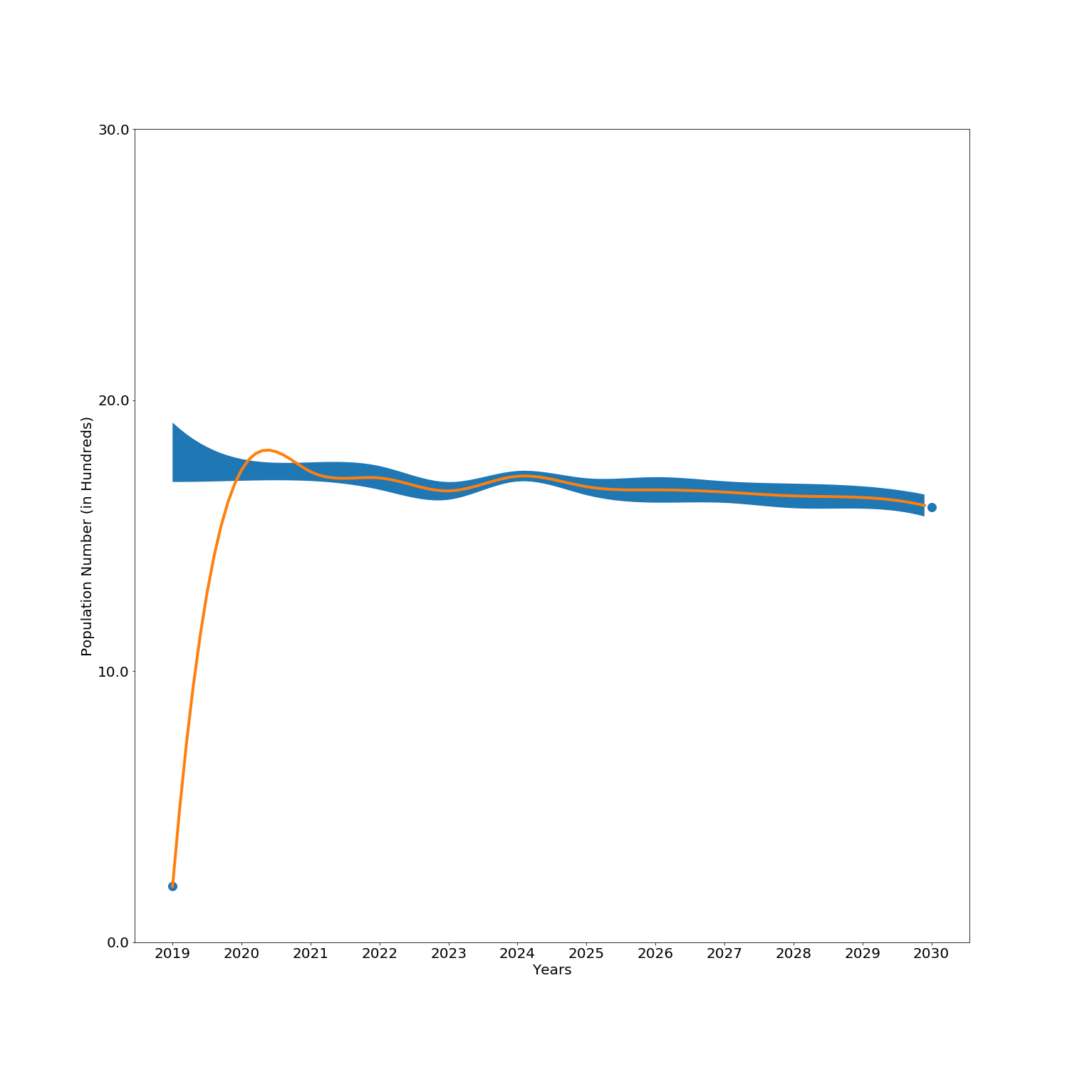
Mothers : Natural Maternal Death

