Slide 1
Part 1 : What is the mobile cloud development and why do we need it?
Notes:
Welcome to the first part of this lecture series : What is mobile cloud development and why do you need it?

Slide 2
What is Mobile Cloud?
A development paradigm where …
Move the computation and data storage away from devices into the cloud
Access the cloud infrastructure from a thin client
Enjoy the robust, reconfigurable computing power and data storage facility from the palm of your hand
Notes:
Mobiles give mobility. Handheld devices are getting more and more powerful – in terms of computational power and memory. We now have devices with enough computational power comparable to desktop computers several years back and unthinkable for mobile devices at that time. But at the same time, the demand of the modern applications is also increasing. Simply put, one cannot store and compute all the data required by any standard modern applications on mobile devices alone.
Cloud, on the other hand, is a platform to employ as much as computational power and storage you need and when you need those.
So why don’t we join these two together? Take the power of cloud and the mobility of handheld devices to create truly scalable application.
Mobile cloud is the result.
This is a development paradigm ….

Slide 3



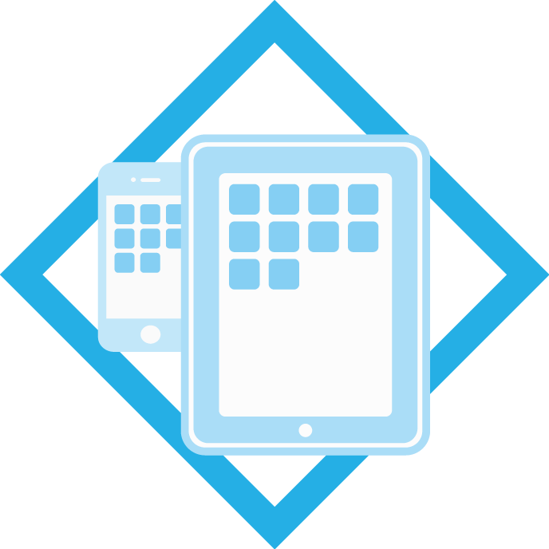
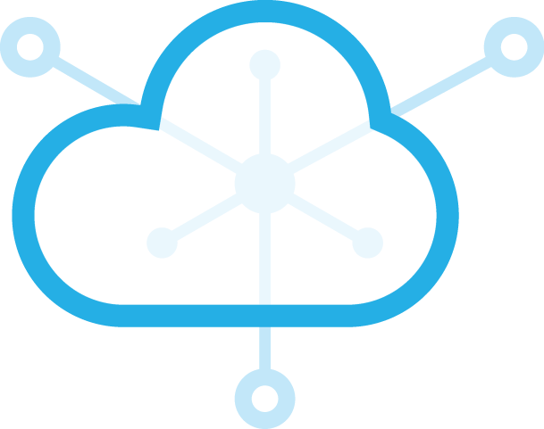






How does Mobile Cloud help?
Build an engaging app that can scale to enterprise
level in weeks and NOT months
Client application : Running on mobile devices
Application service : Cloud APIs that can be glued together to quickly create new apps at scale
Notes:
You design the “computation heavy” part of the application separate from the user interface. This heavy “application service” of your application, you can designate your computation to powerful CPUs and can use as many of those as you need. For storage you can use any of the enterprise level data servers.
The client device, on the other hand, is now free of all these heavy computations. All it needs now is to render the user interface properly, collect the data from the user and present the result in the most suitable way.
With Cloud, the application service can be scaled to any amount of resource the application demands and whenever it demands that. On the other hand, the interface running on client device stays the same. The user still enjoys the slick nature of your application.

Slide 4

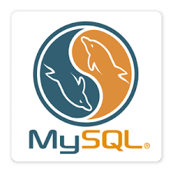


Development decisions made easy
Native
  Java,
  Objective-C
  C#
Hybrid
  Phonegap
  Client
Java,
  Tomcat
  Liberty
Script
  NodeJS
  PHP
  Server
  Storage

