Slide 1
Part 2 : What are the basic components of mobile cloud development?
Notes:
Welcome to the second part of this lecture series : What are the basic components of mobile cloud development?

Slide 2
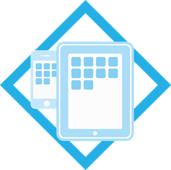
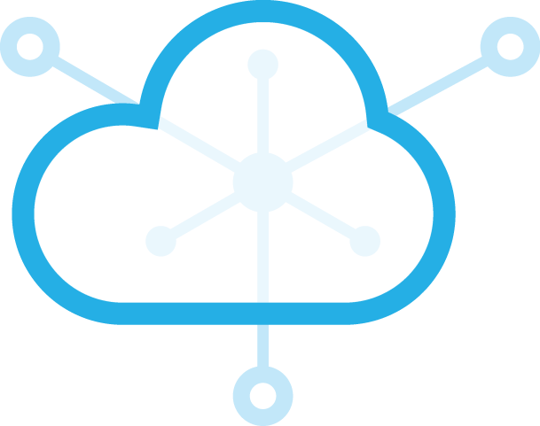
Connecting the Client with Server
REST API
JSON
Client:
Thin UI with navigation logic
Application Service:
Functions to perform heavy computation or database transactions
Notes:
In Part 1 we saw that a mobile cloud application has 2 major parts – 1) client UI and 2) The application service. The client presents several interfaces and a logic to navigate among all these interfaces. The application service exposes several functions as available resources and these functions perform computation or facilitate database transactions of any intensity.
These tasks require data transfer between the client and the service. Each of these two components transfer data between them usually in JSON format. We will see a concrete example a couple of slides later.
The client does not only send or receive data from application service, it also requests certain computation from the applications server. This request is made via REST API.

Slide 3
What is RESTful API?
A set of resources available via unique URI
  http://myserver/checklogin
These resources use HTTP requests to communicate
  GET, POST, PUT, DELETE
Data transfer usually happens in JSON format
  { “user” : “student”, “password” : “letmein” }
Notes:
Before we see an example of how the 2 parts come together, let us briefly introduce REST API. Remember, this is a vast topic by itself. What I am trying to do here is to give you a primer to help you navigate through the rest of the lecture series without major problem. I would recommend you to study REST API further.
Typically, when we think of HTTP requests, we usually think of files served by a server. But the same concept can be expanded to any functions. A server can expose a specific function via unique URL or URI just the same way as it can expose a file to the outside world. This is where the concept of REST API comes in.

Slide 4

How do it all come together?
JSON Data :
{ 'user' : 'student', 'password' : 'letmein' }
Resource URL:
http://myserver/checklogin
JSON Data :
{ 'result' : 'error‘}
JSON Data :
{ 'result' : 'success', 'record' : 'Great Student' }
Show the error and don't let the user in
Let the user into the next page

