Slide 1
Java Collection APIs
Rajib Deka

Slide 2
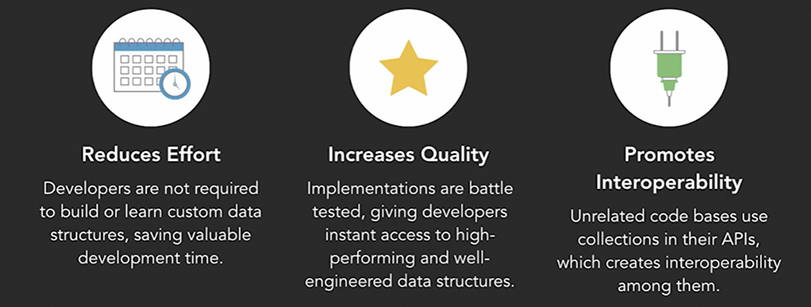
Why do we need collections?
Conventional array can hold fix number of elements
Developers needs time to write algorithms to prepare data structures
Lack of code reusability
Quality of the data structure

Slide 3
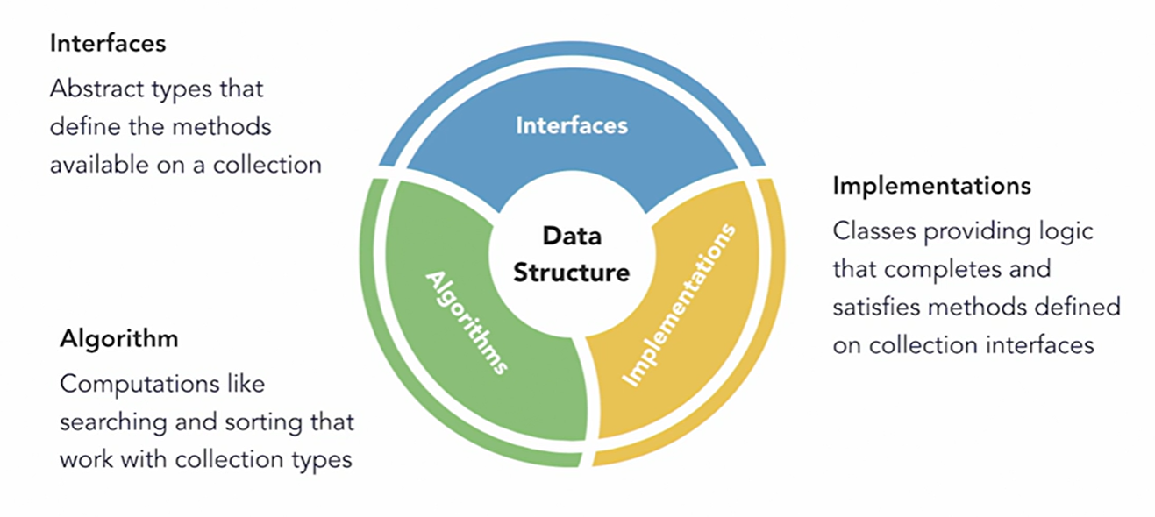
Collection Framework Architecture

Slide 4
Our own Collection API
Develop a collection API to store contacts of an address book
1
Use array to achieve this
2
Show how the interface is implemented
3
Make examples to use the new custom Collection
4

Slide 5
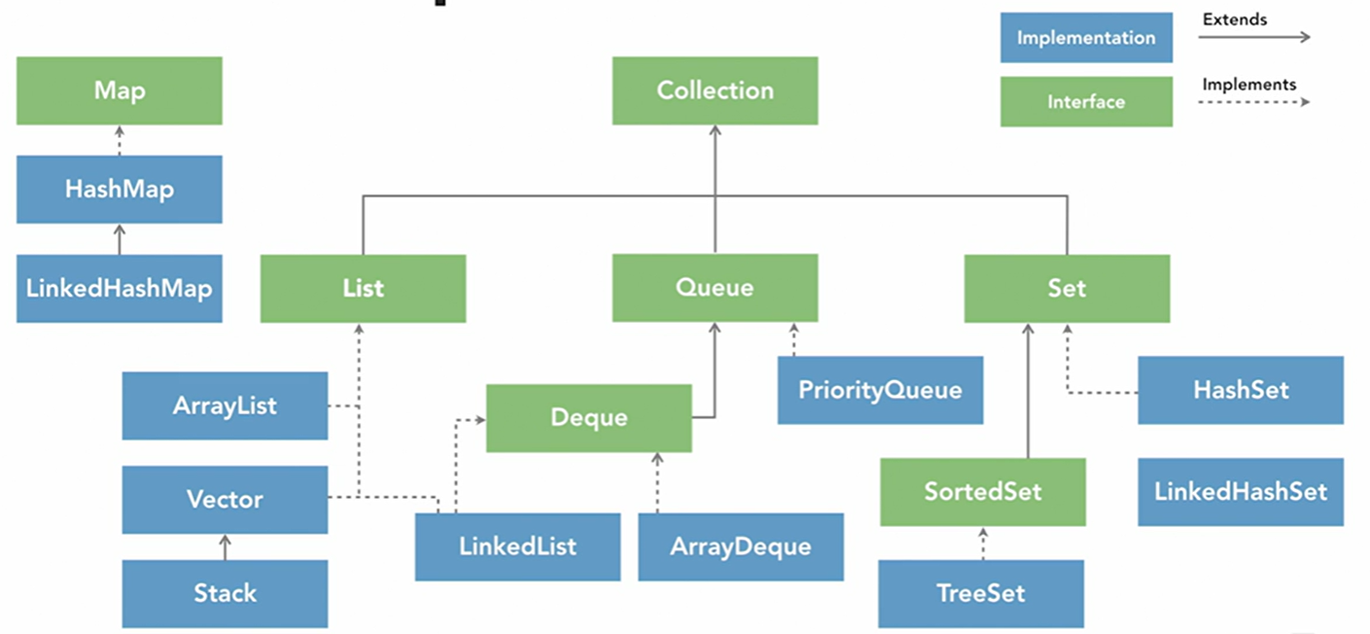
Collection Types

Slide 6
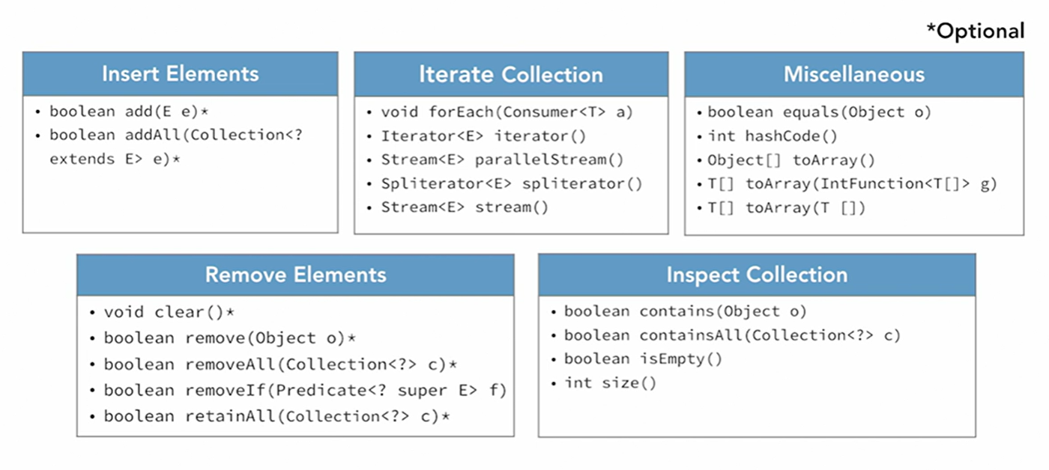
Collection methods

Slide 7
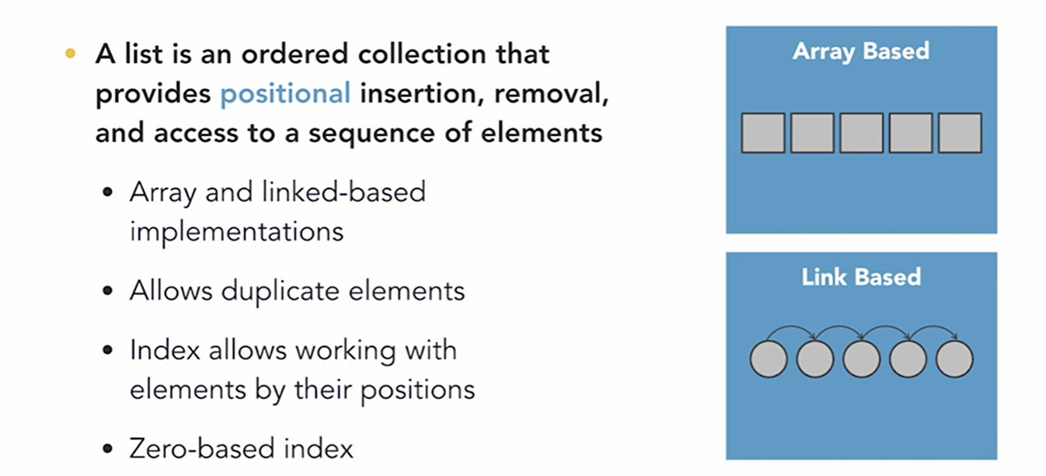
List

Slide 8
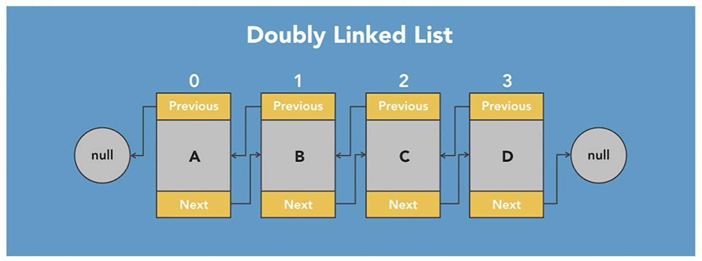
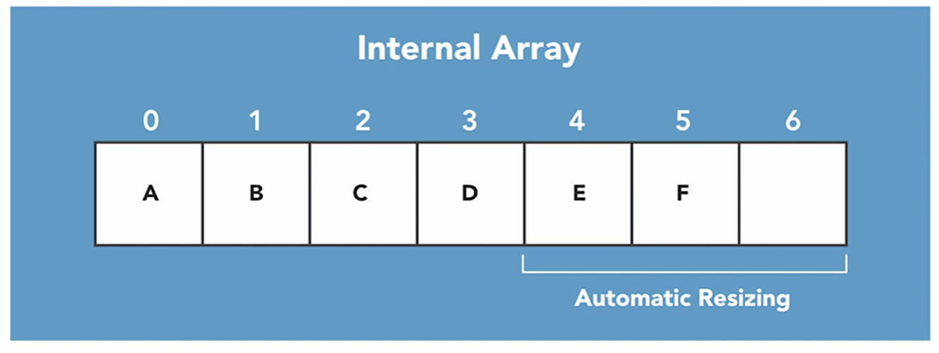
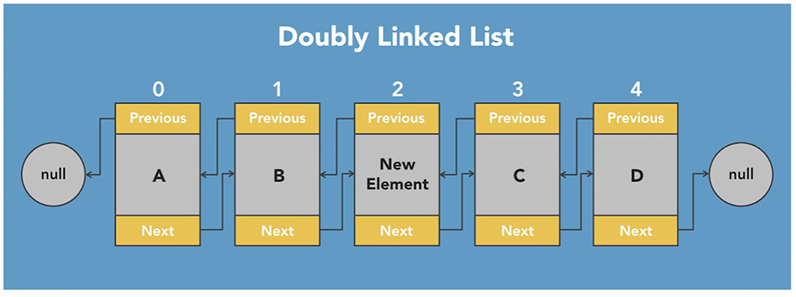
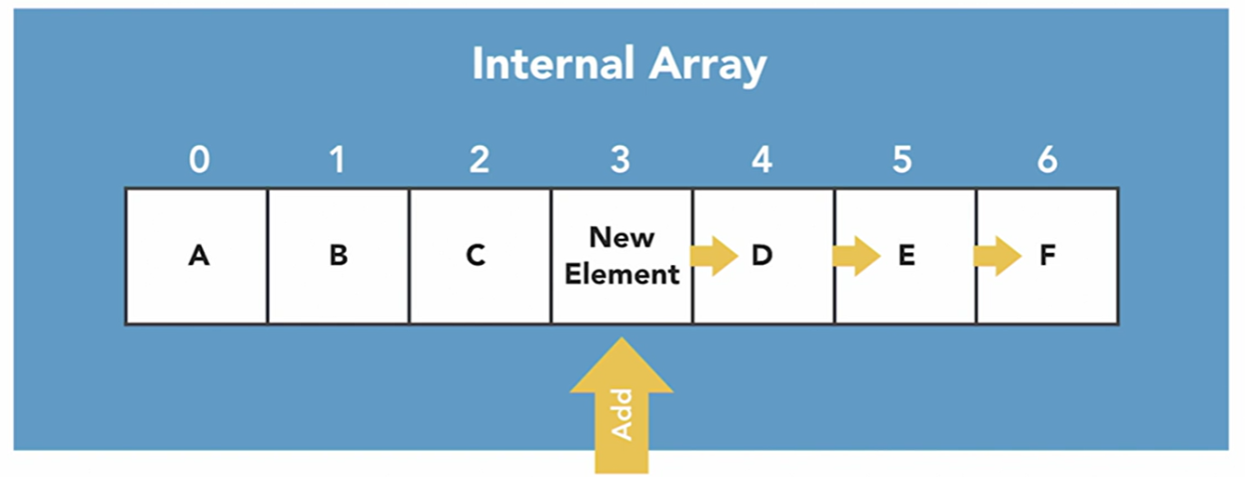
ArrayList vs LinkedList

Slide 9
Set
It does not contain duplicate elements
HashSet is unordered
LinkedHashSet maintains order
Set.of(…) and Set.copyOf(set) returns an unmodifiable set
Set.copyOf(set)
TreeSet uses BST, needs a comparator implemented and is a navigable set.

Slide 10
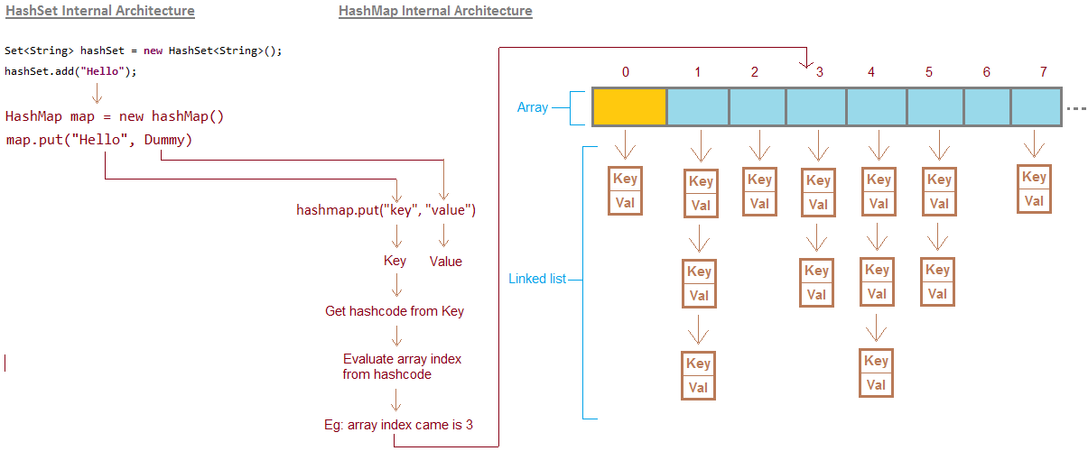
HashSet internal

Slide 11
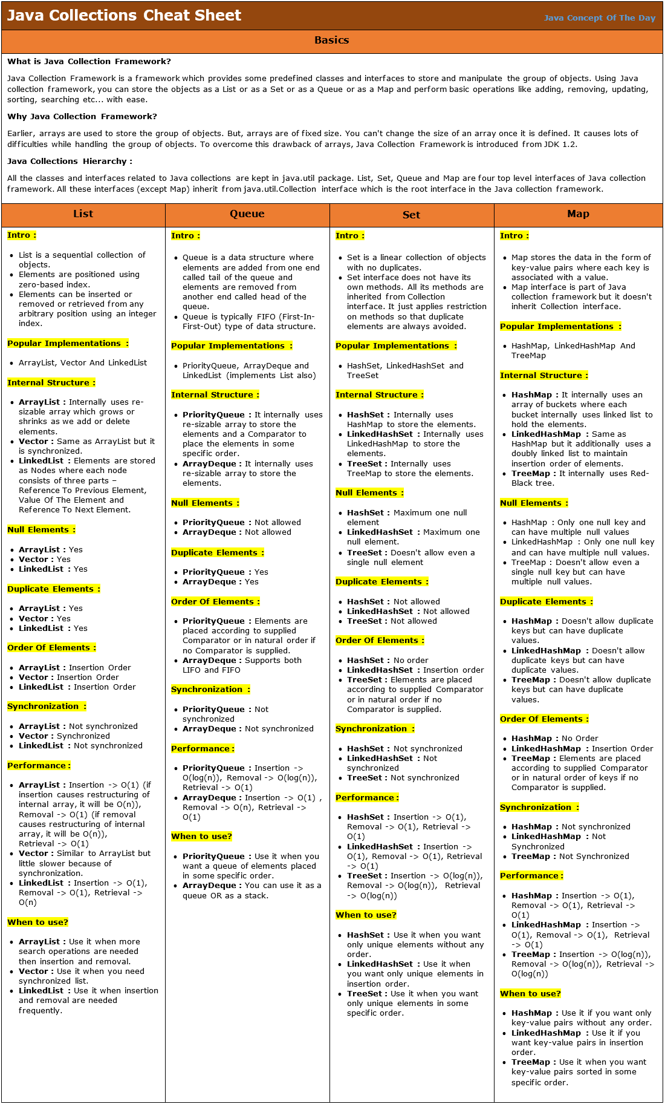
Java Collection cheat sheet

