Slide 1


Market Mechanism-Based User-in-the-Loop Scalable Power Oversubscription for HPC Systems
Md Rajib Hossen¹, Kishwar Ahmed², Mohammad A Islam¹
¹The University of Texas at Arlington, ²The University of Toledo
Acknowledgement: This work is supported in parts by the NSF under grants EECS-2452357 and CNS-2300124

Slide 2
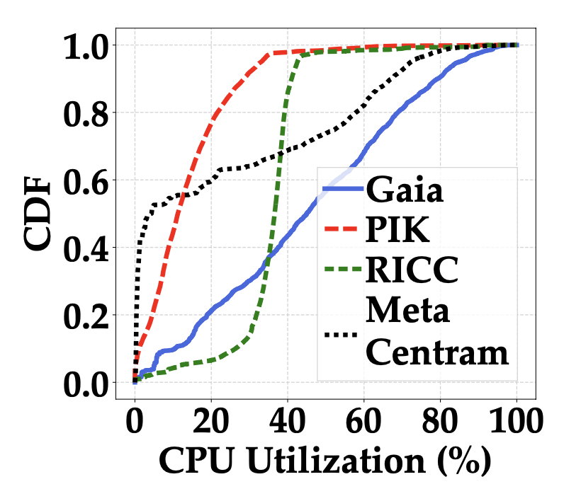
HPC System Utilization
~65%
PIK
~55%
RICC
~20%
Meta Centram
~5%
Gaia
HPC systems are highly underutilized

Slide 3



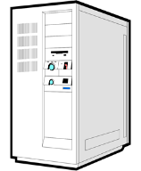

Power Oversubscription
Increase utilization via power oversubscription
Power
Utility
ATS
Backup Generator
Keep this
infrastructure fixed
1+1 UPS With
Redundancy
Cluster
PDU
Additional server racks (without additional infrastructure investment)
Server
Rack
Add new server racks

Slide 4
Benefits of Power Oversubscription
144K added
vs
1.25K cut
Cut back to avoid overload
We can add far more core-hours than we have to cut back!

Slide 5
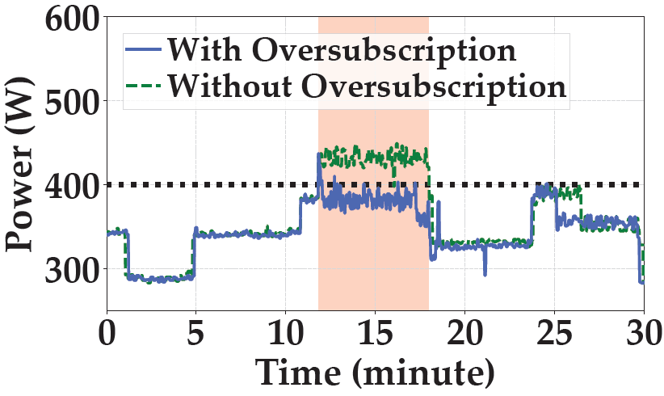
Challenges of Oversubscription
Power capacity
Without handling oversubscription
With handling oversubscription
We propose a user-in-the-loop reactive approach to manage oversubscribed HPC

Slide 6
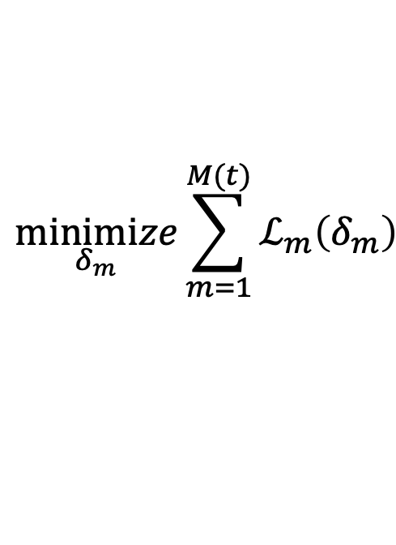
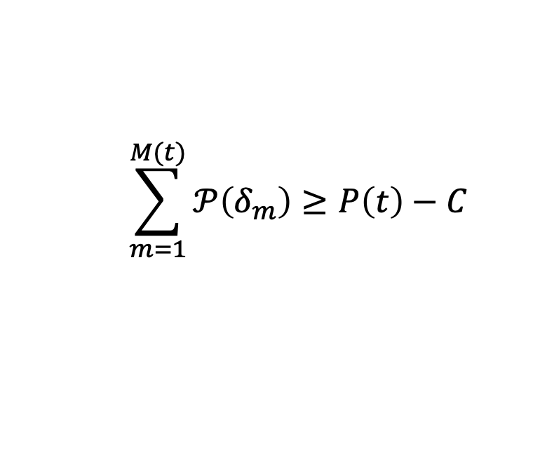
Handling Power Overloads in HPC
Performance
degradation
$$\underset{δ_{m}}{minimize}{\sum_{m=1}^{M(t)}{ℒ_{m}\left(δ_{m}\right)}}$$
OPT:
Target power
reduction
$$\sum_{m=1}^{M(t)}{𝒫\left(δ_{m}\right)≥P\left(t\right)−C}$$
subject to
Challenging for HPC manager to determine the performance impact

Slide 7
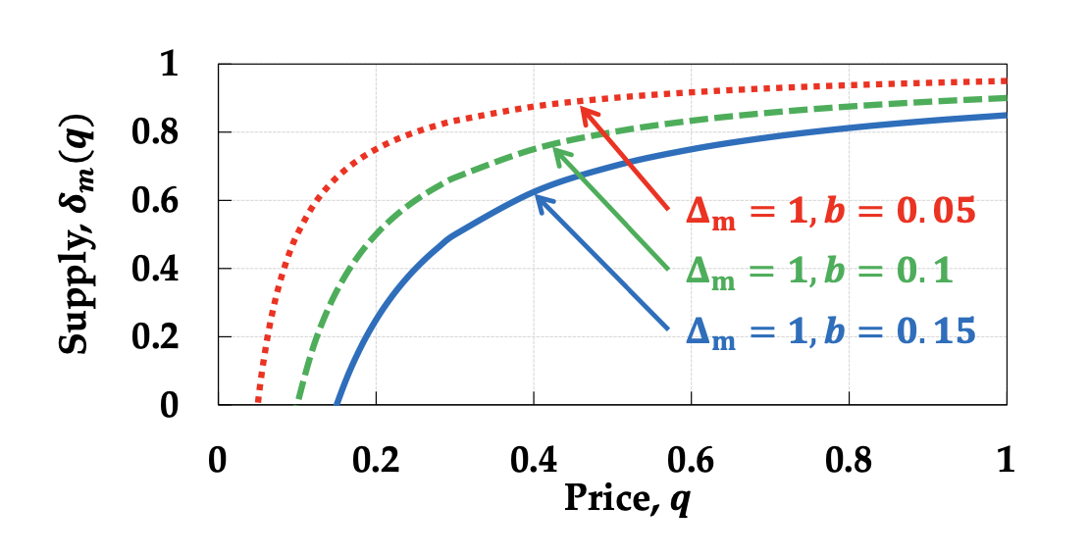
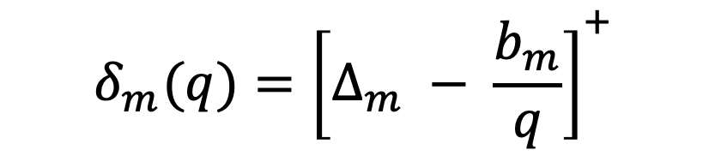
Supply Function Bidding
Engage HPC users in the power reduction decision
Maximum resource reduction
Bidding parameter
Price

Slide 8
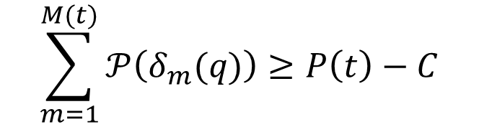
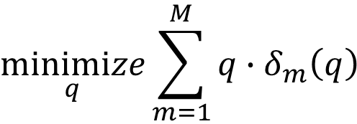
Power Reduction during Overload
$$\underset{q}{minimize}{\sum_{m=1}^{M}{q∙δ_{m}\left(q\right)}}$$
MClr:
$$\sum_{m=1}^{M(t)}{𝒫\left(δ_{m}(q)\right)≥P\left(t\right)−C}$$
subject to
HPC manager no longer needs to determine performance impact!

Slide 9





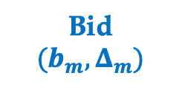


Market-based Power Reduction (MPR)
Cluster Power $P(t)$
Clearing Price $q′$
Resource Reduction $δ_{m}\left(q\right), ∀m$
Cluster Management and Monitoring
HPC Manager
Bid ${(b_{m}, Δ}_{m})$
Job $m$
HPC User
HPC Cluster

Slide 10
MPR with Static Bidding (MPR-STAT)
Cluster Power $P(t)$
Clearing Price $q′$
Resource Reduction $δ_{m}\left(q\right), ∀m$
Cluster Management and Monitoring
HPC Manager
Bid ${(b_{m}, Δ}_{m})$
Job $m$
HPC User
HPC Cluster

Slide 11
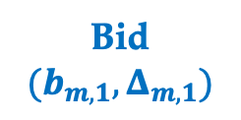


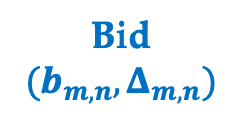
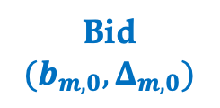

Interactive MPR (MPR-INT)
Cluster Power $P(t)$
$$q_{n}′(t)$$
Resource Reduction $δ_{m}\left(q\right), ∀m$
$$q_{o}′(t)$$
$$q_{1}′(t)$$
Cluster Management and Monitoring
HPC Manager
Bid ${(b_{m, 1}, Δ}_{m, 1})$
Bid ${(b_{m, n}, Δ}_{m, n})$
Bid ${(b_{m, 0}, Δ}_{m, 0})$
Job $m$
HPC User
HPC Cluster
Until clearing price converges

Slide 12
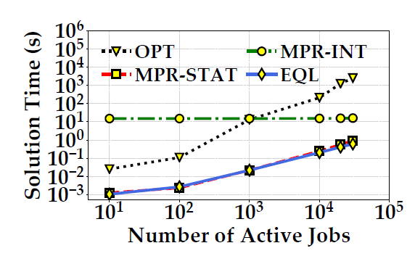
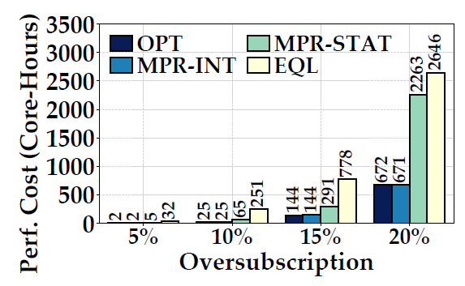

MPR-STAT vs MPR-INT
MPR-STAT
MPR-INT
Quick solution time
Very good performance

Slide 13
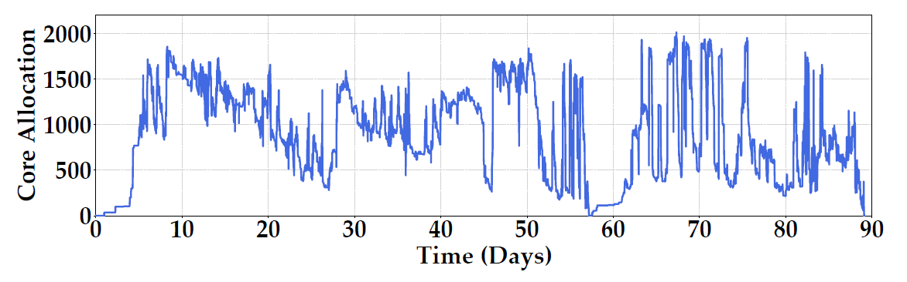
Evaluation
Real-world workload traces
Benchmarks: OPT vs EQL vs MPR

Slide 14
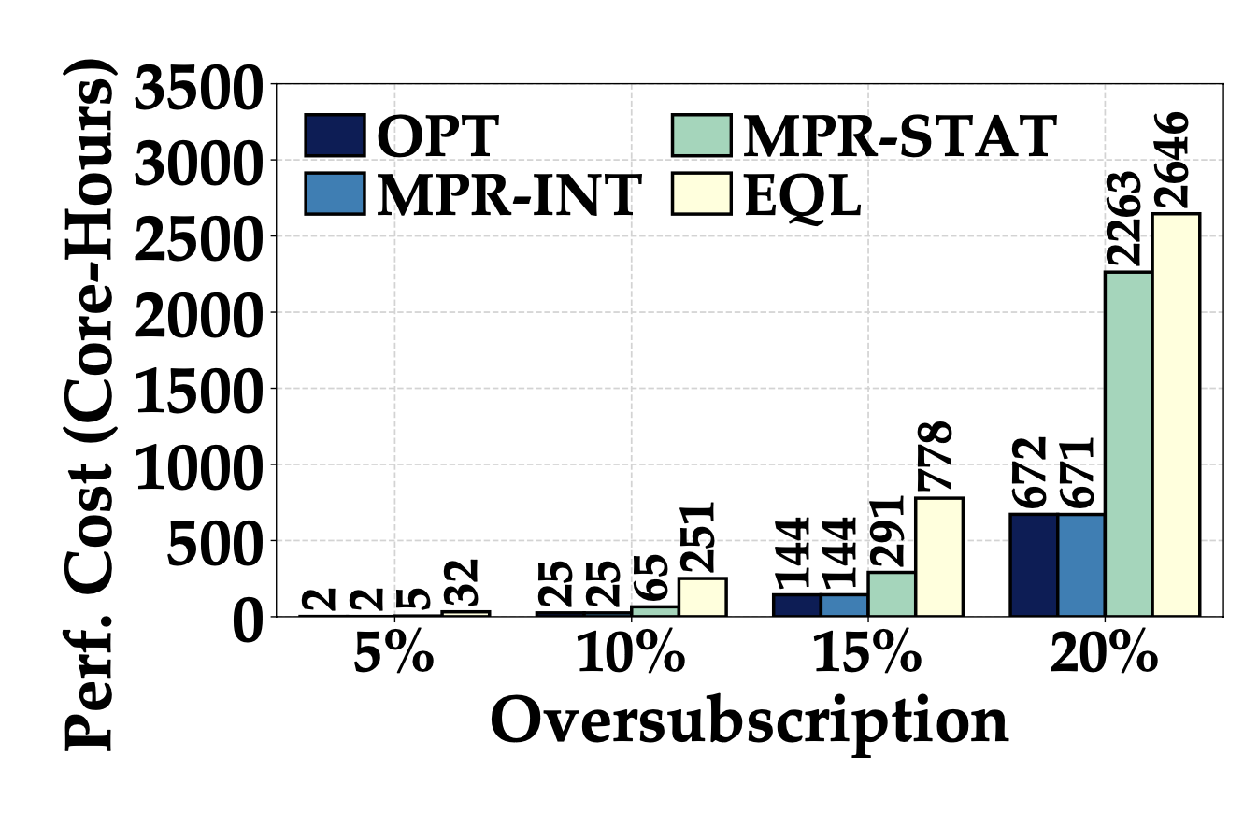
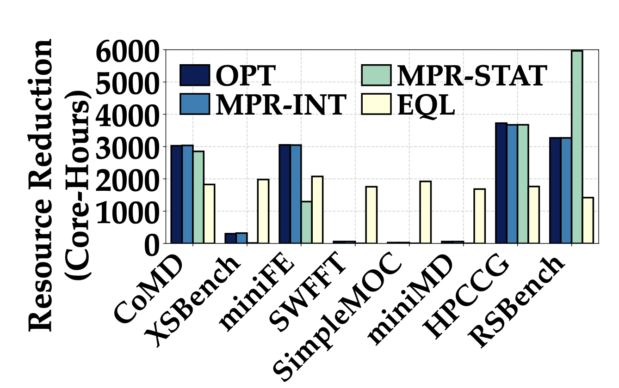
Benchmark Comparison
Performance cost
Profile-wise resource reduction
MPR and OPT incurs lower performance cost

Slide 15
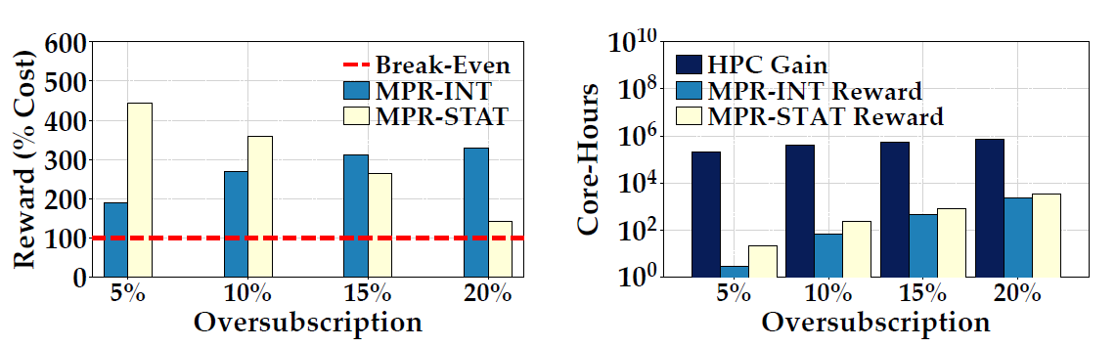
Market Performance
User’s reward
HPC manager’s gain
Both HPC Users and HPC manager benefits from their participation

Slide 16
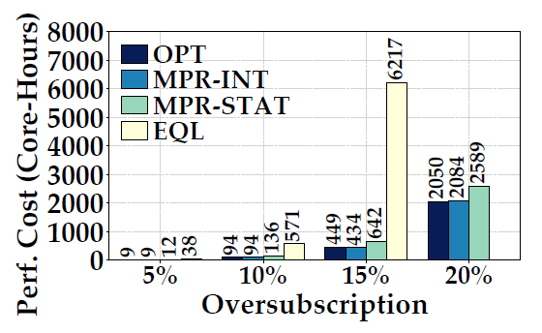
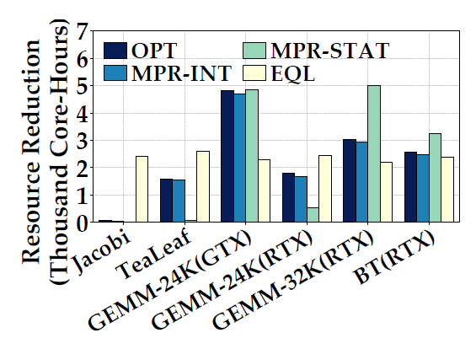
Heterogeneous System Performance
Performance cost
Profile wise resource reduction
MPR and OPT incurs lower performance cost

Slide 17
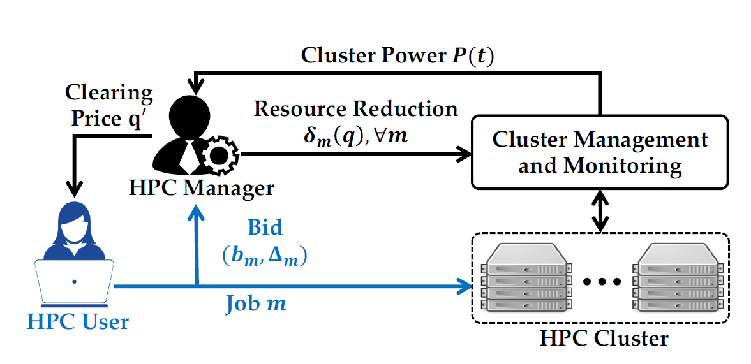
Key Take Away
MPR: A market-based approach to managing oversubscribed HPC
Does not require job-wise power estimation and tracking
User-in-the-loop
Highly-scalable management solution
Go beyond power subscription – carbon reduction, demand response
Thank You!

Slide 18
Questions?

