Slide 1
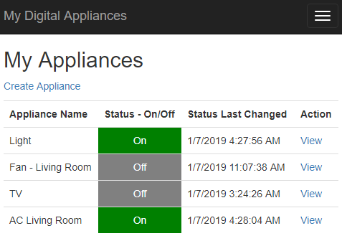
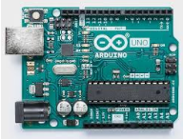
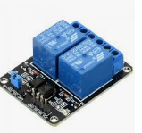
High Level Architecture Diagram
Client (Browser)
Web App + Web API
Azure
SQL Server
Azure
Desktop
Web App
Web API
Tablet
Mobile
The WEB API has an end point for Arduino which sends JSON output. Arduino keep calling the web API on a loop and based on the status of the appliances received from API through JSON, the relays trigger on or off. The appliances are connected to relay to get switched on or off
The Status of the appliances are updated through web portal as “on” or “off”.
The web app is a simple ASP.Net MVC app. The app has 2 set of controllers, one for the view and the other for the API. The view controller calls the API controller. The API controller also exposes end points which is accessed by Arduino UNI
Arduino UNO
Relay
Appliances
Light
Fan
Web Application

