Slide 1

Sentiment Analysis of 2019 Canadian Elections
Objectives
The purpose of this assignment is to compute the sentiment of text information of tweets posted in 2019 Canadian elections.“What can public opinion on Twitter tell us about the Canadian political landscape in 2019?” The goal is to essentially use sentiment analysis on Twitter data to get insight into the 2019 Canadian elections.
To reach our goal first we need to understand what is sentiment analysis and how can we use here to find out peoples sentiment over canadian elections.
What is Sentiment Analysis?
Sentiment analysis is a technology of increasing importance in the modern society as it allows individuals and organizations to detect trends in public opinion by analyzing social media content.

Slide 2
Detail Descriptions of our dataset and Algorithms:
Two sets of data are used for this assignment. The generic_tweets.txt file contains tweets that have had their sentiments already analyzed and recorded as binary values 0 (negative) and 4 (positive). Each line is a single tweet, which may contain multiple sentences despite their brevity.
These are the variables Class, ID, Date, Query, User, Text we are going to use, mainly we need Class and text variables to achieve our goal.
The second data set, Canadian_elections_2019.csv , contains a list of tweets regarding the 2019 Canadian elections, variables are Sentiment, negative_reason, text.
These are the machine learning algorithms(logistic regression, k-NN,
decision trees, random forest, XGBoost) we are using here on Generic_Tweets dataset after that we will validate canadian_eletions_2019 datasets using best three algorithms from generic_tweets dataset. We are using Python Notebook for our analysis.

Slide 3
Process Flow
Data Cleaning
Exploratory Analysis
Model Preparation
All html tags, URLs and attributes are removed.
All characters in the text in lwowercase.
Html character codes are replaced with an ASCII euivalent and all stop words are removed.
Graphical figure(Boxplot, Wordcloud) to visualizes some aspect of the generic tweets and canadian elections.
Split generic dataset randomly into taining(70%) & test(30%).
Use of Machine Learning Algorithms for modeling.
For Feature engineering use Bag of words and TF-IDF methods.
Model validating on canadian elections dataset using SVM, Logistics & Random forest.
Results
Model Implementation
Finally find best model to validate our canadian results

Slide 4
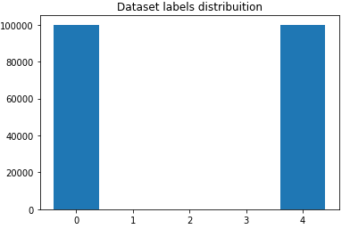

From the Boxplot we can see(4– Positive, 0 - Negative) positive and negative emotions more or less are same.
Wordclouds allows a quick visualization of most frequent words and in our case to confirm if most frequent words of its leader are aligned with the core values of their party. Also it is important to note that negative clouds appear bigger than the positive clouds but that has no relationship with the frequency between them.
For Feature Engineering we are considering two methods “Bag of Words” & “TF-IDF”. First we need to do tokenization, tokenize all the cleaned tweets in our dataset.
Tokens are individual terms or words and tokenization is the process of splitting a string
of text into tokens. Bag-of Words features can be easily created using sklearn’s
CountVectorizer function. We will set the parameter max_features = 1000 to select only top
1000 terms ordered by term frequency across the corpus. TF-IDF works by penalizing the
common words by assigning them lower weights while giving importance to words which
are rare in the entire corpus but appear in good numbers

Slide 5
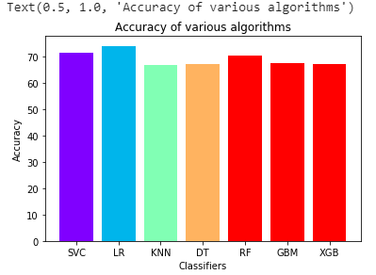
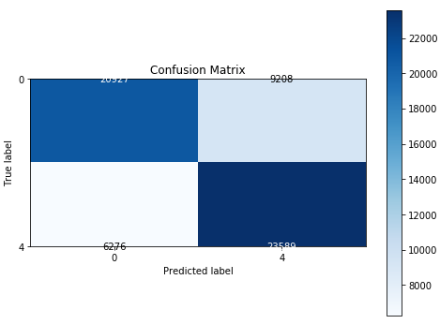
Above accuracy and confusion matrix plot is coming from training data and we can see Logistics Regression giving the better accuracy compare to other models that means 70% of data classify the sentiment emotions with given 74.19 accuracy.
For validating the Canadian_Elections dataset we are using these three machine learning algorithms SVM, Logistics Regression and Random Forest and given that we find Logistics Regression is our best model and we have done hyperparameters tuning of that model to increase the accuracy(Its increases 48% to 78%).

