Slide 1
Node.js Fundamental Session 1
NashTech
05-2024

Slide 2
What is Node.js?
Introduce
Install Node.js
Using nvm
When should I use it?
Execute Model
Single thread
Build a simple page counter service
Understanding module.exports and exports
Why do we need modules?
Different Module Format
Forms, File Uploads, and Security with Node.js and Express
Q&A

Slide 3
What is Node.js?

Slide 4
Introduce
A JavaScript runtime
Built on Chrome’s V8 JavaScript engine
Open-source JavaScript engine
Google Chrome and other Chromium-based web browsers (Brave, Opera, Vivaldi, etc.)
Designed with performance in mind and is responsible for compiling JavaScript directly to native machine code.
NodeJS:
Event-based
Non-blocking
Asynchronous I/O runtime

Slide 5
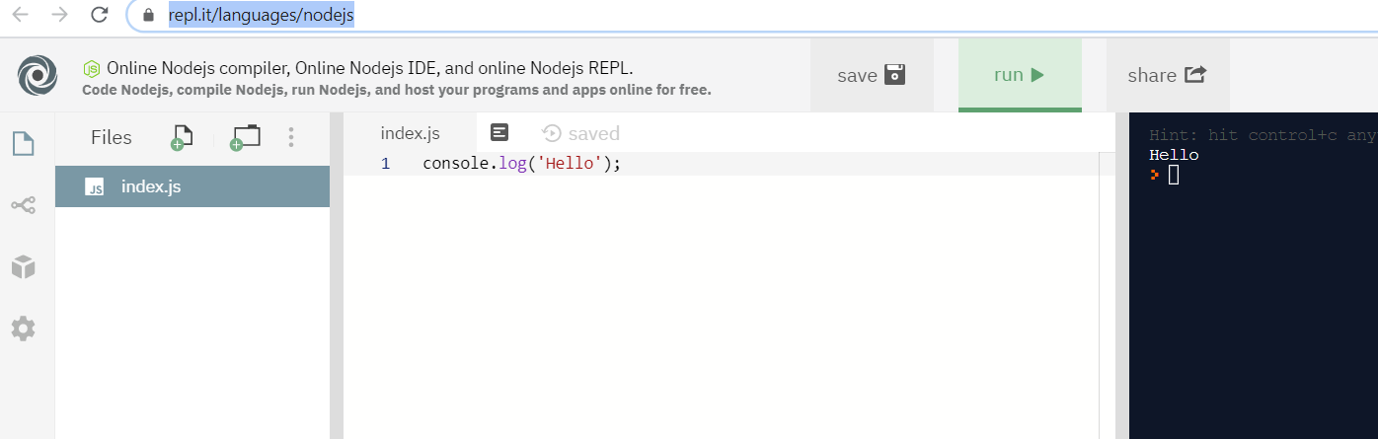
Node.js interpreter online
Link: https://repl.it/languages/nodejs

Slide 6
Reference & Links
This course is based on “Your First Week with Node.js”
Source demo: https://github.com/nashtech-garage/nodejs-training_courses
Demo Repl: vuilendi - Replit

Slide 7
How Do I install NodeJS?
Install Multiple Versions of Node.js using nvm
Windows
Uninstall any existing versions of Node.js
Delete any existing Node.js installation directories (such as C:\Program Files\nodejs)
Delete the existing npm install location (such as C:\Users\<user>\AppData\Roaming\npm)
After this, download and run the latest stable installer and you should be good to go!
macOS/Linus
With cURL:
With Wget:
This will clone the nvm repository to ~/.nvm and will make the required changes to your bash profile, so that nvm is available from anywhere in your terminal.
curl -o- https://raw.githubusercontent.com/creationix/nvm/v0.35.2/install.sh | bash
wget -qO- https://raw.githubusercontent.com/creationix/nvm/v0.35.2/install.sh | bash

Slide 8
Using nvm
Install node version
List all node installed
Use specific node version
Check it
nvm install 12.16
nvm ls
nvm use 12.16.2
node –v npm -v

Slide 9
When should I use it?

Slide 10
Run JavaScript on the Server
Not a new concept - First attempted by Netscape way back in 1994.
Node.js, however, is the first implementation to gain any real traction.
Provides some unique benefits, compared to traditional languages
Node now plays a critical role in the technology stack of many high-profile companies

Slide 11
Execution Model
Node.js is single-threaded but in the background, it uses multiple threads to execute asynchronous code with the help of the libuv library.
It’s also event-driven, which means that everything that happens in Node is in reaction to an event
New request comes in (one kind of event) the server will start processing it
If it then encounters a blocking I/O operation, it will register a callback before continuing to process the next event
When the I/O operation has finished (another kind of event), the server will execute the callback and continue working on the original request
Notes:
In very simplistic terms, when you connect to a traditional server, such as Apache, it will spawn a new thread to handle the request
the server has to wait for the database lookup to complete before it can move on to processing the result
If new requests come in while this is happening, the server will spawn new threads to deal with them
The most common way to support more connections is to add more servers.

Slide 12
2
The event loop efficiently manages a thread pool and executes tasks efficiently…
Node apps pass async tasks to the event loop, along with a callback
1
C++ Thread Pool
Thread 1
Thread 2
Thread n
(function, callback)
…
Node.js
Event Loop
(single-thread)
Task 1
Task 2
Node.js app
Task 3
Return 1
Callback1()
Task 4
3
… and executes each callback as tasks complete

Slide 13
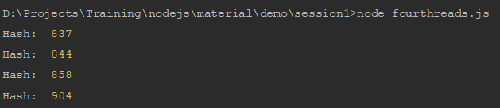
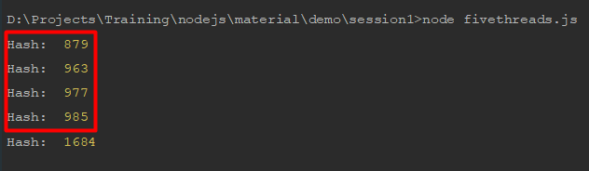
Node.js is single-threaded
We will run test with `fourthreads.js` and `fivethreads.js` and view the result (CPU: 4 process)
Four threads (fourthreads.js)
Five threads (fivethreads.js)

Slide 14
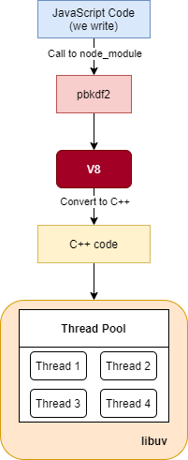
Node.js is single-threaded (2)

Slide 15
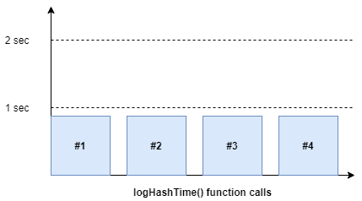
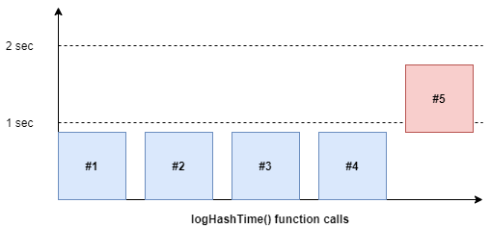
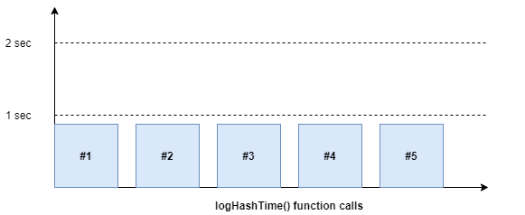
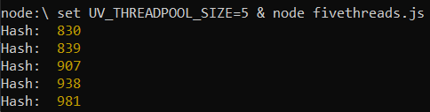
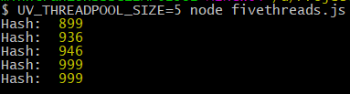
Code run-time
Notes:
UV_THREADPOOL_SIZE=5 node fivethreads.js

Slide 16
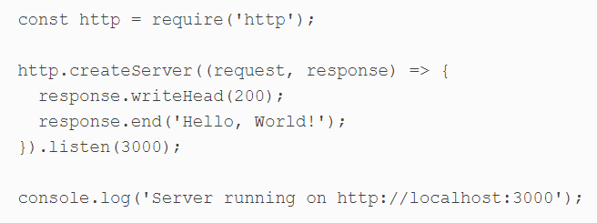
Hello World – Server version
Hello-world-server.js
Run command

Slide 17
What kind of Apps is Node.js is suited to?
Real-time interaction or Collaboration (chat, codeshare)
API handles lots of requests that are
I/O driven (such as those needing to perform operations on a database)
Sites involving data streaming (Node makes it possible to process files while they’re still being uploaded)
Simple CRUD app. (There’s a lot of frameworks that support us to build CRUD app)

Slide 18
Other Uses of Node
Used as a scripting language:
For automate repetitive tasks on your PC
For error prone tasks
Write your own command line tool
Build cross-platform desktop apps
Create your own robots

Slide 19
Build a simple page counter service with Node.js

Slide 20
Prerequisites
Download and install Node.js on platform of your choice.
You can also use a version manager such as nvm
The latest LTS Node release is a good choice
Install nodemon: can used to launch and restart Node.js applications whenever source code is changed
Install small-static-server (ss): can be used in any directory to launch a static, file-based web server
npm install -g nodemon
npm install -g small-static-server

Slide 21
Page Hit v1.0
Source Control (Optional)
Step 1: Initialization
Step 2: Main file (index.js)
Step 3: Additional Modules
Step 4: Test page

Slide 22
Step 0: Source Control
Source control applications such as Git help to back up code and manage revisions. (GitHub, BitBucket, GitLab, etc.)
We should have .gitignore to avoid not-commit files/ folders.
We will have node_modules/ folders when we run `npm install`, we should ignore this folder too.

Slide 23
Step 1: Initialization
Create a new folder, run `npm init` to create `package.json`
Input information for `package.json`. Update “scripts” section:
> npm start → start script
> npm run debug → using nodemon to monitor file changes and reports full stack traces
mkdir project1
cd project1
npm init
"scripts": {
"debug": "nodemon --trace-warnings ./index.js",
"start": "node ./index.js",
"test": "echo \"Error: no test specified\" && exit 1"
},

Slide 24
Step 2: Main file (index.js)
Create `index.js` file
> npm run debug
Wait for the message: “page hit …”.
Load http://localhost:3000/hello/world
'use strict’; const port = 3000, http = require('http'), url = require('url'); // new server http.createServer((req, res) => { let uri = url.parse(req.url).pathname; res.end(uri); }).listen(port); console.log(`page hit web service running on port ${port}`);

Slide 25
Step 3: Additional Modules
It’s practical to split code into other files with reusable chucks of related functionality
Create a new lib directory
Create lib/httppreferrer.js
'use strict'; const url = require('url'), crypto = require('crypto'); module.exports = (req) => { let r = url.parse(req.headers.referer || ''), ref = r.href ? r.protocol + r.host + r.pathname : null; return ref ? crypto.createHash('md5').update(ref).digest('hex') : null; };
Notes:
exports a function which accepts an HTTP request object as a parameter. If this object has a referer set, the function will concatinate its protocol, host and pathname values, then return a 32-character MD5 hash of this string

Slide 26
Step 3: Additional Modules (2)
Create lib/httpresponse.js
'use strict'; module.exports = ({ res = null, status = 200, mime = 'text/plain', content = '' }) => { res.writeHead(status, { 'Access-Control-Allow-Origin': '*', 'Content-Type': mime, 'Cache-Control': 'must-revalidate, max-age=0', 'Content-Length': Buffer.byteLength(content) }); res.end(content); };
Notes:
exports a function which, when passed an object containing an HTTP response object, responds with the appropriate HTTP headers and content
Note that Access-Control-Allow-Origin is a cross-origin resource sharing (CORS) header which allows any page to use the page hit service.

Slide 27
Step 3: Additional Modules (3)
Create lib/pagehit.js
const httpReferrer = require('./httpreferrer'); module.exports = class { // initialize constructor() { // counter storage this.counter = {}; } // increase URL counter count(req) { let hash = httpReferrer(req); if (!hash) return null; // define count default this.counter[ hash ] = this.counter[ hash ] || 0; // return incremented count return ++this.counter[ hash ]; } };
Notes:
When the count() method is passed an HTTP request object, it generates a hash (using lib/httpreferrer.js above). This is used to initialize and increment a property of the this.counter object which has its total count value returned.

Slide 28
Step 3: Additional Modules (4)
'use strict'; const // default HTTP port port = 3000, // Node.js modules http = require('http'), url = require('url'), // page counter object pagehit = new (require('./lib/pagehit'))(), // HTTP response httpResponse = require('./lib/httpresponse'); // new server http.createServer((req, res) => { // get referring page count let count = pagehit.count(req); // error: referring page not found if (!count) { httpResponse({ res, status: 400, content: 'No referrer' }); return; } // send appropriate response let uri = url.parse(req.url).pathname; switch (uri) { // JavaScript document.write() counter case '/counter.js': httpResponse({ res, mime: 'application/javascript', content: `document.write('<span class="pagecounter">${count}</span>');` }); break; // error: invalid HTTP request default: httpResponse({ res, status: 404, content: 'Not found' }); break; } }).listen(port); console.log(`page hit web service running on port ${port}`);
Update index.js, and run “npm run debug”
Notes:
The line pagehit = new (require('./lib/pagehit'))() initializes an object from the lib/pagehit.js class, so the count() method can be called in the server function.
The switch() statement handles routing. In this case, only requests to /counter.js are valid; a JavaScript document.write() statement is returned, which outputs the value of count.

Slide 29
Step 4: Test page
Create another folder, such as testpages. Create file page-jswrite.html
<!DOCTYPE html> <html lang="en"> <head> <meta charset="UTF-8"> <title>page hits</title> </head> <body> <p> This page has been viewed <script src="http://localhost:3000/counter.js"></script> times. </p> </body> </html>
Notes:
The line pagehit = new (require('./lib/pagehit'))() initializes an object from the lib/pagehit.js class, so the count() method can be called in the server function.
The switch() statement handles routing. In this case, only requests to /counter.js are valid; a JavaScript document.write() statement is returned, which outputs the value of count.

Slide 30
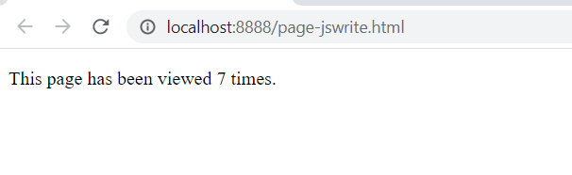
Step 4: Test page (2)
Run ss from this folder in another terminal:
Start a static file web server at http://localhost:8888
cd testpages
ss
server address: http://localhost:8888
root folder : ./testpages/
Notes:
The line pagehit = new (require('./lib/pagehit'))() initializes an object from the lib/pagehit.js class, so the count() method can be called in the server function.
The switch() statement handles routing. In this case, only requests to /counter.js are valid; a JavaScript document.write() statement is returned, which outputs the value of count.

Slide 31
Page Hit v2.0
Step 1: File utilities
Step 2: Modify lib/pagehit.js
Step 3: Test

Slide 32
File Storage
Solutions
Create data directory to store counters. (add data/ to .gitignore file.)
The server will trigger a save event after ten seconds. (this ensures saving occurs as a background task and is throttled during times of high load.)
`this.counter` of pagehit.js is converted to a JSON string and saved to a file with a unique name (based on the current date/time)
Once the file has successfully saved, all previously saved files are deleted from the data directory.
The application looks the most recent JSON file in the data directory and imports into `this.counter`
Storing page counters in memory means they reset every time the Node.js application is restarted

Slide 33
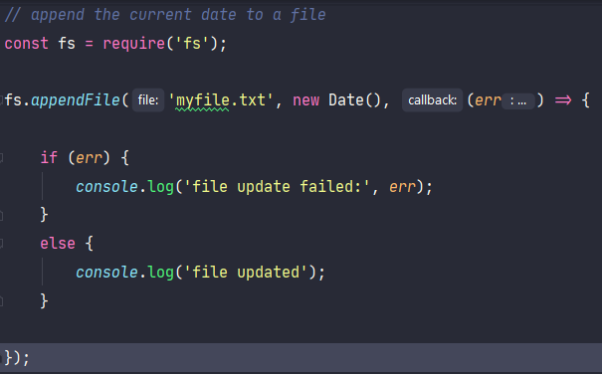
Node.js File System API
Node.js provides an extensive File System (fs) API which can manipulate, read, and write files and directories.
As default, Node.js use asysnc

Slide 34
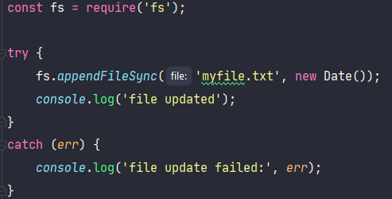
File system with sync
Synchronous 'sync' equivalents are also available
These are not Promise-based and block the entire Node.js process until they complete
For older releases of Node.js

Slide 35
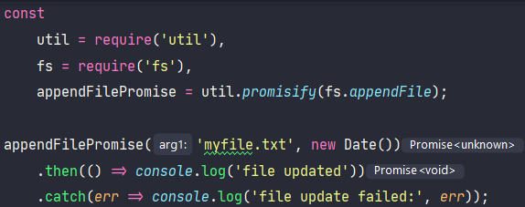
Promisify with file system function
It’s possible to Promisify any file system function using util.promisify

Slide 36
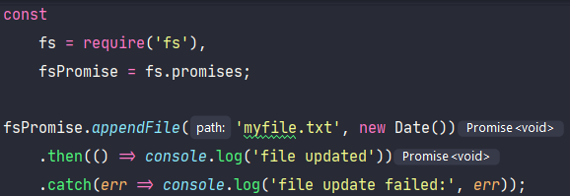
Promisify with file system function (2)
However, this is no longer necessary in recent versions of Node.js, because fs.promises provides Promise-based equivalents of all file system functions

Slide 37
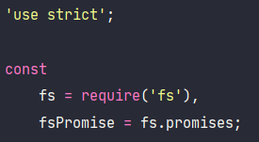
Step 1: File utilities
Create lib/fileutil.js
Use `fs` module for file process
Create info() function to return information of a file or directory, such as its type, permission, and creation time. It uses two fs functions:
access(path, mode): can test for existence, read, and write permissions
stat: returns meta information including the type (file or directory) and creation time.

Slide 38
Step 1: File utilities (2)
// returns information about a file/folder function info(fn) { const file = { path: fn, exists: false, read: false, write: false, isFile: false, isDir: false, time: 0 }; // If the accessibility checks are successful, Promises are resolved with no value return Promise.all([ fsPromise.access(fn, fs.constants.F_OK), fsPromise.access(fn, fs.constants.R_OK), fsPromise.access(fn, fs.constants.W_OK) ]) .then(fInfo => { file.exists = !fInfo[0]; if (!file.exists) return file; else { file.read = !fInfo[1]; file.write = !fInfo[2]; // Promise is resolved with the fs.Stats object for the given path return fsPromise.stat(fn) .then(fStat => { file.isFile = fStat.isFile(); file.isDir = fStat.isDirectory(); file.time = fStat.mtimeMs; return file; }) .catch(() => file); } }) .catch(() => file); }

Slide 39
Step 1: File utilities (3)
A folderUsable() function uses info() to check whether a directory exists, creates it if necessary, and returns information object.
The fs mkdir method is used to create the directory.
// return folder info object if it can be used async function folderUsable(folder) { try { // fetch folder information let fInfo = await info(folder); // create folder if required if (!fInfo.isDir) { await fsPromise.mkdir(folder); fInfo = await info(folder); } // folder accessible? return (fInfo.isDir && fInfo.read && fInfo.write ? fInfo : false); } catch (err) { console.log('folderUsable error:', err); return false; } }

Slide 40
Step 1: File utilities (4)
A folderList() function returns an information object for every file in a directory.
The fs readdir method fetches all file name into an array.
// return a sorted array of info objects for all files in a folder async function folderList(folder, ext = '', sortBy = 'time') { try { // names of all files in folder let filelist = await fsPromise.readdir(folder); // fetch file info filelist = await Promise.all( filelist.map(async f => await info(folder + f)) ); // remove unreadable files and sort return filelist .filter(fn => fn.isFile && fn.read && fn.path.endsWith(ext)) .sort((f1, f2) => f2[sortBy] - f1[sortBy]); } catch (err) { console.log('folderList error', err); return false; } }

Slide 41
Step 1: File utilities (5)
A write() function uses fs writeFile method to output content to a file.
// create a file, returns true or false async function write(fn, content = '') { try { await fsPromise.writeFile(fn, content); return true; } catch (err) { console.log('write error', err); return false; } }

Slide 42
Step 1: File utilities (6)
An unlinkMany() function deletes all files passed in an array of path strings or information objects.
The fs unlink method is processed in parallel on all items
// delete an array of files, return array of true/false async function unlinkMany(fnlist) { return await Promise.all( fnlist.map(async fn => { try { await fsPromise.unlink(fn.path ? fn.path : fn); return true; } catch (err) { console.log('unlink error', err); return false; } }) ); }

Slide 43
Step 1: File utilities (7)
Finally, the public functions are exported for use in other modules
// public functions module.exports = { info, folderUsable, folderList, write, unlinkMany };

Slide 44
Step 2: Modify lib/pagehit.js
The original lib/pagehit.js file is modified to save counter data to a file
We will update constructor()
Class constructors can’t be async themselves, but can run immediately involved async functions
const fileUtil = require('./fileutil'), httpReferrer = require('./httpreferrer'), // default data folder path = require('path'), dataFolder = path.resolve('./data') + path.sep, // file save throttling - no more than every 10 seconds saveFrequency = 10 * 1000;
Notes:
The path module provides useful cross-platform file path-parsing functions. In this case, it’s used to obtain the absolute name of a directory for saving data (data in the project’s folder).

Slide 45
Step 2: Modify lib/pagehit.js (2)
Update constructor()
Set folder property to a file information object
Set the saved property to an array of information objects
If at least one .json file exists, import it using require
constructor() { // counter storage this.counter = {}; // counter storage this.counter = {}; (async () => { // store folder available? this.folder = await fileUtil.folderUsable(dataFolder); if (!this.folder) return; // fetch all JSON files sorted most recent first this.saved = await fileUtil.folderList(this.folder.path, '.json'); // import and merge latest data if (this.saved.length) { Object.assign(this.counter, require(this.saved[0].path)); } })(); }

Slide 46
Step 2: Modify lib/pagehit.js (3)
The count() method is changed to start a 10-second timer whenever a page counter is incremented
this.save() is called 10 seconds after the first update occurs
// increase URL counter count(req) { let hash = httpReferrer(req); if (!hash) return null; // define count default this.counter[ hash ] = this.counter[ hash ] || 0; // save event this.saveTimer = this.saveTimer || setTimeout(this.save.bind(this), saveFrequency); // return incremented count return ++this.counter[ hash ]; }
Notes:
this.save.bind(this) → this.save() will be called after `saveFrequency` time.

Slide 47
Step 2: Modify lib/pagehit.js (4)
The save() method does the following:
Convert counter property to a JSON string and saves to file.
If save successful, delete other files, keep only reference file.
The saveTimer property is reset so further saves become possible
// store latest data async save() { // can save if (!this.folder) return; // save new file let fn = `${this.folder.path}hit${+ new Date()}.json`; if (await fileUtil.write(fn, JSON.stringify(this.counter))) { console.log(`page hits stored: ${fn}`); // delete old files await fileUtil.unlinkMany(this.saved); // add current file to saved list this.saved = [{ path: fn }]; } // reset timer this.saveTimer = null; }
Notes:
this.save.bind(this) → this.save() will be called after `saveFrequency` time.

Slide 48
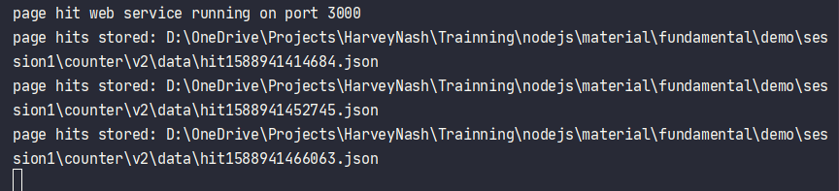
Step 3: Test
> npm run debug
Same test page, run ss

Slide 49
Job DONE?
The service is simplistic. It retains a total count, but couldn’t be used to determine how many people accessed within a period, such as today or this week
A counter for every page is always retained in memory. All OS processes have a memory limit and a busy service would eventually fail.
File handling is difficult, and a busy service would need to save many megabytes of data every few seconds. It would be possible to split data into multiple files or only append changed counters, but file handling would become even more complicated.
File saving can fail—for example, if disk space runs out or the process halts during a save operation. It may be possible to return to a previous file, but data would be lost.
Data is also lost if a counter is updated during a file save operation and the service is stopped soon afterwards!

Slide 50
Module.exports - exports

Slide 51
Why do we need Modules?
Technically we can write code without modules.
In JavaScript, modules should ideally allow us to
Abstract code: to delegate functionality to specialized libraries so that we don’t have to understand the complexity of their actual implementation.
Encapsulate code: to hide code inside the module if we don’t want the code to be changed.
Reuse code: to avoid writing the same code repeatedly.
Manage dependencies: to easily change dependencies without rewriting our code

Slide 52
Different Module Format
As JavaScript originally had no concept of modules, a variety of competing formats have emerged over time
The Asynchronous Module Definition (AMD) format is used in browsers.
The CommonJS (CJS) format is used in Node.js
The ES Module (ESM) format. Such as ES6 (ES2015), Javascript supports a native module format.
The System.register format was designed to support ES6 modules within ES5.
The Universal Module Definition (UMD) format can be used both in the browser and in Node.js.

Slide 53
Different Module Format
Module patterns in ES5
EcmaScript 5 and earlier editions were not designed with modules in mind
Over time, developers produced different patterns to simulate modular design in JavaScript

Slide 54
Immediately Invoked Function Expressions (IIFE)
IIFE is an anonymous function that is invoked when it is declared
The function is surrounded by parentheses
Immediately invoking a function declaration throws an error:
// Function expression (function(){ console.log('test'); })()
// Immediately Invoked Function Declaration function(){ console.log('test'); }() // => Uncaught SyntaxError: Unexpected token )

Slide 55
IIFE (2)
Immediately Invoked Function Expressions allow us to:
Encapsulate code complexity inside IIFE so we don't have to understand what the IIFE code does
Define variables inside the IIFE so they don't pollute the global scope (var statements inside the IIFE remain within the IIFE's closure)
But they don't provide a mechanism for dependency management

Slide 56
Revealing Module
The Revealing Module pattern is like an IIFE, but we assign the return value to a variable
Notice that we don't need the surrounding parentheses here because the word function is not at the beginning of the line.
// Expose module as global variable var singleton = function(){ // Inner logic function sayHello(){ console.log('Hello'); } // Expose API return { sayHello: sayHello } }() // Access module functionality singleton.sayHello(); // => Hello

Slide 57
Revealing Module (2)
Instead of a singleton, a module can also expose a constructor function
We don’t execute the function at declaration time.
// Expose module as global variable var Module = function(){ // Inner logic function sayHello(){ console.log('Hello'); } // Expose API return { sayHello: sayHello } }
var module = new Module(); module.sayHello(); // => Hello

Slide 58
Revealing Module (3)
The Revealing Module pattern offers similar benefits as an IIFE
But again does not offer a mechanism for dependency management.
As JavaScript evolved, many more different syntaxes were invented for defining modules, each with their own benefits and downsides.
We call them module formats.

Slide 59

Different Module Format
Asynchronous Module Definition (AMD)
The AMD format is used in browsers
Using define function to define modules
AMD implementations load smaller JavaScript files, and then only when they are needed

Slide 60
AMD
The AMD format is used in browsers and uses a define function to define modules
AMD implementation allow developers to encapsulate code in smaller, more logically-organized files
//Calling define with a dependency array and a factory function define(['jquery', 'underscore', 'libs/utils'], function($, _, Utils) { //Define the module value by returning a value. var obj = { //... }; return obj; })

Slide 61
AMD (2)
AMD provides some CommonJS interoperability. It allows for using a similar exports and require()
Demo: https://repl.it/@vuilendi/amd-example
define(function(require, exports) { var mod = require('./app/module'); exports.value = module.getValue(); })

Slide 62
Different Module Format
CommonJS (CJS)
The CommonJS (CJS) format is used in Node.js
Using require and module.exports to define dependencies and modules
npm ecosystem is built upon this format

Slide 63
CJS
CommonJS was a project with the goal to establish conventions on module ecosystem for JavaScript outside of the web browser.
The CommonJS (CJS) format is used in Node.js and uses require and module.exports to define dependencies and modules
var dep1 = require('./dep1'); var dep2 = require('./dep2'); module.exports = function(){ // ... }

Slide 64
CJS (2)
CommonJS wraps each module in a function called `require`, and includes an object called `module.exports`
In circle.js
In circle_calculate.js
const PI = Math.PI; exports.area = (r) => PI * r *r; exports.circumference = (r) => 2 * PI * r;
const circle = require('./circle'); console.log(`The area of a circle of radius 4 is ${circle.area(4)}`); console.log(`The circumference of a circle of radius 4 is ${circle.circumference(4)}`);

Slide 65
Different Module Format
ES Module (ESM)
As of ES6 (ES2015), JavaScript supports a native module format.
Using export keyword to export a module’s public API
Using an import keyword to import it

Slide 66
ESM
ES Modules is the ECMAScript standard for working with modules.
This standardization process completed with ES6 and browsers started implementing this standard trying to keep everything well aligned, working all in the same way.
ES Modules are supported in Chrome, Safari, Edge and Firefox (since version 60)
Modules are very cool, because they let you encapsulate all sorts of functionality, and expose this functionality to other JavaScript files, as libraries

Slide 67
ESM: import module
Import a module:
Import with alias, using as
Or load an entire module at once
import package from 'module-name'
import { sayHello } from './lib'; sayHello(); // => Hello
import { sayHello as say } from './lib'; say(); // => Hello
import * as lib from './lib'; lib.sayHello(); // => Hello

Slide 68
ESM: exports
lib.js
Which you can import like this:
// Export default function export default function sayHello(){ console.log('Hello'); } // Export non-default function export function sayGoodbye(){ console.log('Goodbye'); }
import sayHello, { sayGoodbye } from './lib'; sayHello(); // => Hello sayGoodbye(); // => Goodbye

Slide 69
ESM: exports (2)
You can export not only functions, but anything you like:
// Export default function export default function sayHello(){ console.log('Hello'); } // Export non-default function export function sayGoodbye(){ console.log('Goodbye'); } // Export simple value export const apiUrl = '...'; // Export object export const settings = { debug: true }

Slide 70
Different Module Format
System.register
Designed to support ES6 modules within ES5
It is a format that was developed out of collaboration and is supported as a module output in Traceur (as instantiate), Babel, TypeScript and Rollup (as system)
Currently these include SystemJS, SystemJS Self-Executing Bundles and ES6 Micro Loader

Slide 71
System.register
Traceur output & Babel system output
ES6
import { p as q } from './dep'; var s = 'local'; export function func() { return q; } export class C { }
System.register(['./dep'], function($__export, $__moduleContext) { var s, C, q; function func() { return q; } $__export('func', func); return { setters: [ // every time a dependency updates an export, // this function is called to update the local binding // the setter array matches up with the dependency array above function(m) { q = m.p; } ], execute: function() { // use the export function to update the exports of this module s = 'local'; $__export('C', C = $traceurRuntime.createClass(...)); } }; });

Slide 72
Different Module Format
Universal Module Definition (UMD)
UMD format can be used both in the browser and in Node.js
It’s useful when a module needs to be imported by a few different module loaders.

Slide 73
UMD
The UMD (Universal Module Definition) pattern is used when our module needs to be imported by a number of different module loaders (e.g. AMD, CommonJS).
The pattern itself consists of two parts:
An IIFE that checks for the module loader that is being implemented by the user. This will take two arguments root ( a this reference to the global scope) and factory (the function where we declare our module).
An anonymous function that creates our module. This is passed as the second argument to the IIFE portion of the pattern. This function is passed any number of arguments to specify the dependencies of the module.

Slide 74
UMD (2)
In the below example we check for AMD, then CommonJS. If neither of those loaders are in use, we fall back to making the module and its dependencies available globally.
(function (root, factory) { if (typeof define === 'function' && define.amd) { // AMD. Register as an anonymous module. define(['exports', 'b'], factory); } else if (typeof exports === 'object' && typeof exports.nodeName !== 'string') { // CommonJS factory(exports, require('b')); } else { // Browser globals factory((root.commonJsStrict = {}), root.b); } }(this, function (exports, b) { //use b in some fashion. // attach properties to the exports object to define // the exported module properties. exports.action = function () {}; }));

Slide 75
Requiring a Module
Node.js comes with a set of built-in modules that we can use in our code without having to install them
We need to require the module using the require keyword and assign the result to a variable.
Note that in CommonJS, modules are loaded synchronously and processed in the order they occur
const fs = require('fs'); const folderPath = '.'; // /home/test/ fs.readdir(folderPath, (err, files) => { files.forEach(file => { console.log(file); }); });

Slide 76
Creating and Exporting a Module
Now let’s look at how to create our own module and export it for use elsewhere in our program
company.js
company_info.js
Run node company_info.js
const getName = () => { return 'NashTech'; }; exports.getName = getName;
const company = require('./company'); console.log(`Company name: ${company.getName()}`);

Slide 77
Exporting Multiple Methods and Values
Update company.js
Update company_info.js
const getName = () => { return 'NashTech'; }; const getLocation = () => { return '364 Cong Hoa, P13, Q. Tan Binh' } const about = 'Software Development & Outsourcing' exports.getName = getName; exports.getLocation = getLocation; exports.about = about;
const company = require('./company'); console.log(`Company: ${company.getName()} - ${company.about}, location: ${company.getLocation()}`);

Slide 78
Variations in syntax
it’s possible to export methods and values as you go, not just at the end of the file.
Update company.js
Create company_short_info.js
exports.getName = () => { return 'NashTech'; }; const getLocation = () => { return '364 Cong Hoa, P13, Q. Tan Binh' } exports.about = 'Software Development & Outsourcing' exports.getLocation = getLocation;
const { getName, about } = require('./company'); console.log(`Company: ${getName()} - ${about}`);

Slide 79
Exporting a Default Value
In the above example, we’re exporting functions and values individually.
When you have a module that exports just the one thing, it’s more common to use module.exports
Create company_class.js

Slide 80
Exporting a Default Value (2)
Create company_class.js
Create company_class_info.js
class Company { constructor(name, location, about) { this.name = name; this.location = location; this.about = about; } getCompanyStats() { return ` Company Name: ${this.name} About: ${this.about} Location: ${this.location} ` } } module.exports = Company
const Company = require('./company_class'); const ourCompany = new Company(); console.log(ourCompany.getCompanyStats());

Slide 81
What’s the difference between module.exports and exports
Create moduleExport.js
Create testModuleExport.js
exports is reference of modules.exports
module.exports = { getName: () => { return 'NashTech'; }, getLocation: () => { return '364 Cong Hoa, P13, Q. Tan Binh'; }, about: 'Software Development & Outsourcing' };
const { getName, getLocation, about } = require('./moduleExport'); console.log(`Company: ${getName()} - ${about}, location: ${getLocation()}`);

Slide 82
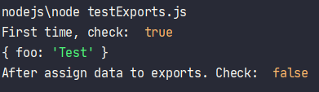
What’s the difference?
Create testExports.js
At the first time, we will get result = true.
After that we got false. So if we assign anything to module.exports, exports will not reference to module.exports.
exports.foo = 'Test' console.log('First time, check: ', exports===module.exports); console.log(module.exports); module.exports = {a: 'A'}; console.log('After assign data to exports. Check: ', exports===module.exports);

