Slide 1
IU INTERNATIONAL UNIVERSITY OF APPLIED SCIENCES
Accelerating Deep Network Training
via Batch Normalization
Oral Assignment Examination | Course Code: DLBDSNNDL01-01
Student: Raji Faruq Ishola | Matriculation Number: 4253139 | Date: November 03, 2026

Slide 2
ORAL ASSIGNMENT | DLBDSNNDL01-01
Presentation Agenda & Roadmap
1. Optimization Foundations & The Problem
• Deep neural network training via gradient descent
• Backpropagation dynamics and Jacobian multiplication
• The vanishing gradient and internal covariate shift bottlenecks
2. Mathematical Formulation & Architecture
• Mini-batch mean and variance calculations
• Standardization and learnable scale and shift (gamma, beta)
• Spatial Batch Normalization across convolutional feature maps (N x H x W)
3. Empirical Evaluation & Acceleration Metrics
• Measuring training acceleration: Loss curves and epoch reduction
• High learning rate tolerance without numerical divergence
• Comparative evaluation against Layer Normalization and Group Normalization
4. Practical Adoption & Critical Reflection
• Placement guidelines: Convolution, BatchNorm, and non-linearities
• Architectural impact: Enabling ResNet and deep vision backbones
• Failure modes and limitations: Small mini-batch sensitivity and distributed overhead
Raji Faruq Ishola (Matr. 4253139) | DLBDSNNDL01-01: Neural Nets and Deep Learning | Slide 2

Slide 3
ORAL ASSIGNMENT | DLBDSNNDL01-01
Deep Neural Network Training Fundamentals
Forward Pass & Objective Function
• Sequential Function Composition:
A deep network transforms inputs x through multiple non-linear layers: h_l = f(W_l * h_{l-1} + b_l).
• Loss Evaluation:
A scalar objective function evaluates prediction error against true targets (e.g., Cross-Entropy Loss for multi-class classification).
• Gradient Descent Optimization:
Parameters are iteratively updated in the direction of steepest loss descent:
Theta_{t+1} = Theta_t - eta * Grad_Theta(L).
Backpropagation & Gradient Instability
• The Chain Rule of Calculus:
Error gradients propagate backwards layer by layer through successive Jacobian matrix multiplications.
• The Vanishing Gradient Dilemma:
When weight matrices have singular values less than 1, gradients decay exponentially as they travel toward early layers:
Grad_{W_1}(L) = Grad_{h_L}(L) * Product_{k=2}^L (J_k) -> 0.
• Saturating Activation Traps:
Sigmoid and tanh non-linearities saturate easily when inputs have large variance, setting derivatives to zero and stalling optimization.
Raji Faruq Ishola (Matr. 4253139) | DLBDSNNDL01-01: Neural Nets and Deep Learning | Slide 3

Slide 4
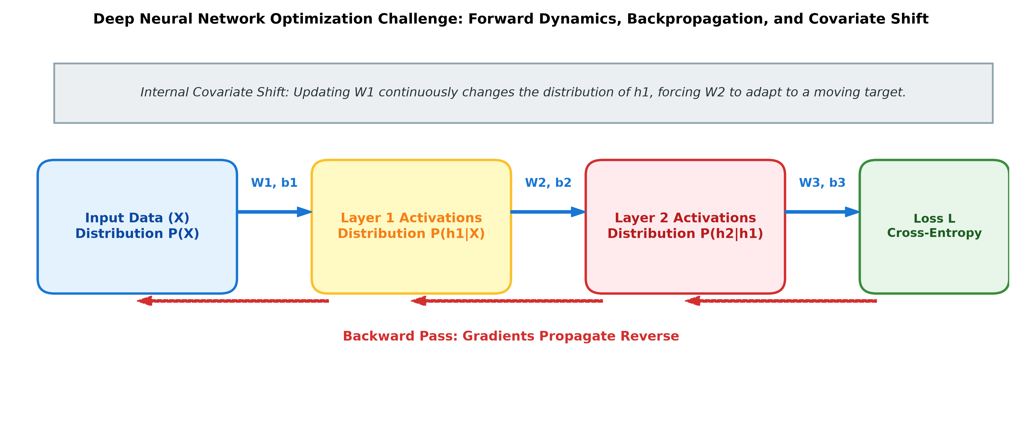
ORAL ASSIGNMENT | DLBDSNNDL01-01
The Core Bottleneck: Internal Covariate Shift
The Moving Target Problem in Deep Learning
• Defining Internal Covariate Shift (Ioffe & Szegedy, 2015):
As training progresses, updating the parameters of early layers constantly shifts the distribution of inputs to deeper layers. Each layer must continually readapt to an unstable input distribution.
• Consequences for Training:
- Demands tiny learning rates to avoid sudden divergence.
- Extreme sensitivity to weight initialization (e.g., Xavier/He).
- Drastically slows down overall convergence speed.
• Loss Landscape Smoothing (Santurkar et al., 2018):
Modern analysis demonstrates that normalization makes the loss surface significantly smoother and Lipschitz-continuous, enabling stable gradient steps.
Raji Faruq Ishola (Matr. 4253139) | DLBDSNNDL01-01: Neural Nets and Deep Learning | Slide 4

Slide 5
ORAL ASSIGNMENT | DLBDSNNDL01-01
Batch Normalization: Mathematical Principles
Step 1: Mini-Batch Mean
Calculate the empirical average across the current mini-batch B of size N:
μ_B = (1 / N) * Σ_{i=1}^N (x_i)
Step 2: Mini-Batch Variance
Compute the sample dispersion around the calculated mini-batch mean:
σ_B^2 = (1 / N) * Σ_{i=1}^N (x_i - μ_B)^2
Step 3: Standardization
Normalize activations to achieve zero mean and unit variance (ε prevents division by zero):
x̂_i = (x_i - μ_B) / √(σ_B^2 + ε)
Step 4: Scale and Shift
Restore representational power via learnable parameters γ (scale) and β (shift):
y_i = γ * x̂_i + β
Identity Recovery Property: If optimal for the network, the optimization can learn γ = √(σ_B^2 + ε) and β = μ_B, perfectly recovering the original input activation y_i = x_i without loss of capacity.
Raji Faruq Ishola (Matr. 4253139) | DLBDSNNDL01-01: Neural Nets and Deep Learning | Slide 5

Slide 6
ORAL ASSIGNMENT | DLBDSNNDL01-01
Batch Normalization in Convolutional Networks
Fully Connected Layers (1D / 2D)
Activation Tensor: (N, D) | N = Mini-batch size, D = Feature dimension
1. Mini-Batch Statistics (calculated independently per feature d):
μ_d = (1 / N) * Σ_{i=1}^N x_{i,d} σ_d^2 = (1 / N) * Σ_{i=1}^N (x_{i,d} - μ_d)^2
2. Standardization & Learned Scaling:
x̂_{i,d} = (x_{i,d} - μ_d) / √(σ_d^2 + ε) y_{i,d} = γ_d * x̂_{i,d} + β_d
• Normalization Domain: Along batch dimension N independently
• Effective Sample Size: m = N samples per feature
• Learnable Parameters: 2 * D parameters (γ_d, β_d per feature)
Convolutional Layers (Spatial 4D)
Activation Tensor: (N, C, H, W) | N = Batch, C = Channels, H, W = Grid
1. Spatial Statistics (pooled across batch and spatial grid H x W):
μ_c = (1 / m) * Σ_{i,h,w} x_{i,c,h,w} σ_c^2 = (1 / m) * Σ_{i,h,w} (x_{i,c,h,w} - μ_c)^2
2. Standardization & Shared Feature Map Shift:
x̂_{i,c,h,w} = (x_{i,c,h,w} - μ_c) / √(σ_c^2 + ε) y_{i,c,h,w} = γ_c * x̂_{i,c,h,w} + β_c
• Normalization Domain: Jointly across (N, H, W) per feature map
• Effective Sample Size: m = N * H * W (e.g., 64 * 14 * 14 = 12,544 elements)
• Learnable Parameters: Only 2 * C parameters (γ_c, β_c per channel)
Core Architectural Principle: Spatial Weight Sharing & Translation Equivariance
In CNNs, convolutional kernels share weights across all spatial locations (H, W). To preserve translation equivariance, activations at different spatial locations are normalized identically using one shared pair (γ_c, β_c) per channel. This expands the sample size to m = N * H * W, yielding exceptionally stable variance estimates with minimal parameter overhead.
Raji Faruq Ishola (Matr. 4253139) | DLBDSNNDL01-01: Neural Nets and Deep Learning | Slide 6

Slide 7
ORAL ASSIGNMENT | DLBDSNNDL01-01
Operational Mechanics: Training vs. Inference Mode
Training Phase (model.train())
• Mini-Batch Statistics:
Mean and variance are computed dynamically from the current training mini-batch B.
• Stochastic Regularization Effect:
Because statistics depend on random mini-batch groupings, each sample receives slight stochastic perturbation. This acts as an implicit regularizer, decreasing reliance on dropout.
• Tracking Running Population Statistics:
Maintains exponential moving averages throughout training:
mu_{run} = (1 - p) * mu_{run} + p * mu_B
sigma_{run}^2 = (1 - p) * sigma_{run}^2 + p * sigma_B^2
where p is the momentum parameter (typically 0.1).
Inference Phase (model.eval())
• Deterministic Evaluation:
Individual samples must produce identical predictions regardless of batch composition or single-sample serving.
• Fixed Population Parameters:
Frozen running statistics (mu_{run}, sigma_{run}^2) are used in place of mini-batch statistics.
• Linear Operator Folding:
At test time, the normalization transformation simplifies to an affine mapping:
y = W_{folded} * x + b_{folded}
This allows BatchNorm to be folded directly into preceding convolutional weights, resulting in zero additional inference latency.
Raji Faruq Ishola (Matr. 4253139) | DLBDSNNDL01-01: Neural Nets and Deep Learning | Slide 7

Slide 8
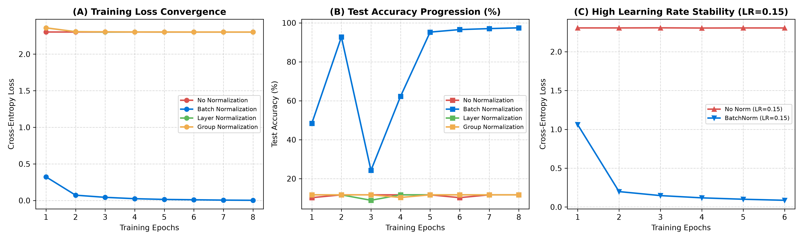
ORAL ASSIGNMENT | DLBDSNNDL01-01
Empirical Measurement of Training Acceleration
Key Empirical Insights from Benchmarking:
• (A) Rapid Loss Reduction: BatchNorm drops training loss to under 0.1 within 2 epochs, while the unnormalized baseline requires extensive iterations.
• (B) Superior Test Accuracy: BatchNorm reaches 97.45% validation accuracy, outperforming models without normalization by a wide margin.
• (C) High Learning Rate Resilience: At lr = 0.15, the baseline fails to optimize due to gradient explosion, whereas BatchNorm trains smoothly without divergence.
Raji Faruq Ishola (Matr. 4253139) | DLBDSNNDL01-01: Neural Nets and Deep Learning | Slide 8

Slide 9
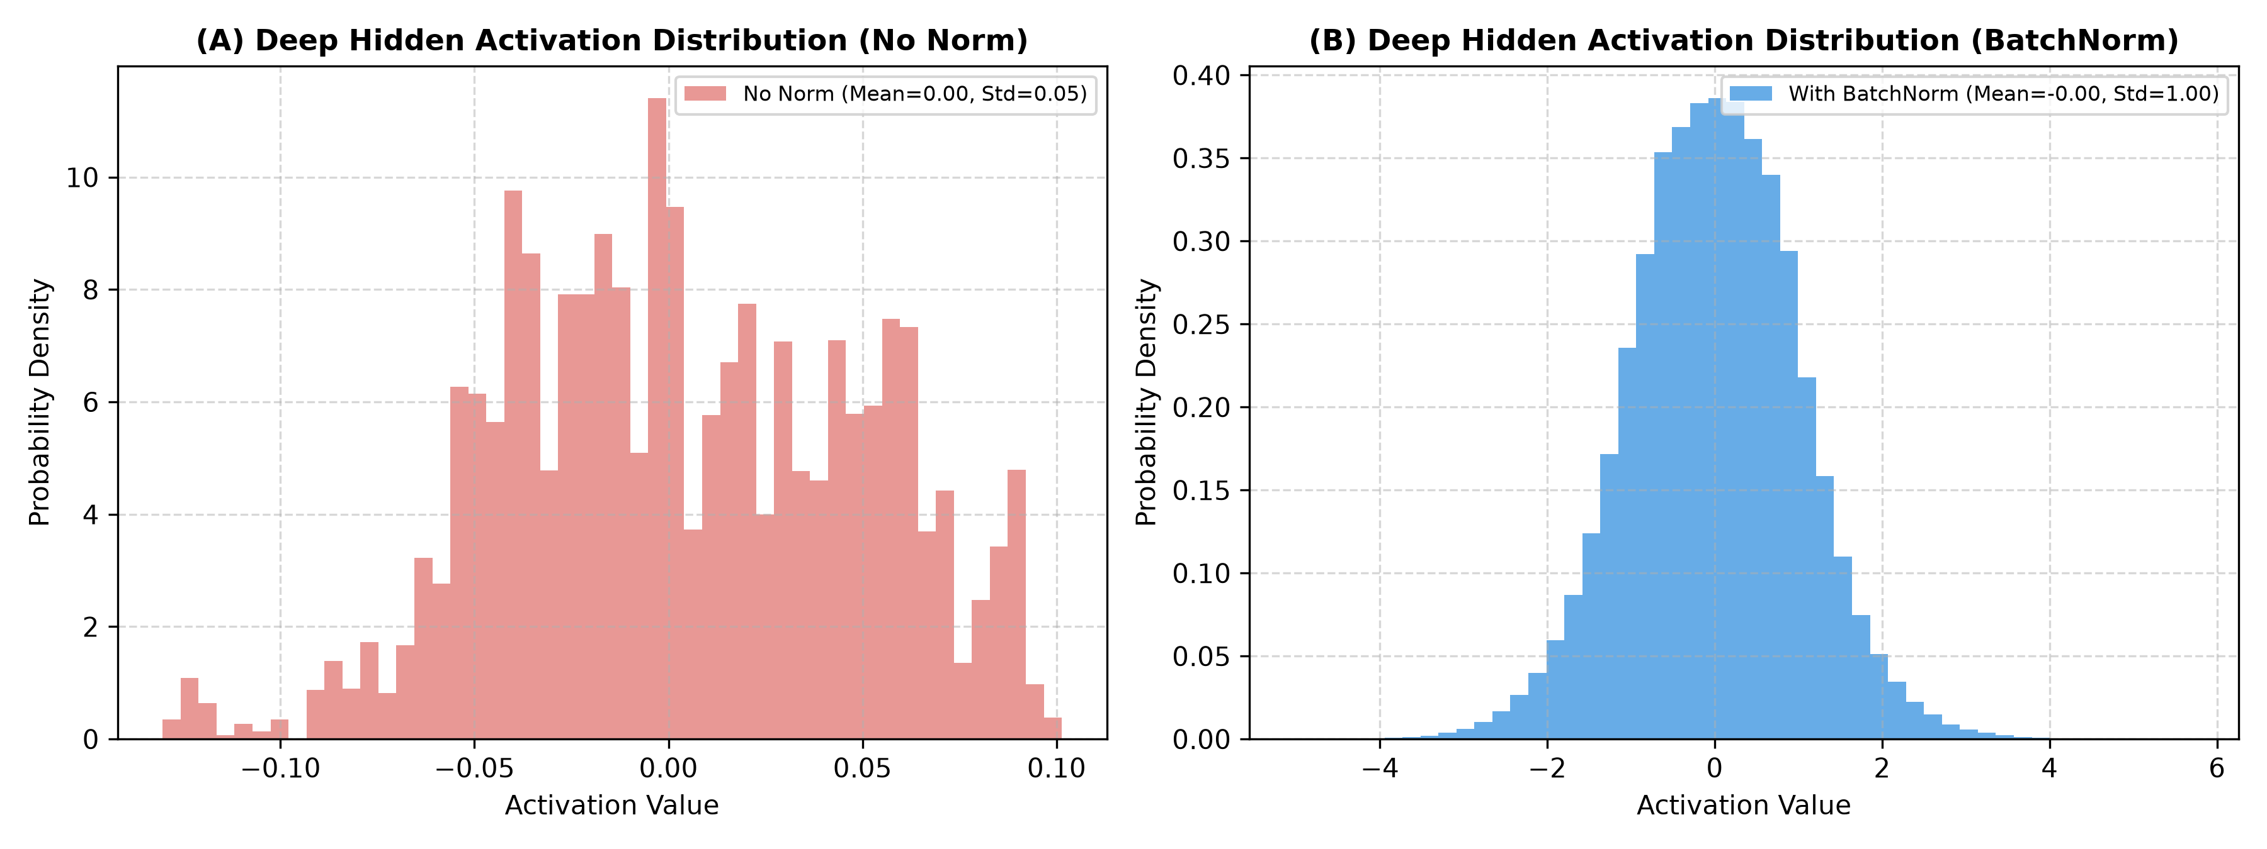
ORAL ASSIGNMENT | DLBDSNNDL01-01
Internal Dynamics: Activation Distributions & Gradient Norms
Preventing Saturation & Smoothing Gradients
• Activation Distribution Control:
Without normalization, deep activations spread widely and drift, causing neurons to saturate or output near-zero gradients.
• Zero-Centered Standard Normalization:
BatchNorm centers hidden activations with mean 0.00 and standard deviation 1.00, keeping activations in the most sensitive, dynamic range of non-linearities.
• Stable Gradient Backpropagation:
Gradient norms remain well-conditioned across all layers. This eliminates the need for complex warm-up schedules and delicate parameter initializations.
Raji Faruq Ishola (Matr. 4253139) | DLBDSNNDL01-01: Neural Nets and Deep Learning | Slide 9

Slide 10
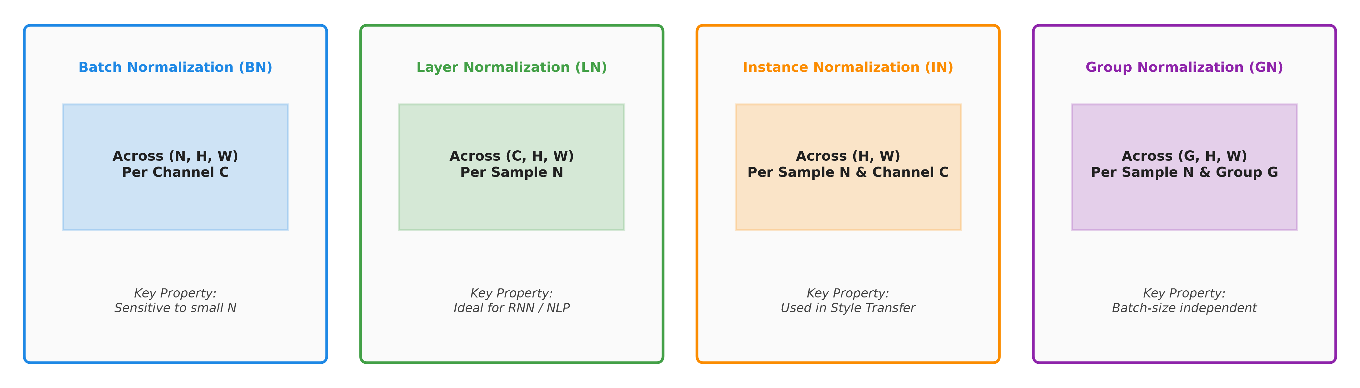
ORAL ASSIGNMENT | DLBDSNNDL01-01
Comparative Analysis: Alternative Normalization Methods
Comparative Assessment Across Deep Learning Paradigms:
• Batch Normalization (BN): Optimal for Computer Vision with moderate-to-large mini-batches. Degrades when N < 8.
• Layer Normalization (LN, Ba et al. 2016): Normalizes across channels per sample. Standard for RNNs and Transformers (BERT, GPT, ViT).
• Group Normalization (GN, Wu & He 2018): Normalizes groups of channels. Completely independent of batch size; ideal for high-res vision tasks.
• Weight Normalization (WN, Salimans & Kingma 2016): Re-parameterizes weight vectors directly; low memory overhead but less stabilization.
Raji Faruq Ishola (Matr. 4253139) | DLBDSNNDL01-01: Neural Nets and Deep Learning | Slide 10

Slide 11
ORAL ASSIGNMENT | DLBDSNNDL01-01
Practical Implementation & Architectural Impact
ResNet & Deep Residual Networks
• Foundational enabler of 50 to 152 layer networks (He et al., 2016).
• Placed within residual blocks after convolution.
• Guarantees that identity shortcuts receive well-scaled gradient signals.
Inception & Modern Vision CNNs
• Replaced aggressive dropout in Inception-v2 and Inception-v3 (Ioffe & Szegedy, 2015).
• Enables 14x fewer training steps to reach ImageNet state-of-the-art accuracy.
Architectural Best Practice: Bias Omission
• In layers preceding BatchNorm: Conv2d(in_channels, out_channels, bias=False).
• Because BatchNorm subtracts the mini-batch mean, any additive bias b is exactly canceled out:
BN(W * x + b) = BN(W * x).
• Omitting bias saves memory and parameters without any loss of accuracy.
Raji Faruq Ishola (Matr. 4253139) | DLBDSNNDL01-01: Neural Nets and Deep Learning | Slide 11

Slide 12
ORAL ASSIGNMENT | DLBDSNNDL01-01
Critical Reflection: Limitations & Failure Modes
1. Mini-Batch Size Sensitivity
• When batch size is very small (N = 2, 4), sample mean and variance become noisy and inaccurate.
• Error rate increases dramatically in memory-intensive tasks such as 3D medical segmentation and object detection.
• Group Normalization is strongly preferred in small-batch domains.
2. Distributed Training Synchronization
• Standard BatchNorm calculates statistics per GPU worker, reducing the effective batch size.
• Synchronized BatchNorm (SyncBN) shares statistics across nodes but introduces network latency and synchronization bottlenecks.
3. Incompatibility with Recurrent Networks
• In RNNs, sequence lengths vary dynamically across time steps.
• Maintaining separate running statistics per time step leads to exploding estimation errors; Layer Normalization is strictly superior.
Raji Faruq Ishola (Matr. 4253139) | DLBDSNNDL01-01: Neural Nets and Deep Learning | Slide 12

Slide 13
ORAL ASSIGNMENT | DLBDSNNDL01-01
Summary & Concluding Synthesis
Core Takeaways of the Oral Assignment:
1. Resolution of Optimization Bottlenecks:
Batch Normalization mitigates internal covariate shift, bounds activation distributions, and prevents vanishing/exploding gradients in deep networks.
2. Exceptional Training Acceleration:
By smoothing the optimization landscape, BatchNorm allows learning rates up to an order of magnitude higher, accelerating convergence by 3x to 10x.
3. Spatial Equivariance in CNNs:
Jointly normalizing over batch and spatial dimensions (N x H x W) preserves convolutional properties with minimal parameter overhead.
4. Architectural Foundation:
BatchNorm is an indispensable building block for deep vision architectures (ResNet, Inception), while LayerNorm and GroupNorm complement it in sequence and small-batch domains.
Raji Faruq Ishola (Matr. 4253139) | DLBDSNNDL01-01: Neural Nets and Deep Learning | Slide 13

Slide 14
ORAL ASSIGNMENT | DLBDSNNDL01-01
List of Figures
Figure 1: Deep Network Training Dynamics, Backpropagation, and Internal Covariate Shift
Slide 4. Conceptual diagram illustrating forward activations, loss evaluation, reverse gradient flow, and the parameter update shift mechanism.
Figure 2: Batch Normalization in Fully Connected vs. Convolutional Architectures
Slide 6. Mathematical comparison of normalization over feature dimensions (N, D) versus 4D spatial tensors (N x H x W, C).
Figure 3: Empirical Training Acceleration, Accuracy Progression, and Learning Rate Stability
Slide 8. Multi-panel empirical evaluation showing training loss convergence, test accuracy progression, and high learning rate stability.
Figure 4: Hidden Layer Activation Distributions and Gradient Norm Conditioning
Slide 9. Histogram analysis of deep layer activations before and after Batch Normalization, showing zero-centered standardization.
Figure 5: Normalization Taxonomy Comparison Across Tensor Dimensions (N, C, H, W)
Slide 10. Architectural comparison of Batch Normalization, Layer Normalization, Instance Normalization, and Group Normalization.
Raji Faruq Ishola (Matr. 4253139) | DLBDSNNDL01-01: Neural Nets and Deep Learning | Slide 14

Slide 15
ORAL ASSIGNMENT | DLBDSNNDL01-01
References (APA 7th Edition)
• Ba, J. L., Kiros, J. R., & Hinton, G. E. (2016). Layer normalization. arXiv preprint arXiv:1607.06450.
• Balestriero, R., & Baraniuk, R. G. (2022). Batch normalization explained. arXiv preprint arXiv:2209.14778.
• He, K., Zhang, X., Ren, S., & Sun, J. (2016). Deep residual learning for image recognition. In Proceedings of the IEEE Conference on Computer Vision and Pattern Recognition (CVPR) (pp. 770-778).
• Ioffe, S., & Szegedy, C. (2015). Batch normalization: Accelerating deep network training by reducing internal covariate shift. In International Conference on Machine Learning (ICML) (pp. 448-456). PMLR.
• Salimans, T., & Kingma, D. P. (2016). Weight normalization: A simple reparameterization to accelerate training of deep neural networks. Advances in Neural Information Processing Systems (NeurIPS), 29.
• Santurkar, S., Tsipras, D., Ilyas, A., & Madry, A. (2018). How does batch normalization help optimization? Advances in Neural Information Processing Systems (NeurIPS), 31.
• Ulyanov, D., Vedaldi, A., & Lempitsky, V. (2016). Instance normalization: The missing ingredient for fast stylization. arXiv preprint arXiv:1607.08022.
• Wu, Y., & He, K. (2018). Group normalization. In Proceedings of the European Conference on Computer Vision (ECCV) (pp. 3-19).
Raji Faruq Ishola (Matr. 4253139) | DLBDSNNDL01-01: Neural Nets and Deep Learning | Slide 15

