Slide 1


Slide 2
product title
what product does

Slide 3

Members
Member Name - NIIT Team
Member Name - NIIT Team
Member Name - NIIT Team
Member Name - NIIT Team

Slide 4
Domain problem
Given problem statement …..
Key ask in problem statement 1
Key ask in problem statement 2

Slide 5
Problem Analysis
Expand the problem to fully understand in the context of the domain
Diagram OR List the stake holders
Any mind map of Analysis & Synthesis or I Wish-I Like type of analysis

Slide 6
Computational Problems
Identified computational problems from the expanded problem analysis
can be data flow, read & write imbalance type of problems
can be algorithmic computational challenges
can be the nature of the process, scale, availability issues
RASP issues
highlight which is OR are make or break problem to solve

Slide 7

Solution

Slide 8
architecture solution
The architecture paradigms, patterns required to solve the problem
List the trade-offs needed to be done
distributed architecture proposed
How R.A.S.P factors are handled in the design or solution

Slide 9
Data Architecture
What is the data problem
What type of data model is required to solve what type of problem, why that model only ?
How R.A.S.P factors are handled at Data architecture level
Whats the different levels of data maintained so data is not lost (if necessary)

Slide 10
Release plan
How do you communicate the architecture to team
What is the plan for realising the architecture solution
Which & how much architecture solution is realised at each release
What are your ask (team, resources) to realise the architecture solution

Slide 11
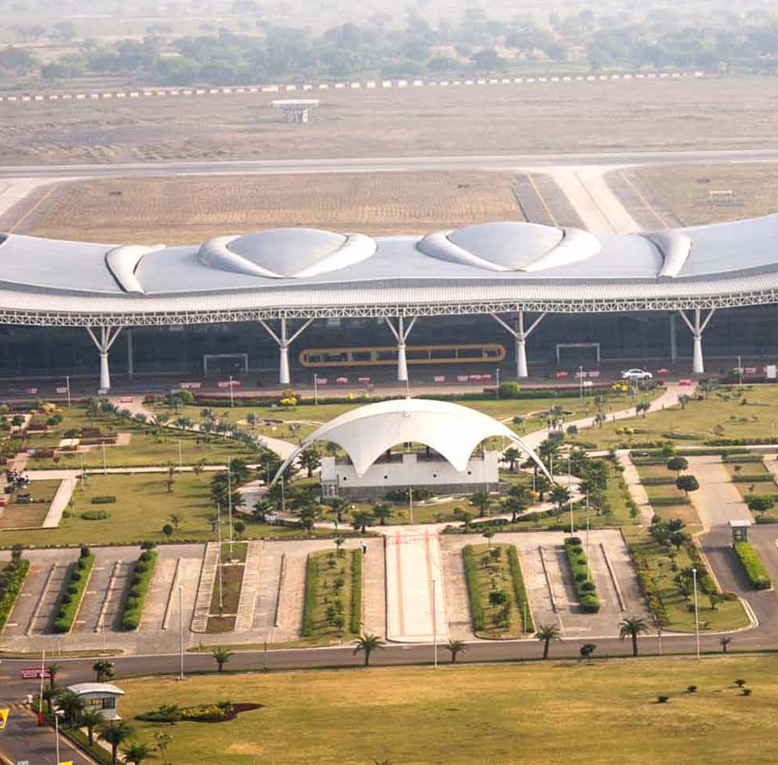


Thanks

