Slide 1
Linear Regression

Slide 2
Goal
To understand regression
To understand linear relationship
To understand gradient descent
To explain the How Good the model is via R^{2.}
Understand the acceptance of the model.

Slide 3
Machine Learning
Supervised Machine Learning
Regression Problem
Classification Problem
Unsupervised Machine Learning
Dimensionality Reduction
Clustering

Slide 4
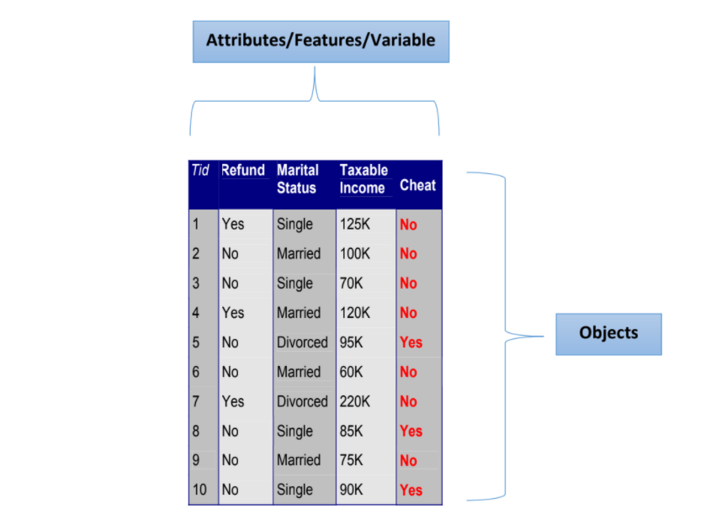
Attribute/Feature/Variables

Slide 5
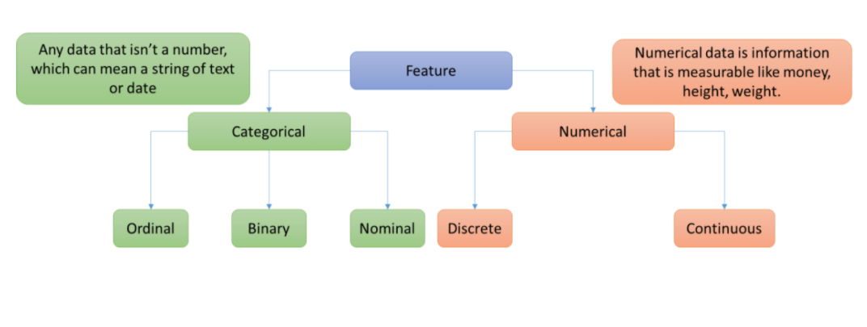
Types of Variables

Slide 6
Historical Origin of Regression
The term Regression was introduced by Francis Galton. In a famous paper, Galton found that, although there was a tendency for tall parents to have tall children and for short parents to have short children, the average height of children born of parents of a given height tended to move or “regress” toward the average height in the population as a whole. In other words, the height of the children of unusually tall or unusually short parents tends to move toward the average height of the population.
Galton’s law of universal regression was confirmed by his friend Karl Pearson, who collected more than a thousand records of heights of members of family groups. He found that the average height of sons of a group of tall fathers was less than their fathers’ height and the average height of sons of a group of short fathers was greater than their fathers’ height, thus “regressing” tall and short sons alike toward the average height of all men.
In the words of Galton, this was “regression to mediocrity”

Slide 7
Regression
Regression searches for relationships among variables.
For example, you can observe several employees of some company and try to understand how their salaries depend on the features, such as experience, level of education, role, city they work in, and so on.
This is a regression problem where data related to each employee represent one observation. The presumption is that the experience, education, role, and city are the independent features, while the salary depends on them.

Slide 8
Terminologies
Feature
Target Variable/ Response Variable
Train Data/ Test Data
Cost Function
Loss Function

Slide 9
Terminologies
Cost Function
Cost function is a measure of how wrong the model is in terms of its ability to estimate the relationship between X and y.

Slide 10
Terminologies
Loss function: is usually a function defined on a data point, prediction and label, and measures the penalty. For example: Square loss
Cost function: is usually more general. It might be a sum of loss functions over your training set plus some model complexity penalty (regularization). For example: MSE

Slide 11
Hypothesis Behind Linear Regression
The dependent variable Y has a linear relationship to the independent variable X.
For each value of X, the probability distribution of Y has the same standard deviation σ. In other words data always follows Normal Distribution.

Slide 12
Relationship Between Feature and Target Variable via Scatter Plot

Slide 13
Data Plotting and Understanding Properties

Slide 14
Data Plotting and Understanding Properties
Average line where y = b = 2

Slide 15
Data Plotting and Understanding Properties
The distance between average value and first data point = b – y₄
The distance between average value and first data point = b – y₅
Average line where y = b = 2
The distance between average value and first data point = b – y₁
The distance between average value and first data point = b – y₂

Slide 16
Overall Distance/residual = d₁ + d₂ + d₃ + d₄ + d₅
The issue with this residual is d₁ and d₂ is positive, d₃ = 0 but d₄, d₅ is negative. So it may be 0 even negative in most of the cases and it will lead to wrong result.
d₅ = b – y₅
d₄ = b – y₄
Average line where y = b = 2
So, we use the square of residuals and sum them up. It’s called “Sum of Squared Residual”.
d₂ = b – y₂
d₁ = b – y₁
Sum of Squared Residuals = d₁² + d₂² + d₃²+ d₄² + d₅²
Our Target is to Minimize The Sum of Squared Residuals

Slide 18
So let’s consider a random straight line equation
y = m * x + c
Where
m = The slope of the line
c = The intercept of the line
We want to find the suitable value for m and c so that the sum of squared residual is minimum.

Slide 19
Sum of squared residuals = (mx₁ + c – y₁)² + (mx₂ + c – y₂)² + (mx₃ + c – y₃)² + (mx₄ + c – y₄)² + (mx₅ + c – y₅)²
Since we want a line that gives us the smallest sum of square residuals, the best way to do this is called “Least Square Method”.

Slide 20
To find out optimal value of m and c, we do derivative of the function.
A derivative of a function tells us about the slope at each point.
Remember that, different line are formed for the different values of m and c
SSR = (mx₁ + c – y₁)² + (mx₂ + c – y₂)² + (mx₃ + c – y₃)² + (mx₄ + c – y₄)² + (mx₅ + c – y₅)²
We differentiate it with respect to a and b and equate to 0. By solving this 2 equations, we get the value of a and b.

Slide 21
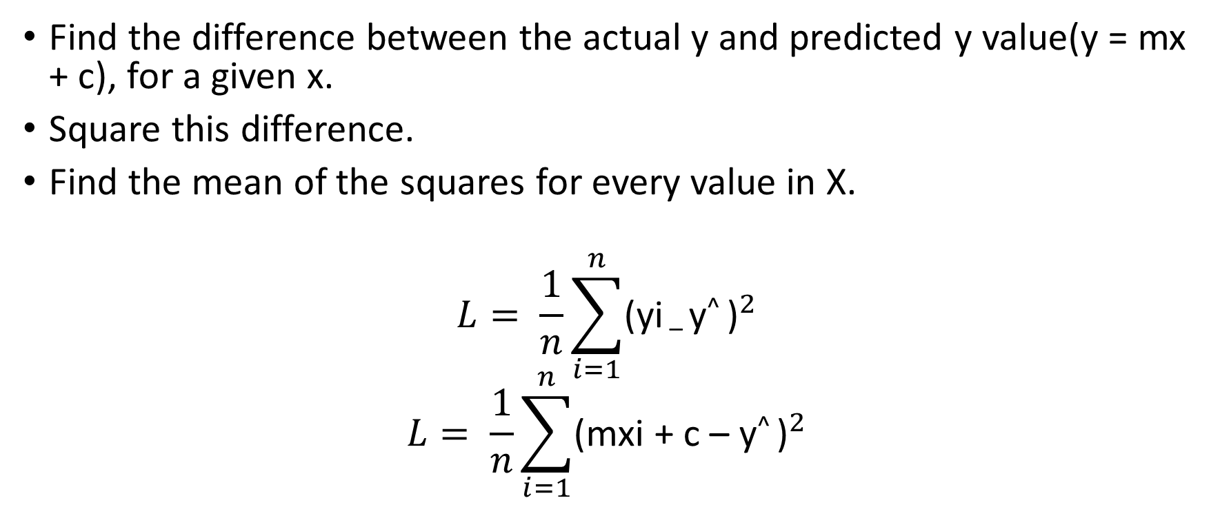
Loss Function
Find the difference between the actual y and predicted y value(y = mx + c), for a given x.
Square this difference.
Find the mean of the squares for every value in X.
$$L= \frac{1}{n}\sum_{i=1}^{n}{{\text{(}\text{yi}\text{ – }\text{y}\text{^ }\text{)}}^{2}}$$
$$L= \frac{1}{n}\sum_{i=1}^{n}{{\text{(}\text{mxi}\text{ + }\text{c} \text{– }\text{y}\text{^ }\text{)}}^{2}}$$

Slide 22
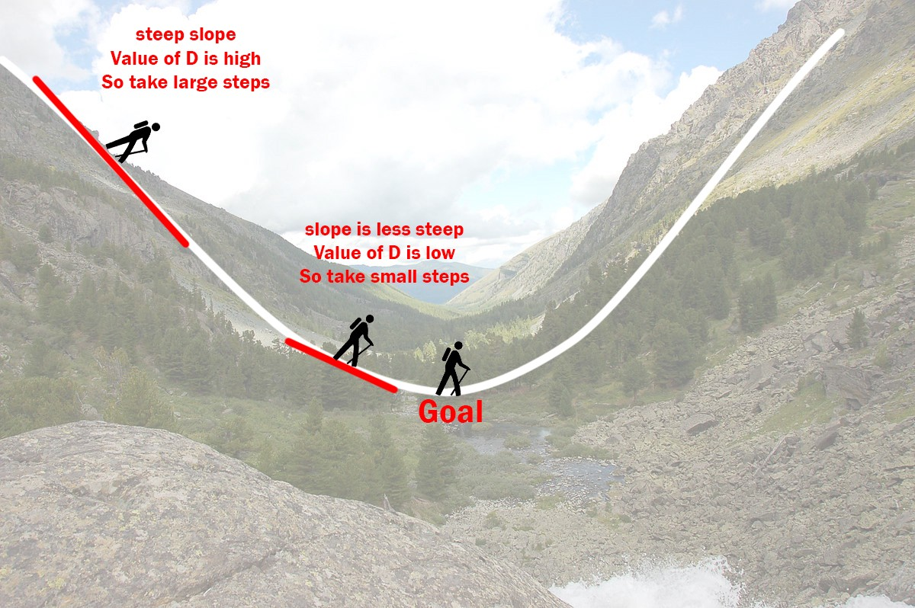
The Gradient Descent Algorithm
Used for finding optimum value

Slide 23
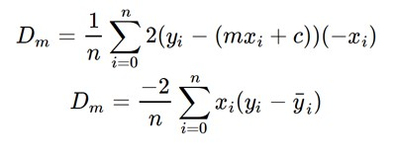
Gradient Descent
Initially let m = 0 and c = 0. Let L be our learning rate. This controls how much the value of m changes with each step. L could be a small value like 0.0001 for good accuracy.
Calculate the partial derivative of the loss function with respect to m, and plug in the current values of x, y, m and c in it to obtain the derivative value D.

Slide 24

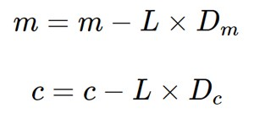
Gradient Descent
Dₘ is the value of the partial derivative with respect to m. Similarly lets find the partial derivative with respect to c, Dc :
Now we update the current value of m and c using the following equation:

Slide 25
Gradient Descent
We repeat this process until our loss function is a very small value or ideally 0 (which means 0 error or 100% accuracy). The value of m and c that we are left with now will be the optimum values.
Notes:
Now going back to our analogy, m can be considered the current position of the person. D is equivalent to the steepness of the slope and L can be the speed with which he moves. Now the new value of m that we calculate using the above equation will be his next position, and L×D will be the size of the steps he will take. When the slope is more steep (D is more) he takes longer steps and when it is less steep (D is less), he takes smaller steps. Finally he arrives at the bottom of the valley which corresponds to our loss = 0.

Slide 26
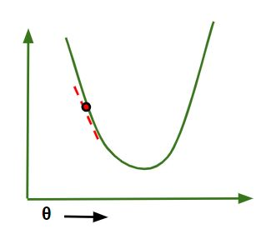
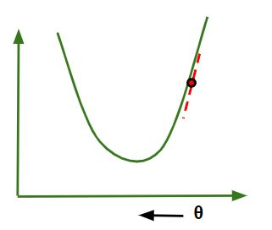
Gradient Descent

Slide 27
Step 1
We want to minimize the sum of squared distance between observed value.
Step 2
We do this by taking derivative to loss function and find where it is 0. Then we solve the equation to find value for m and c.
Step 3
The final line gives the line which has most optimal sum of squared value.

Slide 28
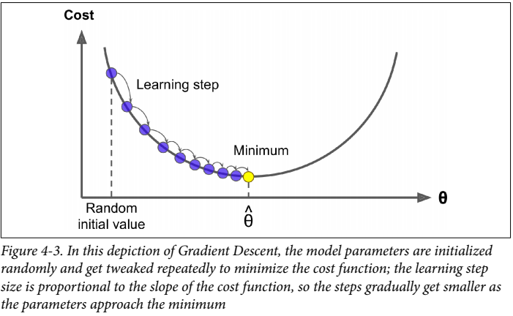
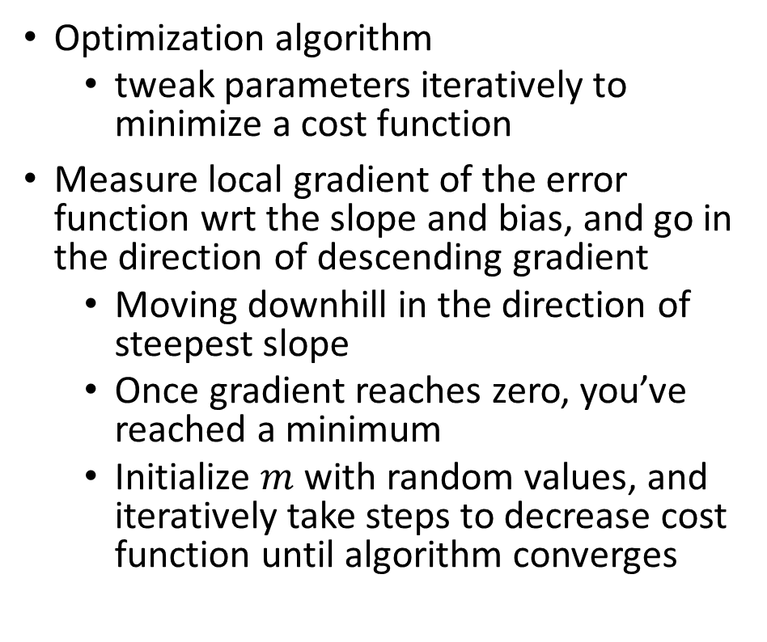
Gradient Descent
Optimization algorithm
tweak parameters iteratively to minimize a cost function
Measure local gradient of the error function wrt the slope and bias, and go in the direction of descending gradient
Moving downhill in the direction of steepest slope
Once gradient reaches zero, you’ve reached a minimum
Initialize $m$ with random values, and iteratively take steps to decrease cost function until algorithm converges

Slide 29
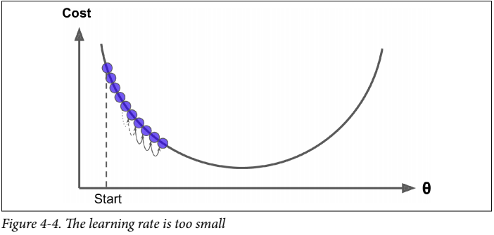
Gradient Descent – Low Learning Rate
Size of the steps determined by the learning rate hyperparameter
If learning rate is too low, the algorithm needs far too many iterations to converge

Slide 30
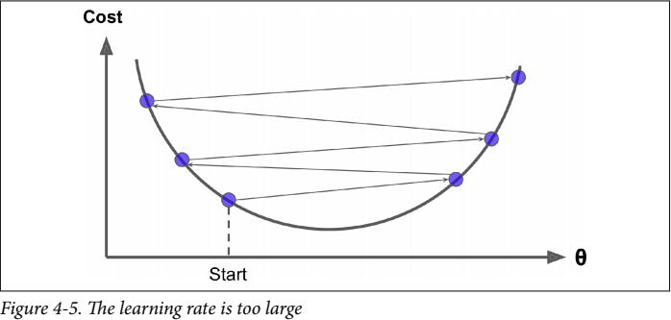
Gradient Descent – High Learning Rate
If learning rate is too high, you might jump across the valley and end up on other side → might make the algorithm diverge!

Slide 31
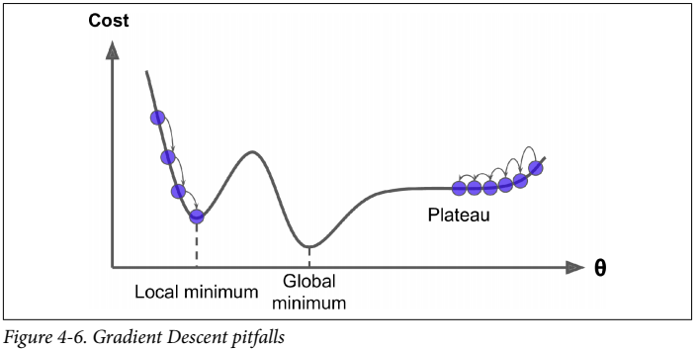
Gradient Descent – Nonconvex cost function
Cost function may not be a nice bowl with a single minimum - could have holes, ridges, plateaus etc
MSE cost function happens to be a convex function → pick any two points on the curve, and a straight line joining them will never intersect the curve

Slide 32
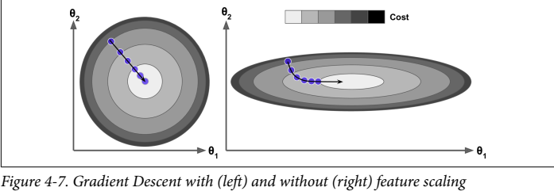
Gradient Descent – Feature Scaling
If features are not scaled, Gradient descent may take a long time to approach the global minimum
The more parameters in model → more dimensions in parameter space → harder to find global minimum

Slide 33
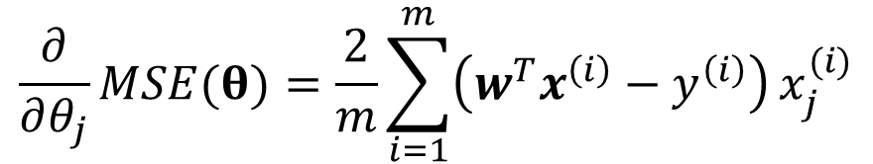
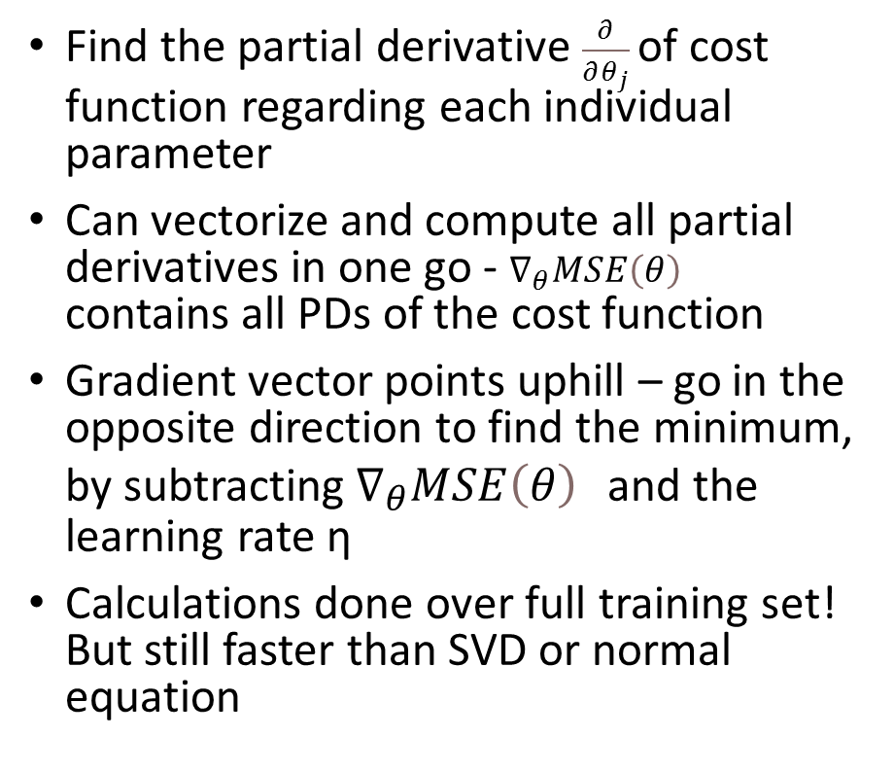

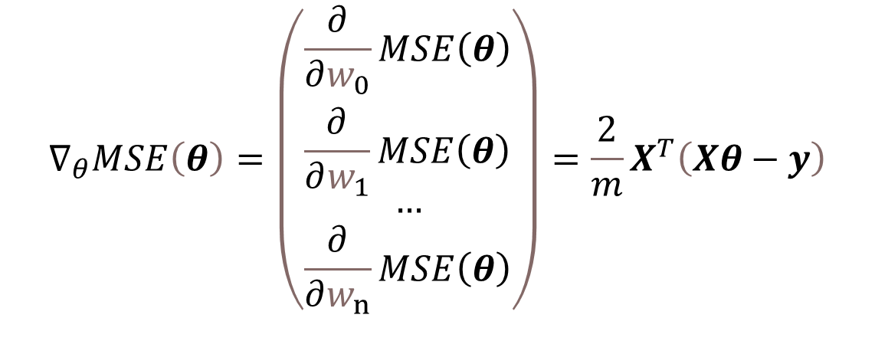
Batch Gradient Descent
Find the partial derivative $\frac{∂}{∂θ_{j}}$of cost function regarding each individual parameter
Can vectorize and compute all partial derivatives in one go - $∇_{θ}MSE\left(θ\right)$ contains all PDs of the cost function
Gradient vector points uphill – go in the opposite direction to find the minimum, by subtracting $∇_{θ}MSE\left(θ\right)$ and the learning rate η
Calculations done over full training set! But still faster than SVD or normal equation
$$\frac{∂}{∂θ_{j}}MSE(θ)=\frac{2}{m}\sum_{i=1}^{m}{\left(w^{T}x^{\left(i\right)}−y^{\left(i\right)}\right)}x_{j}^{(i)}$$
$$∇_{θ}MSE\left(θ\right)=\left(\begin{matrix}\frac{∂}{∂w_{0}}MSE\left(θ\right) \\ \frac{∂}{∂w_{1}}MSE\left(θ\right) \\ … \\ \frac{∂}{∂w_{n}}MSE\left(θ\right)\end{matrix}\right)=\frac{2}{m}X^{T}\left(Xθ−y\right)$$
$$θ=θ−η∇_{θ}MSE\left(θ\right)$$

Slide 34
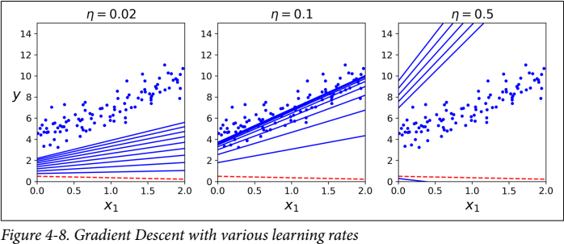
Learning Rate
Learning rate can affect speed of convergence significantly
Stop training when gradient vector becomes very tiny – when its norm is smaller than ϵ (tolerance)

Slide 35
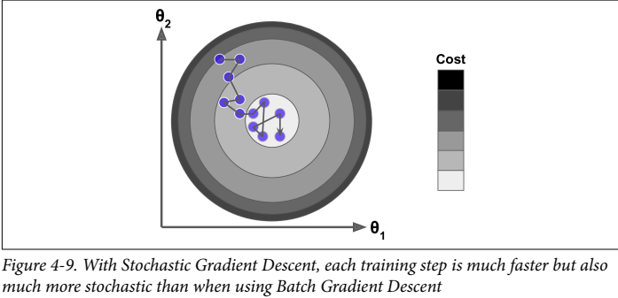
Stochastic Gradient Descent
Batch GD with full training set → very slow with large training sets!
Stochastic GD → random instance in training set picked at every step for gradient compute (only one instance in memory per iteration)
Only decreases on average – will bounce around optimal value
Good when cost function is very irregular
Reduce learning rate to help settle on minimum

Slide 36
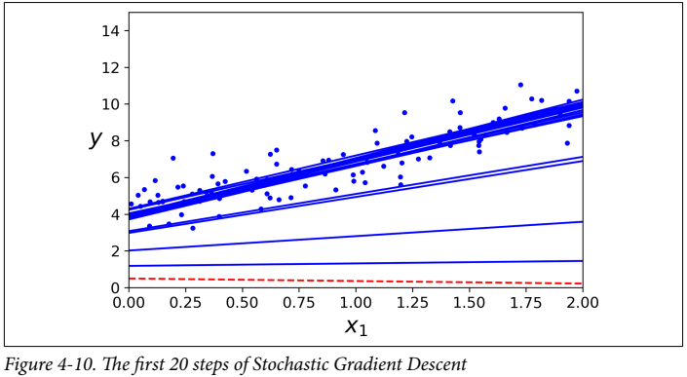
Stochastic Gradient Descent
Learning schedule → gradually lower learning rate
Epoch → each round of m iterations
Just 50 epochs total, instead of 1000 iterations through whole training set
Shuffling required to ensure instances are independent and identically distributed

Slide 37
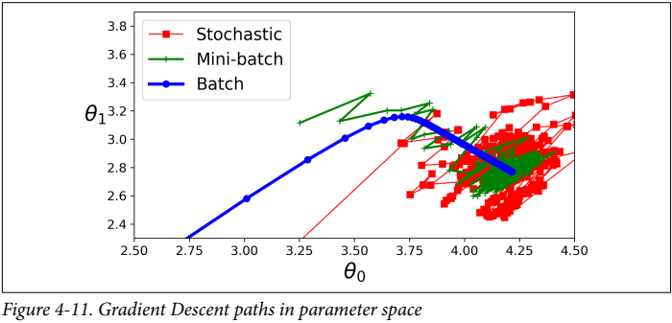
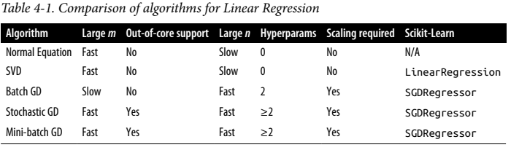
Mini-batch Gradient Descent
Compute gradients on small, random sets of instances called mini-batches.
Best of both worlds – computationally less expensive than Batch GD, and less erratic than Stochastic GD
Good learning schedule required to get to global minimum

Slide 38
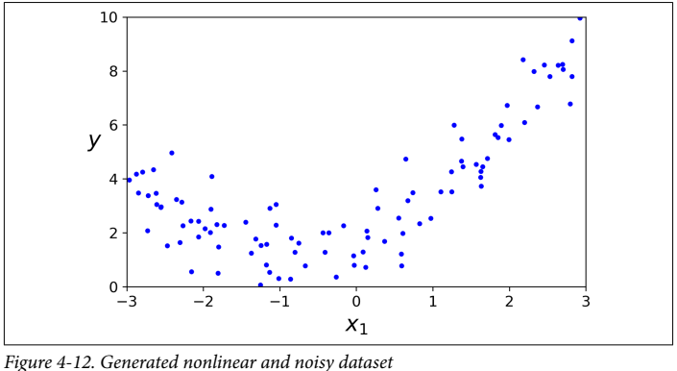
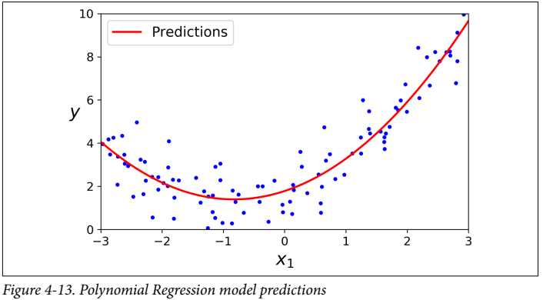
Polynomial Regression
Append powers of each feature as new features
Train a linear model on the extended set of features
Capable of finding relationships between features as well – not possible with just linear regression

Slide 39
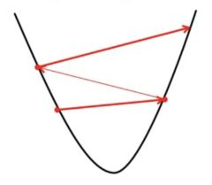
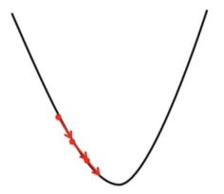
Effect of Learning Rate
If we choose L to be very large, Gradient Descent can overshoot the minimum. It may fail to converge or even diverge.
If we choose L to be very small, Gradient Descent will take small steps to reach local minima and will take a longer time to reach minima.

Slide 40
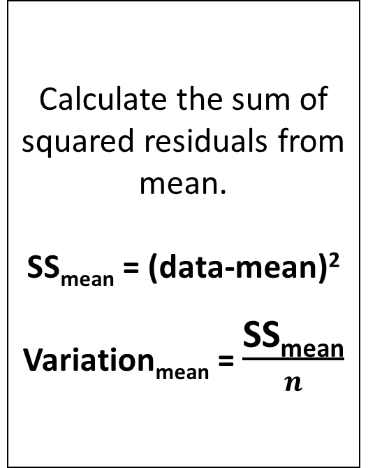
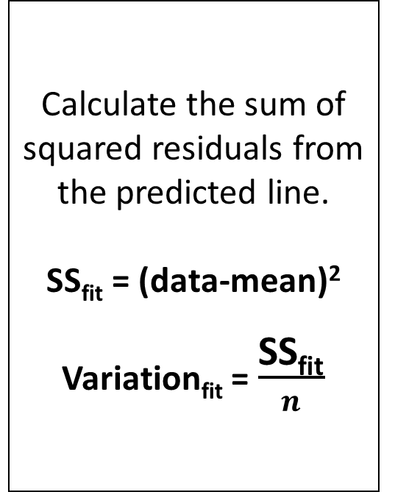
Have shifted all the values on Y axes so that we can eliminate the Effect of X variable.
Calculate the mean. We know mean = 2
Calculate the sum of squared residuals from mean.
SS_{mean} = (data-mean)²
Variation_{mean} = $\frac{\text{SS}\text{mean}}{n}$
Calculate the sum of squared residuals from the predicted line.
SS_{fit} = (data-mean)²
Variation_{fit} = $\frac{\text{SS}\text{fit}}{n}$
We will see that SS_{mean} > SS_{fit} because of considering X variable

Slide 41
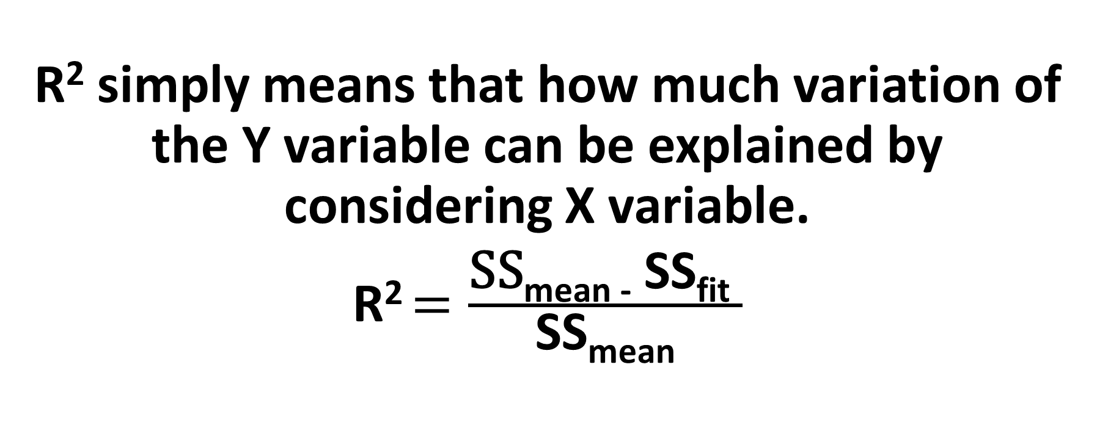
R² Meaning
R² simply means that how much variation of the Y variable can be explained by considering X variable.
R² $=\frac{\text{SS}\text{mean}\text{ − }\text{SS}\text{fit} }{\text{SS}\text{mean}}$

Slide 42
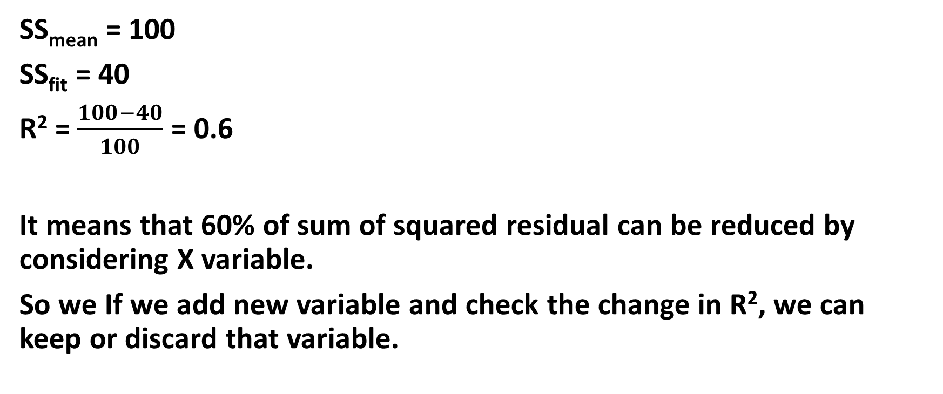
Example
SS_{mean} = 100
SS_{fit} = 40
R² = $\frac{100−40}{100}$ = 0.6
It means that 60% of sum of squared residual can be reduced by considering X variable.
So we If we add new variable and check the change in R², we can keep or discard that variable.

Slide 43
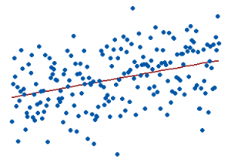
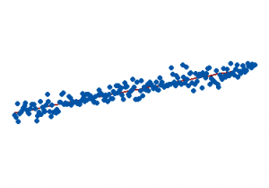
Explanation of R²
The R-squared for the regression model on the left is 15%, and for the model on the right it is 85%. When a regression model accounts for more of the variance, the data points are closer to the regression line. In practice, you’ll never see a regression model with an R2 of 100%. In that case, the fitted values equal the data values and, consequently, all of the observations fall exactly on the regression line.

Slide 44
Resources
From Book “Hands-On Machine Learning with Scikit-Learn, Keras, and TensorFlow_Concepts” page 111-121
To understand Linear Regression watch this video
To understand Gradient Descent watch this video
To read in bangla, banglablog

