Slide 1
Logistic Regression

Slide 2
Today
Recap
Why not Linear Regression
Logistic Function
Logistic Regression
Log Odds
Implementation
Interpretation

Slide 3
Recap
Machine Learning
supervised Learning
Unsupervised Learning
Reinforcement Learning
Regression
Classification
Linear Regression
Logistic Regression

Slide 4
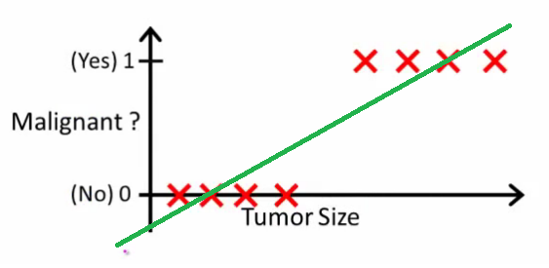
Why not Linear Regression

Slide 5
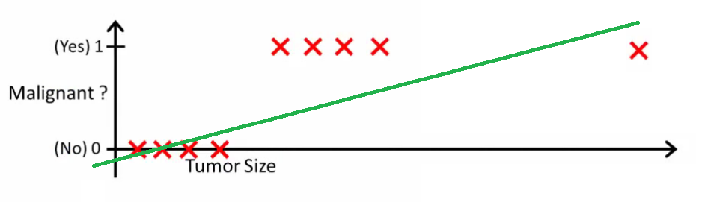
Why not Linear Regression

Slide 6
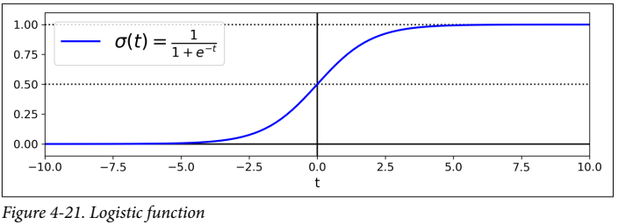
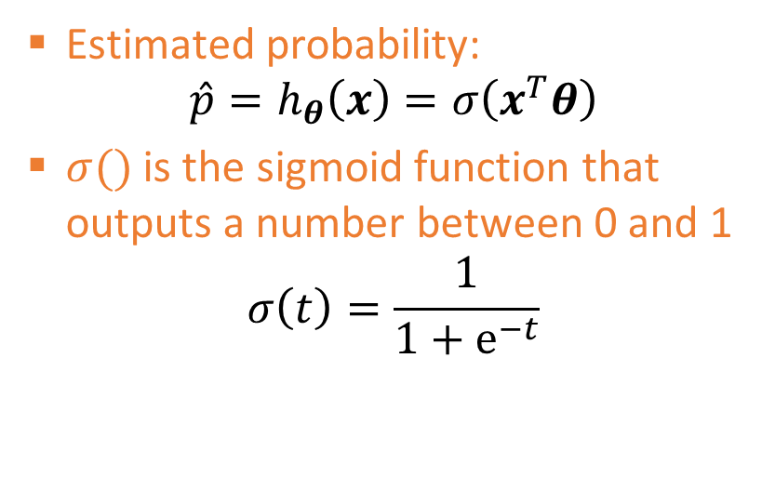

Logistic Regression
Binary classifier- also called Logit Regression, but used in classification tasks
The probability that an instance belongs to a particular class is estimated
If estimated probability is more than 50%, the model predicts the instance to belong to that class – otherwise, it predicts it does not belong to that class
Estimated probability:
$$\hat{p}=h_{θ}\left(x\right)=σ\left(x^{T}θ\right)$$
$σ()$ is the sigmoid function that outputs a number between 0 and 1
$$σ\left(t\right)=\frac{1}{1+ⅇ^{−t}}$$
$$\hat{y}=\left\{\begin{aligned}0 if\hat{p}<0.5 \\ 1 if \hat{p}≥0.5\end{aligned} \right.$$

Slide 7
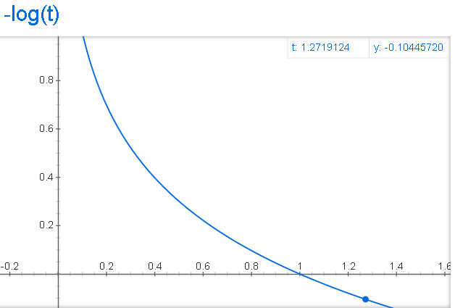
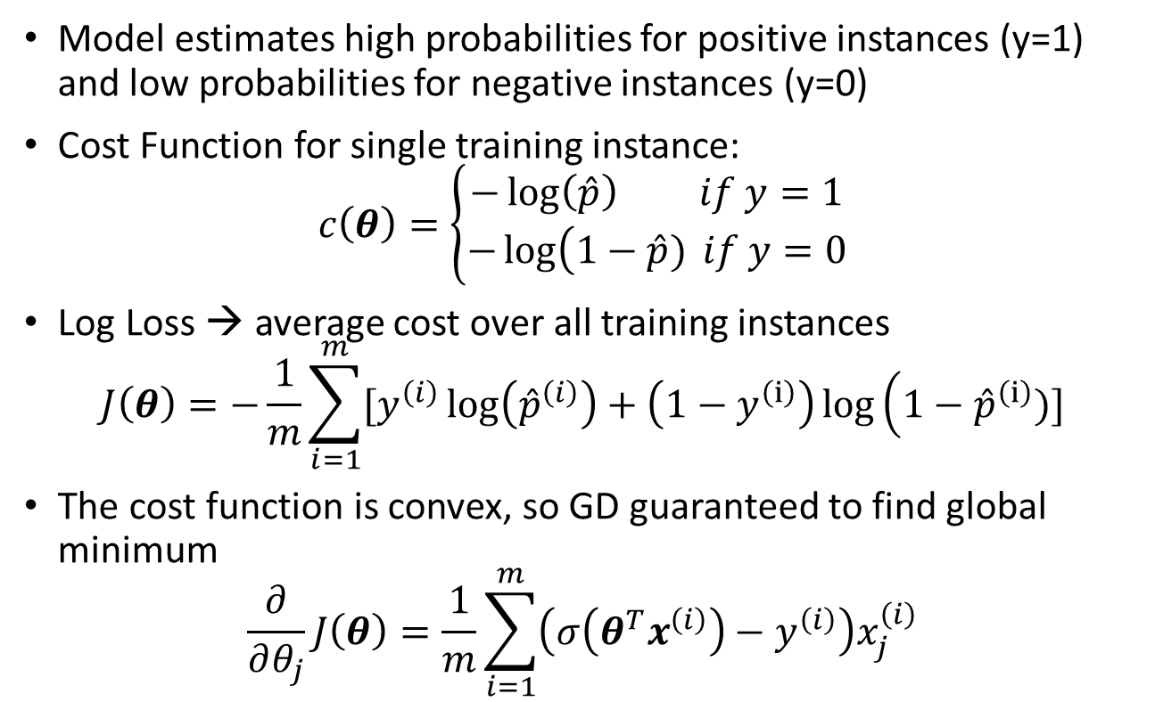
Logistic Regression Training
Model estimates high probabilities for positive instances (y=1) and low probabilities for negative instances (y=0)
Cost Function for single training instance:
$$c\left(θ\right)=\left\{\begin{matrix}−\log\left(\hat{p}\right) if y=1 \\ −\log\left(1−\hat{p}\right.) if y=0\end{matrix}\right.$$
Log Loss → average cost over all training instances
$$J\left(θ\right)=−\frac{1}{m}\sum_{i=1}^{m}{[y^{\left(i\right)}\log\left({\hat{p}}^{\left(i\right)}\right)}+\left(1−y^{\left(ⅈ\right)}\right)\log\left(1−{\hat{p}}^{\left(ⅈ\right)}\right.)]$$
The cost function is convex, so GD guaranteed to find global minimum
$$\frac{∂}{∂θ_{j}}J\left(θ\right)=\frac{1}{m}\sum_{i=1}^{m}{\left(σ\left(θ^{T}x^{\left(i\right)}\right)−y^{\left(i\right)}\right)x_{j}^{\left(i\right)}}$$

Slide 8
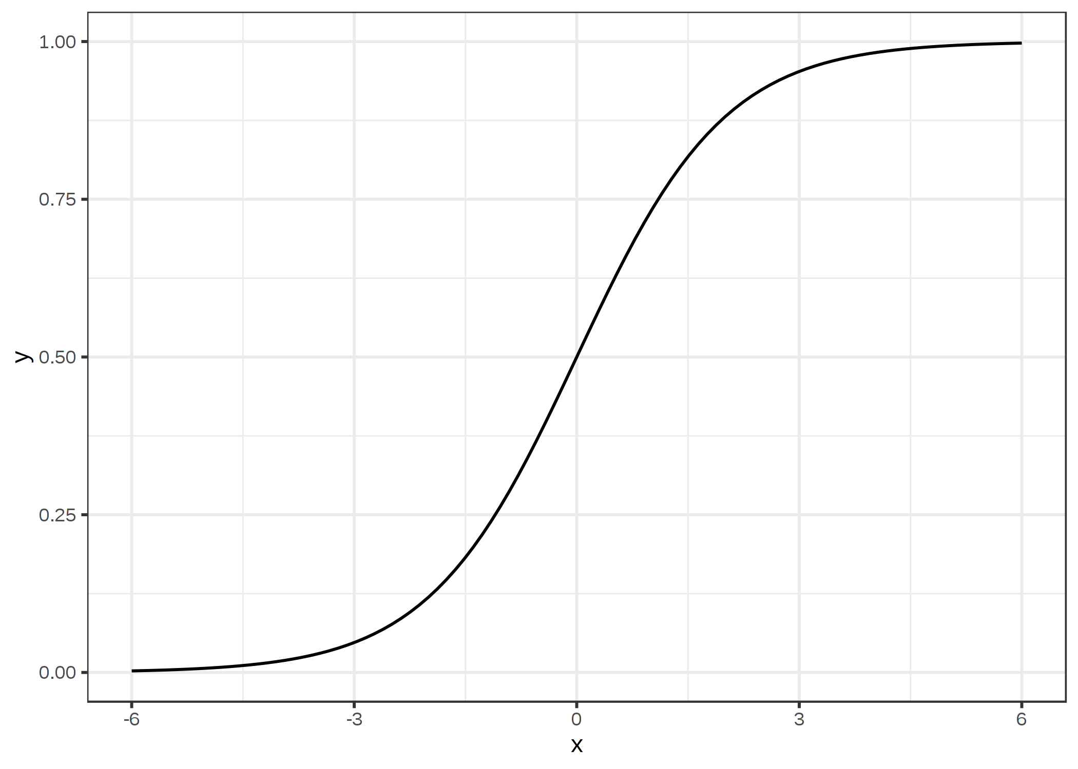
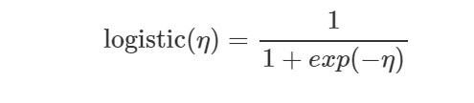
Logistic Function
Instead of fitting a straight line or hyperplane, the logistic regression model uses the logistic function to squeeze the output of a linear equation between 0 and 1.

Slide 9
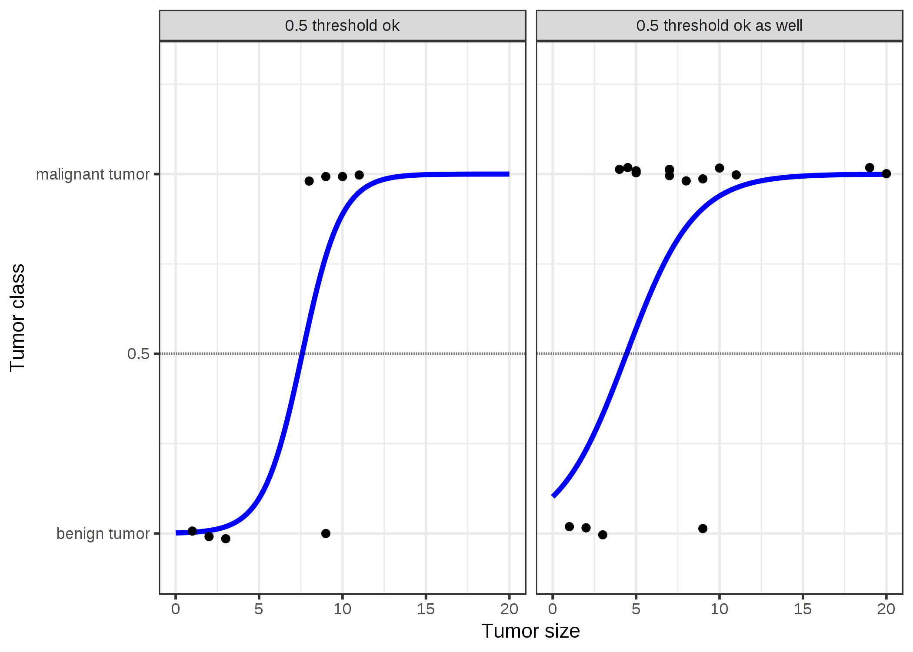
Logistic Function

Slide 10

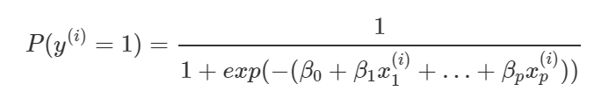
Logistic Regression
Logistic regression models the probabilities for classification problems with two possible outcomes. It's an extension of the linear regression model for classification problems.
The step from linear regression to logistic regression is kind of straightforward. In the linear regression model, we have modelled the relationship between outcome and features with a linear equation:
For classification, we prefer probabilities between 0 and 1, so we wrap the right side of the equation into the logistic function. This forces the output to assume only values between 0 and 1.

Slide 11
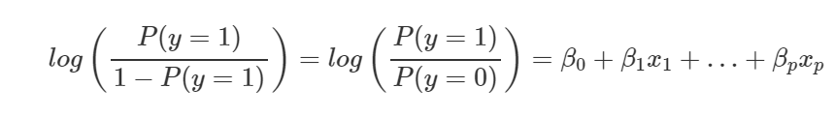
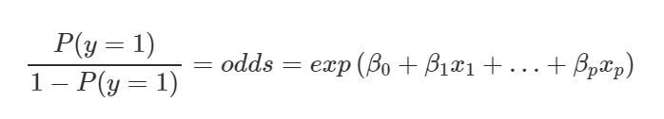
Log Odds
The weights do not influence the probability linearly any longer. The weighted sum is transformed by the logistic function to a probability. Therefore we need to reformulate the equation for the interpretation so that only the linear term is on the right side of the formula.
We call the term in the log() function "odds" (probability of event divided by probability of no event) and wrapped in the logarithm it is called log odds.

