Slide 1

Digital Notice Board & Information Dissemination Platform
Category-Based Personalized Notifications for Educational Institutions — a centralized, secure, and intelligent solution for managing institutional communication.
ACADEMIC PROJECT PRESENTATION
INFORMATION SYSTEMS
KUNDRAPU RAJINI
324129512030

Slide 2

The Problem with Traditional Notice Boards
Missed Announcements
Physical boards are easily overlooked. Students and faculty frequently miss critical updates due to lack of visibility.
Delayed Communication
Manual posting introduces lag. Urgent notices may take hours to reach the intended audience.
Poor Organization
Notices are unsorted and unsearchable. Finding relevant information across departments or semesters is nearly impossible.
No Audience Targeting
Mass emails and generic posts reach everyone — regardless of relevance — causing notification fatigue and disengagement.

Slide 3
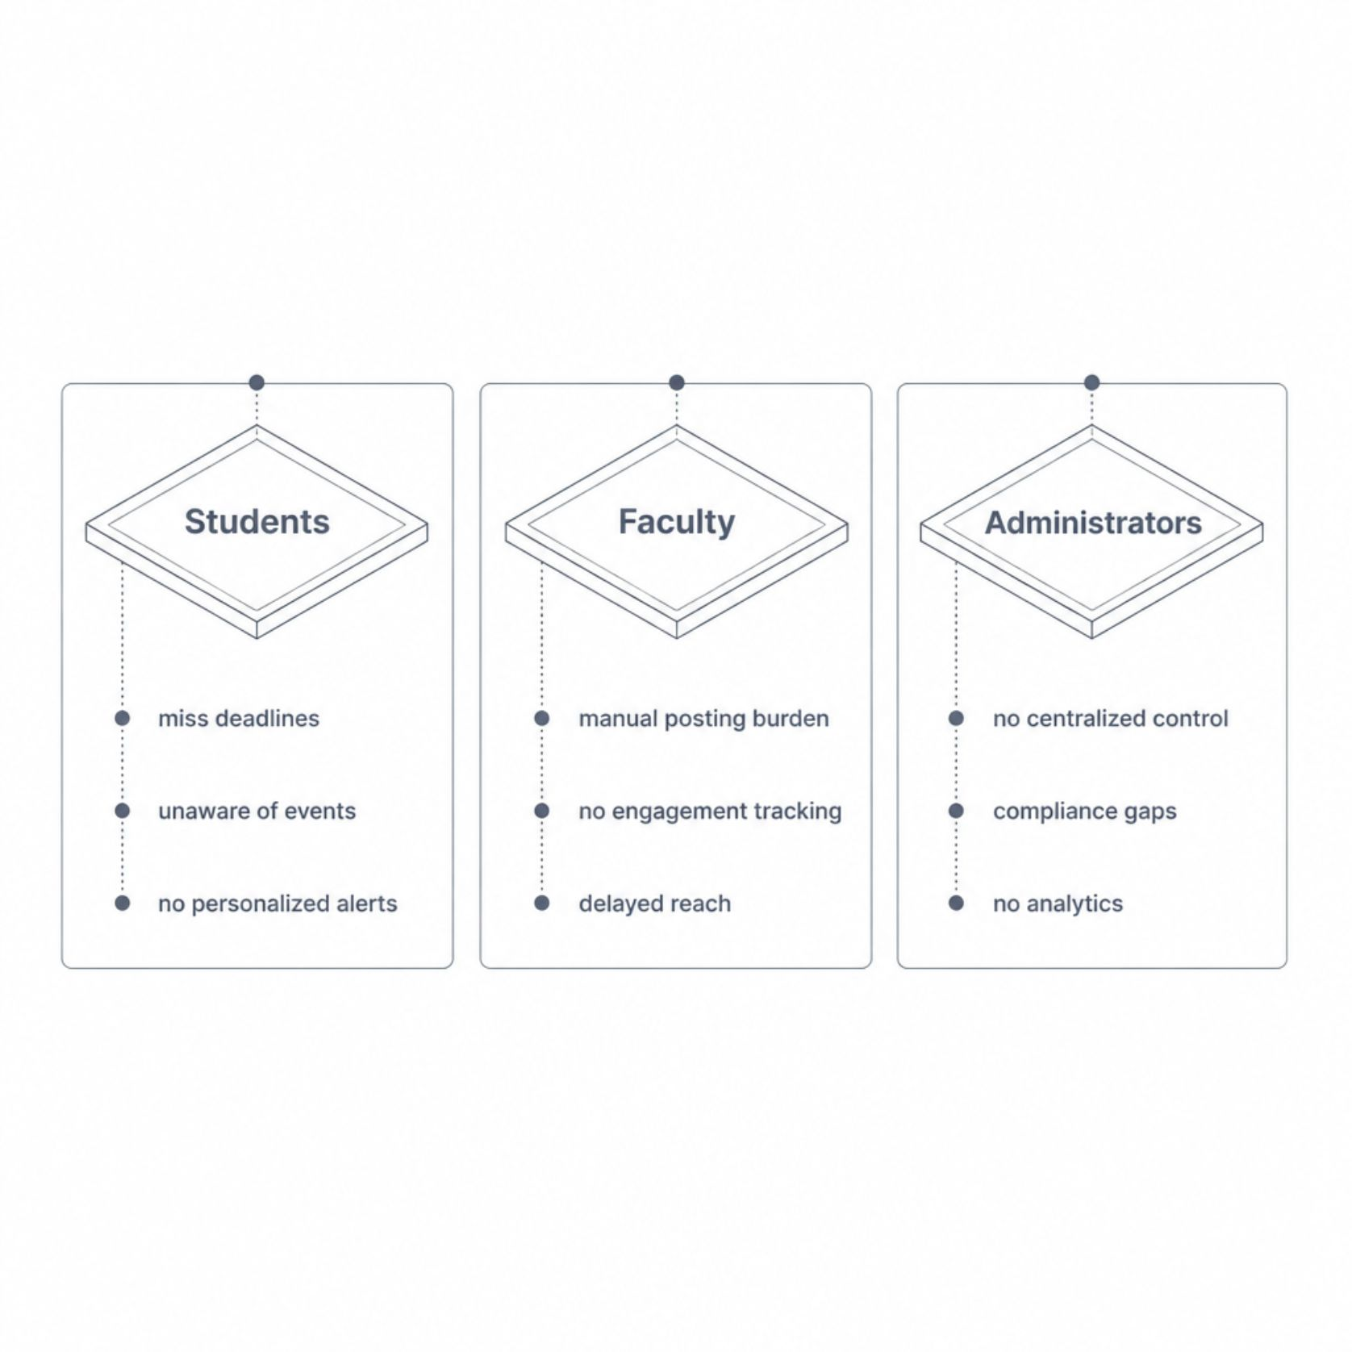
Who Is Affected — and How
A Systemic Communication Breakdown
When announcements fail to reach the right people at the right time, the consequences cascade across the entire institution.
Students
Faculty
Administrators
Miss exam schedules, internship deadlines, and campus events due to untargeted, disorganized communication.
Spend excessive time on manual notice distribution with no feedback on whether messages were received or read.
Lack centralized oversight, compliance tracking, and data-driven insights into institutional communication effectiveness.

Slide 4

The Platform — A Unified Solution
A centralized, web-based platform that replaces fragmented communication with structured, personalized, and trackable institutional announcements.
Distribute
Notify
System routes messages by category, role, department.
Real-time alerts sent via email, SMS, and in-app.
Publish
Engage
Admin/faculty create categorized notices with attachments.
Users search, view, acknowledge, and provide feedback.
The platform closes the communication loop — from creation to acknowledgment — ensuring every notice reaches its intended audience and engagement is measurable.

Slide 5



User Roles & Functionalities
Administrator
Faculty
Student
Full platform control and user management
Create and manage notice categories
Publish institution-wide announcements
Access analytics and compliance reports
Archive and audit all notices
Publish department or course-specific notices
Attach documents, PDFs, and resources
Target audiences by course, year, or section
Track acknowledgment rates per notice
Receive personalized, category-filtered alerts
Search and filter notices by keyword or date
Access archived notices and attachments
Acknowledge receipt and set preferences

Slide 6
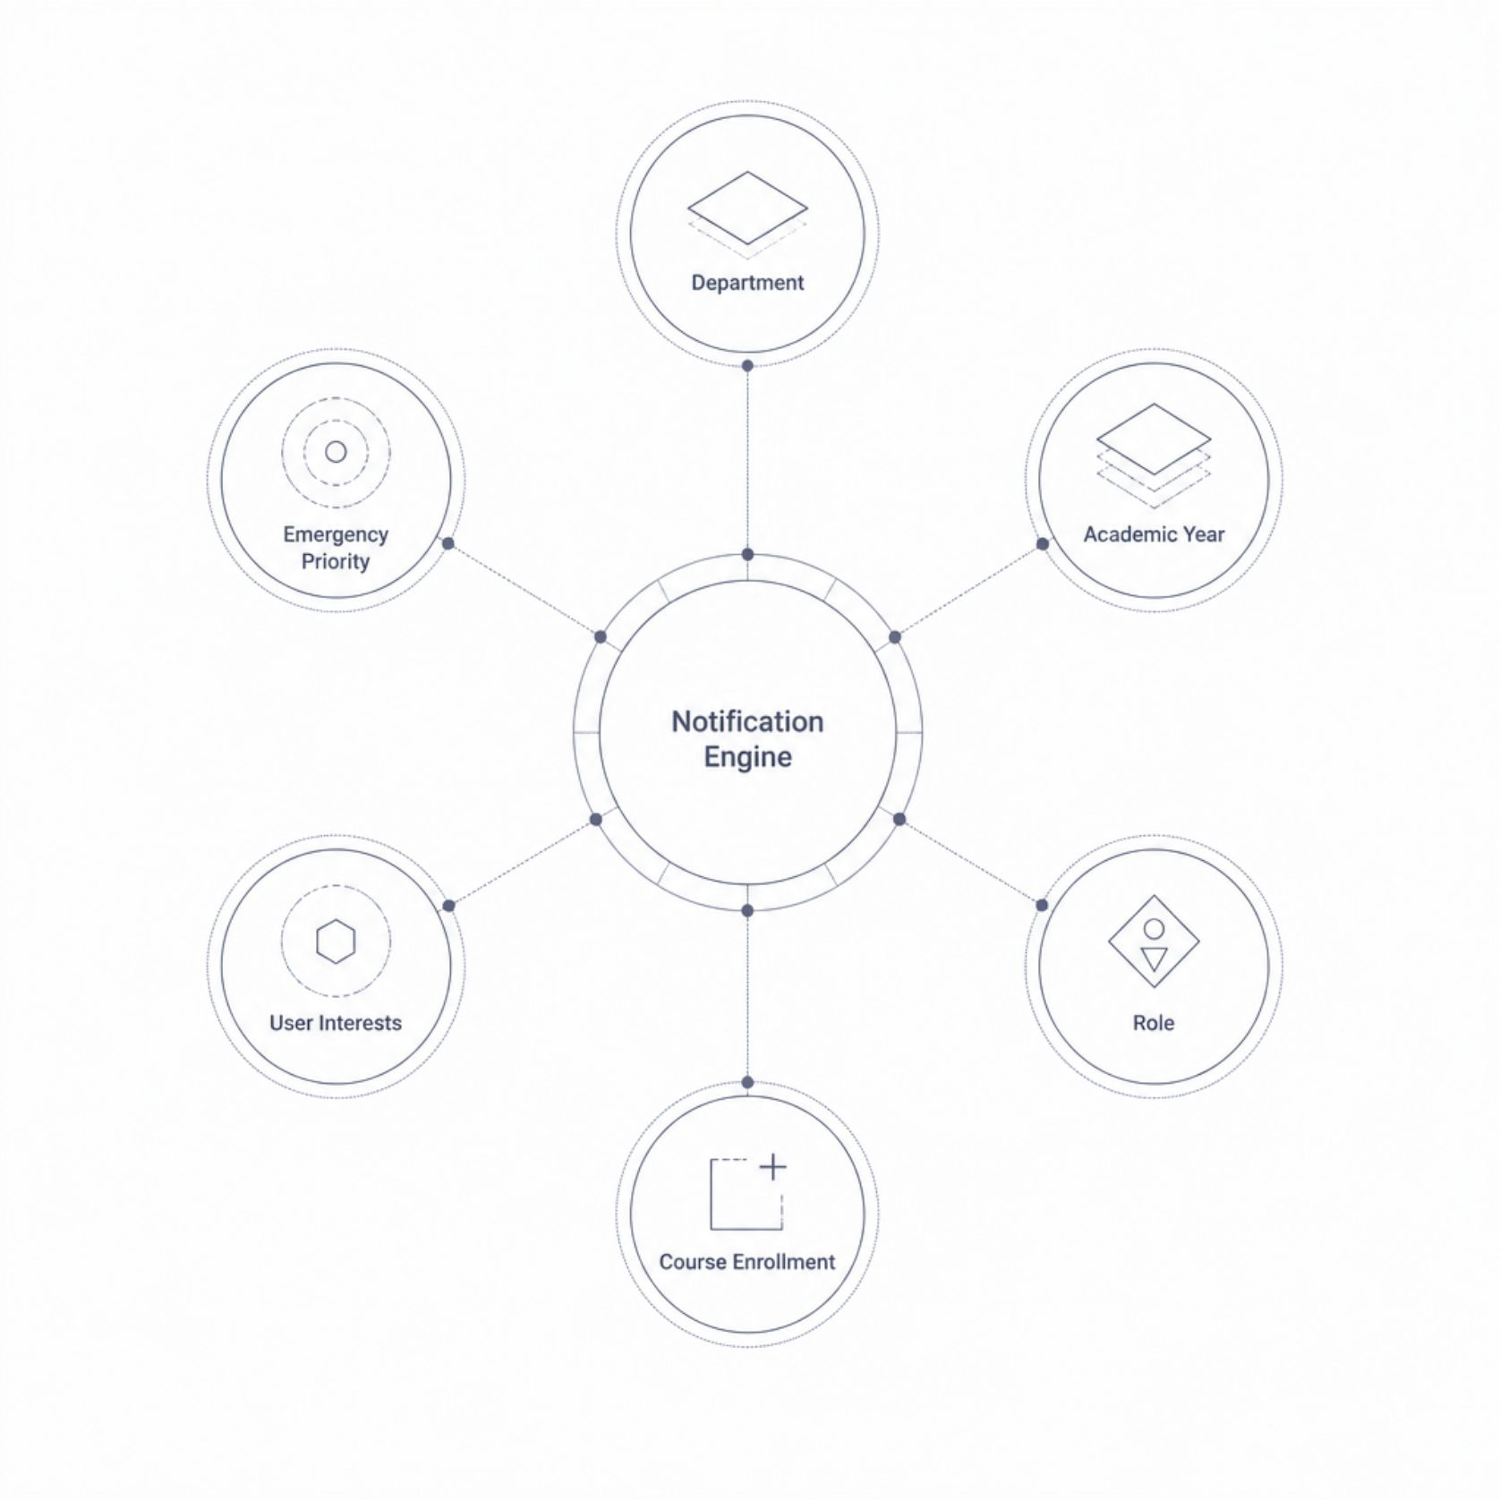
Category-Based Personalized Notifications
The platform's core intelligence lies in its category-based routing engine. Notices are tagged with metadata — department, academic year, role, course, or user-defined interests — and delivered only to matching recipients.
Department & Program
Academic Year & Course
Notices reach only students and faculty within the relevant department.
Targeted alerts for specific cohorts — e.g., final-year project deadlines.
Role-Based Filtering
Interest Subscriptions
Admin-only, faculty-only, or student-only notices are routed automatically.
Users subscribe to categories like "Scholarships," "Events," or "Internships."

Slide 7
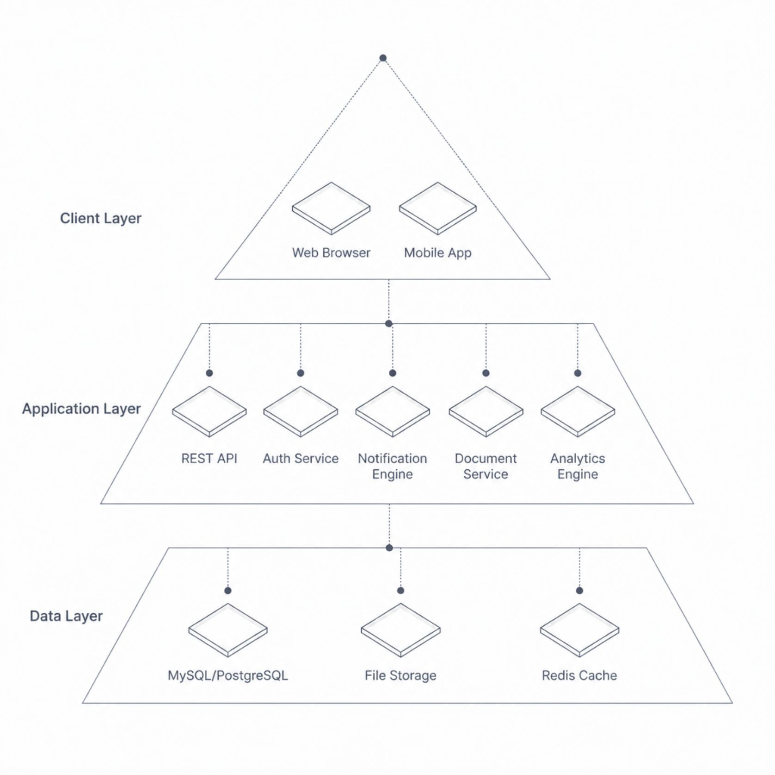

System Architecture & Data Flow
Technology Stack
Frontend
React.js / Angular, Bootstrap
Backend
Node.js / Django / Spring Boot
Database
MySQL / PostgreSQL
Notifications
Firebase, SMTP, Twilio SMS
Storage
AWS S3 / Local File Server
Security
JWT, OAuth 2.0, bcrypt
The architecture supports horizontal scaling — new departments or campuses can be onboarded without restructuring the core system.

Slide 8
Core Functional Modules
Authentication & RBAC
Notification Engine
Secure login with role-based access control. JWT tokens manage sessions; permissions restrict actions by role.
Real-time push, email, and SMS alerts triggered on notice creation. Delivery status and read receipts tracked.
Document Management
Analytics Dashboard
Secure file upload, versioning, and access-controlled downloads. Supports PDF, DOCX, and image attachments.
Engagement metrics, acknowledgment rates, peak activity times, and departmental reach — all in real time.
Search & Archive
Security & Compliance
Full-text search across all notices with filters by date, category, department, and author. Expired notices archived automatically.
Input validation, SQL injection prevention, encrypted storage, audit logs, and GDPR-ready data retention policies.

Slide 9
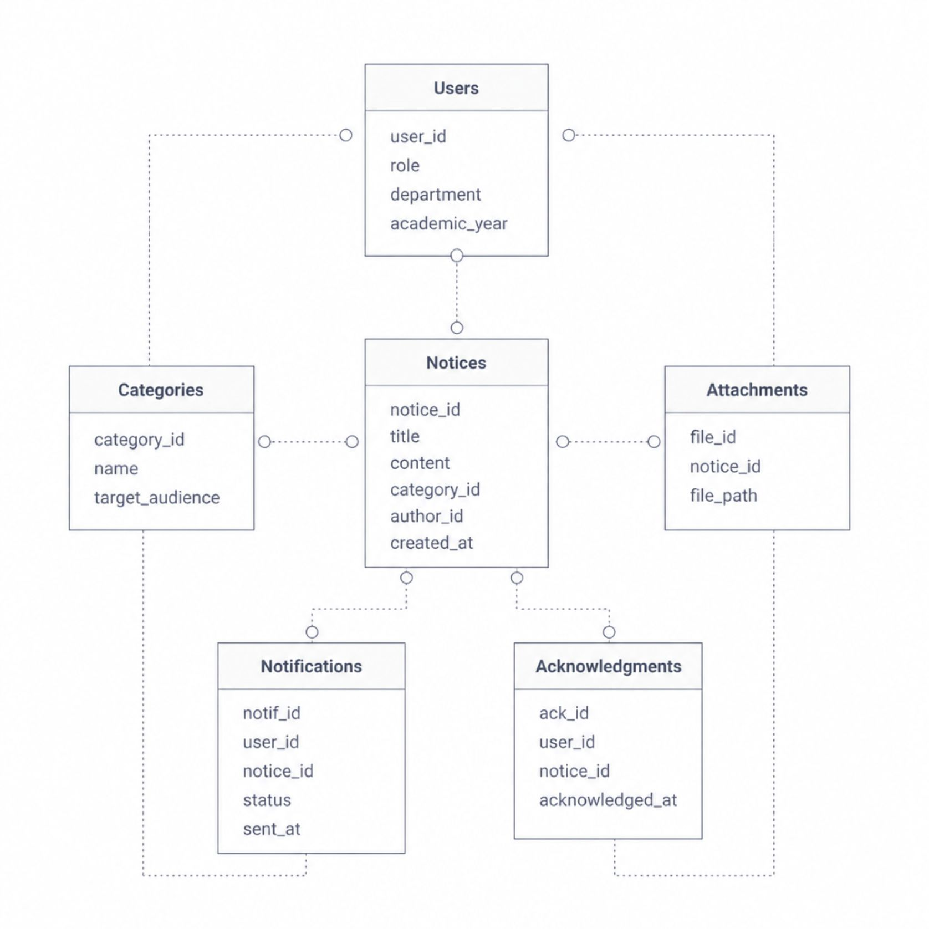
Database Design & Entity Relationships
Key Entity Relationships
Entity
Primary Attributes
Users
user_id, role, department, year, email
Notices
notice_id, title, content, category_id, author_id
Categories
category_id, name, target_filters (JSON)
Attachments
file_id, notice_id, file_path, mime_type
Notifications
notif_id, user_id, notice_id, channel, status
Acknowledgments
ack_id, user_id, notice_id, timestamp
The target_filters JSON field in Categories enables flexible audience targeting without schema changes.

Slide 10


Outcomes, Advantages & Future Roadmap
Expected Outcomes
Key Advantages
90%+ notice reach rate vs. <40% with physical boards
Real-time delivery within seconds of publishing
Measurable engagement and compliance tracking
Reduced administrative overhead by 60%
Centralized, searchable, and auditable notice repository
Personalized delivery eliminates notification fatigue
Scalable across departments, campuses, and institutions
Secure, role-based access with full audit trails
Future Enhancements
AI-powered notice summarization and priority scoring
Mobile app with offline notice caching
Integration with LMS platforms (Moodle, Canvas)
Multi-language support and accessibility features
Applicable across schools, colleges, universities, corporate training centers, and government educational bodies — any institution requiring structured, auditable, and targeted communication.

