Slide 1




Portfolio Project
Building a Web Page using HTML, CSS & JavaScript
C. Rajeshwari
Bsc.Data Science
113 - Vallalar arts and sciences college
Annamalai University

Slide 2
Purpose of a Portfolio Website
A portfolio website acts as a digital identity.
Showcases skills, projects, and achievements to potential employers or clients.
Useful for job applications, freelance work, or personal branding.
Enables developers to practice web development and design principles.
Always accessible online — serves as a 24/7 resume.

Slide 3
Technologies to Use
HTML (HyperText Markup Language): Structures content and defines sections.
CSS (Cascading Style Sheets): Adds design, layout, colors, fonts, and responsiveness.
JavaScript (JS): Provides interactivity and dynamic behavior such as menus, sliders, and form validation.

Slide 4
HTML Structure
HTML forms the skeleton of the website.
Use semantic tags for organization and SEO: <header>, <section>, <article>, <footer>.
Typical sections:
Header: Name/logo and navigation menu
About: Bio, skills, experience
Projects: Screenshots, descriptions, links
Contact: Form for messages or emails

Slide 5
CSS Styling
CSS adds visual design to the HTML structure.
Controls fonts, colors, spacing, layout, and responsiveness.
Adds animations and hover effects to improve user experience.
Use media queries to make the site mobile-friendly.

Slide 6
JavaScript Interactivity
JavaScript makes the website dynamic and interactive.
Typical uses:
Toggling navigation menus
Animating sliders or carousels
Validating forms
Adding event-based effects (clicks, scrolls)

Slide 7
Key Features of a Portfolio Website
Responsive design for desktop, tablet, and mobile.
Interactive UI with hover effects, smooth scrolling, and toggles.
Project showcase with images, descriptions, and demo links.
Contact section with functional form or email integration.
Optional extras: downloadable resume, blog section, social media links.

Slide 8
Recommended Workflow
1. Plan & Wireframe: Sketch layout and sections.
2. HTML: Build the basic structure.
3. CSS: Style the site and ensure responsiveness.
4. JavaScript: Add interactivity and animations.
5. Testing: Verify cross-browser compatibility and mobile responsiveness.
6. Deployment: Host online via GitHub Pages, Netlify, or other hos
ting services.

Slide 9
Common Challenges
Maintaining a responsive layout for all devices.
Keeping the design professional and clean.
Debugging JavaScript errors.
Optimizing website load time.
Ensuring accessibility and SEO compliance.

Slide 10
Final Outcome
A fully functional portfolio website showcasing skills and projects.
Clean, professional, and interactive design.
Works smoothly across devices.
Demonstrates creativity, technical skills, and professionalism.

Slide 11
Code-HTML
<!DOCTYPE html>
<html lang="en">
<head>
<meta charset="UTF-8">
<meta name="viewport" content="width=device-width, initial-scale=1.0">
<title>My Portfolio</title>
<link rel="stylesheet" href="web.css">
</head>
<body>
<header>
<nav>
<h1 class="logo">Rajeshwari</h1>
<ul class="nav-links">
<li><a href="#home">Home</a></li>
<li><a href="#about">About</a></li>
<li><a href="#projects">Projects</a></li>
<li><a href="#contact">Contact</a></li>
</ul>
</nav>
</header>
<section id="home" class="hero">
<h2>Hi, I'm <span>Rajeshwari</span></h2>
<p> Web Developer | Designer | Coder</p>
<button onclick="scrollToSection('contact')">Hire Me</button>
</section>
<section id="about" class="about">
<h2>About Me</h2>
<p>
I am a passionate web developer who loves creating interactive and user-friendly websites.
I specialize in HTML, CSS, JavaScript, and modern frameworks.
</p>
</section>
<section id="projects" class="projects">
<h2>Projects</h2>
<div class="project-list">
<div class="project-card">
<h3>Project 1: To-Do List</h3>
<p>A simple yet powerful To-Do List application built using HTML, CSS, and JavaScript.</p>
</div>
<div class="project-card">
<h3>Project 2: Hospital Management System</h3>
<p>The Hospital Management System is a web-based application designed to streamline hospital operations and improve patient care.</p>
</div>
<div class="project-card">
<h3>Project 3: Learning Management System</h3>
<p>The Learning Management System is a web-based platform designed to simplify online learning and course management.</p>
</div>
</div>
</section>
<section id="contact" class="contact">
<h2>Contact Me</h2>
<form>
<input type="text" placeholder="Rajeshwari" required>
<input type="email" placeholder="rajiravir95@gmail.com" required>
<textarea placeholder="I’m a passionate web developer with skills in HTML, CSS, JavaScript, and modern frameworks. I enjoy building clean, responsive, and user-friendly websites that bring ideas to life." required></textarea>
<button type="submit">submit</button>
</form>
</section>
<footer>
<p>© 2025 Rajeshwari. All rights reserved.</p>
</footer>
<script src="web.js"></script>
</body>
</html>

Slide 12
Code-CSS
* {
margin: 0;
padding: 0;
box-sizing: border-box;
}
body {
font-family: Arial, sans-serif;
line-height: 1.6;
background-color: #f4f4f4;
}
header {
background: #333;
color: #fff;
padding: 1rem 0;
}
.container {
display: flex;
justify-content: space-between;
align-items: center;
padding: 0 20px;
}
h1 {
font-size: 2rem;
}
nav ul {
list-style: none;
}
nav ul li {
display: inline;
margin-right: 20px;
}
}
/* About Section */
.about {
padding: 50px 20px;
background: #f4f4f4;
text-align: center;
}
.about h2 {
margin-bottom: 20px;
}
/* Projects Section */
.projects {
padding: 50px 20px;
background: #fff;
}
.project-list {
display: flex;
flex-wrap: wrap;
justify-content: center;
}
.project-card {
background: #eaeaea;
border-radius: 10px;
margin: 15px;
padding: 20px;
width: 300px;
box-shadow: 0 2px 10px rgba(0, 0, 0, 0.1);
transition: transform 0.3s, box-shadow 0.3s; /* Added box-shadow transition */
}
.project-card:hover {
transform: translateY(-10px); /* Move the box up */
box-shadow: 0 4px 20px rgba(0, 0, 0, 0.2); /* Enhanced shadow on hover */
}
.project-card h3 {
color: #ff5733;
}
/* Contact Section */
.contact {
padding: 50px 20px;
background: #0b1827; /* Change this to your desired background color */
color: white; /* Change text color for better contrast */
text-align: center;
}
.contact form {
max-width: 400px;
margin: auto;
}
.contact input, .contact textarea {
width: 100%;
padding: 10px;
margin: 10px 0;
border: 1px solid #ccc;
border-radius: 5px;
}
.contact button {
background: #ffcc00;
border: none;
padding: 10px 20px;
cursor: pointer;
transition: background 0.3s;
}
.contact button:hover {
background: #e6b800;
}
/* Footer styles */
footer {
background: #333;
color: #fff;
text-align: center;
padding: 10px 0;
}

Slide 13
Code-Javascript
function scrollToSection(sectionId) {
const section = document.getElementById(sectionId);
section.scrollIntoView({ behavior: 'smooth' });
}
document.querySelector('.contact form').addEventListener('submit', function (event) {
event.preventDefault();
alert('Thank you for your message!');
this.reset(); // Reset the form fields after submission
});

Slide 14
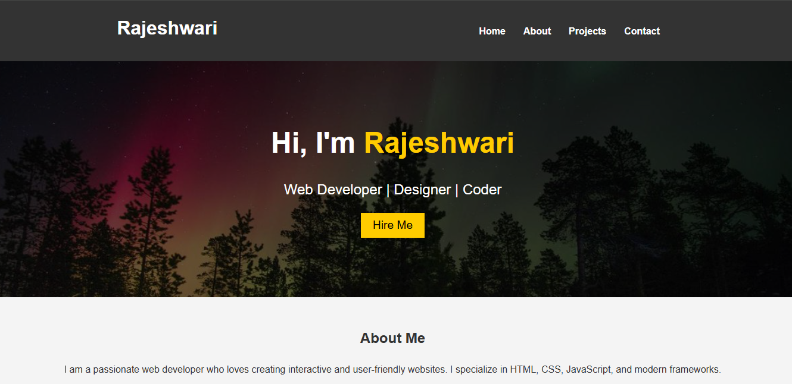
Outcome

Slide 15


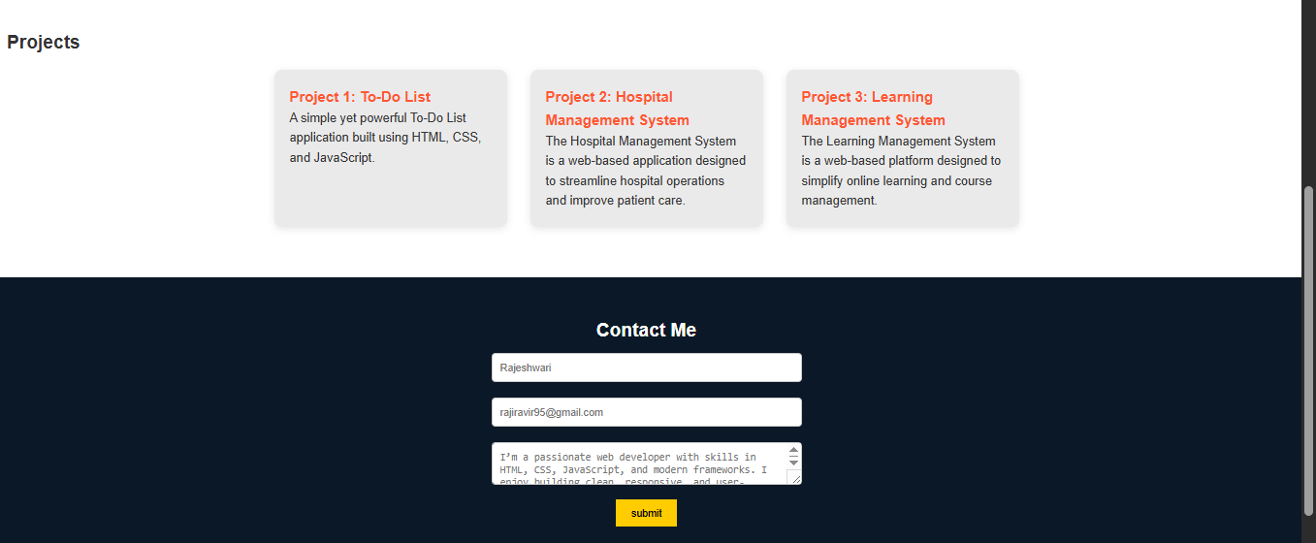



Outcome

Slide 16
Conclusion
A portfolio website serves as a personal brand online.
Combining HTML, CSS, and JavaScript creates a responsive, interactive website.
Potential future enhancements:
Adding a blog section
Integrating APIs like GitHub or LinkedIn
Adding animations, dark mode, or theme switching

Slide 17
Thank
You

