Slide 1
AWS Introduction Rajalakshmi

Slide 2
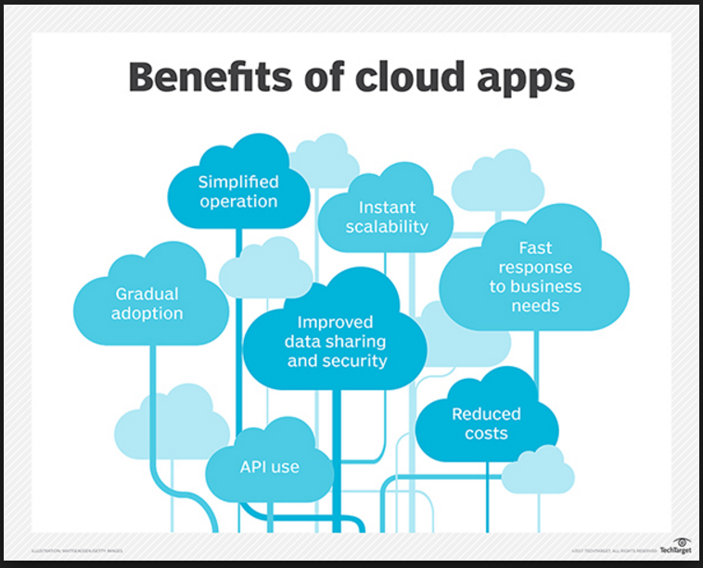
Cloud
A cloud computing, is a software program where cloud-based and local components work together. This model relies on remote servers for processing logic that is accessed through a web browser with a continual internet connection.

Slide 3
AWS
Amazon Web Services (AWS) is a subsidiary of Amazon.com that offers on-demand cloud computing platforms.
Cloud computing is the on-demand delivery of compute power, database storage, applications, and other IT resources through a cloud services platform via the internet with pay-as-you-go pricing.

Slide 4
Types of cloud computing models
Based on Deployment models
Public Cloud
Private cloud
Hybrid cloud
Community cloud
Based on Service models
Infrastructure as a Service
Platform as a Service
Software as a Service
Communication as a Service
Network as a Service

Slide 5
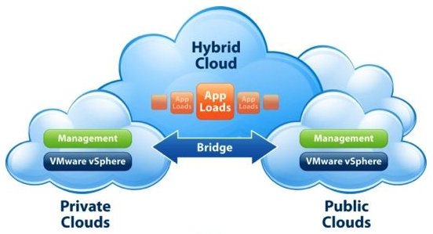
Types of cloud Deployment models
Public Cloud, is a type of hosting which cloud services are delivered over a network for public use.
Private Cloud, is a cloud infrastructure that is solely used by one organization.
Hybrid Cloud, uses both private and public clouds, but can remain separate entities.
Community Cloud, has almost the same features as that of public cloud, however, the infrastructure, services and resources are shared among the companies themselves.
Deployment models

Slide 6
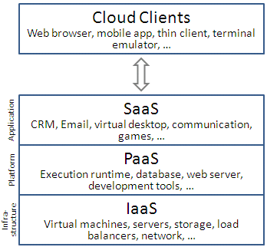
Types of cloud service models
Infrastructure as a Service, provides the hardware and usually virtualized OS to their customers.
Platform as a Service, provides networked computers running in a hosted environment, and also adds support for the development environment.
Software as a Service, provides an application to customer or organizations through a web browser.
Communication as a Service, outsourced enterprise communications solution (caas vendor) is responsible for the management of hardware and software required for applications used by the customers through fixed and mobile devices.
Network as a Service, provides a virtual network service to customers by the owners of the network infrastructure.
Service models

Slide 7
Identity and access management
IAM
AWS Identity and Access Management (IAM) is a web service that helps to securely control access to AWS resources.
IAM used to control who is authenticated (signed in) and authorized (has permissions) to use resources.
IAM Features
Shared access to your AWS account - without sharing administer password or access key.
Granular permissions - grant different permissions to different users for different resources.
Secure access to AWS resources for applications that run on Amazon EC2 - securely provide credentials for applications that run on EC2 instances & also allow access to other AWS resources
Multi-factor authentication (MFA) – provides two-factor authentication to your account and to individual users for extra security, and also a code from a specially configured device.

Slide 8
Identity federation – allows an existing users --- to get temporary access to your AWS account, with the help of internet identity provider.
Identity information for assurance – provides request log records for accessing resources in your account, based on IAM identities.
Integrated with many AWS services
Eventually Consistent - high availability by replicating data across multiple servers within Amazon's data centers around the world.

Slide 9
Regions & availability zones
Each region is a separate geographic area. Each region (Data Centre) is made up by several Availability Zones.
An Availability Zone is an isolated location inside a region. AWS expert commonly call Availability Zones as AZ. Each AZ belongs to a single region. Each region will have minimum two AZ.

Slide 10
Refrences
Amazon.com
Thecloudplus
Uniprint.net
Fastmetrics.com
Talkcloudcomputing.com

