Slide 1

Data Science & Forecasting Analysis
Global Weather Trend Forecasting
Lakshman Rajith Rongala
University of New Haven
February 2026

Slide 2
PM Accelerator Mission
Our mission is to break down financial barriers and achieve educational fairness. With the goal of establishing 200 schools worldwide over the next 20 years, we aim to empower more kids for a better future in their life and career, simultaneously fostering a diverse landscape in the tech industry.

Slide 3
Project Overview
Objective
Analyze global weather trends
Forecast temperature patterns
Identify environmental relationships
Dataset
Global Weather Repository
124,000+ records
40+ features

Slide 4
Data Cleaning & Preparation
Converted timestamps to datetime format
Removed duplicate records
Verified missing values & data consistency
Resampled data to daily frequency for forecasting
Filtered unrealistic temperature values
Dataset required minimal cleaning due to high data quality

Slide 5
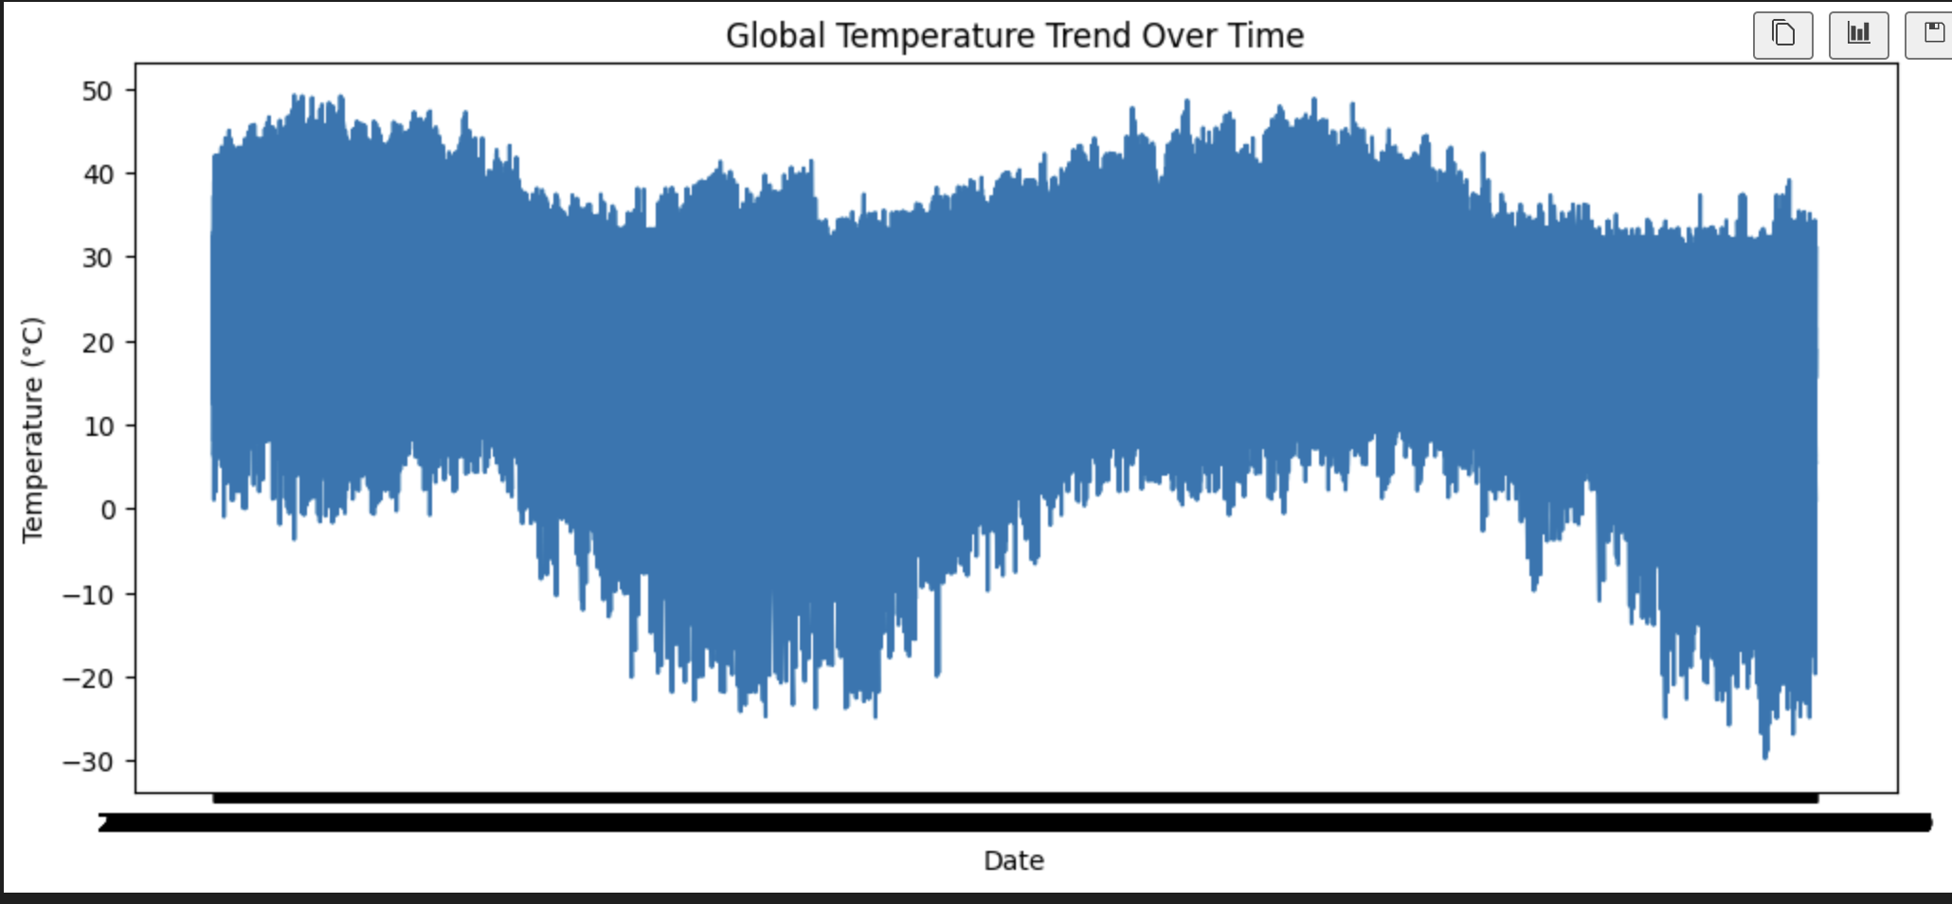
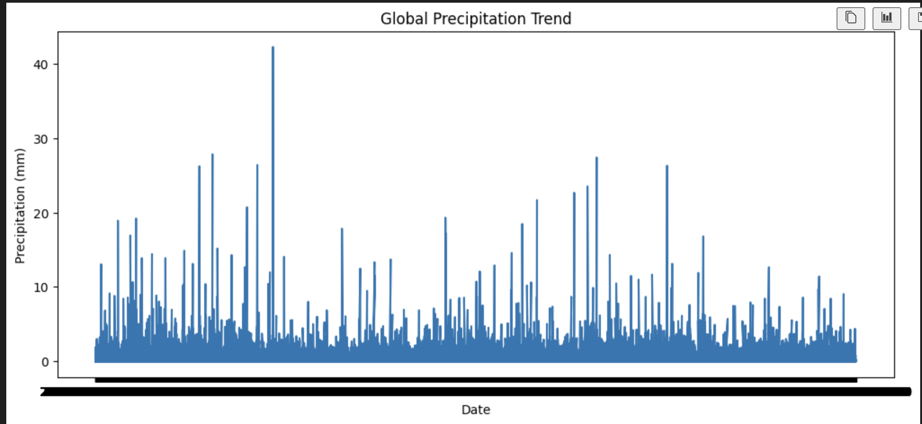
Exploratory Data Analysis
Temperature trend
Precipitation trend
Global temperatures show clear seasonal variation over time.
Precipitation levels vary significantly across time and regions.

Slide 6
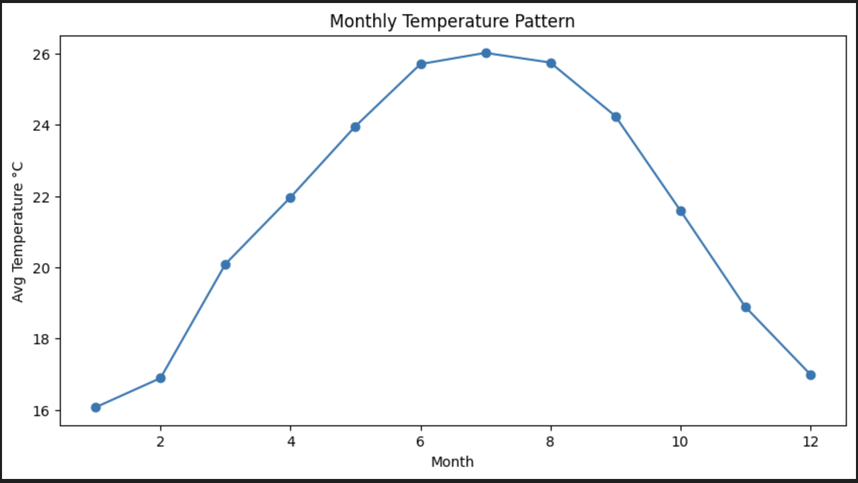
Exploratory Data Analysis
Monthly Seasonal Pattern Chart
Temperatures peak mid-year and decline toward year end, indicating strong seasonality.

Slide 7
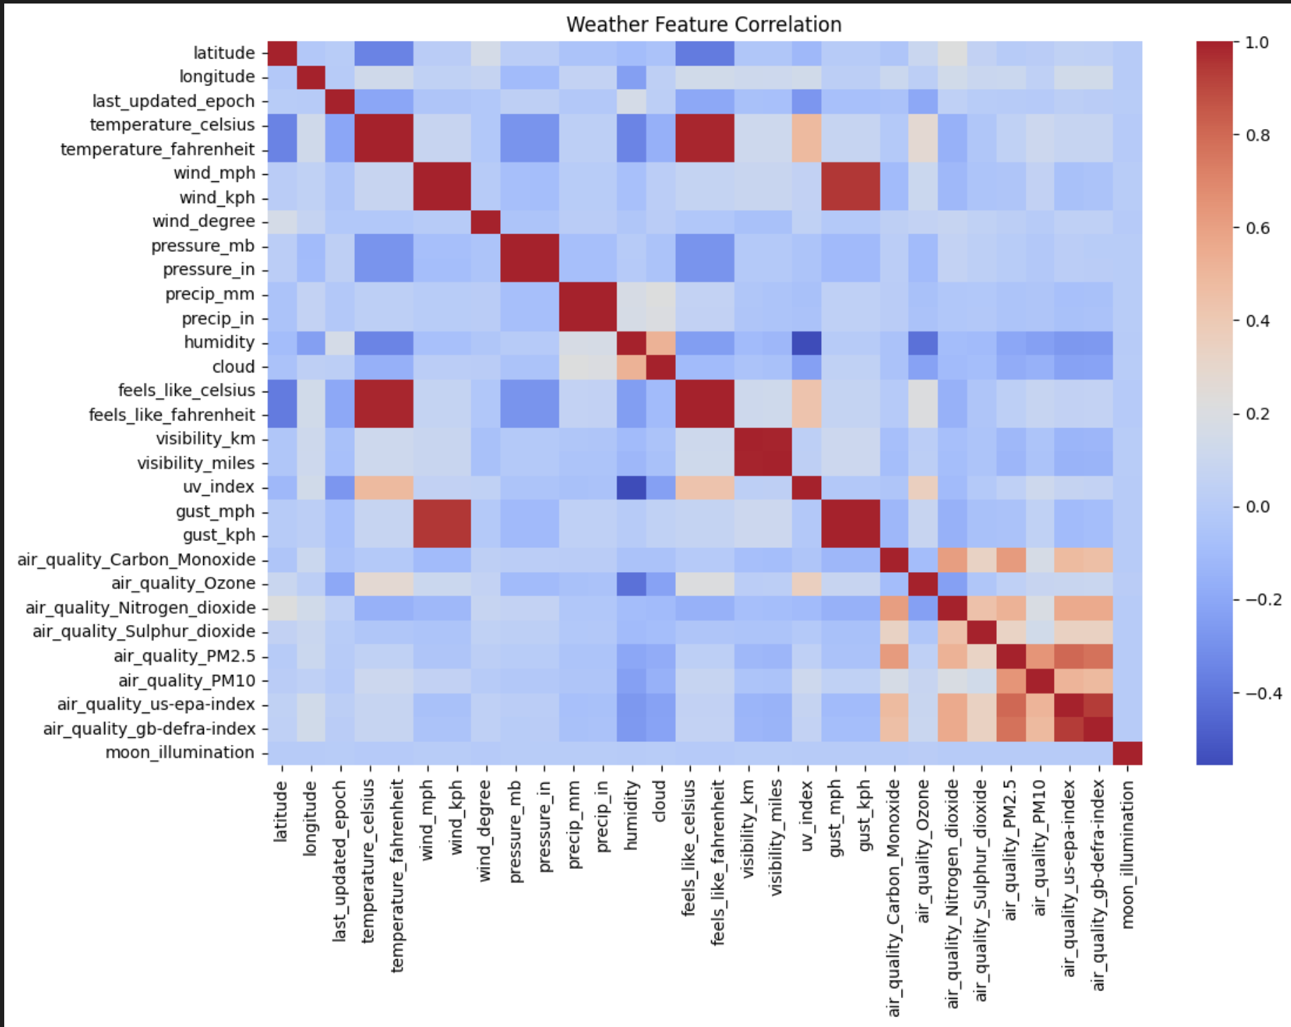
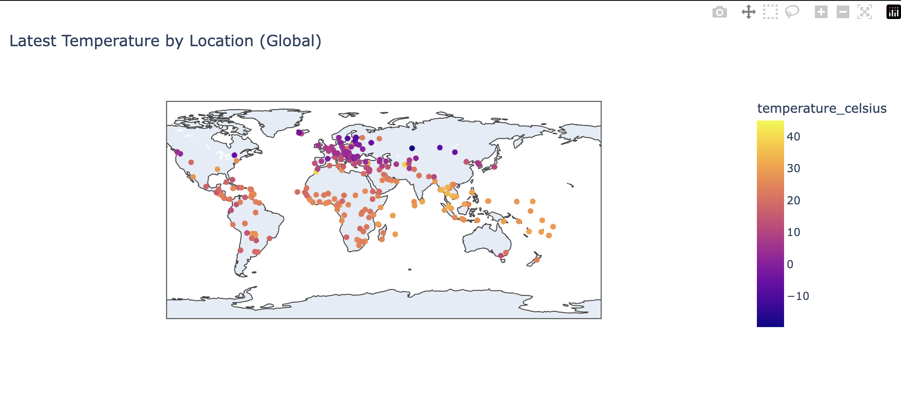
Geographic & Environmental Insights
1) World Temperature Map
2) Air Quality Correlation Heatmap
Temperature distribution follows geographic latitude patterns.
Air quality indicators show relationships with humidity, wind speed, and atmospheric conditions.

Slide 8
Anomaly Detection
dentified unusual temperature spikes using statistical anomaly detection
Extreme deviations from normal patterns were detected
Anomaly detection helps monitor unusual climate behavior
Useful for early detection of extreme weather events

Slide 9
Forecasting Models
Baseline Model
→ Predicts future temperature using the most recent observed value
ETS Model (Exponential Smoothing)
→ Captures underlying trend patterns in time-series data
Random Forest Model
→ Uses past temperatures and seasonal features to learn patterns
Ensemble Model
→ Combines statistical and machine learning forecasts to improve accuracy

Slide 10
Model Performance
Model | MAE
Baseline | 4.99
ETS | 3.12
Ensemble | 2.46

Slide 11
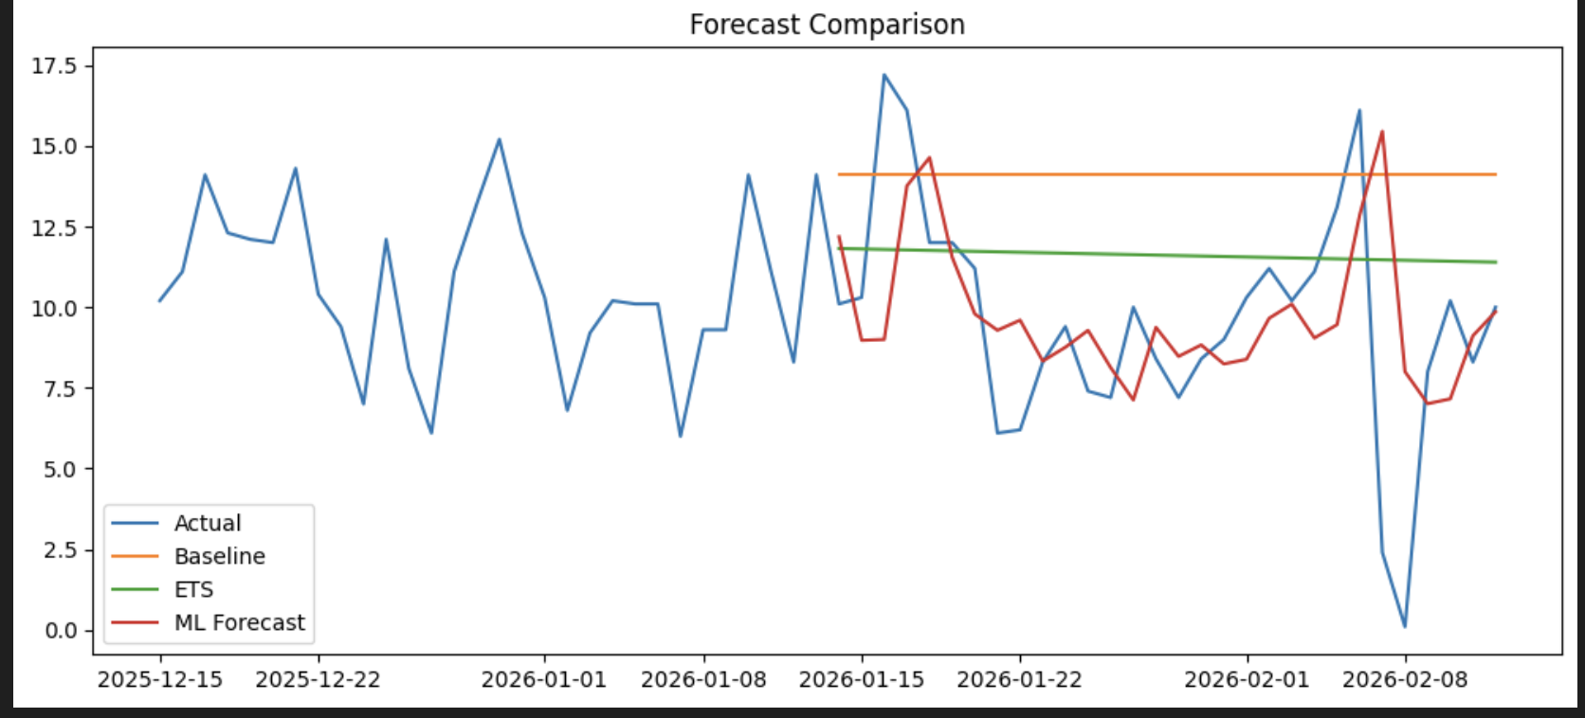
Model Performance
Model Performance Comparison
Ensemble forecasting most closely follows the actual temperature trend, providing the highest prediction accuracy.

Slide 12
Conclusion
This project analyzed a global weather dataset to understand climate patterns and build accurate temperature forecasting models. After cleaning and preparing the data, exploratory analysis revealed strong seasonal trends, geographic temperature variations, and meaningful relationships between weather and air quality variables.
Time-series forecasting techniques were applied to predict future temperatures. While the baseline model provided a simple reference, the Exponential Smoothing (ETS) model significantly improved prediction accuracy by capturing trend patterns. A machine learning model further enhanced performance, and combining models using an ensemble approach produced the most accurate forecasts.
Overall, the analysis demonstrates that integrating statistical methods with machine learning improves forecasting reliability. The insights gained from this study can support climate monitoring, environmental analysis, and data-driven weather prediction systems.

