Slide 1

HTML5

Slide 2
Direct Marketing for Business
Ford in US Market
Ford to Indian Market and then it may get sold

Slide 3
Advantages of Net Marketing
Lower cost of product advertisement
Removal of time restriction from business deals
Larger audience reach

Slide 4
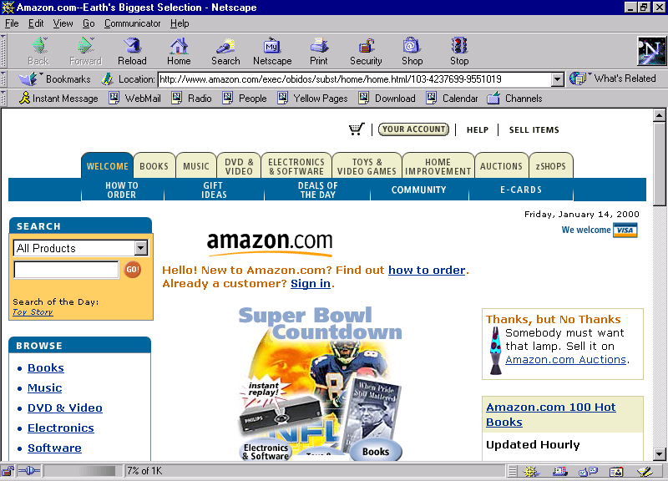
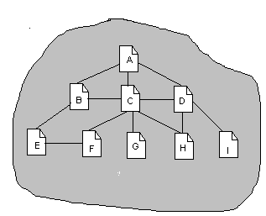
Web Site and Web Page
The first page which opens in a Web Site is the HOME page
There is no restriction with respect to the site size
One web site can span over more than one server also

Slide 5
Features of Web Pages
Web pages allow the following features :
Product Catalogues
Web Chat
Online order tracking
Online Demonstration
Online Feedback System

Slide 6
General Guidelines
Avoid use of too many fonts
Avoid too many colours on the same page
Use pastoral colours in corporate and professional slides
Use bright and sharp hues in kids and entertainment slides

Slide 7
Phases of developing a Web site
The web site can span various phases :
Design Phase
Development Phase

Slide 8
The Design Phase
The design phase covers :
The Goals and Objectives
Target Audience
Storyboarding
Organize your information

Slide 9
Development Phase
The development phase covers :
The layout of the web page and the web site
Unity and Variety
Recognizing the Medium
Effect and Layout
Using color
Background
Text
Navigation around the web site
Hyper tree
Image maps
Hyperlinks
Sub-pages
Table of Contents

Slide 10
What is HTML?
Hyper Text Markup Language is the language for specifying the static content of Web pages.
HTML is a language for describing web pages.
HTML stands for
Hyper Text Markup Language

Slide 11

HTML Introduction
HTML is a markup language
A markup language is a set of markup tags
The tags describe document content
HTML documents contain HTML tags and plain text
HTML documents are also called web pages

Slide 12
HTML Tags
HTML tags are keywords (tag names) surrounded by angle brackets like <html>
HTML tags normally come in pairs like <p> and </p>
The first tag in a pair is the start tag, the second tag is the end tag
The end tag is written like the start tag, with a slash before the tag name
Start and end tags are also called opening tags and closing tags
<tagname>content</tagname>

Slide 13
HTML Elements
In HTML, most elements are written with a start tag (e.g. <p>) and an end tag (e.g. </p>), with the content in between:
<title> HTML Document</title>
<H1>This is Heading 1</H1>
<p>This is a paragraph.</p>

Slide 14
Web Browsers
It uses the tags to determine how the content of the HTML page is to be presented/displayed to the user.
The browser does not display the HTML tags.
The purpose of a web is to read HTML documents and display them as web pages.
Eg for Browsers: Google Chrome, Internet Explorer, Firefox, Safari.

Slide 15
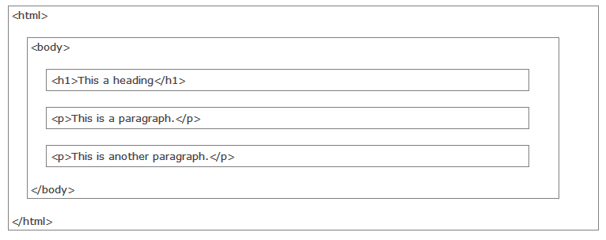
HTML Page Structure

Slide 16
HTML Versions
Version | Year
HTML | 1991
HTML+ | 1993
HTML 2.01 | 1995
HTML 3.2 | 1997
HTML 4.01 | 1999
XHTML 1.0 | 2000
HTML5 | 2012
XHTML | 2012
HTML5 W3C RECOMMENDATION | 2014
HTML 5.1 | 2016

Slide 17
HTML Editors
HTML can be edited by using a professional HTML editor like:
Adobe Dreamweaver
Microsoft Expression Web
Coffee Cup HTML Editor
Ms Visual Studio
However, for learning HTML we recommend a text editor like Notepad (PC) or TextEdit (Mac).

Slide 18
What is HTML5?
HTML5 is the latest standard for HTML.
The previous version of HTML, HTML 4.01, came in 1999, and the internet has changed significantly since then.
HTML5 was designed to replace both HTML 4, XHTML, and the HTML DOM Level 2.
It was specially designed to deliver rich content without the need for additional plugins.
The current version delivers everything from animation to graphics, music to movies, and can also be used to build complicated web applications.
HTML5 is also cross-platform. It is designed to work whether you are using a PC, or a Tablet, a Smartphone, or a Smart TV.

Slide 19
How Did HTML5 Get Started?
HTML5 is a cooperation between the World Wide Web Consortium (W3C) and the Web Hypertext Application Technology Working Group (WHATWG).
WHATWG was working with web forms and applications, and W3C was working with XHTML 2.0.
In 2006, they decided to cooperate and create a new version of HTML.

Slide 20
Rules for HTML5
New features should be based on HTML, CSS, DOM, and JavaScript
The need for external plugins (like Flash) should be reduced
Error handling should be easier than in previous versions
Scripting has to be replaced by more markup
HTML5 should be device-independent
The development process should be visible to the public

Slide 21
The <!DOCTYPE> Declaration
The <!DOCTYPE> declaration helps the browser to display a web page correctly.
There are many different documents on the web, and a browser can only display an HTML page 100% correctly if it knows the HTML version and type used.
In HTML5 there is only one DOCTYPE declaration, and it is very simple:
<!DOCTYPE html>

Slide 22
A Minimum HTML5 Document
<!DOCTYPE html> <html> <head> <meta charset="UTF-8"> <title>Title of the document</title> </head> <body> Content of the document...... </body> </html>

Slide 23
HTML5 - New Features
The <canvas> element for 2D drawing
The <video> and <audio> elements for media playback
Support for local storage
New content-specific elements, like <article>, <footer>, <header>, <nav>, <section>
New form controls, like calendar, date, time, email, url, search

Slide 24
HTML Elements
* The start tag is often called the opening tag. The end tag is often called the closing tag.
HTML documents are defined by HTML elements.
An HTML element is everything from the start tag to the end tag.
Start tag | Element content | End tag
<p> | This is a paragraph | </p>
<a href="default.htm"> | This is a link | </a>
<br>

Slide 25
HTML Element Syntax
An HTML element starts with a start tag / opening tag
An HTML element ends with an end tag / closing tag
The element content is everything between the start and the end tag
Some HTML elements have empty content
Empty elements are closed in the start tag
Most HTML elements can have attributes

Slide 26
Nested HTML Elements
Most HTML elements can be nested (can contain other HTML elements).
HTML documents consist of nested HTML elements.
The <p> element
The <body> element
The <html> element

Slide 27
Empty HTML Elements
HTML elements with no content are called empty elements.
<br> is an empty element without a closing tag (the <br> tag defines a line break).
In XHTML, all elements must be closed.
Adding a slash inside the start tag, like <br />, is the proper way of closing empty elements in XHTML (and XML).

Slide 28
HTML Attributes
Attributes provide additional information about HTML elements.
HTML elements can have attributes
Attributes provide additional information about an element
Attributes are always specified in the start tag
Attributes come in name/value pairs like: name="value"

Slide 29
Attribute Example
Attribute values should always be enclosed in quotes.
HTML links are defined with the <a> tag.
The link address is specified in the href attribute:
<a href="http://www.newhorizons.com">This is a link</a>

Slide 30
HTML Headings
Headings are important in HTML documents.
Headings are defined with the <h1> to <h6> tags.
<h1> defines the most important heading. <h6> defines the least important heading.
<h1>This is a heading</h1> <h2>This is a heading</h2> <h3>This is a heading</h3>

Slide 31
Headings…
Use HTML headings for headings only.
Don't use headings to make text BIG or bold.
Search engines use your headings to index the structure and content of your web pages.
Since users may skim your pages by its headings, it is important to use headings to show the document structure.
H1 headings should be used as main headings, followed by H2 headings, then the less important H3 headings, and so on.

Slide 32
HTML Lines
The <hr> tag creates a horizontal line in an HTML page.
The hr element can be used to separate contents.
<p>The hr tag defines a horizontal rule:</p>
<hr>
<p>This is a paragraph.</p>

Slide 33
HTML Paragraphs
HTML documents are divided into paragraphs.
Paragraphs are defined with the <p> tag.
<p>Happiness is not something ready made. It comes from your own actions.</p>
<p>There is only one happiness in this life, to love and be loved.</p>

Slide 34
HTML Formatting Tags
HTML uses tags like <b> and <i> for formatting output, like bold or italic text.
These HTML tags are called formatting tags
HTML Text Formatting
This text is bold This text is italic This is computer output This is _{subscript} and ^{superscript}
This is _{subscript} and ^{superscript}

Slide 35
<strong> & <em>
Often <strong> renders as <b>
<em> renders as <i>
<b> or <i> defines bold or italic text only.
<strong> or <em> means that you want the text to be rendered in a way that the user understands as "important".

Slide 36
HTML Text Formatting Tags
Tag | Description
<b> | Defines bold text
<em> | Defines emphasized text
<i> | Defines a part of text in an alternate voice or mood
<small> | Defines smaller text
<strong> | Defines important text
<sub> | Defines subscripted text
<sup> | Defines superscripted text
<ins> | Defines inserted text
<del> | Defines deleted text
<mark> | Defines marked/highlighted text

Slide 37
Text Formatting Tags
Super Script - <SUP> …. </SUP>
<P> This Is My 7 <SUP> th </SUP> Program Using HTML </P>
Sub Script - <SUB> …. </SUB>
<P> H<SUB>2</SUB>O Is The Chemical Name For Water</P>

Slide 38
HTML Comments
Comment tags <!-- and --> are used to insert comments in HTML.
Comments are not displayed by the browser, but they can help document your HTML.
With comments you can place notifications and reminders in your HTML.
<!-- This is a comment --> <p>This is a paragraph.</p> <!-- Remember to add more information here -->

Slide 39
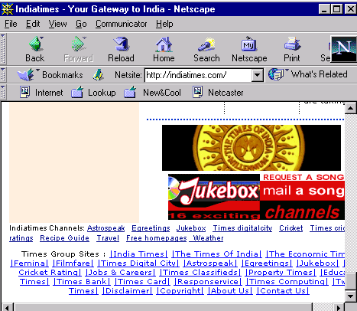
HTML Links
Links are found in nearly all Web pages.
Links allow users to click their way from page to page.
Graphical Hyperlinks
Text Hyperlinks

Slide 40
HTML Hyperlinks (Links)
The HTML <a> tag defines a hyperlink.
A hyperlink (or link) is a word, group of words, or image that you can click on to jump to another document.
When you move the cursor over a link in a Web page, the arrow will turn into a little hand.
The most important attribute of the <a> element is the href attribute, which indicates the link's destination.

Slide 41
HTML Link Syntax
The href attribute specifies the destination of a link.
An unvisited link is underlined and blue
A visited link is underlined and purple
An active link is underlined and red
<a href="url">Link text</a>
<a href="http://www.newhorizons.com">New Horizons</a>

Slide 42
HTML Links - The id Attribute
The id attribute can be used to create a bookmark inside an HTML document.
Bookmarks are not displayed in any special way. They are invisible to the reader.
An anchor with an id inside an HTML document:
Create a link to the "Useful Tips Section" inside the same or different document.
<a id="tips">Useful Tips Section</a>
<a href="#tips">Visit the Useful Tips Section</a>
<a href="http://www.htmltips.com/html_links.htm#tips"> Visit the Useful Tips Section</a>

Slide 43
The HTML <head> Element
The <head> element is a container for all the head elements.
Elements inside <head> can include scripts, instruct the browser where to find style sheets, provide meta information, and more.
The following tags can be added to the head section: <title>, <style>, <meta>, <link>, <script>, <noscript>, and <base>.

Slide 44
The HTML <meta> Element
Metadata is data (information) about data.
The <meta> tag provides metadata about the HTML document.
Metadata will not be displayed on the page, but will be machine parsable.
Meta elements are typically used to specify page description, keywords, author of the document, last modified, and other metadata.
The metadata can be used by browsers (how to display content or reload page), search engines (keywords), or other web services.
<meta> tags always go inside the <head> element.

Slide 45
<meta> Tags - Examples
Define keywords for search engines:
<meta name="keywords" content="HTML, CSS, XML, XHTML, JavaScript">
Define a description of your web page:
<meta name="description" content="Free Web tutorials on HTML and CSS">
Define the author of a page:
<meta name="author" content="Hege Refsnes">
Refresh document every 30 seconds:
<meta http-equiv="refresh" content="30">

Slide 46
Color Code
Colors are set using “RGB” color codes, which are, represented as hexadecimal values. Each 2-digit section of the code represents the amount, in sequence, of red, green or blue that forms the color. For example, a RGB value with 00 as the first two digits has no red in the color.

Slide 47

Main Colours

Slide 48
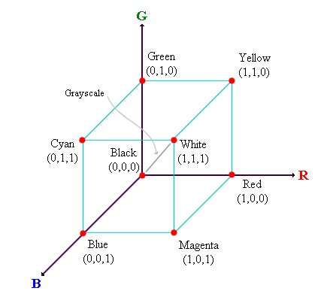
RGB Colour Model

Slide 49
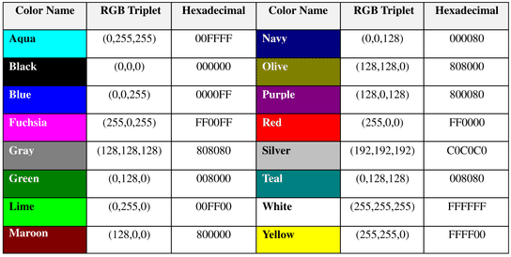
16 Basic Colors

Slide 50
Color Codes
WHITE
BLACK
RED
GREEN
BLUE
MAGENTA
CYAN
YELLOW
AQUAMARINE
BAKER’S CHOCOLATE
VIOLET
BRASS
COPPER
PINK
ORANGE
#FFFFFF
#000000
#FF0000
#00FF00
#0000FF
#FF00FF
#00FFFF
#FFFF00
#70DB93
#5C3317
#9F5F9F
#B5A642
#B87333
#FF6EC7
#FF7F00

Slide 51
Color Codes
If you require more information about color values, there is an excellent site entitled “VGDesign’s Interactive Color Cube” that displays the background color code when you put your cursor over a small color sample. The Web address is :
http://www.vgdesign.com/color.html

Slide 52
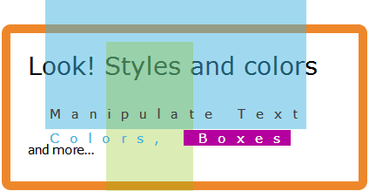
HTML Styles - CSS
CSS (Cascading Style Sheets) is used to style HTML elements.

Slide 53
Style Sheets Introduction
Individual Elements in Page
To affect the entire document
Style Sheets
Formatting styles like fonts, colors in Web Pages

Slide 54
Style Sheet
Style Sheet -A collection of formatting styles
Style Rules
Selector
Declaration
Syntax:
Selector {Declaration}
Property:Value
Example :
H1{Color:Blue}

Slide 55
Styling HTML with CSS
CSS was introduced together with HTML 4, to provide a better way to style HTML elements.
CSS can be added to HTML in the following ways:
Inline - using the style attribute in HTML elements
Internal - using the <style> element in the <head> section
External - using an external CSS file

Slide 56
Inline Styles
An inline style can be used if a unique style is to be applied to one single occurrence of an element.
To use inline styles, use the style attribute in the relevant tag. The style attribute can contain any CSS property.
The background-color property defines the background color for an element
<body style="background-color:yellow;"> <h2 style="background-color:red;">This is a heading</h2> <p style="background-color:green;">This is a paragraph.</p>
<p style="font-family:arial;color:red;font-size:20px;">A paragraph.</p>
<h1 style="text-align:center;">Center-aligned heading</h1>

Slide 57
Internal Style Sheet
An internal style sheet can be used if one single document has a unique style.
Internal styles are defined in the <head> section of an HTML page, by using the <style> tag
<head> <style> body {background-color:yellow;} p {color:blue;} </style> </head>

Slide 58
Types of Selectors
Simple Selector
Selectors
HTML Selector
Class Selector
Simple Selector
<P> {Color:Blue}
HTML Selector
P {Color:Blue}
Uses names of HTML Elements

Slide 59
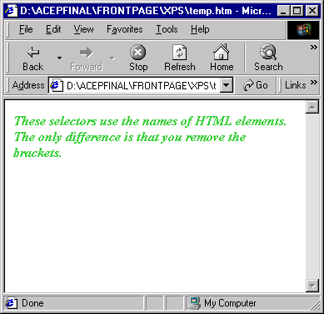
HTML Selector
<HTML>
<HEAD>
<STYLE TYPE="text/css">
P {font-style:italic;
fontweight:bold;
color:limegreen}
</STYLE>
</HEAD>
<BODY>
<P>These selectors use the names of
HTML elements. The only
difference is that you remove the
brackets.
</P>
</BODY>
</HTML>

Slide 60
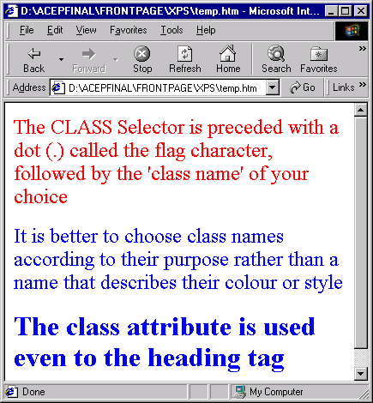
Class Selector
To apply styles to specific parts of a document
<HEAD>
<STYLE TYPE="text/css">
.note { color: blue }
.syntax { color: red }
p.syntax {color:red}
P{font-size: large}
</STYLE>
</HEAD>
<BODY>
<P class="syntax">The CLASS Selector is
preceded with a dot (.) called the flag
character, followed by the 'class name’
of your choice
<P class="note">It is better to choose class names
according to their purpose rather than
a name that describes their colour or
style
<H1 class="note"> The class attribute is used even
to the heading tag
<H1>
</HTML>

Slide 61
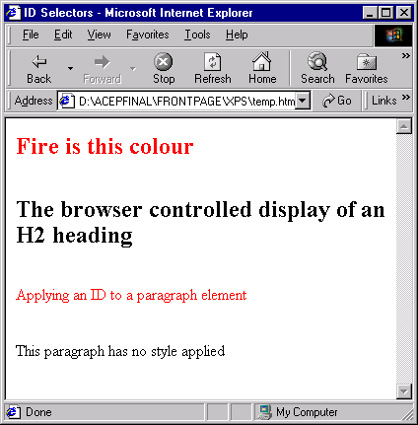
ID Selectors
An ID selector is preceded by a hash (#) mark and to apply ID
selector the ID attribute of an HTML element is used
<HEAD>
<STYLE TYPE="text/css">
#control { color: red }
</STYLE>
<H2 id="control">Fire is this
colour</H2>
<H2>The browser controlled display
of an H2 heading</H2>
<P id="control">Applying an ID to a
paragraph element</P>
<P>This paragraph has no style
applied</P>
</BODY>
</HTML>

Slide 62
External Style Sheet
An external style sheet is ideal when the style is applied to many pages.
With an external style sheet, you can change the look of an entire Web site by changing one file.
Each page must link to the style sheet using the <link> tag.
The <link> tag goes inside the <head> section
<head> <link rel="stylesheet" type="text/css" href="mystyle.css"> </head>

Slide 63
Cascading Style Sheets
Style rules can be saved in a single file called style sheet to apply common style to many documents
Style sheet can then be imported or linked.
<HTML>
<HEAD>
<LINK REL=STYLESHEET TYPE="TEXT/CSS"
HREF="PATH WHERE THE STYLE SHEET IS SAVED"
</HEAD>
BODY TAGS
</HTML>
REL=STYLESHEET - Relation to the external document in a style sheet.

Slide 64
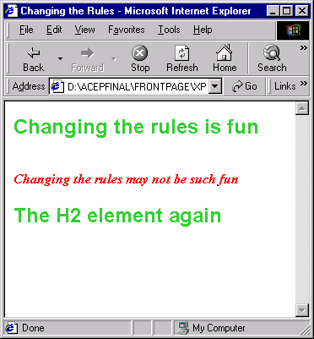
Linking Style Sheets
SHEET1.CSS
H2 {color:limegreen;
font-family:"Arial";
font-size:normal;
}
.warning {color:red;
font-weight:bold;
font-style:italic;
}
<!DOCTYPE HTML>
<HEAD>
<TITLE> Changing the Rules</TITLE>
<LINK REL=stylesheet HREF="sheet1.css" TYPE="text/css">
</HEAD>
<H2>Changing the rules is fun</H2>
<BR>
<P class="warning">Changing the rules may not be such fun
<H2>The H2 element again<P>
</HTML>

Slide 65

HTML Images
Norwegian Mountain Trip

Slide 66
The <img> Tag and the Src Attribute
In HTML, images are defined with the <img> tag.
The <img> tag is empty, which means that it contains attributes only, and has no closing tag.
To display an image on a page, you need to use the src attribute.
Src stands for "source".
The value of the src attribute is the URL of the image you want to display.

Slide 67
Syntax for defining an image
<img src="url" alt="some_text">
The URL points to the location where the image is stored.
The required alt attribute specifies an alternate text for an image, if the image cannot be displayed

Slide 68
Set Height and Width of an Image
The height and width attributes are used to specify the height and width of an image.
The attribute values are specified in pixels by default
<img src="smiley.gif" alt="Smiley face" width="42” height="42">

Slide 69
HTML Blocks
HTML elements can be grouped together with <div> and <span>.
Most HTML elements are defined as block level elements or as inline elements.
Block level elements normally start (and end) with a new line when displayed in a browser.
Examples: <h1>, <p>, <ul>, <table>

Slide 70
HTML Inline Elements
Inline elements are normally displayed without starting a new line.
Examples: <b>, <td>, <a>, <img>

Slide 71
The HTML <div> Element
The HTML <div> element is a block level element that can be used as a container for grouping other HTML elements.
It is a block level element, the browser will display a line break before and after it.
When used together with CSS, the <div> element can be used to set style attributes to large blocks of content.
Defines a section in a document (block-level)

Slide 72
<div> Element
Another common use of the <div> element, is for document layout.
It replaces the "old way" of defining layout using tables.
Using <table> elements for layout is not the correct use of <table>.
The purpose of the <table> element is to display tabular data.

Slide 73
The HTML <span> Element
Defines a section in a document (inline)
The HTML <span> element is an inline element that can be used as a container for text.
The <span> element has no special meaning.
When used together with CSS, the <span> element can be used to set style attributes to parts of the text.

Slide 74
HTML Layouts
Web page layout is very important to make your website look good.
Design your webpage layout very carefully.
Most websites have put their content in multiple columns (formatted like a magazine or newspaper).
Multiple columns are created by using <div> or <table> elements.
CSS are used to position elements, or to create backgrounds or colorful look for the pages.

Slide 75
HTML Layouts - Using <div> Elements
The div element is a block level element used for grouping HTML elements.
The biggest advantage of using CSS is that, if you place the CSS code in an external style sheet, your site becomes MUCH EASIER to maintain.
You can change the layout of all your pages by editing one file.

Slide 76
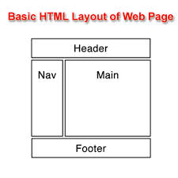
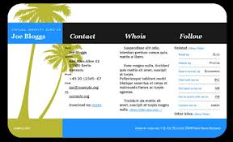
Layout - Templates

Slide 77
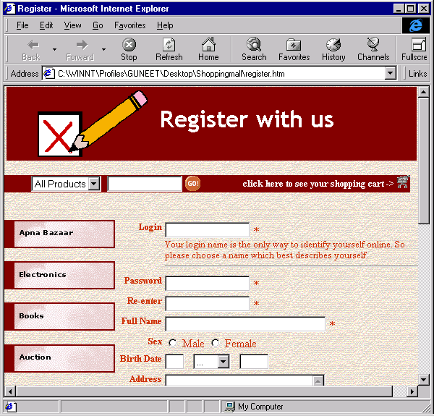
Forms
A form is a collection of fields on a page.
Form Fields

Slide 78
Form Handler
Form handler collects information from the form. It is used to:
Store the data submitted by the user into a text file. The data can be retrieved as and when required.
Update a database with the data submitted by the user.
Post the data on a Web page

Slide 79
Creating Forms
Forms are classified into three:
Form Header
Input Fields
Action Buttons
<Form>….</Form> tag
Syntax:
<HTML>
<BODY>
<FORM>
Form Elements
</FORM>
</BODY>
<HTML>

Slide 80
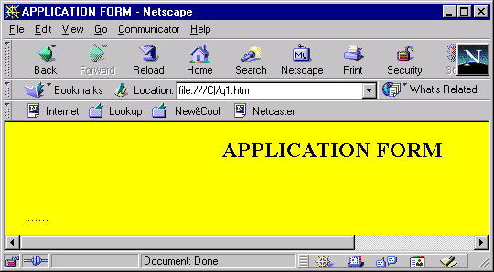
Creating Form Header
Example- creating a simple form header using <Caption> Tag
<HTML>
<HEAD>
<TITLE> Application Form </TITLE>
</HEAD>
<BODY bgcolor="gray" >
<TABLE CellPadding=10 Width="700">
<CENTER>
<CAPTION ALIGN="TOP">
<H2>APPLICATION FORM</H2>
</CAPTION>
</CENTER>
</TABLE>
</HTML>
Form Elements are
added using Table

Slide 81
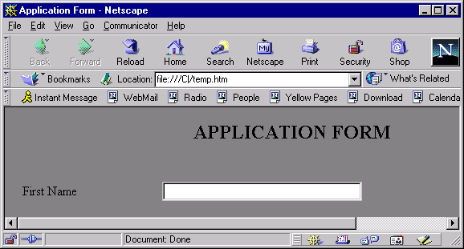
Text Input Type
Example
<FORM>
<FONT FACE="COURIER NEW">
<FONT SIZE="4">
<TR>
<TD>First Name</TD>
<TD><INPUT TYPE = "TEXT"
NAME = "EName1"
SIZE = "30"
MAXLENGTH = "30"
VALUE = "">
</TD>
</TR>
}

Slide 82
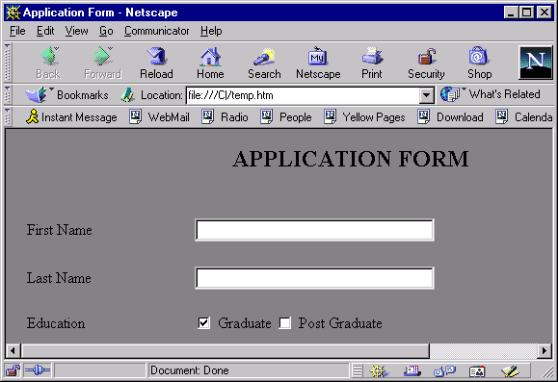
Checkbox Input Type
<TR>
<TD>Education</TD>
<TD>
<INPUT TYPE = "CHECKBOX"
NAME = "Education"
VALUE = "Graduate” CHECKED>
Graduate
<INPUT TYPE = "CHECKBOX"
NAME = "Education"
VALUE = "Post Graduate">
Post Graduate
</TD>
</TR>

Slide 83
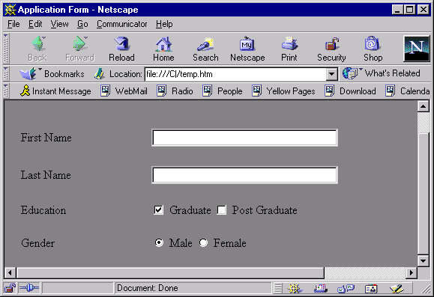
Radio Button Input Type
<TR>
<TD>Gender</TD>
<TD>
<INPUT TYPE ="RADIO"
NAME = "Gender"
VALUE = "Male" CHECKED> Male
<INPUT TYPE = "RADIO”
NAME = "Gender"
VALUE = "Female" > Female
</TD>
</TR>

Slide 84
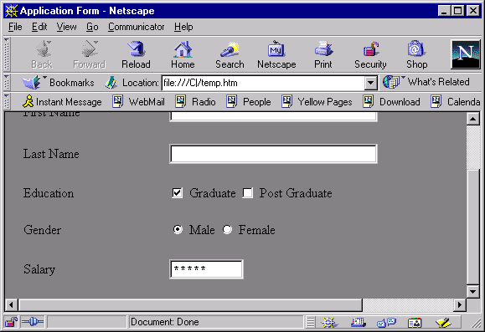
Password Input Type
<TR>
<TD>Salary</TD>
<TD>
<INPUT TYPE = PASSWORD" NAME= "Salary"
SIZE = "10">
</TD>
</TR>

Slide 85
Multiple Line Text Input
<TEXTAREA>…... <TEXTAREA> Tag
TEXTAREA Tag Attributes
Rows
Cols
Wrap
OFF
VIRTUAL
PHYSICAL
Syntax
<TEXTAREA ROWS=” “ COLS=” “ WRAP=” “

Slide 86
Pull Down Menus
<SELECT>……</SELECT> Tag
<OPTION>…..</OPTION> Tag
Syntax
<SELECT NAME=”ListName”>
<OPTION>Option1
<OPTION>Option2
</SELECT>

Slide 87
Action Buttons
Submit Button
Attributes
TYPE
VALUE
Reset Button
Attributes
TYPE
VALUE
Syntax
<TR>
<INPUT TYPE = "SUBMIT" VALUE = "SUBMIT">
<INPUT TYPE = "RESET" VALUE = "RESET">
</TD>
</TR>

Slide 88
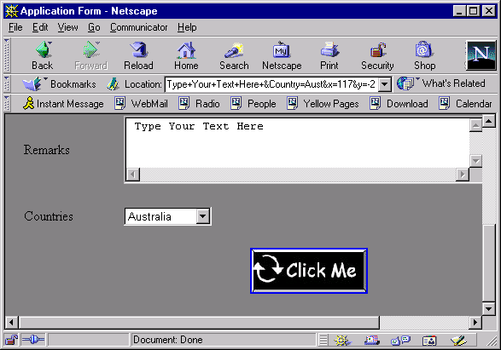
Image Input Type
Syntax
<INPUT TYPE = “IMAGE” SRC = “Image Name”>
Example
<INPUT TYPE = "IMAGE" SRC = "ClickButton.jpg">

Slide 89
FORM Tag
Form Tag
Method Attribute
Action Attribute
Syntax
<FORM
ACTION="MAILTO:emailID"
METHOD="POST” NAME="NAME OF THE FORM”>
………..
</FORM>

Slide 90
WEB Databases
Need For Database Applications
Keep track of the customers who visit the site frequently to provide effective promotional schemes like discounts, Reward points based on the purchase amount that can be refunded later.
Provide customized information to customers, suppliers and employees
To hold on line quizzes, puzzles to encourage customer participation.
Keep track of the products sold
To maintain on-line catalogs

