Slide 1

HTML5

Slide 2
Semantic Elements
Semantic = Meaning.
Semantic elements = Elements with meaning.
A semantic element clearly describes its meaning to both the browser and the developer.
non-semantic elements: <div> and <span> - Tells nothing about its content.
semantic elements: <form>, <table>, and <img> - Clearly defines its content.

Slide 3
New Semantic Elements
Many of existing web sites today contains HTML code like this:
<div id="nav">,
<div class="header">, or
<div id="footer">,
to indicate navigation links, header, and footer.

Slide 4
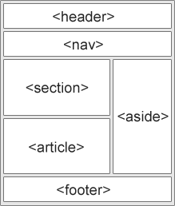
Semantic Elements…
HTML5 offers new semantic elements to clearly define different parts of a web page.
<header>
<nav>
<section>
<article>
<aside>
<figure>
<figcaption>
<footer>
<details>
<summary>
<mark>
<time>

Slide 5
HTML5 <section> Element
The <section> element defines a section in a document.
According to W3C's HTML5 documentation: "A section is a thematic grouping of content, typically with a heading.“
The <section> tag defines sections in a document. Such as chapters, headers, footers, or any other sections of the document.
<section>
<h1>WWF</h1> <p>The World Wide Fund for Nature (WWF) is....</p> </section>

Slide 6
HTML5 <article> Element
The <article> element specifies independent, self-contained content.
An article should make sense on its own and it should be possible to distribute it independently from the rest of the web site.
Examples of where an <article> element can be used:
Forum post
Blog post
News story
Comment
<article> <h1>Internet Explorer 9</h1> <p>Windows Internet Explorer 9 (abbreviated as IE9) was released to the public on March 14, 2011 at 21:00 PDT.....</p> </article>

Slide 7
HTML5 <nav> Element
The <nav> element defines a set of navigation links.
The <nav> element is intended for large blocks of navigation links.
However, not all links in a document should be inside a <nav> element!
<nav> <a href="/html/">HTML</a> | <a href="/css/">CSS</a> | <a href="/js/">JavaScript</a> | <a href="/jquery/">jQuery</a> </nav>

Slide 8
HTML5 <aside> Element
The <aside> element defines some content aside from the content it is placed in (like a sidebar).
The aside content should be related to the surrounding content.
<p>My family and I visited The Epcot center this summer.</p> <aside> <h4>Epcot Center</h4> <p>The Epcot Center is a theme park in Disney World, Florida.</p> </aside>

Slide 9
HTML5 <header> Element
The <header> element specifies a header for a document or section.
The <header> element should be used as a container for introductory content.
You can have several <header> elements in one document.
<article> <header> <h1>Internet Explorer 9</h1> <p><time pubdate datetime="2011-03-15"></time></p> </header> <p>Windows Internet Explorer 9 (abbreviated as IE9) was released to the public on March 14, 2011 at 21:00 PDT.....</p> </article>

Slide 10
HTML5 <footer> Element
The <footer> element specifies a footer for a document or section.
A <footer> element should contain information about its containing element.
A footer typically contains the author of the document, copyright information, links to terms of use, contact information, etc.
You can have several <footer> elements in one document.
<footer> <p>Posted by: Hege Refsnes</p> <p><time pubdate datetime="2012-03-01"></time></p> </footer>

Slide 11
HTML5 <figure> and <figcaption> Elements
The <figure> tag specifies self-contained content, like illustrations, diagrams, photos, code listings, etc.
While the content of the <figure> element is related to the main flow, its position is independent of the main flow, and if removed it should not affect the flow of the document.
The <figcaption> tag defines a caption for a <figure> element.
The <figcaption> element can be placed as the first or last child of the <figure> element.

Slide 12

<figure> and <figcaption> Elements Example
Brighten your day with an exquisite cup of coffee
<figure> <img src="img_pulpit.jpg" alt="The Pulpit Rock" width="304" height="228"> <figcaption>Fig1. - The Pulpit Pock, Norway.</figcaption> </figure>

Slide 13
Semantic Elements in HTML5
Tag | Description
<article> | Defines an article
<aside> | Defines content aside from the page content
<details> | Defines additional details that the user can view or hide
<figcaption> | Defines a caption for a <figure> element
<figure> | Specifies self-contained content, like illustrations, diagrams, photos, code listings, etc.
<footer> | Defines a footer for a document or section
<header> | Specifies a header for a document or section
<main> | Specifies the main content of a document
<mark> | Defines marked/highlighted text
<nav> | Defines navigation links
<section> | Defines a section in a document
<summary> | Defines a visible heading for a <details> element
<time> | Defines a date/time

Slide 14
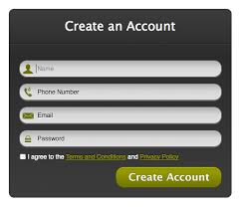
HTML5 Form Elements
HTML5 has the following new form elements:
<datalist>
<keygen>
<output>
Not all browsers support all the new form elements. However, you can already start using them; If they are not supported, they will behave as regular text fields.

Slide 15
HTML5 <datalist> Element
The <datalist> element specifies a list of pre-defined options for an <input> element.
The <datalist> element is used to provide an "autocomplete" feature on <input> elements. Users will see a drop-down list of pre-defined options as they input data.
Use the <input> element's list attribute to bind it together with a <datalist> element.

Slide 16
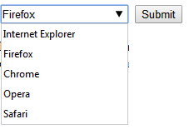
<datalist> Element Example
An <input> element with pre-defined values in a <datalist>:
<input list="browsers"> <datalist id="browsers"> <option value="Internet Explorer"> <option value="Firefox"> <option value="Chrome"> <option value="Opera"> <option value="Safari"> </datalist>

Slide 17
HTML5 <keygen> Element
The purpose of the <keygen> element is to provide a secure way to authenticate users.
The <keygen> tag specifies a key-pair generator field in a form.
When the form is submitted, two keys are generated, one private and one public.
The private key is stored locally, and the public key is sent to the server.
The public key could be used to generate a client certificate to authenticate the user in the future.

Slide 18

<keygen> Element Example
A form with a keygen field:
<form action="demo_keygen.asp" method="get"> Username: <input type="text" name="usr_name"> Encryption: <keygen name="security"> <input type="submit"> </form>

Slide 19

HTML5 <output> Element
The <output> element represents the result of a calculation (like one performed by a script).
Perform a calculation and show the result in an <output> element:
<form
oninput="x.value=parseInt(a.value)+parseInt(b.value)">0 <input type="range" id="a" value="50">100 + <input type="number" id="b" value="50">= <output name="x" for="a b"></output> </form>

Slide 20

HTML5 Media Elements
HTML Audio
HTML Video

Slide 21

HTML5 Video
HTML5 provides a standard way for showing videos in modern websites.
Before HTML5, there was no standard for showing videos/movies on web pages.
Before HTML5, videos could only be played with a plug-in (like flash). However, different browsers supported different plug-ins.
HTML5 defines a new element which specifies a standard way to embed a video or movie on a web page: the <video> element.

Slide 22
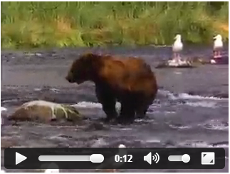
HTML5 Video - How It Works
<video width="320" height="240" controls> <source src="movie.mp4" type="video/mp4"> <source src="movie.ogg" type="video/ogg"> Your browser does not support the video tag. </video>

Slide 23
HTML5 Video - How It Works
The control attribute adds video controls, like play, pause, and volume.
It is also a good idea to always include width and height attributes.
If height and width are set, the space required for the video is reserved when the page is loaded.
However, without these attributes, the browser does not know the size of the video, and cannot reserve the appropriate space to it.
The effect will be that the page layout will change during loading (while the video loads).
You should also insert text content between the <video> and </video> tags for browsers that do not support the <video> element.
The <video> element allows multiple <source> elements. <source> elements can link to different video files. The browser will use the first recognized format.

Slide 24
HTML5 Audio
HTML5 provides a standard for playing audio files.
Before HTML5, there was no standard for playing audio files on a web page.
Before HTML5, audio files had to be played with a plug-in (like flash).
However, different browsers supported different plug-ins.
HTML5 defines a new element which specifies a standard way to embed an audio file on a web page: the <audio> element.

Slide 25

HTML5 Audio - How It Works
<audio controls> <source src="horse.ogg" type="audio/ogg"> <source src="horse.mp3" type="audio/mpeg"> Your browser does not support the audio element. </audio>

Slide 26
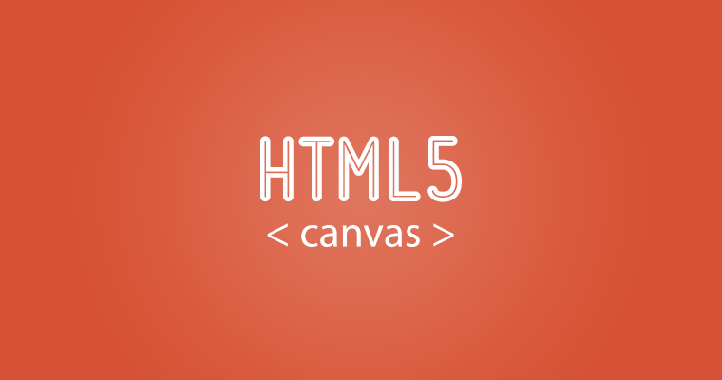
HTML Graphics

Slide 27
HTML5 Canvas
The HTML5 <canvas> element is used to draw graphics, on the fly, via scripting (usually JavaScript).
The <canvas> element is only a container for graphics.
You must use a script to actually draw the graphics.
Canvas has several methods for drawing paths, boxes, circles, text, and adding images.

Slide 28
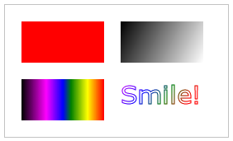
Create a Canvas
A canvas is a rectangular area on an HTML page, and it is specified with the <canvas> element.
By default, the <canvas> element has no border and no content.
<canvas id="myCanvas"
width="200" height="100" style="border:1px solid #000000;"> </canvas>

Slide 29

Draw Onto The Canvas With JavaScript
First, find the <canvas> element.
Then, call its getContext() method.
The getContext("2d") object is a built-in HTML5 object, with many properties and methods for drawing paths, boxes, circles, text, images, and more.
The fillStyle property can be a CSS color, a gradient, or a pattern.
<script> var c = document.getElementById("myCanvas"); var ctx = c.getContext("2d"); ctx.fillStyle = "#FF0000"; ctx.fillRect(0,0,150,75); </script>

Slide 30
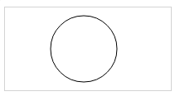
Canvas - Paths
To draw straight lines on a canvas, we will use the following two methods:
moveTo(x,y) defines the starting point of the line
lineTo(x,y) defines the ending point of the line
To actually draw the line, we must use one of the "ink" methods, like stroke().
To draw a circle on a canvas, we will use the following method:
arc(x,y,r,start,stop)

Slide 31

Canvas - Text
To draw text on a canvas, the most important property and methods are:
font - defines the font properties for text
fillText(text,x,y) - Draws "filled" text on the canvas
strokeText(text,x,y) - Draws text on the canvas (no fill)

Slide 32
Canvas - Gradients
Gradients can be used to fill rectangles, circles, lines, text, etc.
Shapes on the canvas are not limited to solid colors.
There are two different types of gradients:
createLinearGradient(x,y,x1,y1) - Creates a linear gradient
createRadialGradient(x,y,r,x1,y1,r1) - Creates a radial/circular gradient

Slide 33
Gradients…
Once we have a gradient object, we must add two or more color stops.
The addColorStop() method specifies the color stops, and its position along the gradient.
Gradient positions can be anywhere between 0 to 1.
To use the gradient, set the fillStyle or strokeStyle property to the gradient, and then draw the shape, like a rectangle, text, or a line.

Slide 34
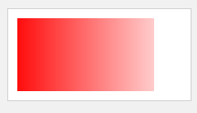
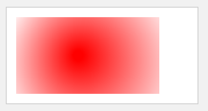
Gradients…
Create a linear gradient. Fill rectangle with the gradient: Using createLinearGradient()
Create a radial/circular gradient. Fill rectangle with the gradient:Using createRadialGrdient()

Slide 35
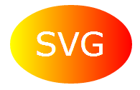
HTML5 Inline SVG
SVG stands for Scalable Vector Graphics
SVG is used to define vector-based graphics for the Web
SVG defines the graphics in XML format
SVG graphics do NOT lose any quality if they are zoomed or resized
Every element and every attribute in SVG files can be animated
SVG is a W3C recommendation

Slide 36
SVG Advantages
SVG images can be created and edited with any text editor
SVG images can be searched, indexed, scripted, and compressed
SVG images are scalable
SVG images can be printed with high quality at any resolution
SVG images are zoomable (and the image can be zoomed without degradation)

Slide 37
Comparison of Canvas and SVG
Canvas | SVG
Resolution dependent No support for event handlers Poor text rendering capabilities You can save the resulting image as .png or .jpg Well suited for graphic-intensive games | Resolution independent Support for event handlers Best suited for applications with large rendering areas (Google Maps) Slow rendering if complex (anything that uses the DOM a lot will be slow) Not suited for game applications

Slide 38

HTML5 APIs
Geolocation
Drag/Drop
Web Storage
App Cache

Slide 39

HTML5 Geolocation
The HTML5 Geolocation API is used to get the geographical position of a user.
Since this can compromise user privacy, the position is not available unless the user approves it.
Geolocation is much more accurate for devices with GPS, like iPhone.

Slide 40
Using Geolocation
Use the getCurrentPosition() method to get the user's position.
<script> var x = document.getElementById("demo"); function getLocation() { if (navigator.geolocation) { navigator.geolocation.getCurrentPosition(showPosition); } else { x.innerHTML = "Geolocation is not supported by this browser."; } } function showPosition(position) { x.innerHTML = "Latitude: " + position.coords.latitude + "<br>Longitude: " + position.coords.longitude; } </script>

Slide 41
Drag and Drop
Drag and drop is a very common feature.
It is when you "grab" an object and drag it to a different location.
In HTML5, drag and drop is part of the standard, and any element can be draggable.

Slide 42
Make an Element Draggable
First of all: To make an element draggable, set the draggable attribute to true.
<img draggable="true">

Slide 43
What to Drag - ondragstart and setData()
Specify what should happen when the element is dragged.
The ondragstart attribute calls a function, drag(event), that specifies what data to be dragged.
The dataTransfer.setData() method sets the data type and the value of the dragged data:
function drag(ev) { ev.dataTransfer.setData("text", ev.target.id); }
"text" and the value is the id of the draggable element ("drag1").

Slide 44
Where to Drop - ondragover
The ondragover event specifies where the dragged data can be dropped.
By default, data/elements cannot be dropped in other elements.
To allow a drop, we must prevent the default handling of the element.
This is done by calling the event.preventDefault() method for the ondragover event:
event.preventDefault()

Slide 45
Do the Drop - ondrop
When the dragged data is dropped, a drop event occurs.
The ondrop attribute calls a function, drop(event):

Slide 46
Web Storage – Local & Session
HTML local storage, better than cookies.
With local storage, web applications can store data locally within the user's browser.
Before HTML5, application data had to be stored in cookies, included in every server request.
Local storage is more secure, and large amounts of data can be stored locally, without affecting website performance.
Unlike cookies, the storage limit is far larger (at least 5MB) and information is never transferred to the server.
Local storage is per domain. All pages, from one domain, can store and access the same data.

Slide 47
HTML Local Storage Objects
HTML local storage provides two objects for storing data on the client:
window.localStorage - stores data with no expiration date
window.sessionStorage - stores data for one session (data is lost when the browser tab is closed)

Slide 48
The localStorage Object
The localStorage object stores the data with no expiration date.
The data will not be deleted when the browser is closed, and will be available the next day, week, or year.
// Store localStorage.setItem("lastname", "Smith"); // Retrieve document.getElementById("result").innerHTML = localStorage.getItem("lastname");
localStorage name/value pair

Slide 49
The sessionStorage Object
The sessionStorage object is equal to the localStorage object, except that it stores the data for only one session.
The data is deleted when the user closes the specific browser tab.

