Slide 1
Docker Overview
Presenter: Mohammed Rafiq
Date : 31stJul & 1st Aug2021

Slide 2
Agenda
What is a container ?
Traditional approach vs Docker approach
Docker Vs Virtual Machine
Container Vs Image
Basic Docker Commands
Hands-on Labs with DB containers
Docker Networks
Running multiple containers – docker-compose
Docker Volumes
Building our own Docker Image → Dockerfile
Pushing images to repository
Deploy containerized applications

Slide 3
What is a container ?
Way to package applications with all necessary dependencies and configurations.
Portable → Can be easily transported
More efficient for both development and deployment

Slide 4
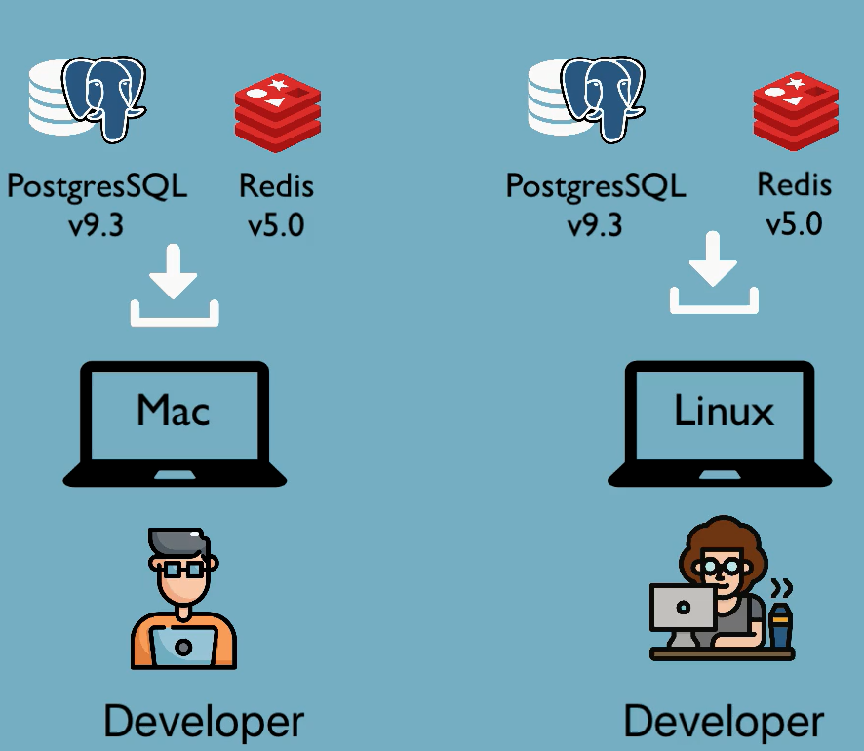
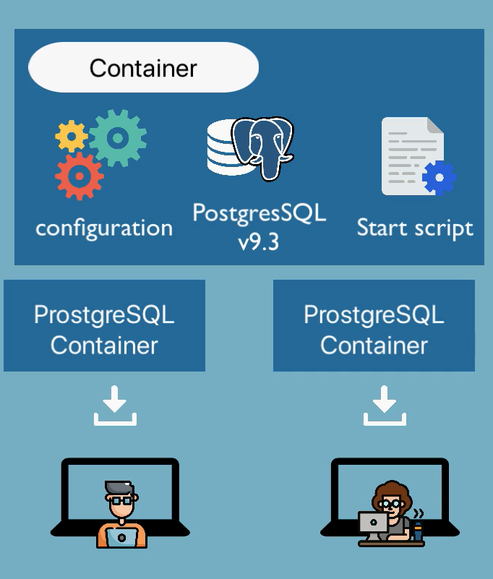
Application Development
Before Containers
After Containers
Installation process different for each OS
Multiple steps involved, so manual mistakes possible.
Own isolated environment.
One command to install applications.

Slide 5
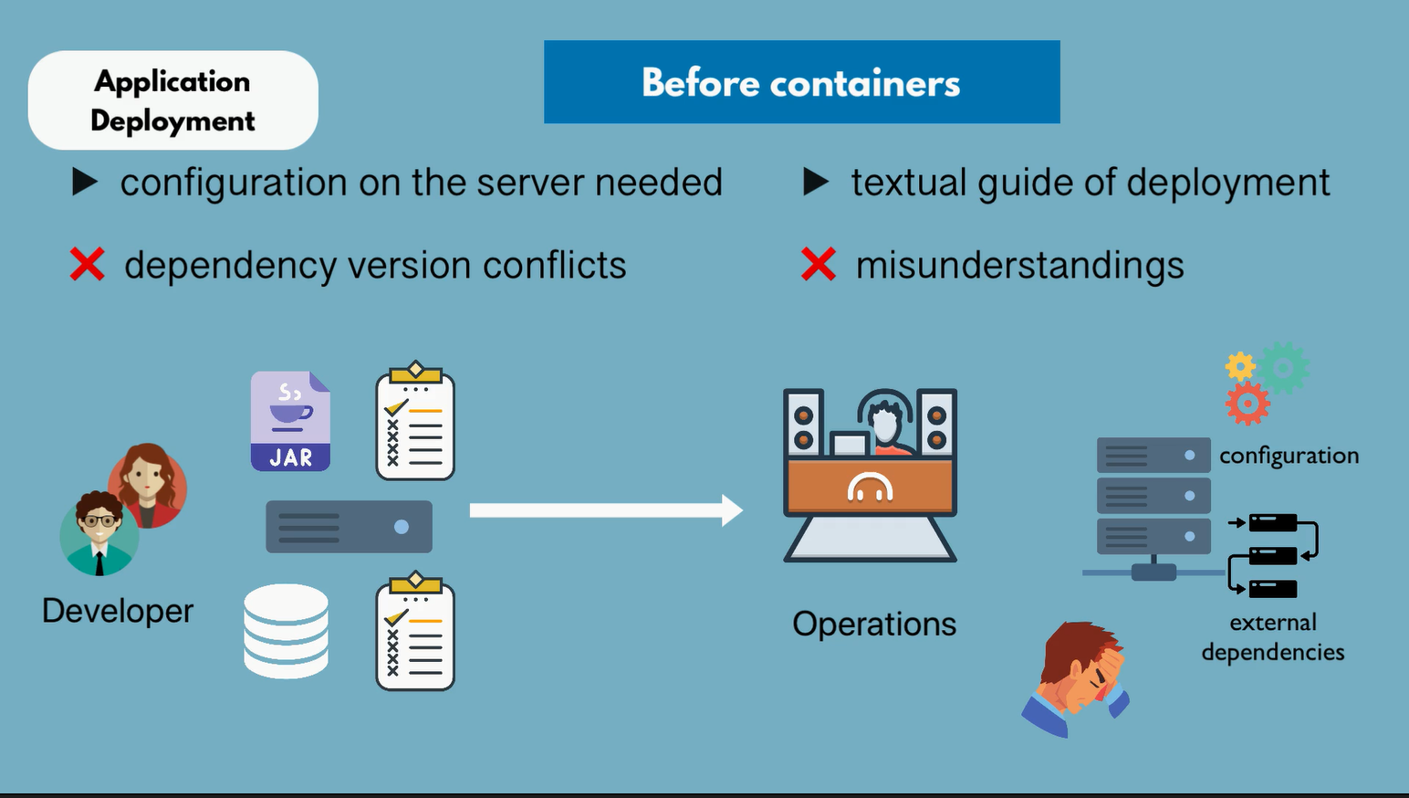

Slide 6
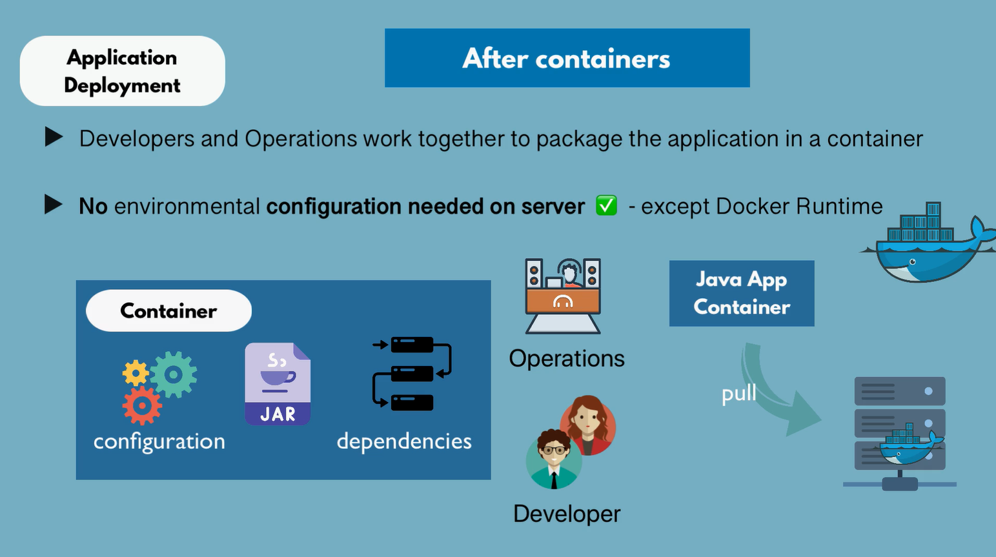

Slide 7
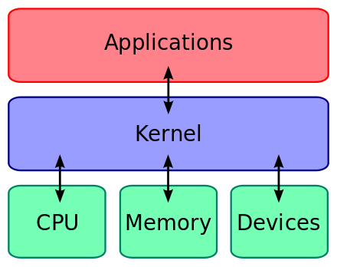
Basic OS Architecture
Hardware Layer → CPU, Memory, Devices
Kernel Layer→ Communicates with hardware.
Application Layer → Applications run on kernel layer.
Exp: Linux OS – Ubuntu, CentOS, Mint, etc
same kernel(Linux) – Different applications
Operating System Layers

Slide 8
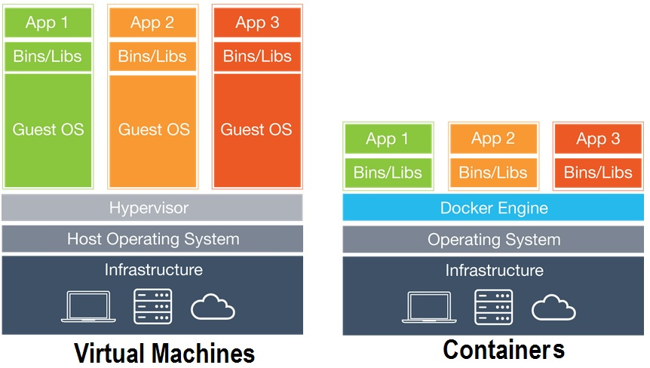
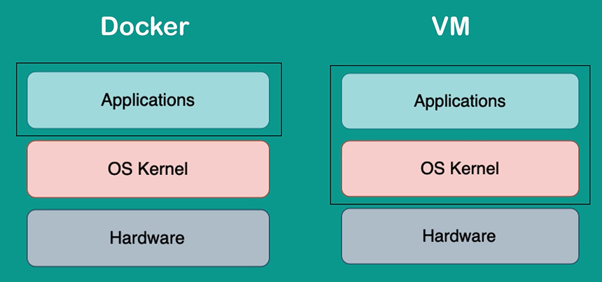
VM Vs Docker -- Architecture

Slide 9
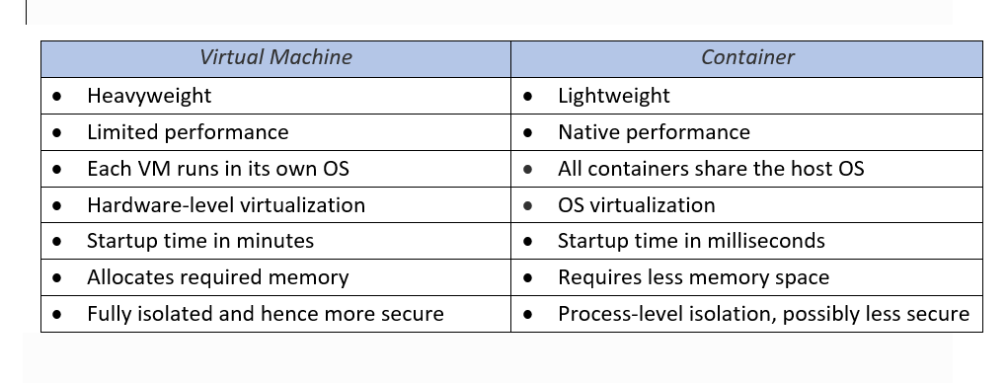
VM Vs Docker -- Features

Slide 10
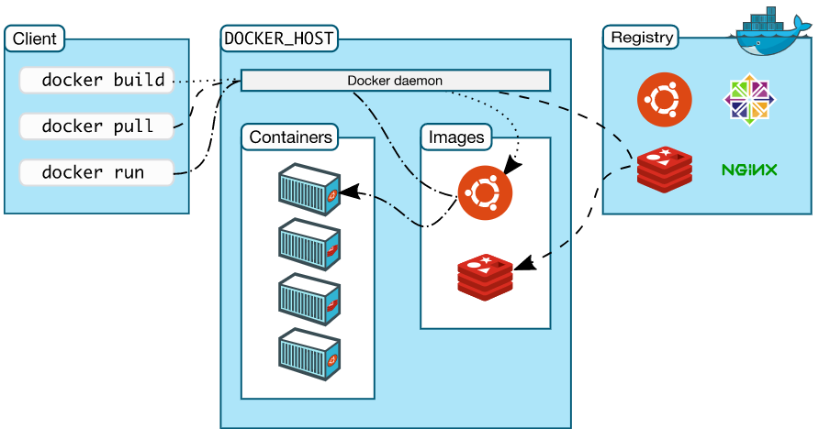
Docker Architecture

Slide 11
Image Vs Container
Image is a set of instructions that defines what should run inside a container.
A Docker image typically specifies:
Which external image to use as the basis for the container
Commands to run when the container starts;
How to set up the file system within the container; and
Additional instructions, such as which ports to open on the container, and how to import data from the host system.
Exp: Dockerfile & docker-compose files
Docker containers are the way to execute that package of instructions in a runtime environment.
We can run multiple containers based on one image
Analogy: Docker image as the recipe for a cake, and a container as a cake we baked from it.

Slide 12
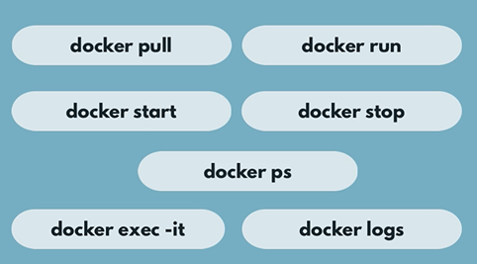
Docker – Basic Commands

Slide 13
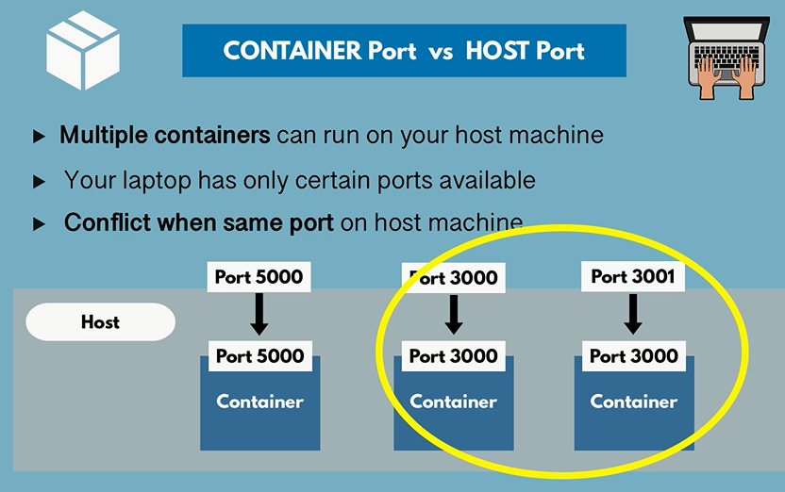

Slide 14
BASIC COMMANDS
DOCKER PULL <IMAGE_NAME>
DOCKER RUN <IMAGE_NAME>
1) docker run -d <image>
2) docker run --name <name> -d <image>
3) docker run -p <host-port>:<c-port> <image>
Docker ps- running containers
docker ps -a --> running and stopped containers
docker start <name/id>
docker stop <name/id>
docker kill <name/id>
docker container logs <name/id>
docker logs <name/id>
docker exec -it <name/id> [/bin/bash, /bin/sh ]
docker run vs docker start ???
docker run --> docker pull + docker start

Slide 15
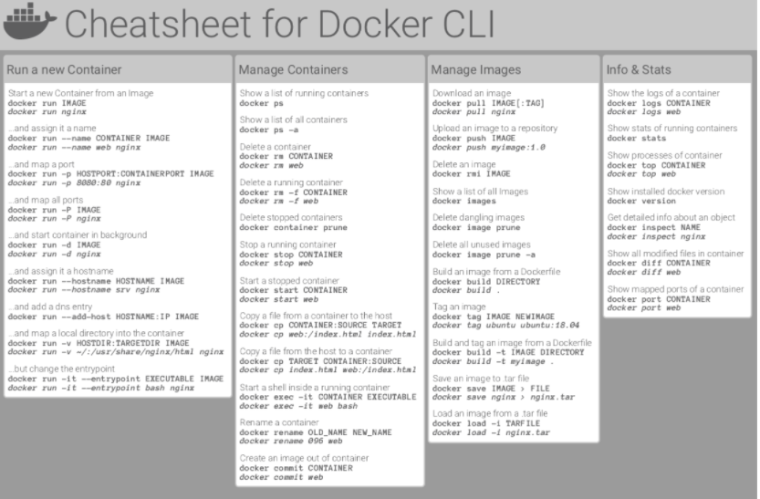

Slide 16
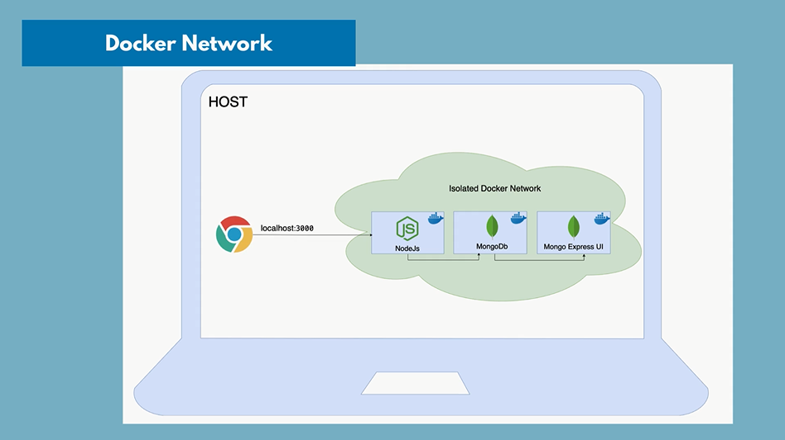

Slide 17
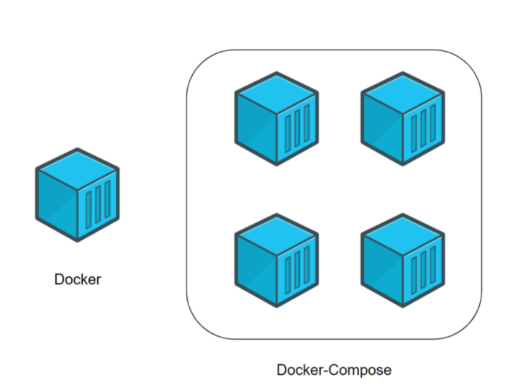
Docker-compose
Docker is used to manage an individual container (service) for your application.
Docker-Compose is used to manage several containers at the same time for the same application.
Command: docker compose –f <filename.yaml> up/down -d

Slide 18
Docker-compose example for Postgres (PGDatabase & PGAdmin)
version: '3'
services:
postgres-db:
image: postgres
hostname: docker-pg
environment:
POSTGRES_DB: dockerpg
POSTGRES_USER: postgres
POSTGRES_PASSWORD: postgres
ports:
- 5432:5432
networks:
- pgnetwork
pgadmin:
image: dpage/pgadmin4
hostname: docker-pgadmin
environment:
PGADMIN_DEFAULT_EMAIL: admin@gmail.com
PGADMIN_DEFAULT_PASSWORD: admin
ports:
- 8080:80
networks:
- pgnetwork
networks:
pgnetwork:

Slide 19
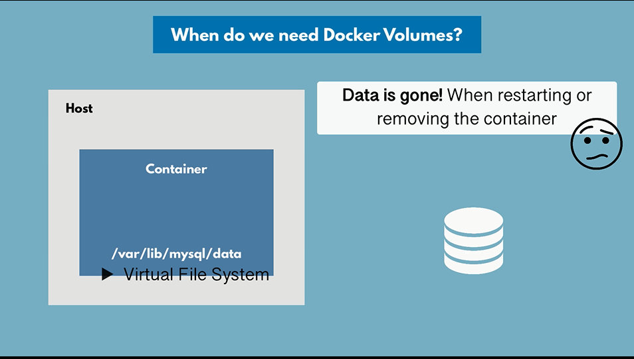

Slide 20
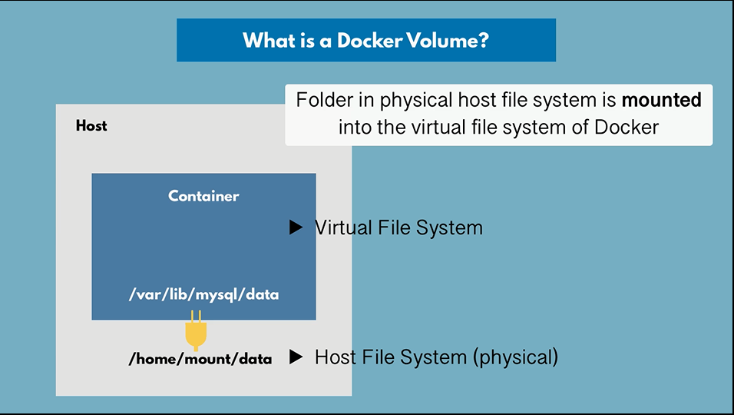

Slide 21
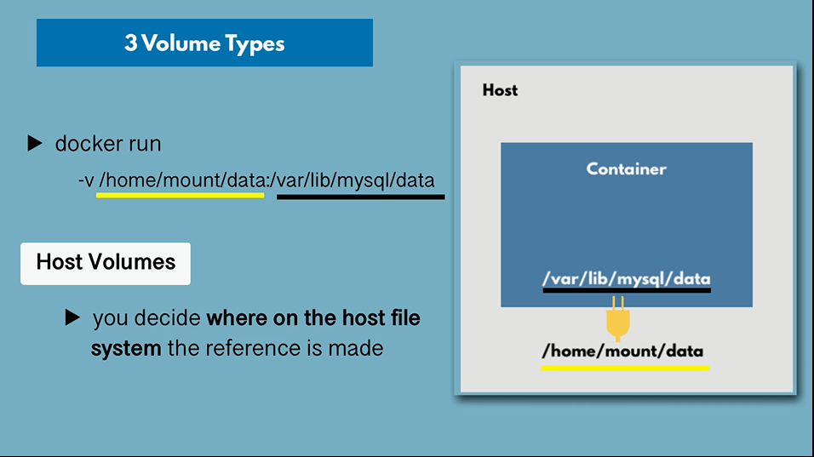

Slide 22
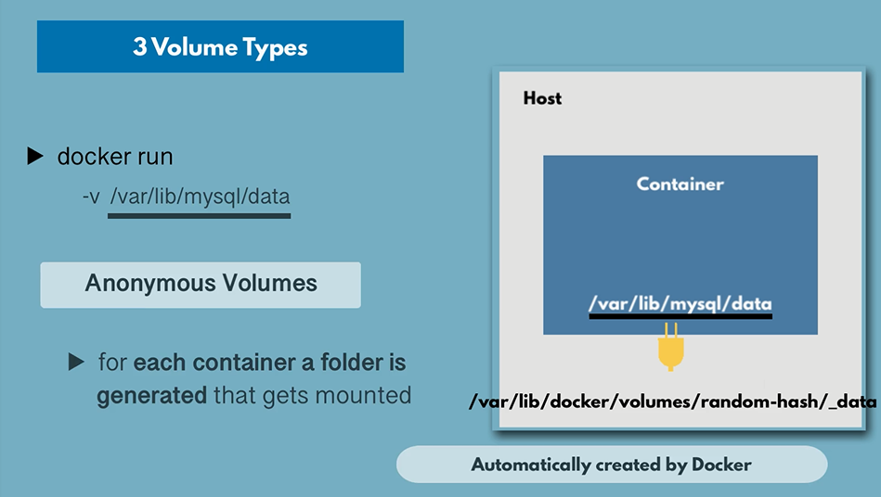

Slide 23
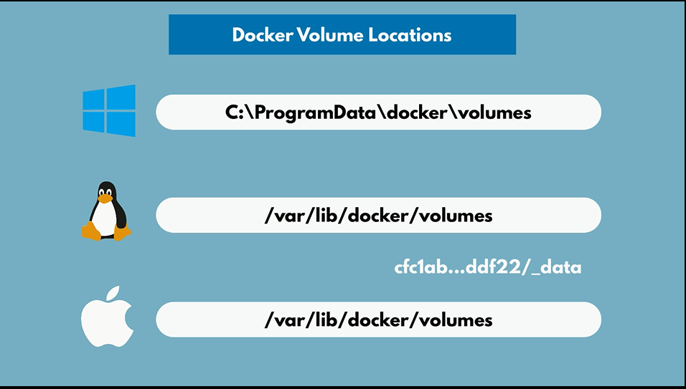

Slide 24
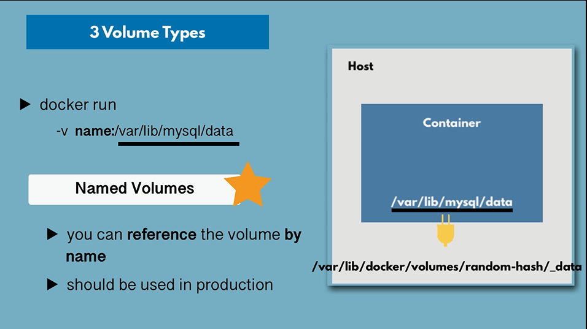

Slide 25
Thank You…!!

