Slide 1
AWS Load Balancer & Autoscaling Hands-On
Presenter: Mohammed Rafiq
Date : 18-July-2021

Slide 2
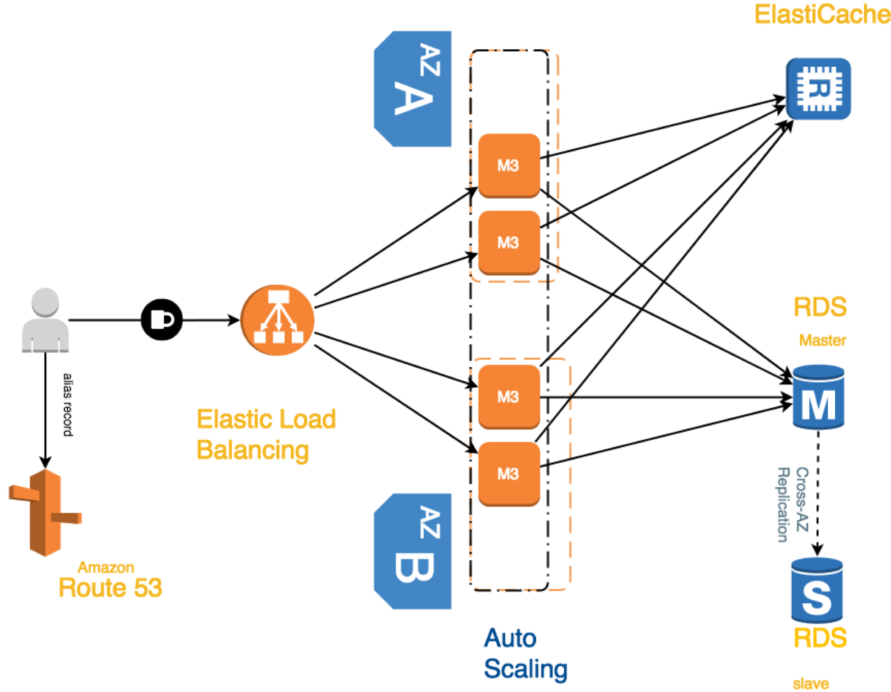
Data / Private Subnet
Private Subnet
Public Subnet
© Stephane Maarek

Slide 3

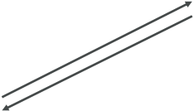



EC2
Instance
Load Balancer
User 1
User 2
User 3
EC2
Instance
EC2
Instance
© Stephane Maarek

Slide 4
© Stephane Maarek

Slide 5

© Stephane Maarek

Slide 6
Maximum size
Actual Size / Desired Capacity
Minimum size
Scale Out as Needed
EC2
Instance
EC2
Instance
EC2
Instance
EC2
Instance
EC2
Instance
EC2
Instance
AUTO SCALING GROUP
© Stephane Maarek

Slide 7

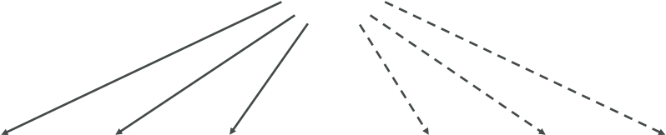
Web Traffic
Load Balancer
EC2
Instance
EC2
Instance
EC2
Instance
EC2
Instance
EC2
Instance
EC2
Instance
AUTO SCALING GROUP
© Stephane Maarek

Slide 8
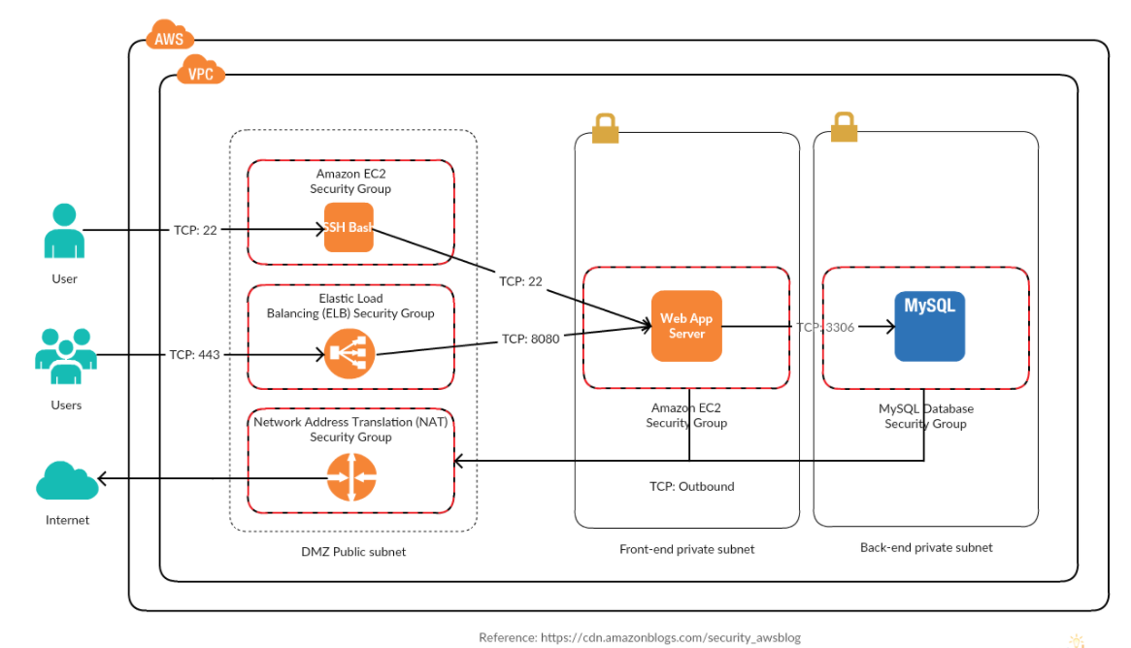

Slide 9

© Stephane Maarek

Slide 10

© Stephane Maarek

Slide 11
Thank you..!!

