Slide 1

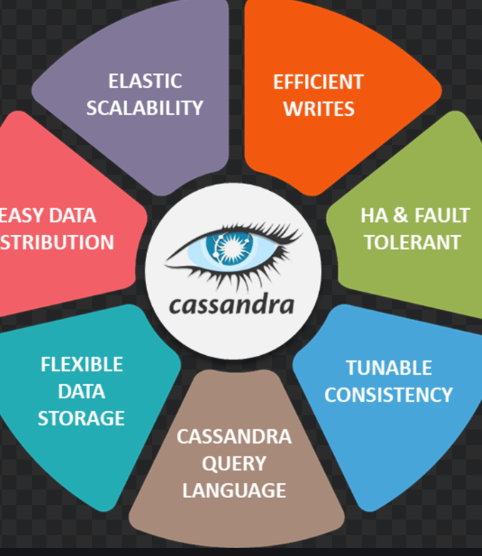
Appache Casandra and Java Tutorial
-Rajitha P

Slide 2
What is Apache Cassandra?
It is high-performance distributed database designed to handle large amounts of data.
It is a type of NoSQL database

Slide 3
What will be covered?
Eclipse
Appache-Cassandra
Perform data Operations using Java
Data on CQL environment
Effects on

Slide 4
Machine Requirements:
Appache Cassandra Files
Eclipse

Slide 5
General Flow:
Step1:Create keyspace and table in CQL
Step2:Perform below operations with respect to data in Eclipse for single cluster instance and entire cluster
Connecting to created Keyspace
Insert new data
Update exiting data
Delete
Step3:Check the effect of above operations in declared keyspace

Slide 6
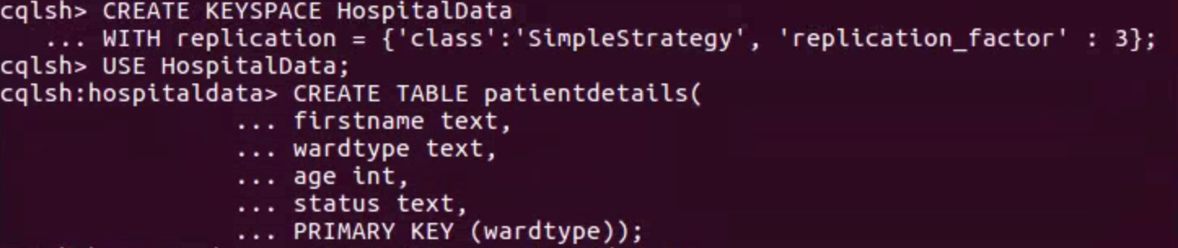
Step1:

