Slide 1
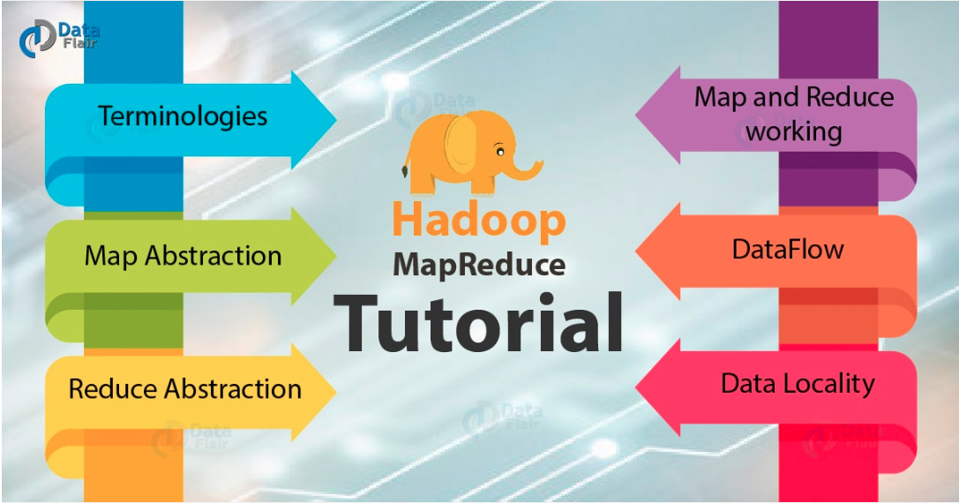
-Rajitha P
-Rajitha P

Slide 2
What is MapReduce?
MAPREDUCE is a software framework and programming model used for processing huge amounts of data.
MapReduce program work in two phases, namely, Map and Reduce.
Hadoop is capable of running MapReduce programs written in various languages: Java, Ruby, Python, and C++

Slide 3
Machine requirements:
Hadoop Environment
Eclipse

Slide 4
Goal:
To find the number of registered Corona Cases for a given country

Slide 5
Data:
US
China
Italy
Italy
US
US
Italy
China
China
US
China
India
China
US
US
US
Italy
China
US

Slide 6
How Map-reduce works?
Input
Mapper(Key,Value)
Reducer(Key,Values)
US
India
US
India
US
(US,1)
(India,1)
(US,1)
(India,1)
(US,1)
(US,3)
(India,2)

Slide 7
General Flow:
Create jar file which has map function and reduce function using eclipse.
Make the Inputdata available in Hue (Hue is a Web interface for analyzing data with Apache Hadoop)
Run command to communicate between jar file and data in Hadoop environment

Slide 8
Other Use Cases:
Poll results (Declare winning candidate, where input is Voter’s candidate name)

