Slide 1

PNEUMONIA DETECTION USING CHEST X-RAYS
Project Supervisor: Dr. S.L. Jany Shabu ,
Name of the Student: Mr. Rajeev Nayan
Register Number: 39110828

Slide 2
Presentation Outline
Introduction
Objectives
System Architecture / Ideation Map
Module Implementation
Application Snapshots
Results and Discussions
Conclusion & Future work
References

Slide 3
Introduction
Deep learning is an important artificial intelligence tool, which plays a crucial role in solving many complex computer vision problems.
Deep learning models, specifically convolutional neural networks (CNNs), are used extensively for various image classification problems.

Slide 4
Introduction
Pneumonia is an infection that inflames the air sacs in one or both lungs.
The air sacs may fill with fluid or pus (purulent material), causing cough with phlegm or pus, fever and difficulty breathing.
A variety of organisms, including bacteria, viruses and fungi, can cause pneumonia.
Chest X-ray, blood tests, and culture of the sputum may help confirm the diagnosis.

Slide 5
Problem Statement
Build a Binary classifier to detect Pneumonia using chest x-rays
Objective:
To Classify whether the person is diagnosed with Pneumonia or is Normal with high accuracy using chest x-ray images.

Slide 6
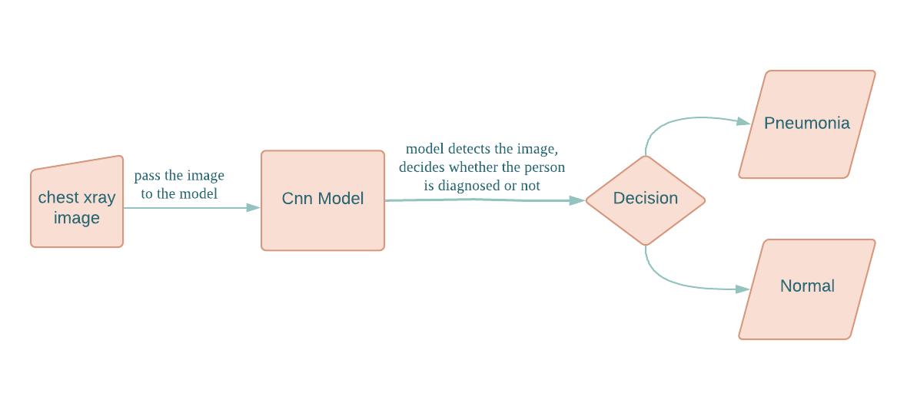
System Architecture / Ideation Map

Slide 7
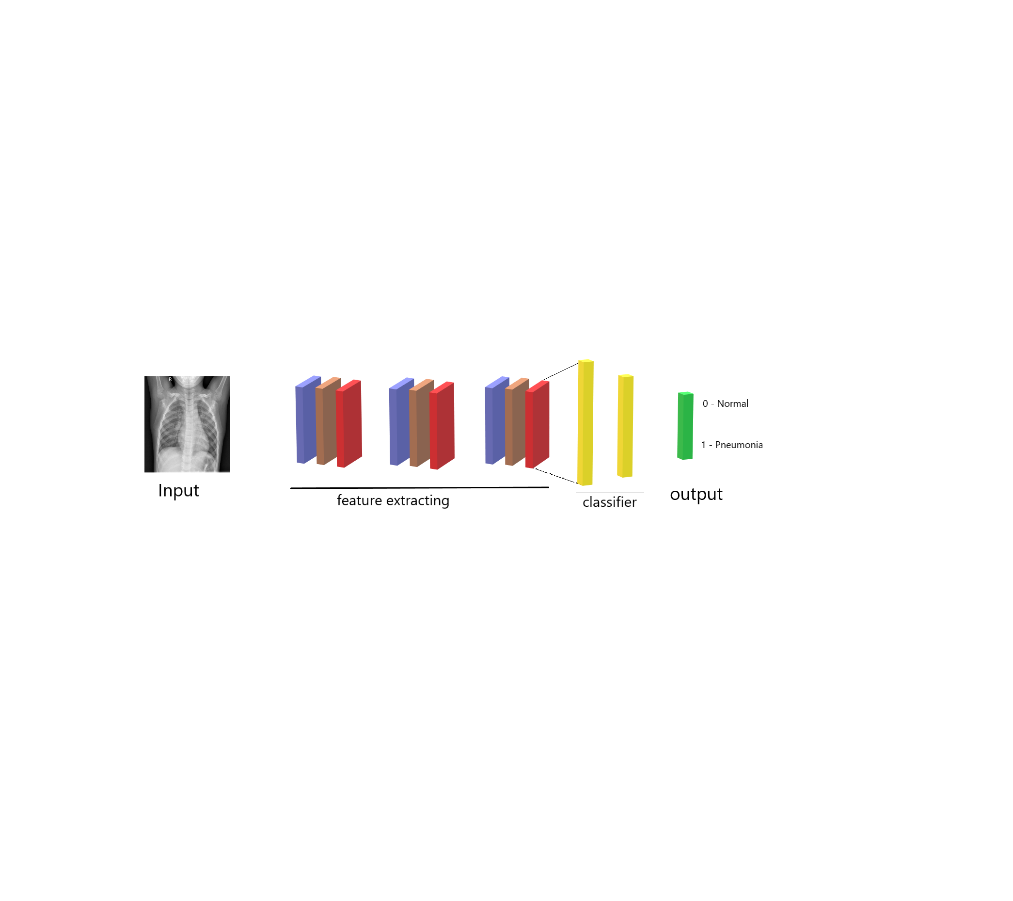
System Architecture / Ideation Map
CNN Model Architecture

Slide 8
Project Implementation
Technical stacks used is Python version 3.7, Google collab,Jupyter Notebook.
Libraries used keras for cnn model building, opencv for image reading and resizing image.

Slide 9
Project Implementation
I have used 3 convolution layer each consisting of pooling layer and dropout layer.
The model is trained on 15 epochs.
The accuracy of training and validation comes out to be 97.64 and 97.23 respectively in percentage.
The loss of training and validation comes out to be 0.0682 and 0.0689 respectively.

Slide 10
Methodology
The first is step is to collect the dataset for the training and testing the model.
The second step includes the Pre-processing the data which means dealing with outliers, null data, doing data normalization, data augmentation before fitting it into the model.
The Third step is to split the dataset into training and testing and passing the training data into the model for training.
The fourth and last step involves model evaluation, testing the accuracy of model.

Slide 11
Methodology
The Deep Convolution Neural Neural Network model designed to detect the pneumonia cases from chest x-rays images that comprises of pneumonia,normal chest x-rays
I have used chest x-rays images that are available for the open source from Kaggle.
I created train and test data sets that consist of 5773 and 1444 images respectively. The images in train and test data are properly labelled with “Normal” or “Pneumonia”.

Slide 12
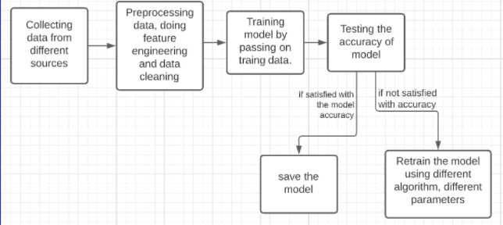
Methodology
Project Workflow

Slide 13
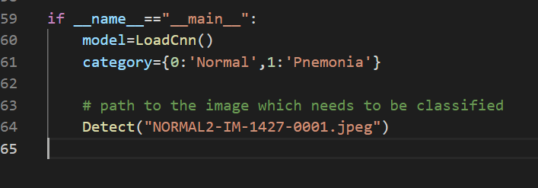

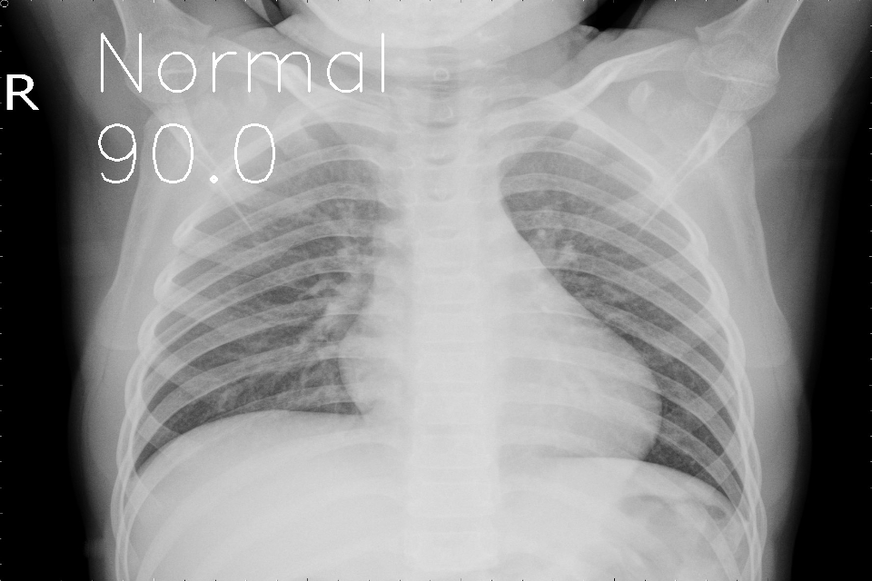
Application Snapshots
Output:

Slide 14
Results and Discussion
Publically available pneumonia chest x-ray datasets were used. https://www.kaggle.com/paultimothymooney/chest- xray-pneumonia
The datasets consist of 7217 chest x-ray images from a large population of both adults and children.

Slide 15
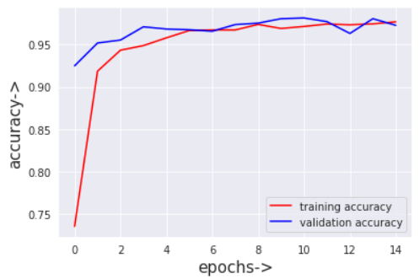
Results and Discussion
Accuracy:
Training and validation both accuracy is being increased together which shows model is a good fit.
The training and validation both accuracy comes out to be 97.64 and 97.23 percent respectively.

Slide 16
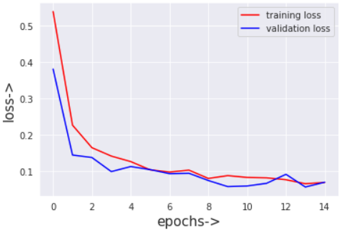
Results and Discussion
Loss:
Training and validation both losses is being decreased together which shows the model is good fit.
The training and validation both loss comes out to be 0.0682 and 0.0689 respectively.

Slide 17
Conclusion
This project classifies the person x-ray whether its Pneumonia diagnosed or not.
We cannot guarantee that this is 100% accurate because there are several circumstances in which person is diagnosed with pneumonia.
Since this is a project for health care , so the model should be trained on millions of data to get a good accuracy and to use this tool in health care.
This can be used to examine and anybody can use this to check if they are diagnosed or not , since its just require chest x-ray and gives the output in a second.

Slide 18
Future Research
In this project i have only used few convolution neural network and whichever gave me best and high accuracy i have used that model to train the data.
We can use more other methods such as Vgg , DenseNet, InceptionNet , etc , to train the model and improve the accuracy and loss.

Slide 19
References
[1] | WHO Pneumonia. World Health Organization. (2019), https://www.who.int/news-room/fact-sheets/detail/pneumonia
[2] | Journal - Pneumonia dettection in chest x-ray images using deep learning models.(2021) Researchers: Rohit Kundu,Ritacheta Das,Zong Woo Geem ,Gi-Tae Han,Ram Sarkar https://journals.plos.org/plosone/article?id=10.1371/journal.pone.0256630
[3] | Krish naik youtube channel https://www.youtube.com/user/krishnaik06

