Slide 1
🍕 Pizza Sales Analytics Project Using SQL
This project was independently designed and implemented by me (Rajiv Kumar from MNNIT Allahabad) to analyze pizza sales data using SQL. It explores order trends, revenue, popular pizza types and sizes, and category-wise performance. The analysis leverages JOINs, aggregate functions, window functions, and data aggregation to extract actionable business insights. The goal is to support data-driven decisions for menu optimization, promotions, and revenue growth.

Slide 2

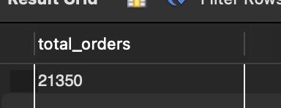
Find the total number of orders to assess overall customer demand.
Business Insight :- Total of 21,350 orders reflects high customer demand and overall business activity.

Slide 3
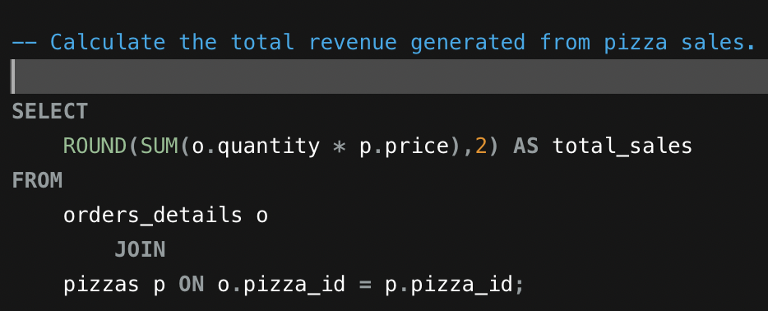

Calculate total revenue generated from pizza sales.
Business Insight :-Total revenue of ₹817,860.05 indicates strong overall sales performance and helps evaluate business profitability.

Slide 4
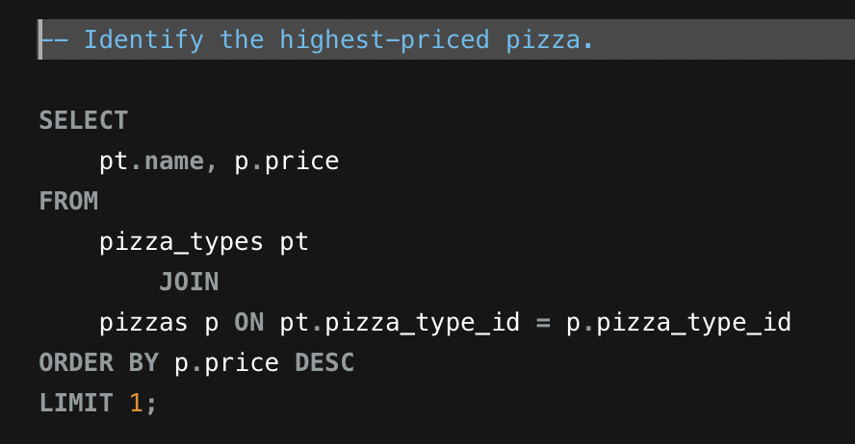

Identify the most expensive pizza on the menu to highlight premium offerings.
Business Insight :-“The Greek Pizza” priced at ₹35.95 is the premium menu item and a potential high-margin product.

Slide 5
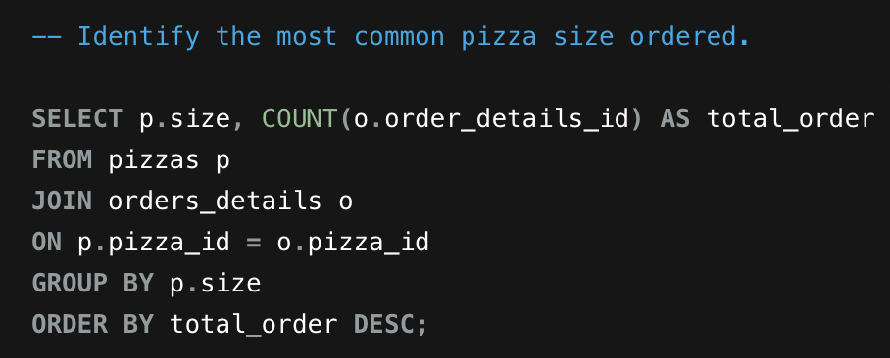
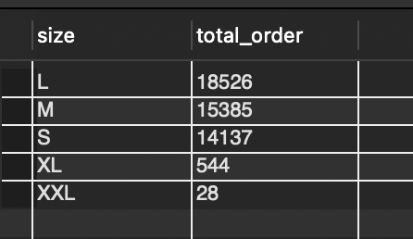
Determine the most commonly ordered pizza size to understand customer preferences
Business Insight :-“Large size (L) with 18,526 orders is the most popular, guiding inventory and portion planning.

Slide 6
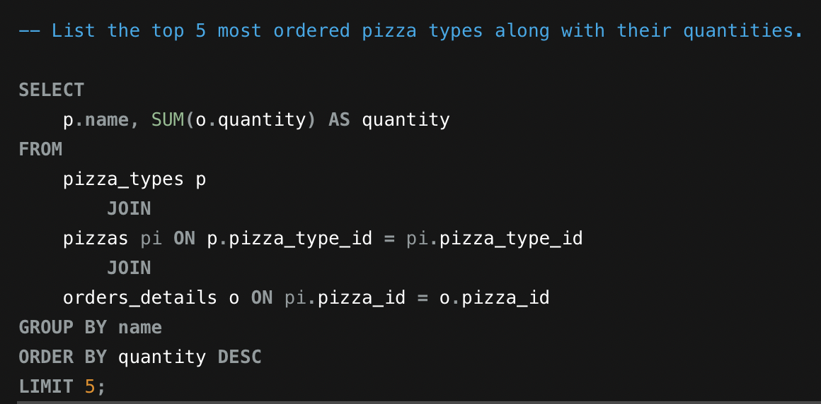
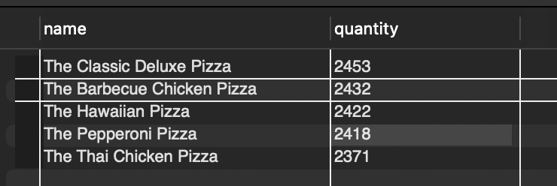
Identify the top 5 most ordered pizza types to understand customer favourites.
Business Insight :-“The Classic Deluxe Pizza” leads with 2,453 orders, showing customer preference trends and guiding menu focus.

Slide 7
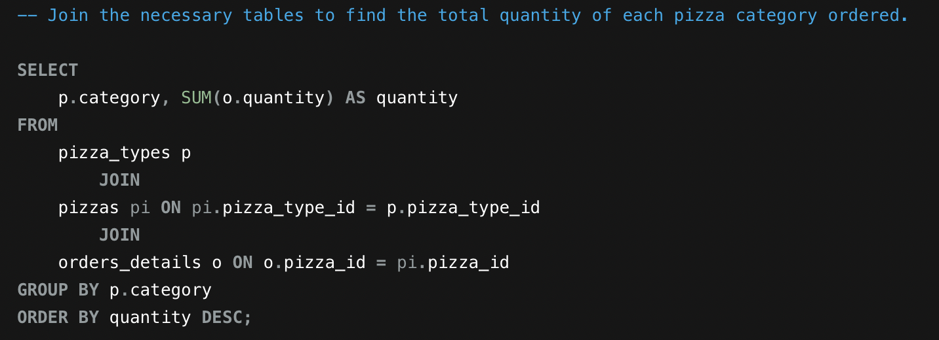
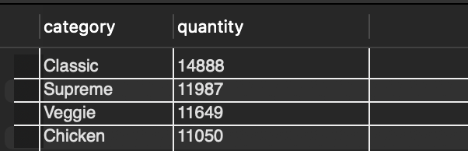
Find the total quantity ordered for each pizza category to analyze category performance.
Business Insight :-Classic category leads with 14,888 orders, highlighting the most popular pizza category for inventory and marketing focus.

Slide 8
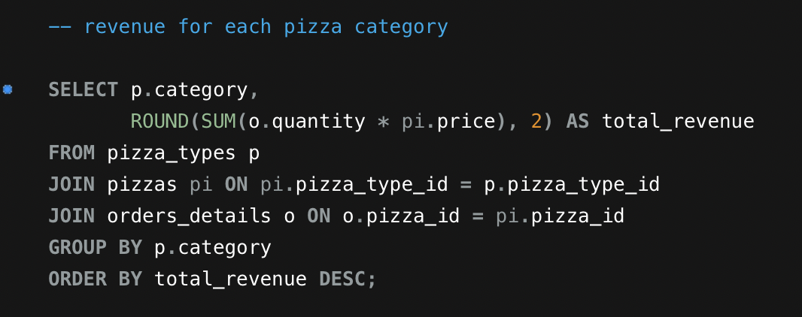
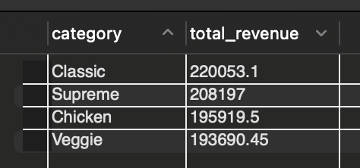
Calculate total revenue for each pizza category to identify top-performing categories.
Business Insight :-Classic category leads with ₹220,053.10, followed by Supreme, Chicken, and Veggie, guiding focus on high-revenue categories for promotions and inventory planning.

Slide 9
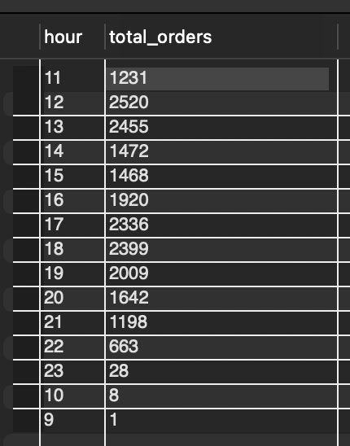
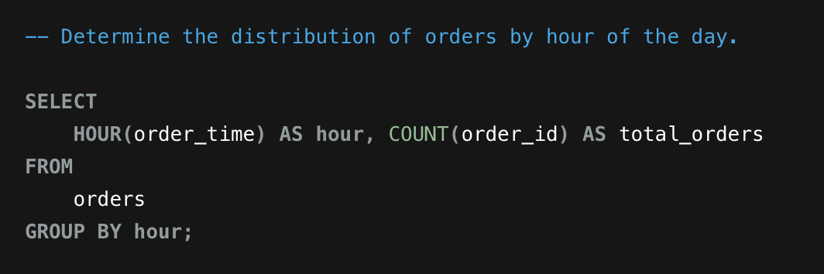
Analyze order distribution by hour to identify peak ordering times.
Business Insight :-Most orders occur between 12 PM–1 PM and 5 PM–6 PM, indicating peak lunch and evening demand periods.

Slide 10
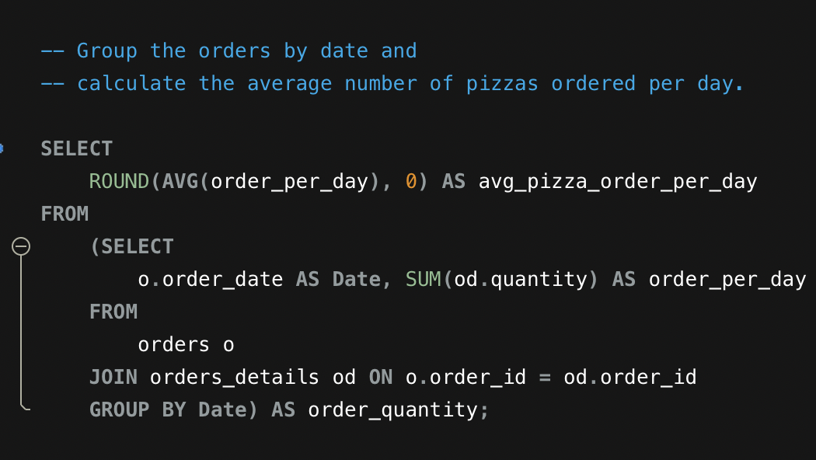
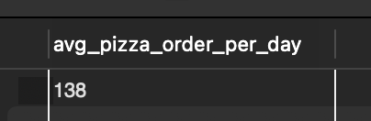
Calculate the average number of pizzas ordered per day to understand daily demand.
Business Insight :-An average of 138 pizzas per day indicates steady daily demand, helping plan inventory and staffing.

Slide 11
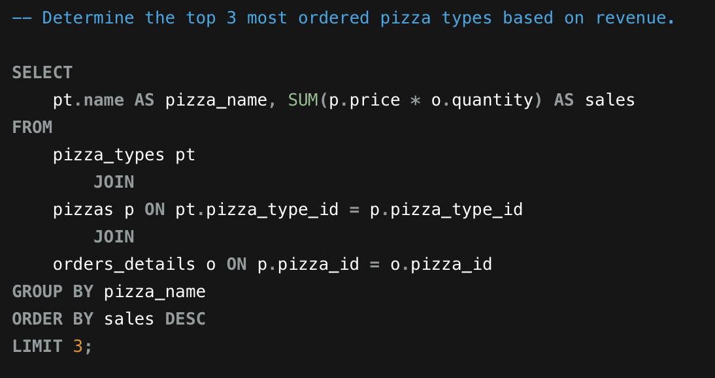
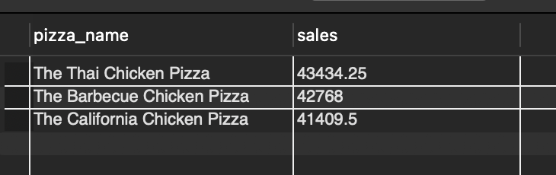
Identify the top 3 pizza types generating the highest revenue to highlight key revenue drivers
Business Insight :-“The Thai Chicken Pizza” leads with ₹43,434.25, followed by Barbecue and California Chicken Pizzas, showing which items contribute most to revenue and should be prioritized for promotions.

Slide 12
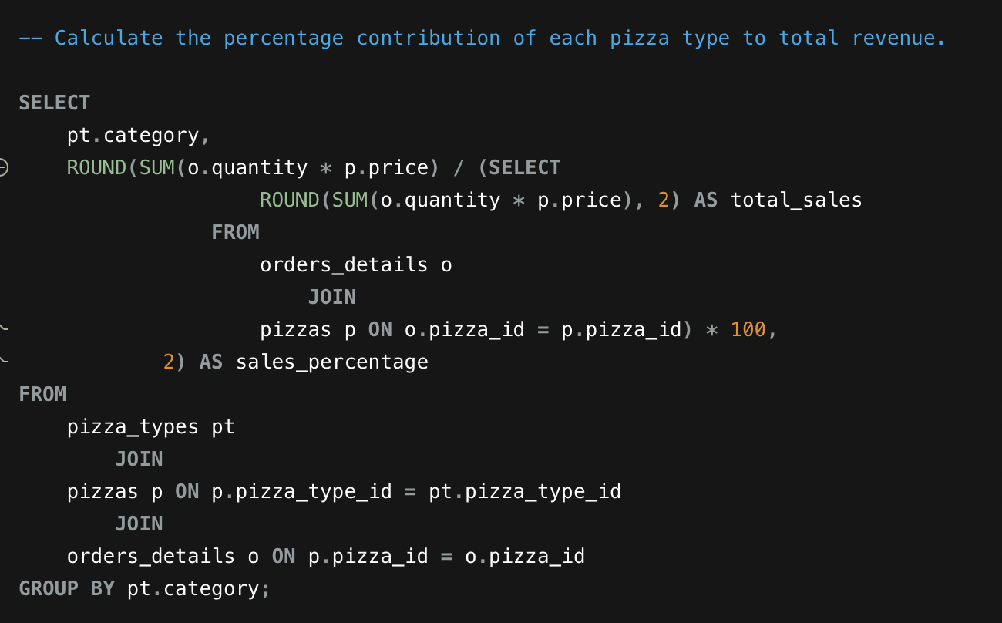
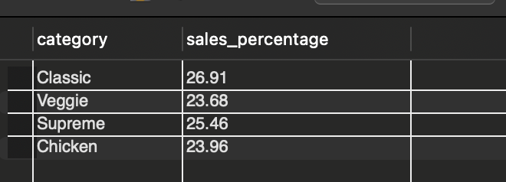
Calculate each pizza category’s contribution to total revenue to identify revenue distribution.
Business Insight :-Classic pizzas contribute 26.91% of total revenue, followed closely by Supreme, Chicken, and Veggie, highlighting top revenue-driving categories for strategic focus.

Slide 13
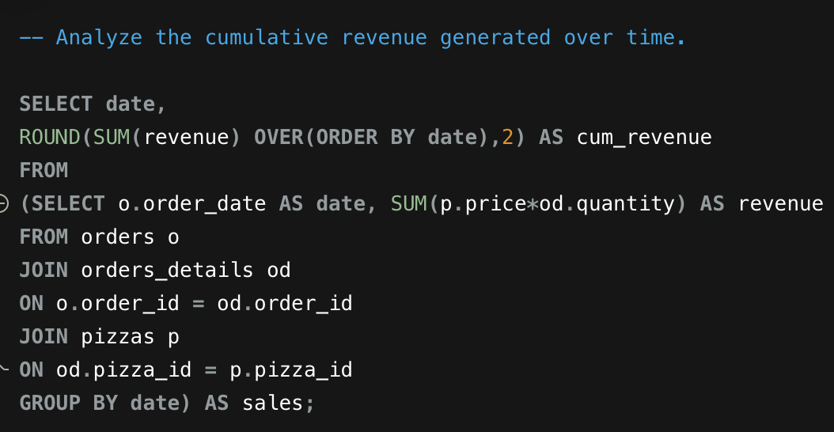
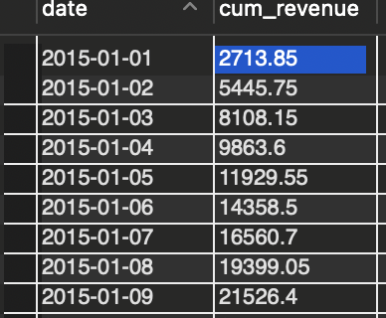
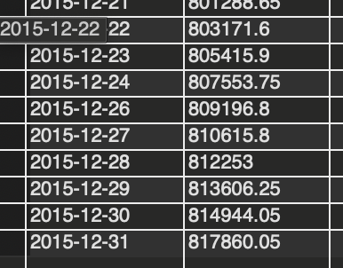
Analyze cumulative revenue over time to monitor overall sales growth and trends throughout the year.
First 9 days of
The year.
Last 9 days of
The year
Business Insight :-Cumulative revenue reaches ₹817,860.05 by year-end, showing consistent sales growth and helping identify peak periods for strategic planning.

Slide 14
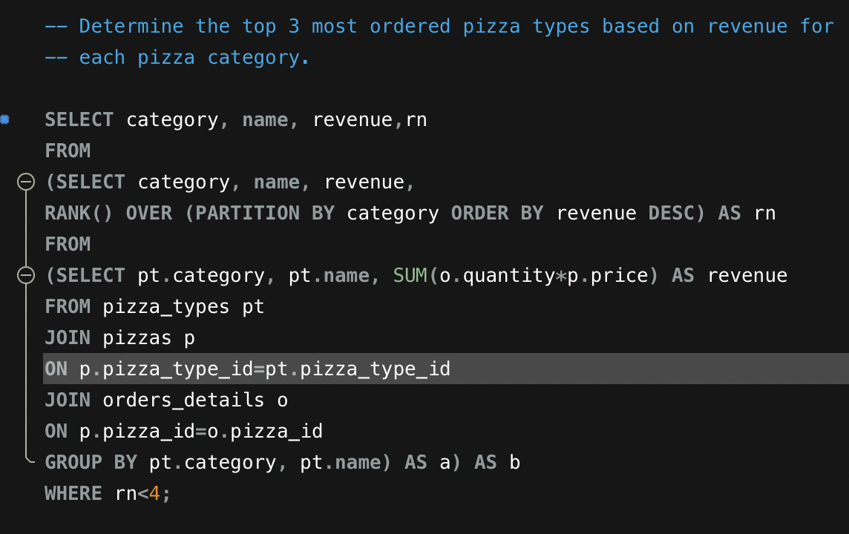
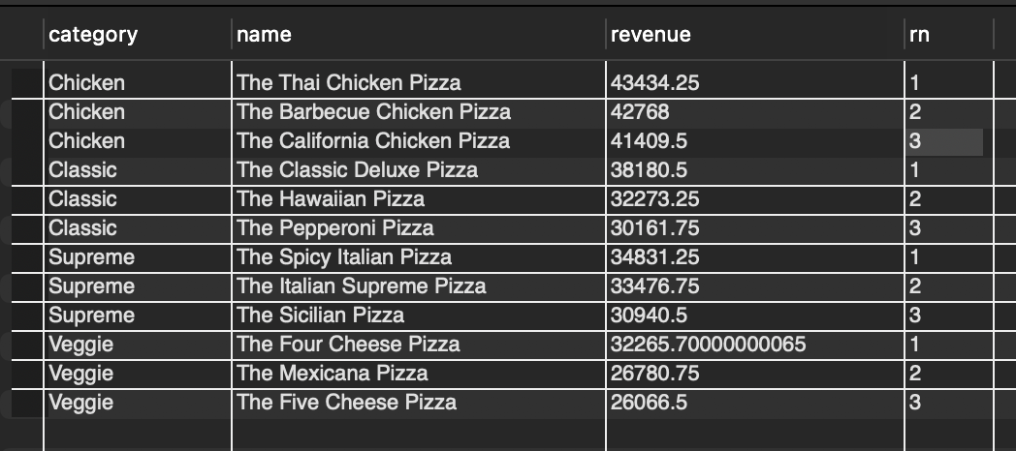
Identify the top 3 revenue-generating pizza types within each category to highlight category leaders.
Business Insight:- Top pizzas like “The Thai Chicken Pizza,” “The Classic Deluxe Pizza,” “The Spicy Italian Pizza,” and “The Four Cheese Pizza” lead revenue in their categories, driving business focus.

Slide 15
Key Business Insights & Takeaways
Total Orders: 21,350 pizzas were sold, generating a total revenue of ₹817,860.05. Top-Selling Pizza Types: “The Thai Chicken Pizza” and “The Classic Deluxe Pizza” lead revenue in their categories. Popular Pizza Sizes: Large (L) pizzas were the most frequently ordered. Category Revenue Contribution: Classic pizzas contributed the highest revenue (26.91%), followed by Supreme, Chicken, and Veggie. Cumulative Revenue Trend: Steady growth over time highlights peak periods and supports strategic planning.

