Slide 1

Emerging themes and first ideas
AI | North America
A&A013
Working draft based on interviews as of 12/01/2017
Enabling sales growth at Tier-1 auto suppliers
GLOBAL MARKETING & SALES
Document for discussion | 15/01/2018
M&S Growth Case Competition
Paolo Sandrone || Dragana Pajovic || Rohit Panchanadikar
January 9 20XX
CONFIDENTIAL AND PROPRIETARY
Any use of this material without specific permission of McKinsey & Company is strictly prohibited
CONFIDENTIAL AND PROPRIETARY
Any use of this material without specific permission of McKinsey & Company is strictly prohibited

Slide 2



‘Secret sauce’ for sales growth: 5 key steps for an auto supplier to set up for success when engaging with new customers
AUTOMOTIVE & ASSEMBLY (AI) | NORTH AMERICA
A&A013
Unit of measure
Growth with Detroit - 3
1
Develop value propositions for priority products based on customer feedback, competitive teardowns and portfolio strategy of the company
CREATE
INVEST
CREATE
PERFORM
2
Build a perspective on relative competitive positioning using value mapping
$100M+ increase in sales in 5 years
with Detroit-3
3
Deploy advanced analytics to prioritize and track opportunities
PERFORM
4
INVEST
Chalk out a customer battle plan, with detailed opportunity list and engagement plan
CREATE
PERFORM
5
Set up a resource plan and governance process to deliver on set targets

Slide 3
Lessons learned on growth…
Match core competency to the customer offering through well thought out portfolio strategy
Focus on data driven decisions by leveraging competitive benchmarking and value mapping as key sources of insight
Create
Ensure early and constant customer engagement to build relationships and get on priority supplier lists
Introduce a customer-centric engagement plan, tailored to the DNA and geography of each OEM’s organization
Perform
Notes:
This client is a retailer facing a growth challenge. They raised their game across all three dimensions, although their primary emphasis was on invest and perform.
In Invest, they searched across the company for opportunities to free up resources, while simultaneously identifying their highest ROI investment opportunities, in this case international and wholesale, and new product lines.
The greatest opportunities in invest were in in advanced analytics/digital, increasing in-store conversion, and optimizing pricing and promotions

Slide 4
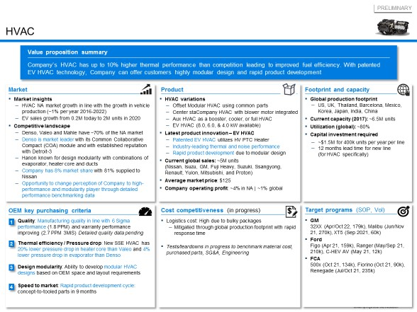
A winning value proposition developed for priority products using a standardized fact-based approach
1
INVEST
CREATE
PERFORM
Unit of measure
Value proposition framework
Value proposition library for priority products
Key assessment criteria
Market
Market size and opportunity
Key competitors
Product spec, description, functionality
Current products vs. versions in development
Current OEM business
Average market price and profitability
Product
Technology, materials, benefit to the customer
Level of application engineering needed
Key feature criteria and performance vs. competition
Quality & warranty performance
Manufacturing footprint – current & planned
Capital investment required
Capabilities
Cost compe-titiveness
Logistics / material / conversion / SG&A cost
Cost competitiveness vs. competition
Operating margin %
Fact based value proposition exercise helped identify a winning value proposition in specific product categories

Slide 5
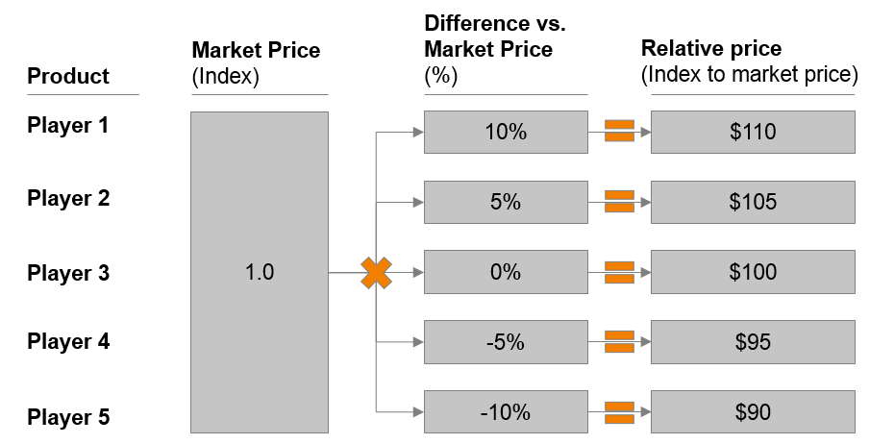
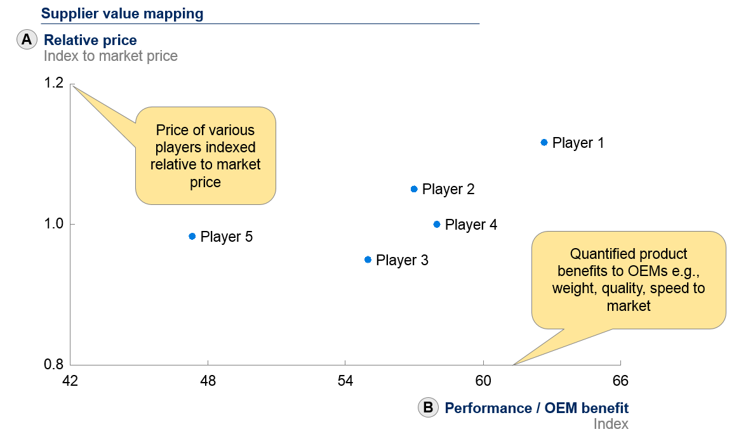
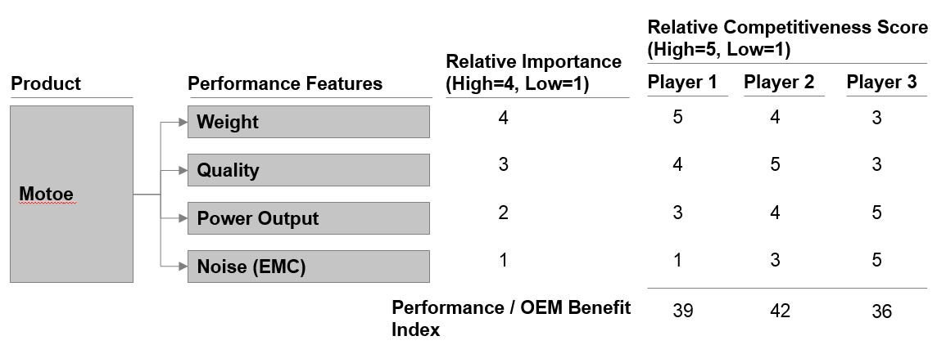
Value mapping of key products helped identify relative performance and price for current Detroit-3 suppliers
2
INVEST
CONCEPTUAL
Unit of measure
CREATE
PERFORM
A
Relative price Estimated by mapping the price of various players relative to the market price
Value Mapping Tool to visualize the relative price and customer benefit for different players in the market
B
Customer Benefit Quantified by rating each player on the performance features defined for each product
Value mapping helped identify market perception on the brand, allowing for tailored sales approach

Slide 6
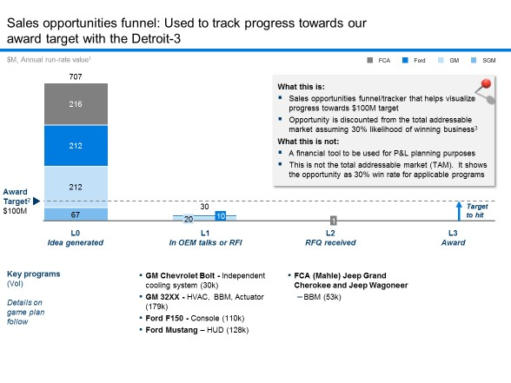
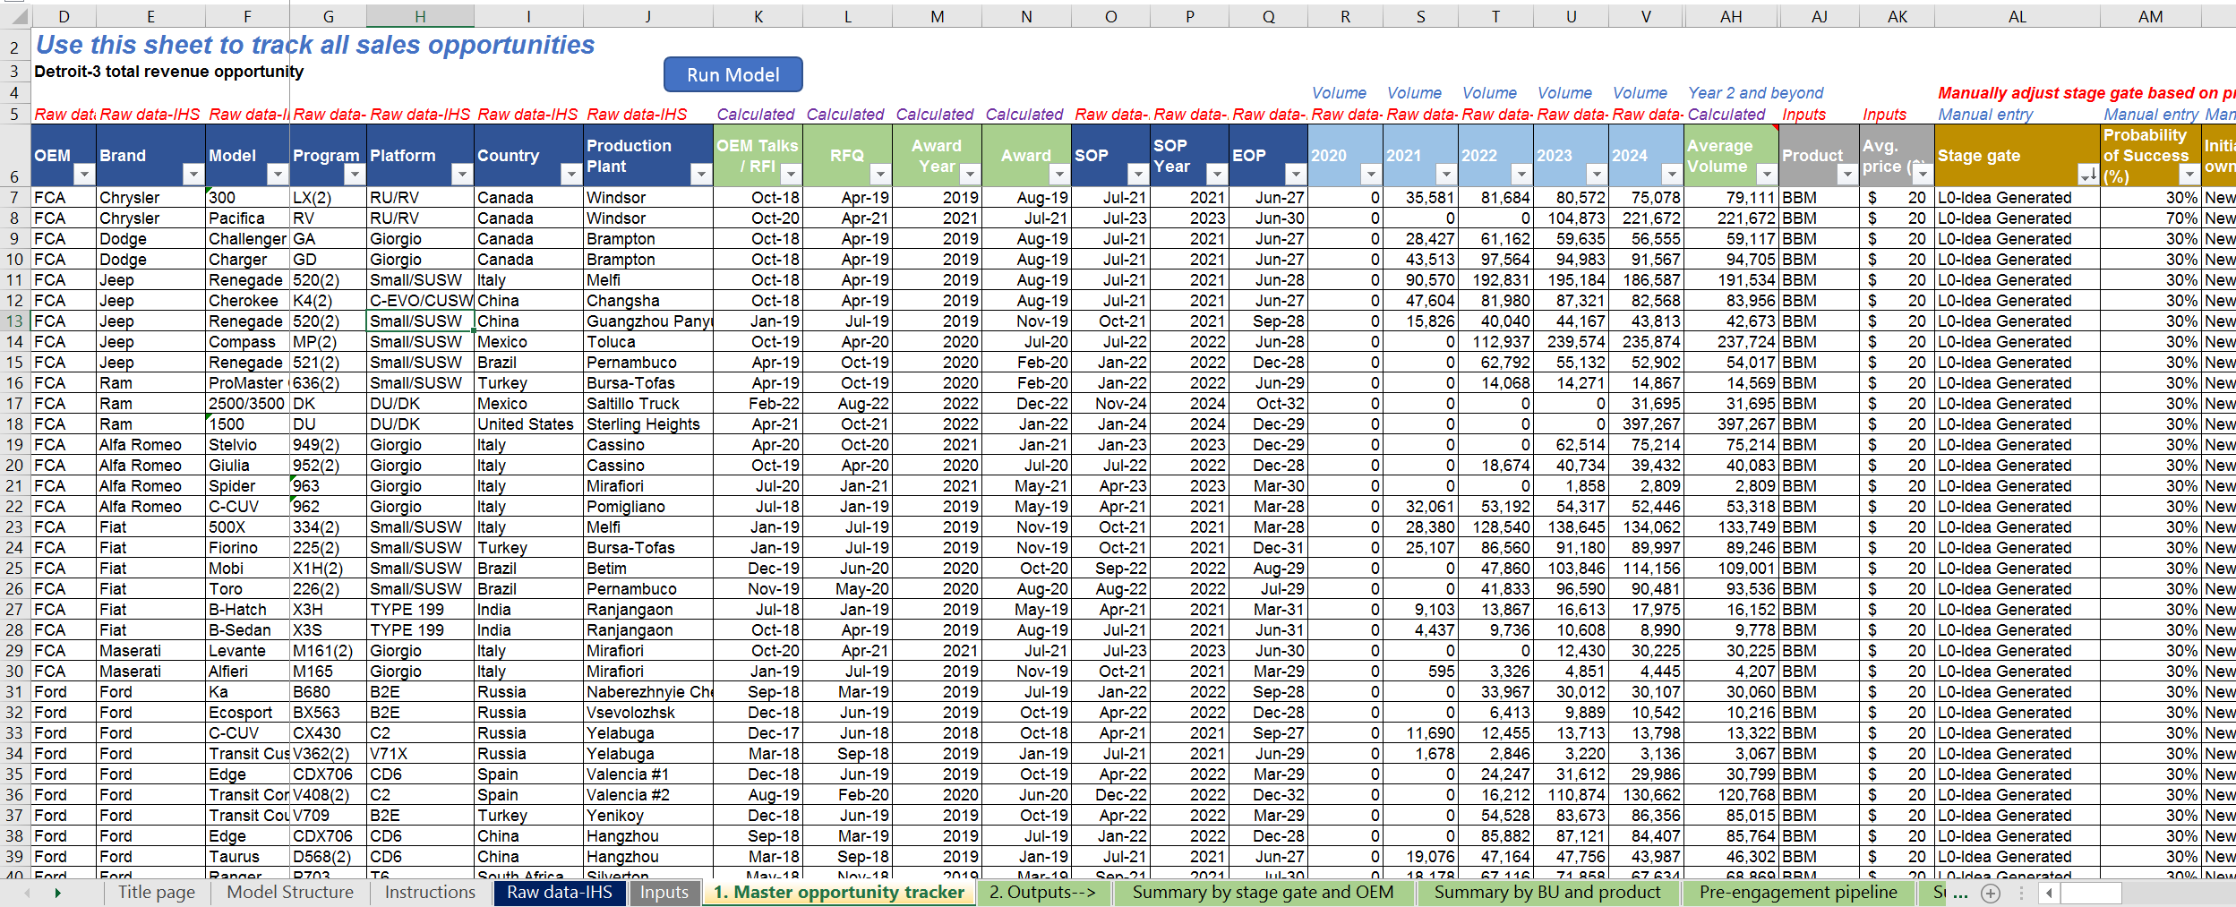
Advanced analytics were deployed to develop a tool to prioritize programs and measure sales targets
3
INVEST
Unit of measure
CREATE
PERFORM
Data-driven program analysis…
…for progress tracking towards plan
Dynamic model incorporates IHS data, product price, pre-engagement-to-SOP timeline, win rate, and progress towards award
Data as driver for value creation: Tracker helped identify and prioritize sales opportunities with greatest value creation potential

Slide 7
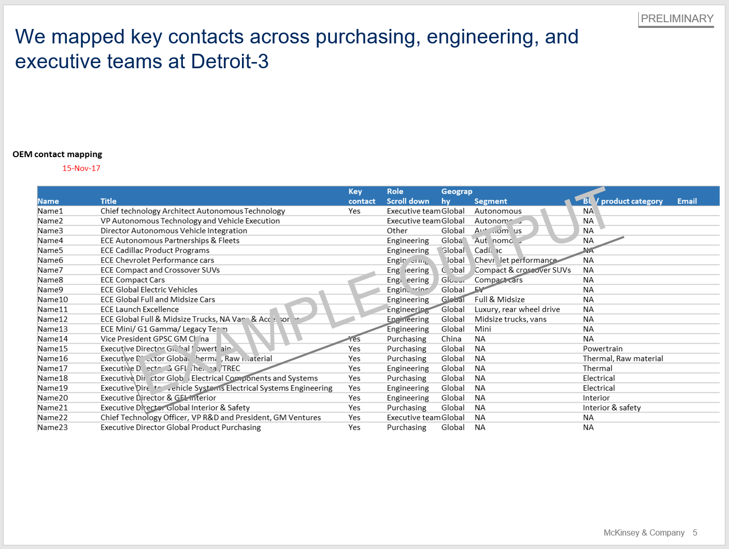
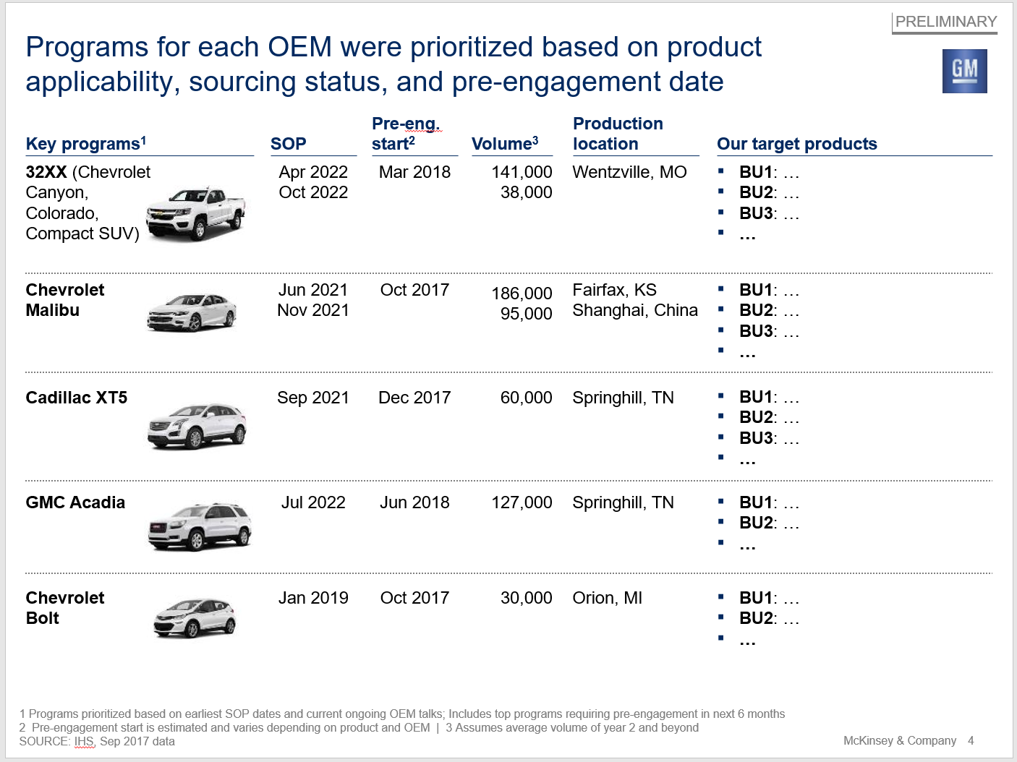
Tailored, early, and constant engagement helped build OEM relationship and stay laser focused on high-value opportunities
4
INVEST
Unit of measure
CREATE
PERFORM
Tailored approach: Customer battle plan be adapted to the sourcing DNA and organization archetype of each OEM

Slide 8
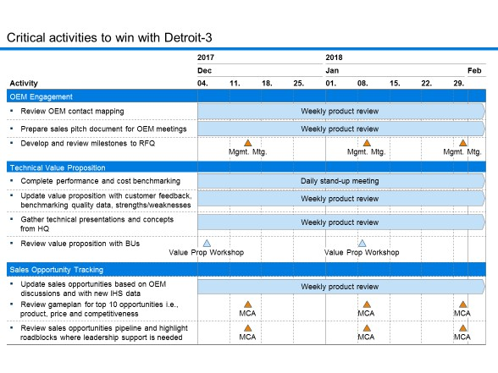
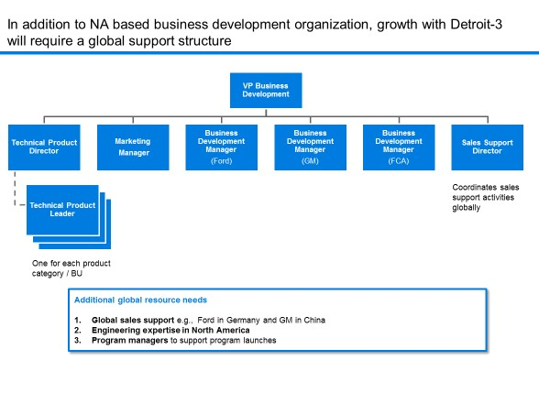
Agile sales organization, located close to the customer ensured rapid responsiveness
5
INVEST
CREATE
PERFORM
Planning and governance…
…matched with sales close to customer
Local is key: Client put in place a NA centric business development organization, with a global support structure, and agile responsiveness to local customer needs

Slide 9



Our team
PAOLO SANDRONE
DRAGANA PAJOVIC
ROHIT PANCHANADIKAR
Partner, Chicago)
(EM, Chicago)
(ASC, Minneapolis)
Leader in the AI – M&S JV
Serves variety of AI clients on growth related topics
AI L2 capable
Serves AI clients on M&S topics, driving sales growth opportunities
AI L2 path
Serves AI clients on M&S, strategy and operations topics
6+ years on prior experience with Cummins and Tata Motors

