Slide 1
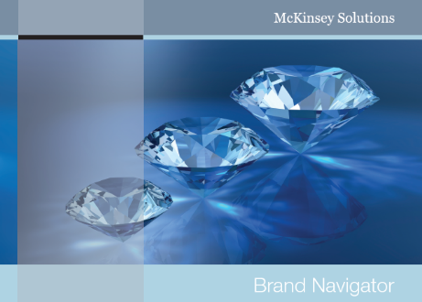
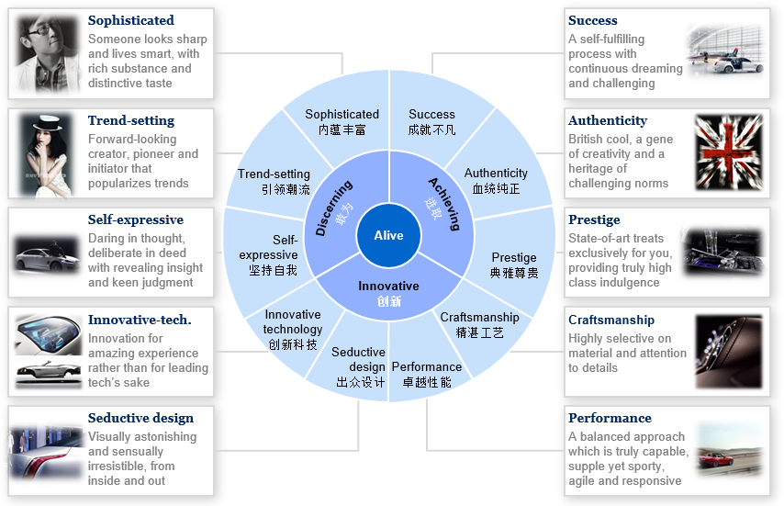
Leading European premium car manufacturer – we developed a new Asia brand strategy which is more relevant to local consumer needs
Automotive & Assembly (AI) | Asia-Pacific
A&A021
Situation
What we did
Impact
Leading European premium car manufacturer, among top 5 market position in Asia in terms of market share
Regarded as a niche brand among local consumers, the client’s sedan brand faced obstacles to tackle huge opportunities in growing segments
Brand health index hasn’t been improved for years, with low transfer rate to purchases
Brought in Brand Navigator, McKinsey proprietary integrated, customer insights solution, to make holistic, Asia specific brand diagnostics to pinpoint the issues
Carried a quali + quanti consumer research works, covering different tiered cities, to dig out in-depth consumer insights and recognize right target segments
Translated insights into key branding strategies, including creating a Asia specific “Brand Wheel” which guide all future branding initiatives
Significant improved the brand health index, with 20% conversion increase from awareness to familiarity and 15% from familiarity to likeness
Optimized MROI by 10%, due to more focused marketing spending on right vehicle mix and compelling brand messages
Boosted strong topline growth by doubling the original sales target in the second year of implementing the new brand strategy

