Slide 1
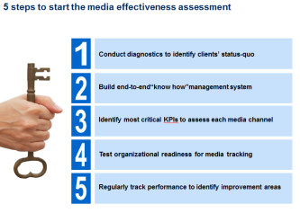
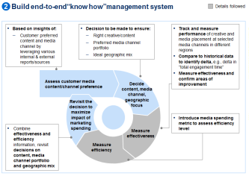
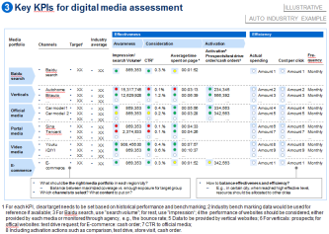



Leading Auto JV in Asia – we developed a toolkit to assess media effectiveness, especially the digital media
Automotive & Assembly (AI) | Asia-Pacific
A&A025
Situation
What we did
Impact
Leading mass-market brand in Asia
Stagnant sales performance with the highest media spending over the years among key competitors (lowest SOM vs. SOS)
Received pressure from the global to investigate the effectiveness of media spending
Designed an approach to conduct the assessment
Built a “know how” management system for client
Identified key KPIs for each media
Established a systematic tracking & assessment process, and helped to adjust future planning/decision-making constantly based on implication drew from results
Increased transparency of media spending through setting clear data flow among different departments
Media spending continuously decreased (exact dollar impact WIP)
Methodology expected to apply to other brands within same group
M&S Expertise
Sha sha
Arthur Wang
Junna Shi

