Slide 1

Emerging themes and first ideas
Financial | Asia-Pacific
BAN040
Working draft based on interviews as of 12/01/2017
Pricing Excellence for CLIENT
GLOBAL MARKETING & SALES
Document for discussion | 15/01/2018
Bin Zhou
Nov. 20XX
CONFIDENTIAL AND PROPRIETARY
Any use of this material without specific permission of McKinsey & Company is strictly prohibited
CONFIDENTIAL AND PROPRIETARY
Any use of this material without specific permission of McKinsey & Company is strictly prohibited

Slide 2
Study background
Methodology walk-through
Important findings

Slide 3
Why is the pricing of banking more challenging than other industries?
The general business model of banking makes pricing more customer-oriented rather than product-oriented
ALM duty
BU duty
Simplified business model
Deposit
Loan
Sell the surplus deposit to inter-bank exchange market
Buy money externally if deposit is not sufficient to meet capital requirement
Deposit cost
Fund value
Fund cost
Loan value
On the aggregated level, loan and deposit customers are the same entity
Deposit pricing:
- maximize the profit
- meet the capital requirement (keep pace with loan growth)
Loan pricing:
- maximize the profit
- boost the cross-sell of deposit and fee product
SOURCE: Team analysis

Slide 4
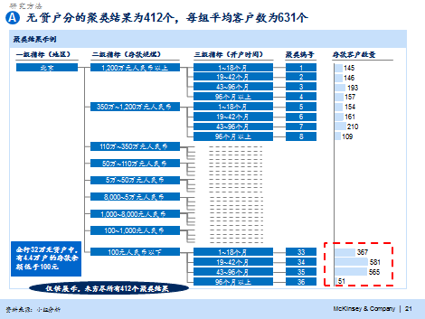
This study mainly covers four pricing topics
Analytics-driven approach
Pricing leakage analysis
Analyzed pricing data for 500K corporate clients YTD 2015 (totally 200 million items of data)
Applied mature pricing leakage analysis model to review current pricing level from bank-wide, comprehensive customer relationship and single product perspective
Long-term mechanism and short-term quick-wins based on leakage analysis
Pricing governance system
High-level pricing org structure for CLIENT, including board, ALCo, ALM, SBU pricing committee and pricing center etc.
Definition and description of roles & responsibilities for different departments (committees)
Defined and designed 8 pricing core processes (flow chart)
Put forward main supporting mechanism & capabilities for pricing implementation
Deposits list pricing
Comprehensive analysis of multiple available list pricing strategy options, including several deposit list rate case studies home and abroad
Preliminary suggestions on CLIENT’s list rate strategy: “pyramid” deposit list rate strategy
Preliminary suggestions on CLIENT’s list rate mgmt mechanism
Relationship pricing model
Developed a relationship pricing model based on customer clustering and internal benchmarking
Leveraged the risk-based pricing model and Excel calculator for lending
Piloted risk-based pricing model in some branches and did data calculation and analysis in batch
SOURCE: team analysis

Slide 5
Study background
Methodology walk-through
Important findings

Slide 6
Core concept in pricing diagnostic: Focus on the overall EVA (economic value added) of a customer rather than single product pricing; Take risk cost and capital cost into full account in pricing process
Basic concept
Methodology
Challenges in application
Leakage definition:
Customer’s overall EVA<0
Single product pricing is lower average within the cluster
Leakage takes customer overall EVA and product pricing as two important metrics, fully considering profit transfer in the process of multiple product sales
Com-mercial leakage
Customer clustering
Individual product pricing
Multi-product pricing
Frequent change of FTP curve: FTP has been reduced for multi times this year with large variations
Identify most influential variables and perform customer clustering via statistical regression
Understand individual product pricing distribution within each cluster and take customer EVA into full account; perform internal benchmarking on this basis
Within each cluster, analyze EVA distribution of different customer and understand impact of individual product pricing on EVA
Lack of accurate measurement of risk cost: we create proxies by revising “provision” field
Client
Pricing
1
1
Rating
2
Higher cost of fund: coefficient for cost of fund is up to 14%, higher than peers
2
3
3
4
A
B
C
5
Industry
Technical leakage
Inaccurate data record: some income accounting cannot be attributed to customers and products
End-to-end technical leakage diagnostic
4
Through interview and other qualitative analysis methods, sift through end-to-end pricing process and identify potential technical leakages
Propose tentative anti-leakage advice
SOURCE: Team analysis

Slide 7
Customer clustering methods and main results
Basic variables
Key factors in the clustering model
Clustering results
Account transaction details
Details on deposit/loan/fee-based operations
Breakdown on part of off-balance sheet (OBS) activities and off OBS activities
Factors specific to non-loan customers
Deposit size
Divide into nine scales on the basis of deposit amount
Clustering of non-borrowers
Clusters: 412
Maximum number of customers in a cluster: 3,423
Minimum number of customers in a cluster: 5
Average number of customers in a cluster: 631
Multicollinearity
Operating performance
Industry Category
Region
Account opening time
Divide into four intervals by account opening time
Customer basic info
Common factors
Region
Locate the branches in China into 19 regions.
Customer risk data
Risk rating
Debt rating
Default and Overdue
RM data
Operating institutions
RM
Clustering of borrowers
Clusters: 120
Maximum number of customers in a cluster: 961
Minimum number of customers in a cluster: 1
Average number of customers in a cluster: 156
Factors specific to loan customers
Risk level
Grade corporate credits into four levels: High-grade, good-grade, investment-grade and other
Customer value data
Info about customers’ EVA
Product holding history
Internal tags on customer value
Industry Category
Categorized industries into eight categories: agriculture, real estate, manufacturing, high-tech, transportation, services, culture and public utilities
Industrial cluster data
Group customer tags
Upstream & downstream industrial chain tags
Factor analysis
SOURCE: McKinsey analysis

Slide 8
There are 412 clusters for non-loan customer and each has 631 customers on average
Example of clustering result
Tier 1 indicator (geo zone)
Tier 2 indicator (size of deposits)
# of deposit customers
Tier 3 indicator (tenure)
Cluster #
Beijing
> RMB 12 MN
1~18 months
1
19~42 months
2
43~96 months
3
>96 months
4
RMB 3.5 -12 MN
1~18 months
5
19~42 months
6
43~96 months
7
>96 months
8
RMB 1.1-3.5 MN
RMB 500K -1.1 MN
RMB 50-500K
Among 320K non-loan customers across the bank, 44K have deposit balance smaller than RMB 100
RMB 8-50K
RMB 1-8K
RMB 100-1K
< RMB 100
1~18 months
33
19~42 months
34
43~96 months
35
Only for presentation; non-exhaustive for 412 clusters
>96 months
36
SOURCE: Team analysis

Slide 9
There are 120 clusters for loan customers and each has 156 customers on average
Example of clustering result
Tier 1 indicator (geo zone)
Tier 3 indicator (industry)
# of deposit customers
Tier 2 indicator (risk)
Cluster #
Beijing
High quality
1
Good
2
Investment
3
Junk
4
Not rated
5
Jiangsu
High quality
6
Good
Manufacturing
7
Service
8
Real estate
9
Public utilities
10
Other
11
Investment
Manufacturing
12
Service
13
Junk
14
Not rated
15
Hebei
Good
Manufacturing
17
Service
18
Other rating
20
Not rated
21
NE city cluster
22
SW city cluster
Only for presentation; non-exhaustive for 120 clusters
23
SOURCE: Team analysis

Slide 10
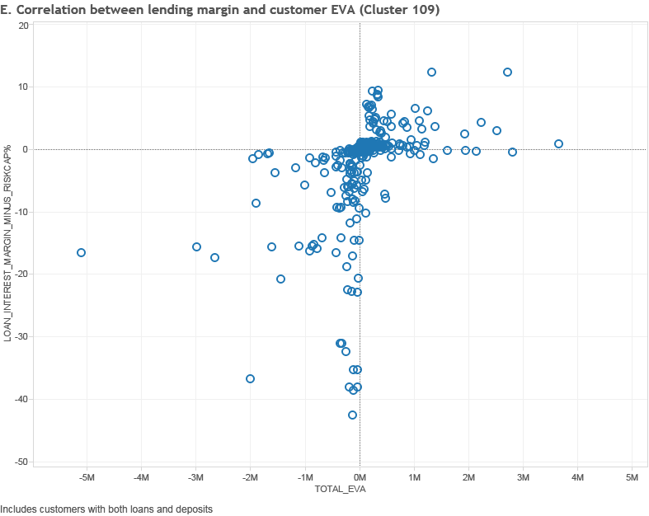
Leakage analysis: RM is able to identify leakage customers from combining the product dimension and EVA dimension
SANITIZED EXAMPLE
Correlation between lending margin¹ and EVA
Main observations
Lending margin (%)
1
Lending margin and customer comprehensive EVA are both negative: pricing purely falls in the range of negative margin and customers fail to create corresponding comprehensive EVA; pricing cant’ be justified with negative EVA
Suggestion: review pricing for each loan one by one
20
10
0
-10
2
2
Lending margin is negative, but customer comprehensive EVA is slightly positive: deposit and fee business create larger EVA to compensate for discounts in lending business
Suggestion: understand sales of such business by sampling and learn from its experience of comprehensive pricing
-20
-30
1
Typical business example:
Structured deposits+ loan
Small amount of normal deposits + loan
Pure loan
-40
-50
-5
-4
-3
-2
-1
0
1
2
3
4
5
Overall EVA (RMB MN)
1 Lending margin is defined as NIM (net interest margin) minus cost of capital and cost of risk
SOURCE: Team analysis

Slide 11
Relationship pricing: Within each cluster a reference population is selected in order to define key benchmark metrics
SANITIZED EXAMPLE
1
sEVA/Turnover (%)
sEVA/Turnover (%)
1st decile
2nd decile
2
1
Rank clients in descending order in terms of sEVA/ Turnover
3rd decile
Reference population
2
Select the 2nd and 3rd decile to be used as reference population
3
Calculate reference margins for the selected products
Sorted clients
3
Reference population metrics (2nd & 3rd decile)
Metric
Benchmark ‘price-volume’ curve
Commercial Margin
Loans
Deposits
Letters of credits
Guarantees
Etc.
Balance (RMB MN)
i
ii
iii
iv
v
Lending margin (%)
SOURCE: McKinsey team analysis; CEE 2020 Pricing and Account planning team analysis

Slide 12
Relationship pricing: Within each cluster a reference population is selected in order to define key benchmark metrics
Median
Distribution of loan rate for customers with different risk levels
Loan rate
AA & above
AA-
A+
A
A-
BBB+
BBB & below
>10%
5-6%
0
0
1
1
0
1
0-1%
0
1
2
2
EVA per customer
RMB 10K
158.4
29.4
25.6
21.3
2.8
2.7
-337.1
# of Co.¹
Number
241
1,391
2,720
4,192
3,553
2,214
1,260
1 Around 4,263 loan customers have no risk rating
SOURCE: Team analysis

Slide 13
Risk-based pricing model help clients to differentiate the risk pricing of loans, which serves as the solid basis for relationship pricing
Comparison of lending interest rate level for customers with different credit rating
Actual exercise
interest rate
Model calculated
interest rate
Risk cost ratio
Loan rate by different calculation methods
%
AA+
AA
AA-
A+
A
A-
BBB+
BBB
BBB-
BB
B
Interest rate differential¹
0.40
0.56
0.43
0.36
0.16
-0.30
-0.84
-2.77
-4.33
-6.70
-9.58
Actual exercise rate>model calculated rate
Relatively smaller differential
Actual exercise rate<model calculated rate
Differential shows sharp increase with decrease of rating
1 Interest rate differential=actual exercise rate-model calculated rate
SOURCE: Team analysis

Slide 14
Study background
Methodology walk-through
Important findings

Slide 15

We’ve gained 8 major findings from CLIENT’s pricing practice through quantitative leakage analysis
Product pricing
1
No reflection of loan risk premium: no differentiated pricing for customers with different levels of risk
2
Loan re-pricing activity needs to be improved for downgraded customers: only 6% downgraded customers were given loan repricing and pricing leakage was found for too many downgraded customers
3
Too much discounts for fee business: fee business items, e.g. bank acceptance, letter of guarantee, letter of credit etc., are undercharged, unable to cover corresponding cost of capital
4
Bundling pricing to be optimized: high interest rate liability and low interest loan origination may be found on the same customer
5
Cross-sell performance not improved by bundling pricing: fail to develop deposit and fee business for large loan customers through comprehensive pricing, leading to some loan customers with negative EVA
EVA-mgmt
6
Customer EVA contribution is concentrated: 24% core customers created 88% total EVA
7
EVA mgmt capability varies greatly across braches: 6 branches with overall negative EVA; EVA loss of customers with negative EVA in Top 10 branches accounts for 60% of the total
8
A few RMs have poor EVA mgmt capability: loss of worst performing RMs in EVA mgmt takes up 80% of all customers with negative EVA
SOURCE: Team analysis

Slide 16




Quick-wins: quick wins are suggested to be implemented in three dimensions, i.e. repricing initiatives, pricing authorization optimization and EVA mgmt
Estimated impacts
RMB 100 MN
Customer involved
Number
Quick-wins
1
For customers with comprehensive EVA<0, derivative deposits of lending and off-sheet business shall be priced at the list rate
3.5
7,926
Launch “repricing” initiative
2
For loan customers with comprehensive EVA<0 and on the steady decline trend, set up minimum threshold for lending margin or comprehensive margin for their new business, or select to exit
3
For loan customers with rating adjusted, reprice their new loans
3.6
2,394
4
For non-loan customers having single business, adjust small-volume deposits under RMB 500K to tiered pricing with list rate as the floor
0.5
201,397
5
For customers with comprehensive EVA<0, set up the minimum ratio of earnest money for off-sheet business like bank acceptance etc. and set up the metrics of derivative deposit size for loan customers
4.5
8,120
Adjust future pricing authorization
6
For customers with comprehensive EVA<0, fee business cannot be free of charge in principle
0.8
1,192
7
HO controls overall volume of structured deposits and coordinate liability strategy as a whole
8
Order 6 branches with worst EVA mgmt level to make rectification and launch repricing activity
Reinforce EVA and pricing mgmt
9
Carry out list-based administration for bottom 20% RMs with worst EVA mgmt capability
Total
～RMB 1.3 BN
SOURCE: Team analysis

Slide 17
It is estimated annualized EVA in the amount of RMB ~2.6 BN may be created through pertinent “quick-win” initiatives
PRELIMINARY ESTIMATE
Anti-leakage quick-win initiatives respectively focus on loan and non-loan customers with leakage, expected to create RMB 2.6 BN annualized EVA increment¹
Estimate of impact from anti-leakage quick-wins
RMB BN
PRELIMINARY ESTIMATE, HALF-YEAR DATA
22.8
Overview of estimation method:
EVA improvement estimation is based on 5 initiatives that can calculate financial impacts quantitatively from anti-leakage quick-wins
Caliber of estimation is half-year financial impact and the potential of RMB 2.6 BN is annualized result
+13%
20.2
Baseline EVA
Quick-win improvement
Potential EVA
1 In the figure above, expected increment is derived based on business data from Jan to Jun 2015
SOURCE: Team analysis

Slide 18
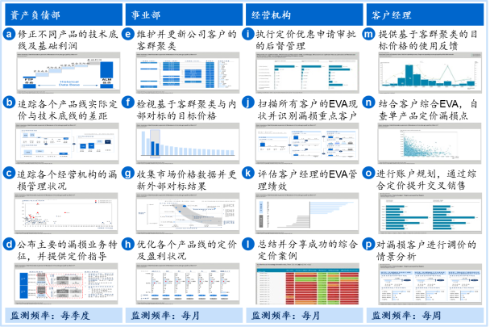
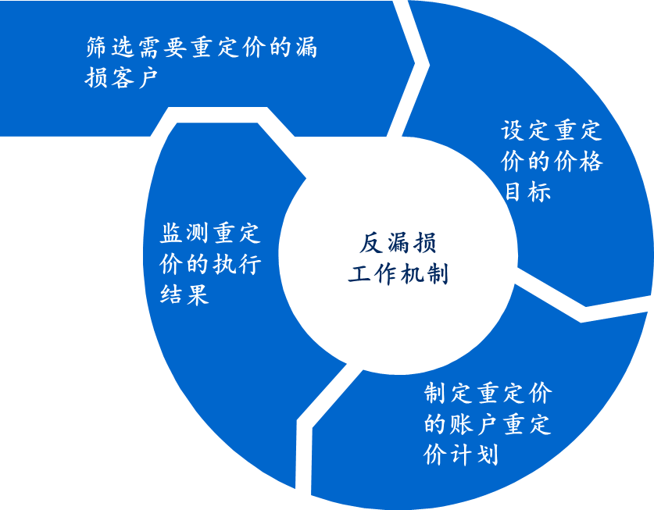
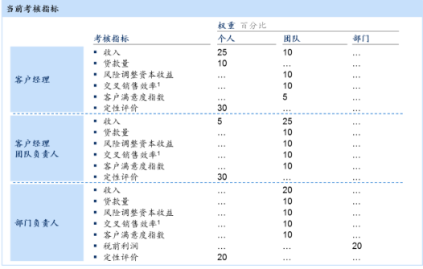
Long-term anti-leakage mechanism should contain three components, ‘monitoring-action-evaluation’
Build long-term leakage monitoring system
Implement anti-leakage working mechanism
Add relevant KPIs
Specific activities
Develop analytic models and system required for leakage monitoring
Design corresponding leakage monitoring dashboard based on functional difference across departments in the pricing process
Define frequency for leakage monitoring and assessment and embed in daily activities of relevant depts
Set up leakage reporting (esp. leakage warning) “principal review & explanation” system
Screen customers in need of repricing; screeing criteria include:
Large negative EVA
Low comprehensive IRR
Business promise unfulfilled
Risk rating downgraded
Set up the contents of repricing through internal and external benchmarking
Coordinate RMs and product managers to develop account repricing plan
Monitor the result of repricing execution
Define major responsibilities and supporting measurement mechanism for all pricing functions and RMs
Set up relevant consequence mgmt system, including:
Rating and promotion
Bonus
Expenses
Discount authority
Main outputs
Reporting view system for different internal users
“Repricing” work plan and ex-post supervision process
Pricing related KPI measurement and consequence mgmt execution mechanism
SOURCE: Team analysis

