Slide 1

Emerging themes and first ideas
GEM | Asia-Pacific
BAS006
Working draft based on interviews as of 12/01/2017
CLIENT Case Study
GLOBAL MARKETING & SALES
Document for discussion | 15/01/2018
Business Building
CONFIDENTIAL AND PROPRIETARY
Any use of this material without specific permission of McKinsey & Company is strictly prohibited
CONFIDENTIAL AND PROPRIETARY
Any use of this material without specific permission of McKinsey & Company is strictly prohibited

Slide 2


One of Asia’s largest steel maker (~$9 billion) is looking to break the 1% CAGR routine to grow by 5% CAGR and create higher value to shareholders
BASIC MATERIALS (GEM) | ASIA-PACIFIC
BAS006
Consumer durables will have higher growth rate & shareholder value multiplier
Objective of the program
Steel is a commodity and companies has less pricing leverage, even after branding
Over supply of steel in the last decade have kept pricing low
Company has sluggish 1% growth rate, and wants to break away from the commodity pricing shackles to create higher shareholder value
Multiplier
Revenue
Multiplier
EBIDTA
Build a consumer durable business for their value added products – starting with doors/windows and then for wardrobes
Set this business up for 30-40% CAGR business for the next 5 years
Build a consumer durables organization that can sustain this business after we leave (a major deviation from the steel making and B2B2C steel selling
FMCG
consumer
durables
Steel
Steel value @ ` 50/kg
Steel Re-Bars
Steel value @ ` 500/kg
Doors & Windows

Slide 3
CLIENT hit a ~9X monthly run rate 10 months after we started the program – work toward which included functions beyond sales & channel
Program started
Starting at $ 3 mil to $ 30 mil in 10 months and on the way to $ 150 mil by end of 2019
Growth of sales in 9 months, Bookings normalized
+60%
+29%
Q2
Q3
Q4
Q5
Q6
Q7

Slide 4
8 key initiatives across 4 major functions that drove the impact
Sales & Channel
30 new distributors added expanding the current reach from 30% to 70% - Distributor addition time reduced from 0.5-1 year to 2 months
100+ sales executives hired, trained and deployed on prioritized districts in 1.5 months – we leveraged 4-5 hiring agencies, batch days and selling point to achieve this
Extensive lead generation system put in to drive 10,000
Product & supply
Increased capacity from 1500 doors to 15000 per month in 10 months by adding 2 new manufacturing units and china sourcing (This is a new product, hence all set up was ground up)
Released 30% on PnL through DTV – helping
Organization
Business milestone linked organizational blueprint to scale up from just 1 member in Nov’XX to 25 now and towards 75 by Jan’XX
Introduced innovative staffing model, recruited experienced sales persons from related industry to drive every problem solving for growth
Marketing
Built a CDJ based marketing campaign - we worked with JWT to create the campaign, media mix to generate leads in prioritized areas

Slide 5


We appointed 30 new distributors in 8 weeks to help achieve 100% coverage
Created a system to accelerate channel expansion at a distributor level
Creating new reach model
CLIENT Distributor
Door distributor
15% of the existing channel fit for selling and servicing doors and windows business – thus providing only 30% of the required coverage
Company had a long drawn process to appoint distributors and typically took 6 months to appoint 1 distributors
We created a 8 week process (organized company around it) and drove a ‘batch day’ type process to appoint 30 new distributors across the country with capability to drive 70% of the required coverage
We added 4-5 distributors in a territory compared to 1 previously, as this business as oppose to steel needed more depth in reach
Steel Rebar dealers
Door dealers
~40 Distributors, 1000 retailers, 30% coverage
+~30 Distributors, 2000 retailers, 70% coverage

Slide 6
Innovative staffing model, with full time experts on boarded to act as regional sales lead and coaches
Sales expert
Profile
Role in CLIENT
Sambhav Malhotra
Brings 10+ years of experience in Asian Paints across different verticals of channel sales and B2B sales and marketing
Setting up lead management process and enablers for conversion for B2B housing segment
RM Venkateshwar
Brings 19 years of experience across B2B and B2C in consumer electronics with Whirlpool, LG Electronics, Philips Electrolux and Haier Appliances
Development of channel in their region to ensure effective micro market coverage
On-ground stake-holder management to ensure implementation of enablers set up by central team
In-time sharing of insights from the field with central team to shape next steps
Narain Das
Brings over 25 years of sales experience in channel sales from across consumer durables, telecom & renewable energy and LED lighting industries
Chirag Kapadia
Bring 11 years of experience in Asian Paints handling sales and marketing across Hyderabad, Gujarat and east India

Slide 7
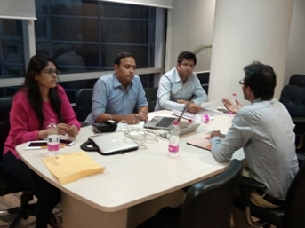
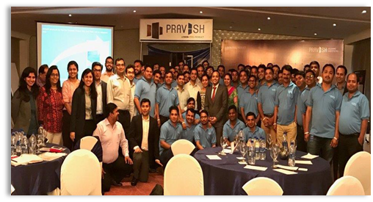

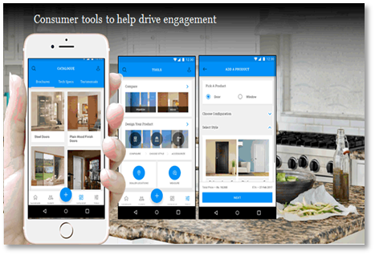
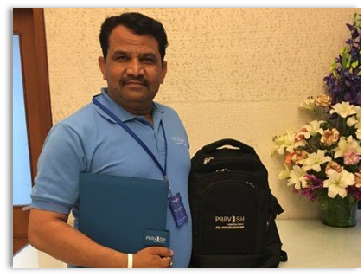
100+ sales executives enabled to drive sales on ground to enhance consumer demand
Hired
200+ candidates interviewed across 20+ batch days in 18 cities
Varied background across construction material, consumer durables and other direct selling sectors
Average work experience of 2-3 years
All SE trained over extensive one day workshop in North and East
Topics covered include Consumer Behavior, Product Knowledge, Lead Management and Sales Planning
Trained
Equipped for success
“Selling Point” App launched in North as pilot & practical training imparted to all SE
Leads provided to each SE by BM/SM and continuous process for each collection and allocation put in place

