Slide 1
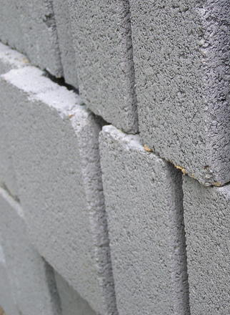
We developed a solution selling business for CLIENT with clear value propositions for their customers
Basic Materials (GEM) | Global
BAS007
Approach
Sources of value (EBITDA potential)
1
Segmented and prioritized customers in the market according to cost efficiency and sophistication of capabilities
Throughput optimization
Cost optimization
Module
Quality
Operations
Plant management
Technical management
Workforce excl. plant and technical management
2
Defined value propositions to each segment
Maintenance
Major maintenance project management
Preventative maintenance
Rapid on-call maintenance
Supply chain
Complete plant spares ordering service
3
Defined an enhanced services setup with dedicated competences
Holistic inventory management
Consulting
Skills
Development
Capability/technical specialized skills
4
Designed key tools and capabilities required (e.g., risk assessment, NPV calculation approach, training modules, etc.)
General operations
Equipment
New line
Plant optimisation
Financing

