Slide 1

Case example: Using digital and omnichannel to drive 3x growth in SMB for high performing, fast growth SaaS player
BASIC MATERIALS (GEM) | GLOBAL
BAS008
Dramatically accelerate (3x) growth in SMB
How many leads are needed to meet deal participation objectives?
How to optimize sales post lead-gen?
What marketing activities and sales channels will be most effective for winning in SMB, and in particular, what role can digital play?
Design the optimal marketing, sales & service team to serve SMB
What stages of the CDJ/sales funnel can be completed via digital?
What sales rep roles are required in which channels?
What are the operational implications (scalability) of dramatic growth?

Slide 2





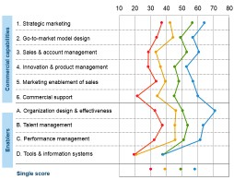








We used multiple sources of insight, including OSI
Client data
25+ interviews…
Healthcare (2)
Public Sector (2)
Retail (2)
Manufacturing (2)
S&D (1)
Benchmarks
Inside Sales (5)
Lead Development (5)
Sales Operations (2)
Marketing (4)
… and more

Slide 3

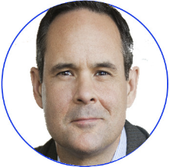

OSI identified key buying factors, possible GTM models & helped quantify impact of potential changes in channel offerings for SMB
Demographics
840 SMB decision makers
36% 30% 27%
HR Technology/IT Operations
Shopper profile
36%
are “best fit” with Client offering
~50%
are suite-led
60%
use 3+ modules
~40%
aware of Client
Journey insights
Top 3 steps
to look for a new solution are digital
Product insights
~40% <50%
Online search
Review websites
Direct website visits
~75%
cannot define HCM as a full
Biggest pain point?
“Too many steps to get a quote”
said they use rank Payroll as HCM when it the most important was defined solution
suite of solutions
“I would like it if the companies all had online chat so I could immediately have a question answered and make a decision
on a solution quicker”
“Most solutions are expensive and geared towards big businesses, not the small guys”
“I would like an immediate response to my queries through the websites or phone through customer service rather than wait forever”
SOURCE: Client Customer Insights Survey, April-May 2017 (McKinsey deployed)

Slide 4
Summary diagnostic findings
A
A portion of the SMB market is addressable with current products, and an additional portion is accessible with near-term offer development
Client’ sales funnel conversion rates are best practice; adding more leads to the top of the funnel is critical (rather than incremental improvements throughout the funnel)
Client digital marketing & lead generation capabilities are weak in the SMB segment, although SMB customers are increasingly turning to online & “remote sales”(e.g., web, chat) to buy
Commercial capabilities for SMB lags enterprise, and most roles, tools & processes are designed for enterprise and force-fit to SMB
Sales ROI is generally efficient, and SMB is more efficient than organization as a whole. Coverage ratios indicate an opportunity to grow the frontline sales team at faster pace than support, and to reduce overall cost of sales through additional investments in inside sales
B
C
D
E

Slide 5
Summary of recommendations
Customer acquisition funnel
1
Create SMB focus Form dedicated SMB marketing team
Increase SMB marketing program spend w major focus on personalized marketing
Increase demand generation thru digital
2
Improve demand management thru digital & inside sales
Re-engineer lead flow; add LDR capacity
Grow inside sales
Tier org by account size, add capacity
3
Add field sales
Selectively add capacity

Slide 6
SMB focus – Focus digital & traditional marketing on SMB to further develop & embed SMB “DNA” in the organization
1
Moving beyond being a powerful “enterprise” brand…
Client sales and marketing team strengths tailored to enterprise needs:
Verticalization of messages, outreach, customer & prospect engagement
Focus on “quality over quantity” leads
Marketing & selling process that focus on enterprise buyers w
sophisticated decision makers & longer sales cycles
Marketing tactics (channels, messages) mostly cover all sizes (e.g., SEM targets all company sizes) w some that focus specifically on larger companies
…to being a powerful enterprise & SMB brand
To drive growth, increase focus on SMB-specific marketing, e.g.,
More vertical-agnostic messaging appealing to SMBs
Mindset of driving “quantity” sometimes at the cost of “quality” of leads, e.g., serve more leads that convert at lower rate, given # of SMBs to reach
Deliver marketing & selling processes that serve SMBs, e.g., addressing shorter buying cycles, shorter response time, quick access to quotes, automated email response, leveraging digital as much as possible
Further personalize digital marketing tactics to target SMBs e.g., home page customized by size of business, SEM for “small business” keywords, etc.

Slide 7
Demand Gen & Lead Management – Prioritizing changes to marketing channels based on potential for incremental leads – Digital wins!
2
Value-opportunity comparison to prioritize SMB marketing channels for Client
Recommendations
Lowest priority
Low-mid priority
Mid-high priority
Highest priority
Increase investment for high-value digital channels
Adjust tactics by channel to differentiate between enterprise and SMB preferences using digital as much as possible
h
Website (web, mobile
Value potential (# of leads)
High
b
Direct mail & email marketing
e
Referrals (3rd party): review sites
e
Referrals (3rd party): online ads
f
Search marketing: SEO
f
Search marketing: SEM
Moderate
c
Local events
Deploy predictive lead scoring to target “ideal” customers and enable inbound LDRs to drive scale
a
Content marketing: social media
a
Content marketing: whitepapers etc.
d
Lead scoring
a
Content marketing: radio ads
Redesign lead flow and adjust lead capture processes for scale
Low
i
Outbound calls
g
Sponsorships
Low
Med
High
Gap between current state and “best in class” SMB personalized marketing
SOURCE: Team analysis, Client marketing lead progression data FY2016, Digital Opportunity Scan 2017, Client Market Insights Survey April-May 2017 (McKinsey deployed)

Slide 8
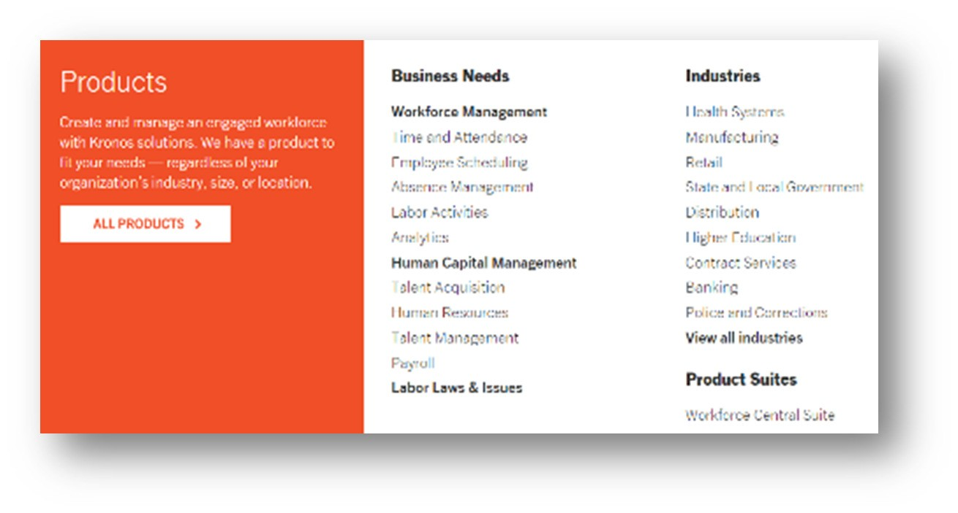
Demand Gen & Lead Management –Customized web journeys and product packaging for SMBs
2
Consideration & evaluation
Purchase
Use & service
Identify (awareness)
Research
Use & service
Make it easy to find what visitors need by personalizing content e.g., "Tell us who you are" with personal options e.g., "I am an HR executive",
Promote whitepapers strategically for SMBs based on relevance
Make it easy to answer questions for SMBs:
Build “live chat” for SMBs (based on personalized data) that is persistent at navigation
Show product features as an easy to navigate, finite list e.g., show as a list of options or fixed icons with highlights
For SMBs, reduce contact form to 3 fields (Name, email address, zip code) and mention estimated time to complete (e.g., ~30 seconds)
Minimize steps to download whitepapers by bringing the 'Download now' option on home page
Add a live calendaring option on rollover (schedule consultation) to view available time slots for web demos

Slide 9
GTM Model – We scaled up Inside Sales and Lead Development to ensure
3
SMB focus
Sufficient coverage to generate and support 3x deal growth
All sales teams retain vertical alignment
IS up to 600; Field 600-2500
Inside Sales
SMB Field Sales
MM Field Sales (Non-Mfg)
Enterprise (Non Mfg)
IS I
100-
300ee
IS II
301-
600ee
MM Field Sales (MFG)
Enterprise (MFG)
Outbound LDR
BDR
Outbound LDR
Inbound LDRs
Differences vs. current state
SMB dedicated field sales team carved out to sell to medium-sized accounts
Five distinct sales roles across the entire organization, with clear activities & hand-offs
IS organization tiered based on split of accounts, with tenure-driven ISR I and ISR II roles
Re-engineered Lead Development team segmented by inbound/outbound, clearly assigned to Inside or Field sales, and brought to best practice ratios

