Slide 1
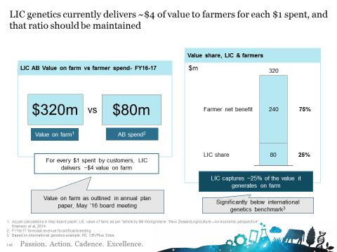
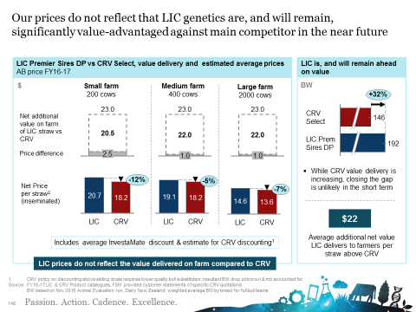
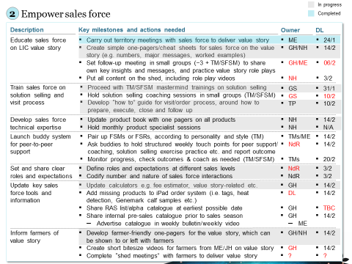
Quick win in pricing for B2B Agri client
Chemicals & Agriculture (GEM) | Asia-Pacific
CHA017
Transformation of the Asia-Pacific focused B2B business enabled quick results
Transformation impact on the company metrics FY’16 to FY’17
FY’16
FY’17
Net profit increase
NZDm
Increase in sales of specific biotech product % to scale
-0,3
3,0
+3
+50%
This performance is driven by pulling Commercial RTS levers
Commercial lever
Example initiatives
Better understanding of customer needs, translated into clear value proposition
Rapid assessment of customer needs helped to develop clear value proposition for the solutions, that could be easily communicated to client
Pricing for core products
Analytical approach to pricing decisions (annual price reviews for the core products) helped to increase margin without negative effect on sales volumes
Capability building for salesforce
Training for sales force on how to “sell solutions” and deliver value proposition, topped with specific products trainings (for complicated genetics products) resulted in sustained cross-sell rate
Performance management
Change of the approach to target and KPI setting for the sales force
Rapid assessment of customer needs helped to create clear value proposition for core product
Leveraging an analytical approach to pricing, client managed to increase core product prices by 10% sustaining the sales volumes
Sales force capability building was critical in ensuring successful communication of updated value proposition

