Slide 1

Context of this project
CONSUMER/PACKAGED GOODS (CONSUMER)
CPG016
The client is a major CPG player in its home market
It has established a global base by acquiring well-known brands in a top developed market; McKinsey helped developed growth strategy that has fueled strong growth for the acquired business
It has extended into additional developed markets as well as a high growth developing market with additional brands
The client has invested heavily in R&D with strong results. They came to us ready to utilize new, potentially breakthrough technologies across its businesses
The combination of its existing footprint, financial strength and these breakthrough technologies points to high growth potential. Our aspiration: 3x size in 10 years
The objectives of our work together are to define the strategies by geography, construct growth options to achieve these targets, and partner to take action on these options with our clients

Slide 2
Framework for our work: Driving strategic, disruptive innovation
Define strategies
Construct options
Take action
Prioritize hunting spaces
Build insights
Develop & Test
Quantify
Opportunities
Develop
Prototypes
Test & Learn in-market
Simulate
Impact
Advanced analytics connecting consumer behaviors, needs, and attitudes
Where new needs are emerging
What competitors are vulnerable
Deep dive into hunting spaces, understand opportunities
Preliminary sizing and assessment to qualify most promising spaces
Design thinking and agile sprints to texturize hunting spaces, develop, and test most promising product propositions
Simulate potential product launch success, assess company’s ability to win
Prioritize concepts
Refine and produce prototypes of most promising concepts
Small in market tests of prototypes to more accurately determine success factors
Launch, refine, or drop
Repeat
WHAT
Growth Mapping
Growth Spaces
Simulations
McKinsey Design (LUNAR, Veryday, Digital Labs)
Growth Mapping: Scenario simulations
CF&S synergy analysis
McKinsey Design (LUNAR, Veryday, Digital Labs)
Team execution
McKinsey Design
Growth Mapping: simulations
CAPABILITIES
Deep touch qualitative

Slide 3
DEFINE THE STRATEGY: We started with Growth Mapping - an analytical approach that segments and aligns all three key ingredients for growth
Usage and Purchasing Segmentation:
What consumers buy & how they use it
Need states segmentation:
Why they buy it
What makes Growth Mapping distinctive
Quantitative, behavioral lens provides unique view of market demand
Analytically integrated view for more precise insights on how to capture growth
Quantifies opportunity size based on proprietary modeling approaches
Modular approach allows you select which elements of the approach are most relevant to your needs
Machine learning to deliver faster insights within ~3 weeks after survey close for immediate impact
Dynamically integrated with market trends to better “play forward” opportunity
Growth Map
Consumer segmentation
Who they are

Slide 4
DEFINE THE STRATEGY: Growth Spaces pinpoint best areas to compete in, initiating the development of a consumer back story
Growth in Snacking: Opportunity Matrix
Need States
Whole-some Nou-rishment
Late Night Mun-ching
Fresh Nutrition
Smart Energy
Controlled Wellness
Positive Break
Tide Me Over
Grab & Go
Quick Cravings
Sweet Reward
By doing a deep dive on each cell, we determine which ones to compete in:
How much overall value do these areas represent?
What is the competitive frame?
How much headroom is there?
How should our portfolio brands be focused?
Here we identified 3 Smart Energy Need states with growth potential:
Immediate Nourishment Snacking
Health Life Snacking
Tasty Energy Boost
Consumer Segments
Healthy Foodie
6.1B/ +4%
Simple
Purist
Our Brand
Waist Watcher
Nourishing Fuel (5B, +6%):
Benefits Sought: Sustained energy, nourishment, satiation
Product RTBs: High protein and high quality ingredients
Occasion: Skews morning
Attitudes: Wants natural / organic ingredients, exercises regularly, plans for snacking to eat healthier
Snacks: Protein bars, protein drinks, Greek yogurt, almonds
Satisfaction: High
Improvement Opportunities: More protein, less package waste, locally sourced
How might we…
…leverage growth in protein-oriented snacking to better meet mental and physical energy needs of time-pressed adults?
…find new ways to provide Smart Energy without providing overly processed solutions?
…provide more satisfying protein experiences than basic bars?
Healthy Life Snacking: $5B +4%
Good Source of Protein means : promote long term health, energy boost to Busy Jugglers and Waist Watchers
Food eaten: Jerky, White meat, Fresh vegetables
Busy Juggler
Our Brand
Taste Lover
Value Conscious
Tasty Energy Boost: $3B +5%
Good Source of Protein means: good for me energy and tasty to Mindless Snackers and Value Conscious consumers
Food eaten: Peanuts, Red meat, Cheese
Example(s):
High protein bites with Greek Yogurt
Protein trios with dairy, nut and veg protein
Hummus filled/centered crackers
Mindless Snacker

Slide 5
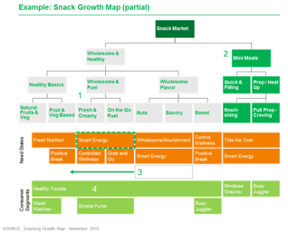
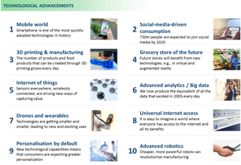
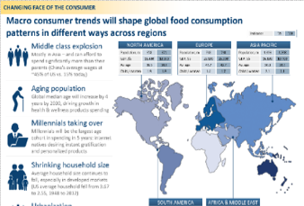
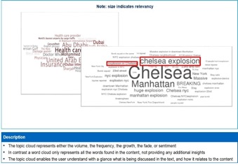
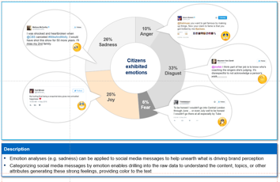
DEFINE THE STRATEGY: Combining with other inputs (e.g., social media), we further developed Growth Spaces
Example: Absorbing energy smartly
Primary target
Healthy and active people who are busy but always want to stay in the best condition
Size
JPY ○○○ oku
Occasions
Absorbing energy on the go
Consuming alone, rather than with someone
Nutrition comes first
Key needs
Nutrition
Finish quickly with minimal preparation
Give energy
Simple portioning
Fits daily routine
Existing products
Bars
Smoothies
Granola/trail mix
Yogurt
Nuts
Fruit
Products
Price
Channels
Promotions
SOURCE: McKinsey

Slide 6
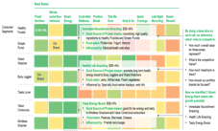












CONSTRUCT OPTIONS: Immersion and Collision workshops built the story quickly and iteratively
a
Growth map
b
Deep dive trend investigation
Trends identified in Phase 1
Health awareness: The increase in the social insurance burden has increased consumers’ awareness of health
Digital: Millennials, who are digital natives and place an emphasis on health, will be at the center of consumption moving forward
Values: Consumers’ purchasing behavior emphasizes products’ unique values and mission
In Phase 2, perform a deep dive of trends in Japanese/American market opportunities that were identified from the growth map
Immersion workshop
Understanding the customer: A thorough understanding of consumer image, pain points, needs, etc.
Areas with market opportunities, and a rough policy for each
c
Social media insight
d
Other company case studies for materials/products
SOURCE: McKinsey

Slide 7
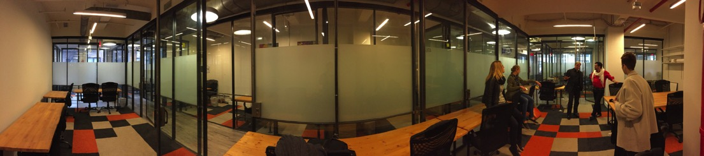
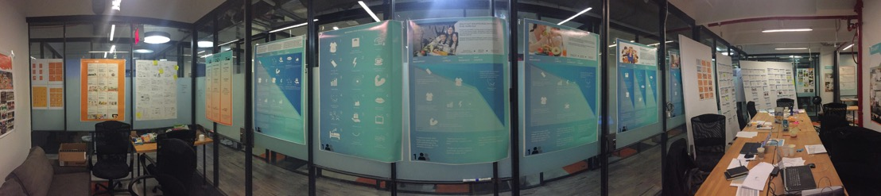
CONSTRUCT OPTIONS: Our ‘innovation garage’ is enabling us to embed new ways of working – and rapidly create new ideas
Collaborating in a shared space, a garage, the start-up way
Cover the walls with our insights and discoveries

Slide 8
CONSTRUCT OPTIONS: Sprints are a testing/learning process used to refine ideas by creating concepts and prototypes and testing them with consumers
Sprint 0
Sprint 1
Sprint 2
Prioritization
Consumer panel
Test as a package that combines the concept, improved product and functions
Priority product
Focus segment
Consumer panel
Test ideas and gather input
Test concepts, prototypes and sketches of usage scenes
Improved concept, tentative branding, actual models, etc.
Improve materials
Narrow down
Prioritize
10 people
16 concepts
20 people
8 concepts
20 people
5 concepts
3 concepts
SOURCE: LUNAR, McKinsey

Slide 9
CONSTRUCT OPTIONS: We evaluated new offerings across multiple criteria to prioritize initiatives
Example Offering Opportunity Map
Example Offering Prioritization
Criteria considered
Bubble Size = Incremental $ Revenue Pool
Idea prioritization
indexed scoring¹
Size of the Prize, $MM
Project type
Strategic fit vs. business objectives
Revenues and costs
Value and profitability (ROI)
Risk vs. reward
Risk vs. time (POI)
Pipeline strength and continuity
Business mix
Potential obstacles to investigate
Go Forward
Proceed Opportunistically
Opportunity
Eliminate / Re-invent
Recommended opportunities
Grow penetration in existing liquid egg segment
20
High Risk / High Reward
Big Opportunity / Low Risk
Develop ready to drink, all natural protein and fruit beverage to source from smoothies
120
Source volume from frozen breakfast with protein box
50
Source volume from hot cereal with microwavable protein cup
80
Develop ready to eat creamy protein product to source Greek Yogurt
180
100 = Ø scoring
Opportunities to deprioritize
Expand egg protein to “no egg/no heat” occasions
70
Develop egg-based protein bars
70
Compete with value added shell eggs in full prep
100
Develop egg-based protein biscuit
70
Develop minimal prep egg product to compete with Family Cereals
130
High Risk / Low Upside
Low Cost / Low Risk / Low Upside
Expand Liquid Egg Whites to family value
60
1 Index based on Category attractiveness (size of prize, category growth potential, consumer needs and product benefits”) and client’s ability to win (internal capabilities and execution risk)

Slide 10
TAKING ACTION: The next phase of our partnership
Intent to partner to support a series of product launches to enable the Firm to bring a full multi-disciplinary team to bear to support growth
Base fees of 40-50% of full fees
Additional payments made based on pre-set milestones (to be refined) – consumer concept acceptance, identification of manufacturing/distribution partners, commencement of manufacturing, sell-in to key accounts, launch and finally first year revenue
Exposure to revenue risk limited to only part of symmetric upside
Strong emphasis on capability building to ensure new product revenue is not the only metric of success for the client

Slide 11
Discussion
Can your clients mesh innovation agility with innovation disruption?
Are nimbler competitors opening new doors first?
Are your clients looking at only technical superiority to create competitive advantage?
What else?
Unit of measure

