Slide 1
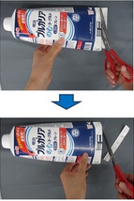
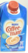

Identified requirements and ChemicalCo in Asia carton packaging market
Chemicals & Agriculture (GEM) | Asia-Pacific
CPG023
Client context
Approach
Impact
One of the top food/beverage carton packaging companies based in Europe
Considered Asia market entry; approached by three Asian carton manufacturers regarding a potential strategic partnership
To develop a strategy and tactics for negotiating with these, required to understand the aseptic carton packaging market at a deeper level
Assessed business archetypes exist in Japan carton packaging market
Identified requirements and ChemicalCo to win the market
“Table stake”: Meeting industry standards in aseptic filling …
“Key success factors”: Recycle-friendly product design …
Conducted consumer focus group interviews to test clients’ products vs. competitors existing in the market
Decided on one of three Asian carton manufacturers to proceed strategic partnership
On-going discussion with partner to potential JV schemes in Asian market
or
??
Client name: X
Team set-up: X
Fees Structure: X
What was unique: X

